Slide 1
www.CHEMSHEETS.co.uk
CALORIMETRY
© www.chemsheets.co.uk AS1048 30-Jun-2015

Slide 2
1 g of water
1 ºC hotter
Energy required =
4.18 J
1 g of water
2 ºC hotter
Energy required =
2 x 4.18 J
= 8.36 J
© www.chemsheets.co.uk AS1048 30-Jun-2015

Slide 3
1 g of water
1 ºC hotter
Energy required =
4.18 J
5 g of water
1 ºC hotter
Energy required =
5 x 4.18 J
= 20.9 J
© www.chemsheets.co.uk AS1048 30-Jun-2015

Slide 4
1 g of water
1 ºC hotter
Energy required =
4.18 J
3 g of water
10 ºC hotter
Energy required =
3 x 10 x 4.18
= 125.4 J
© www.chemsheets.co.uk AS1048 30-Jun-2015

Slide 5
1 g of copper
1 ºC hotter
Energy required =
0.39 J
10 g of copper
5 ºC hotter
Energy required =
10 x 5 x 0.39
= 19.5 J
© www.chemsheets.co.uk AS1048 30-Jun-2015

Slide 6
Energy required (q) =
mass heated (m)
x
energy needed to make 1 g of substance 1ºC hotter
x
temperature rise (∆T)
© www.chemsheets.co.uk AS1048 30-Jun-2015

Slide 7
Energy required (q) =
mass heated (m)
x
x
temperature rise (∆T)
specifc heat capacity (c)
© www.chemsheets.co.uk AS1048 30-Jun-2015

Slide 8
q = m c ∆T
© www.chemsheets.co.uk AS1048 30-Jun-2015

Slide 9
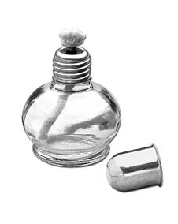
2 moles of ethanol burned
Energy given out =
2734 kJ
Energy given out by 1 mole =
2734 kJ
2
= 1367 kJ
∆H =
–1367 kJ mol⁻¹
© www.chemsheets.co.uk AS1048 30-Jun-2015

Slide 10
q
moles in reaction
∆H =
© www.chemsheets.co.uk AS1048 30-Jun-2015

Slide 11
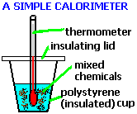
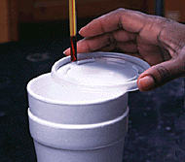
© www.chemsheets.co.uk AS1048 30-Jun-2015

Slide 12
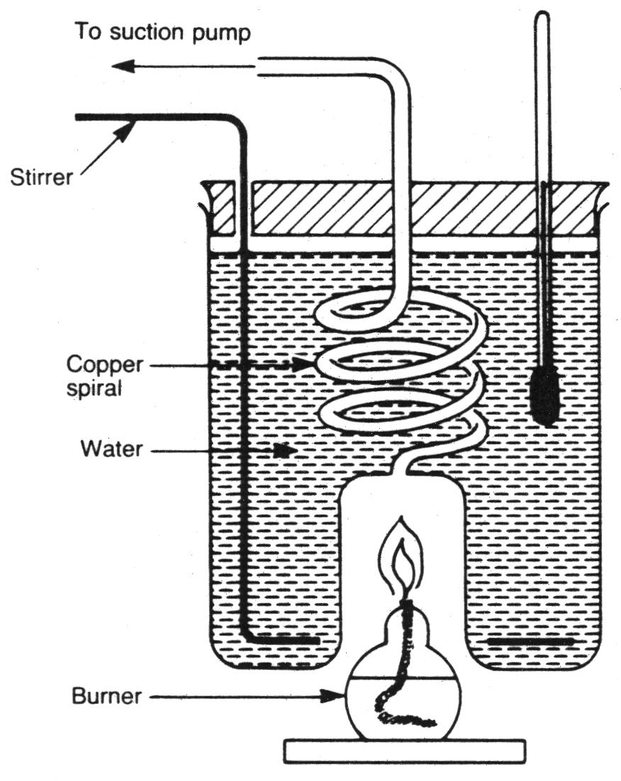
© www.chemsheets.co.uk AS1048 30-Jun-2015

Slide 13
1) In an experiment, 0.600 g of propane (C₃H₈) was completely burned in air. The heat evolved raised the temperature of 100 g of water by 64.9°C. Use this data to calculate the enthalpy of combustion of propane (the specific heat capacity of water is 4.18 J g⁻¹ K⁻¹).
q = mc∆T
m = 100
c = 4.18
∆T = 64.9
q = 100 x 4.18 x 64.9 = 27130 J
∆H = q / mol
moles of propane = mass / M_{r}
= 0.600 / 44.0 = 0.01364
∆H = –27.13 / 0.01364
= -1990 kJ mol⁻¹ (3 sig fig)
© www.chemsheets.co.uk AS1048 30-Jun-2015

Slide 14
2) 50 cm³ of 1.0 mol dm⁻³ hydrochloric acid was added to 50 cm³ of 1.0 mol dm⁻³ sodium hydroxide solution. The temperature rose by 6.8°C. Calculate the enthalpy of neutralisation for this reaction. Assume that the density of the solution is 1.00 g cm⁻³, the specific heat capacity of the solution is 4.18 J g⁻¹ K⁻¹.
q = mc∆T
m = 100
c = 4.18
∆T = 6.8
q = 100 x 4.18 x 6.8 = 2842 J
∆H = q / mol
Mol HCl = conc x vol
= 1.0 x ⁵⁰/₁₀₀₀ = 0.050
Mol NaOH = conc x vol
= 1.0 x ⁵⁰/₁₀₀₀ = 0.050
HCl + NaOH → NaCl + H₂O
∆H = –2.842 / 0.050
= -57 kJ mol⁻¹ (2 sig fig)
© www.chemsheets.co.uk AS1048 30-Jun-2015

Slide 15
3) 100 cm³ of 0.200 mol dm⁻³ copper sulphate solution was put in a calorimeter and 2.00 g of magnesium powder added. The temperature of the solution rose by 25.1°C. Work out which reagent was in excess and then calculate the enthalpy change for the reaction. Assume that the density of the solution is 1.00 g cm⁻³, the specific heat capacity of the solution is 4.18 J g⁻¹ K⁻¹. Ignore the heat capacity of the metals.
q = mc∆T
m = 100
c = 4.18
∆T = 25.1
q = 100 x 4.18 x 25.1 = 10490 J
∆H = q / mol
Mol CuSO₄ = conc x vol
= 0.200 x ¹⁰⁰/₁₀₀₀ = 0.020
Mol Mg = mass / M_{r}
= 2.00 / 24.3 = 0.0823
XS
CuSO₄ + Mg → MgSO₄ + Cu
∆H = –10.49 / 0.020
= -525 kJ mol⁻¹ (3 sig fig)
© www.chemsheets.co.uk AS1048 30-Jun-2015

Slide 16
1) In an experiment, 1.00 g of propanone (CH₃COCH₃) was completely burned in air. The heat evolved raised the temperature of 150 g of water from 18.8°C to 64.3°C. Use this data to calculate the enthalpy of combustion of propanone (the specific heat capacity of water is 4.18 J g⁻¹ K⁻¹).
q = mc∆T
m = 150
c = 4.18
∆T = 45.5
q = 150 x 4.18 x 45.5 = 28530 J
∆H = q / mol
moles of propane = mass / M_{r}
= 1.00 / 58.0 = 0.01724
∆H = –28.53 / 0.01724
= -1650 kJ mol⁻¹ (3 sig fig)
© www.chemsheets.co.uk AS1048 30-Jun-2015

Slide 17
2) In an experiment, 1.00 g of hexane (C₆H₁₄) was completely burned in air. The heat evolved raised the temperature of 200 g of water from 293.5 K to 345.1 K. Use this data to calculate the enthalpy of combustion of hexane (the specific heat capacity of water is 4.18 J g⁻¹ K⁻¹).
q = mc∆T
m = 200
c = 4.18
∆T = 51.6
q = 200 x 4.18 x 51.6 = 43140 J
∆H = q / mol
moles of propane = mass / M_{r}
= 1.00 / 86.0 = 0.01163
∆H = –43.14 / 0.01163
= -3710 kJ mol⁻¹ (3 sig fig)
© www.chemsheets.co.uk AS1048 30-Jun-2015

Slide 18
3) In an experiment, 1.56 g of propan-1-ol (CH₃CH₂CH₂OH) was completely burned in air. The heat evolved raised the temperature of 0.250 dm³ of water from 292.1 K to 339.4 K. Use this data to calculate the enthalpy of combustion of propan-1-ol (the specific heat capacity of water is 4.18 J g⁻¹ K⁻¹).
q = mc∆T
m = 250
c = 4.18
∆T = 47.3
q = 250 x 4.18 x 47.3 = 49430 J
∆H = q / mol
moles of propane = mass / M_{r}
= 1.56 / 60.0 = 0.02600
∆H = –49.43 / 0.02600
= -1900 kJ mol⁻¹ (3 sig fig)
© www.chemsheets.co.uk AS1048 30-Jun-2015

Slide 19
4) 25 cm³ of 2.0 mol dm⁻³ nitric acid was added to 25 cm³ of 2.0 mol dm⁻³ potassium hydroxide solution. The temperature rose by 13.7°C. Calculate the enthalpy of neutralisation for this reaction. Assume that the density of the solution is 1.00 g cm⁻³, the specific heat capacity of the solution is 4.18 J g⁻¹ K⁻¹.
q = mc∆T
m = 50
c = 4.18
∆T = 13.7
q = 50 x 4.18 x 13.7 = 2863 J
∆H = q / mol
Mol HNO₃ = conc x vol
= 2.0 x ²⁵/₁₀₀₀ = 0.050
Mol KOH = conc x vol
= 2.0 x ²⁵/₁₀₀₀ = 0.050
HNO₃ + KOH → NaNO₃ + H₂O
∆H = –2.863 / 0.050
= -57.3 kJ mol⁻¹ (3 sig fig)
© www.chemsheets.co.uk AS1048 30-Jun-2015

Slide 20
5) 50 cm³ of 2.0 mol dm⁻³ hydrochloric acid was added to 50 cm³ of 2.0 mol dm⁻³ ammonia solution. The temperature rose by 12.4°C. Calculate the enthalpy of neutralisation for this reaction. Assume that the density of the solution is 1.00 g cm⁻³, the specific heat capacity of the solution is 4.18 J g⁻¹ K⁻¹.
q = mc∆T
m = 100
c = 4.18
∆T = 12.4
q = 100 x 4.18 x 12.4 = 5183 J
∆H = q / mol
Mol HCl = conc x vol
= 2.0 x ⁵⁰/₁₀₀₀ = 0.100
Mol NH₃ = conc x vol
= 2.0 x ⁵⁰/₁₀₀₀ = 0.100
HCl + NH₃ → NH₄Cl
∆H = –5.183 / 0.100
= -51.8 kJ mol⁻¹ (3 sig fig)
© www.chemsheets.co.uk AS1048 30-Jun-2015

Slide 21
6) 50 cm³ of 1.0 mol dm⁻³ nitric acid was added to 20 cm³ of 1.0 mol dm⁻³ barium hydroxide solution. The temperature rose by 7.9°C. Calculate the enthalpy of neutralisation for this reaction (per mole of nitric acid reacting). Assume that the density of the solution is 1.00 g cm⁻³, the specific heat capacity of the solution is 4.18 J g⁻¹ K⁻¹.
q = mc∆T
m = 70
c = 4.18
∆T = 7.9
q = 70 x 4.18 x 7.9 = 2312 J
∆H = q / mol
Mol HNO₃ = conc x vol
= 1.0 x ⁵⁰/₁₀₀₀ = 0.050
XS
Mol Ba(OH)₂ = conc x vol
= 1.0 x ²⁰/₁₀₀₀ = 0.020
2 HNO₃ + Ba(OH)₂ → Ba(NO₃)₂ + 2 H₂O
∆H = –2.312 / 0.040
= -57.8 kJ mol⁻¹ (3 sig fig)
© www.chemsheets.co.uk AS1048 30-Jun-2015

Slide 22
7) 25 cm³ of 1.00 mol dm⁻³ copper sulphate solution was put in a calorimeter and 6.0 g of zinc powder added. The temperature of the solution rose by 50.6°C. Work out which reagent was in excess and then calculate the enthalpy change for the reaction. Assume that the density of the solution is 1.00 g cm⁻³, the specific heat capacity of the solution is 4.18 J g⁻¹ K⁻¹. Ignore the heat capacity of the metals.
q = mc∆T
m = 25
c = 4.18
∆T = 50.6
q = 25 x 4.18 x 50.6 = 5288 J
∆H = q / mol
Mol CuSO₄ = conc x vol
= 1.0 x ²⁵/₁₀₀₀ = 0.025
Mol Zn = mass / M_{r}
= 6.0 / 65.4 = 0.0917
XS
CuSO₄ + Zn → ZnSO₄ + Cu
∆H = –5.288 / 0.025
= -212 kJ mol⁻¹ (3 sig fig)
© www.chemsheets.co.uk AS1048 30-Jun-2015

Slide 23
8) 50 cm³ of 0.10 mol dm⁻³ silver nitrate solution was put in a calorimeter and 0.2 g of zinc powder added. The temperature of the solution rose by 4.3°C. Work out which reagent was in excess and then calculate the enthalpy change for the reaction (per mole of zinc that reacts). Assume that the density of the solution is 1.00 g cm⁻³, the specific heat capacity of the solution is 4.18 J g⁻¹ K⁻¹. Ignore the heat capacity of the metals.
q = mc∆T
m = 50
c = 4.18
∆T = 4.3
q = 50 x 4.18 x 4.3 = 898.7 J
∆H = q / mol
Mol AgNO₃ = conc x vol
= 0.1 x ⁵⁰/₁₀₀₀ = 0.005
Mol Zn = mass / M_{r}
= 0.2 / 65.4 = 0.00306
XS
2 AgNO₃ + Zn → ZnNO₃ + 2 Ag
∆H = –0.8987 / 0.0025
= -359 kJ mol⁻¹ (3 sig fig)
© www.chemsheets.co.uk AS1048 30-Jun-2015

Slide 24
9) 3.53 g of sodium hydrogencarbonate was added to 30.0 cm³ of 2.0 mol dm⁻³ hydrochloric acid. The temperature fell by 10.3 K. Work out which reagent was in excess and then calculate the enthalpy change for the reaction. Assume that the density of the solution is 1.00 g cm⁻³, the specific heat capacity of the solution is 4.18 J g⁻¹ K⁻¹.
q = mc∆T
m = 30
c = 4.18
∆T = 10.3
q = 30 x 4.18 x 10.3 = 1292 J
∆H = q / mol
Mol HCl = conc x vol
= 2.0 x ³⁰/₁₀₀₀ = 0.060
XS
Mol NaHCO₃ = mass / M_{r}
= 3.53 / 84.0 = 0.0420
HCl + NaHCO₃ → NaCl + H₂O + CO₂
∆H = 1.292 / 0.0420
= +30.8 kJ mol⁻¹ (3 sig fig)
© www.chemsheets.co.uk AS1048 30-Jun-2015

Slide 25
10) A calorimeter was calibrated by burning 2.00 g of methanol (CH₃OH) whose enthalpy of combustion is -715 kJ mol⁻¹. The temperature of the calorimeter rose from 19.6°C to 52.4°C. The same calorimeter was used to measure the enthalpy of combustion of propan-2-ol. 1.50 g of propan-2-ol CH₃CH(OH)CH₃ raised the temperature by from 19.8°C to 56.2°C. Calculate the heat capacity of the calorimeter and then the enthalpy of combustion of propan-2-ol.
∆H = q / mol
q = ∆H x mol
Mol CH₃OH = mass / M_{r}
= 2.00 / 32.0 = 0.0625
q = ∆H x mol
= 715 x 0.0625 = 44.69 kJ
q = mc∆T
mc = q/∆T
= 44.69 / 32.8 = 1.363 kJ K⁻¹
© www.chemsheets.co.uk AS1048 30-Jun-2015

Slide 26
10) A calorimeter was calibrated by burning 2.00 g of methanol (CH₃OH) whose enthalpy of combustion is -715 kJ mol⁻¹. The temperature of the calorimeter rose from 19.6°C to 52.4°C. The same calorimeter was used to measure the enthalpy of combustion of propan-2-ol. 1.50 g of propan-2-ol CH₃CH(OH)CH₃ raised the temperature by from 19.8°C to 56.2°C. Calculate the heat capacity of the calorimeter and then the enthalpy of combustion of propan-2-ol.
q = mc∆T
mc = 1.363
∆T = 36.4
q = 1.363 x 36.4 = 49.61 kJ
∆H = q / mol
Mol C₃H₇OH = mass / M_{r}
= 1.50 / 60.0 = 0.0250
∆H = –49.61 / 0.0250
= -1984 kJ mol⁻¹ (3 sig fig)
© www.chemsheets.co.uk AS1048 30-Jun-2015

