Slide 1
www.CHEMSHEETS.co.uk
IR
SPECTROSCOPY
© www.chemsheets.co.uk AS 1087 12-Jul-15

Slide 2
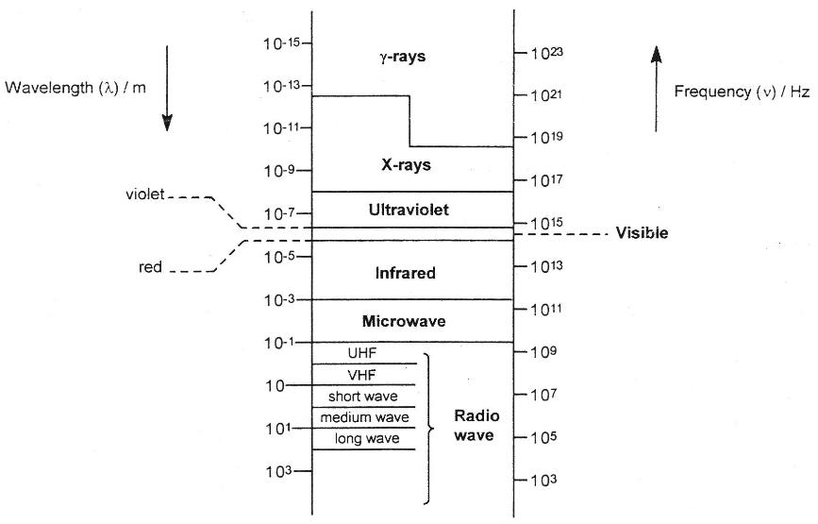
Electromagnetic spectrum

Slide 3
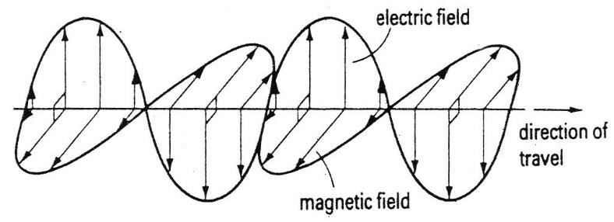
Light is one form of electromagnetic radiation.
Light is only a very small part of the electromagnetic spectrum.
Electromagnetic waves consist of electric and magnetic fields which are perpendicular to each other and to the direction of travel of the wave.
The electric and magnetic fields vibrate at the same frequency as each other.

Slide 4
Atoms, molecules and ions can absorb (or emit) electromagnetic radiation of specific frequencies, and this can be used to identify them.
Electromagnetic radiation absorbed | What the energy is used for | Spectroscopy technique
Ultra-violet / visible | Movement of electrons to higher energy levels | Ultra-violet / visible spectroscopy
Infra-red | To vibrate bonds | Infra-red spectroscopy
Microwaves | To rotate molecules | Microwave spectroscopy
Radio waves | To change nuclear spin | NMR spectroscopy
© www.chemsheets.co.uk AS 1087 12-Jul-15

Slide 5
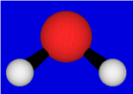
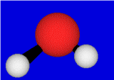
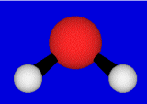
Bond vibrations
All bonds vibrate at a characteristic frequency.
There are different types of vibration.
Symmetric stretch
Assymmetric stretch
Bending
The frequency depends on the mass of the atoms in the bond, the bond strength, and the type of vibration.
The frequencies at which they vibrate are in the infra-red region of the electromagnetic spectrum.

Slide 6
IR Spectra
If IR light is passed through the compound, it will absorb some or all of the light at the frequencies at which its bonds vibrate.
Wavenumbers (cm⁻¹) are used as a measure of the wavelength or frequency of the absorption.
Wavenumber = 1
wavelength (cm)
IR light absorbed is in the range 4000 – 400 cm⁻¹.
Above 1500 cm⁻¹ is used to identify functional groups.
Below 1500 cm⁻¹ is used for fingerprinting.
© www.chemsheets.co.uk AS 1087 12-Jul-15

Slide 7
Fingerprinting
(below 1500 cm⁻¹)
Complicated and contains many signals – picking out functional group signals difficult.
This part of the spectrum is unique for every compound, and so can be used as a "fingerprint".
This region can also be used to check if a compound is pure.
© www.chemsheets.co.uk AS 1087 12-Jul-15

Slide 8
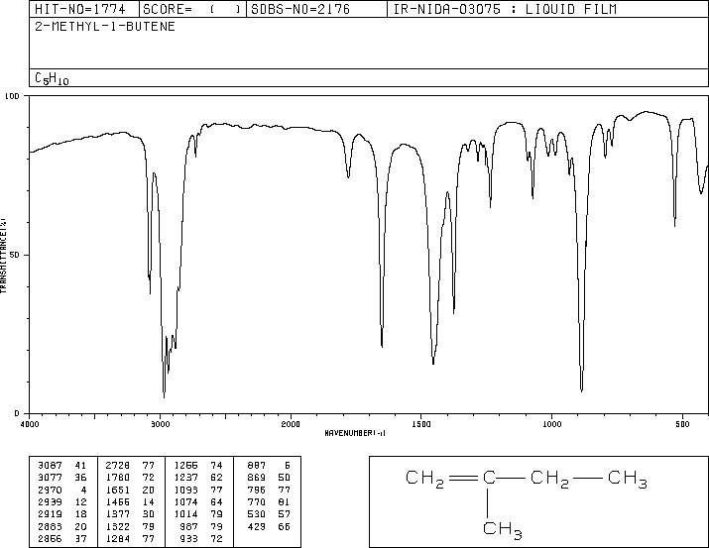
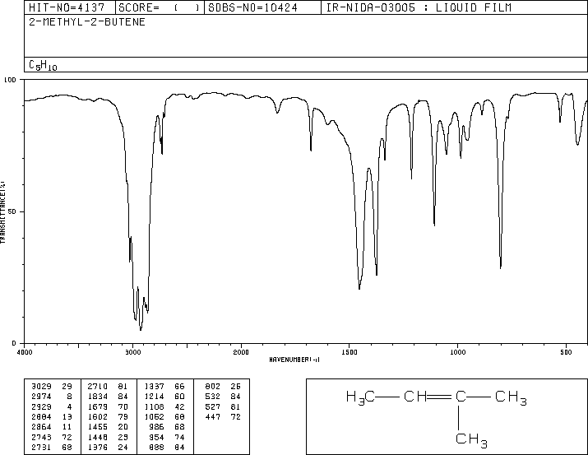

Slide 9
Functional Groups
(above 1500 cm⁻¹)
© www.chemsheets.co.uk AS 1087 12-Jul-15

Slide 10
C=C
1620-1680 cm⁻¹
O-H (alcohol)
3230-3550 cm⁻¹
O-H (acid)
2500-3000 cm⁻¹
C=O
1680-1750 cm⁻¹
© www.chemsheets.co.uk AS 1087 12-Jul-15

Slide 11
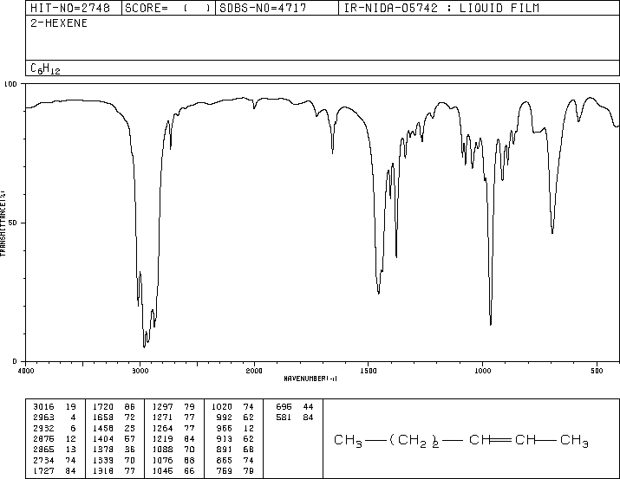
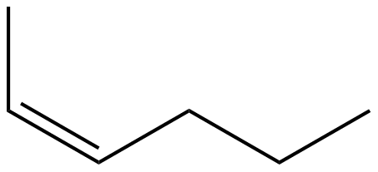
C=C
hex-2-ene

Slide 12
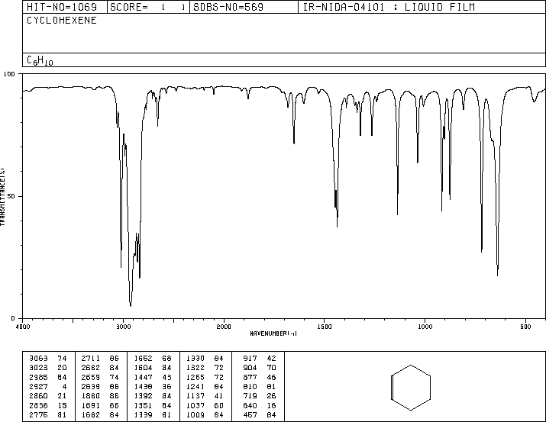

C=C
cyclohexene

Slide 13
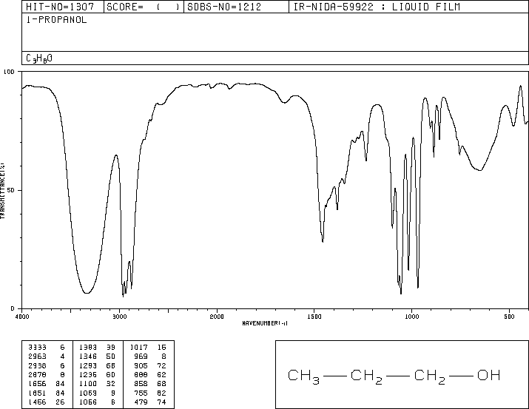

Alcohol O-H
propan-1-ol

Slide 14
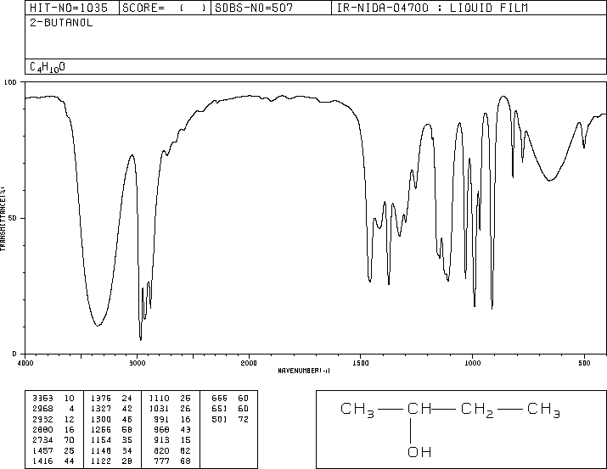
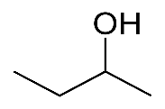
Alcohol O-H
butan-2-ol

Slide 15
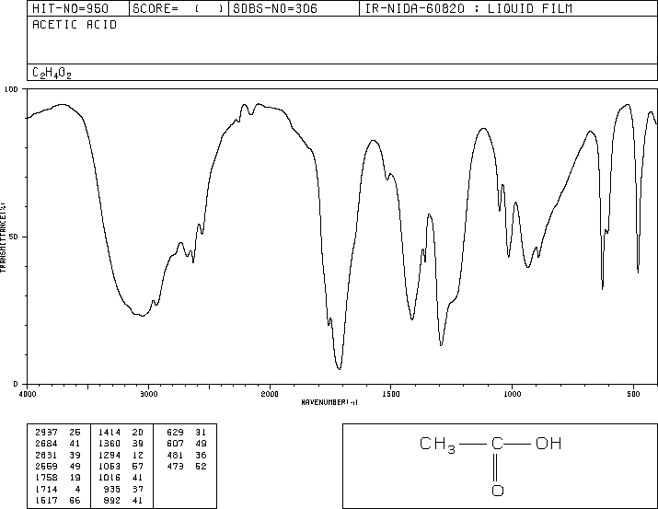
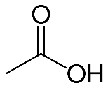
Acid O-H
C=O
ethanoic acid

Slide 16
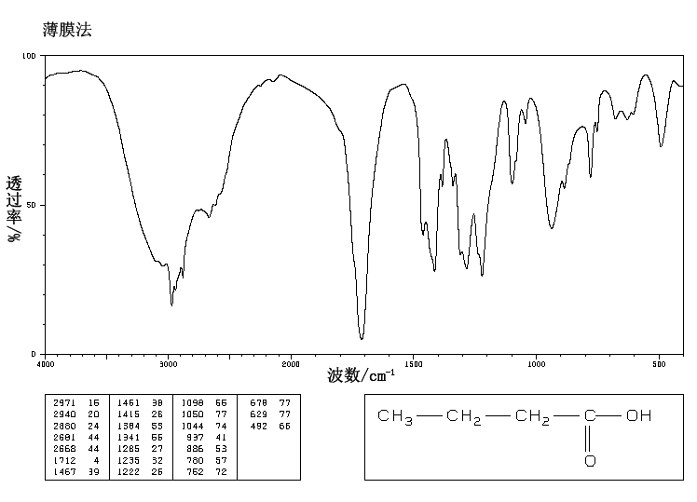
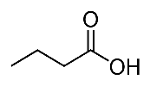
Acid O-H
C=O
butanoic acid

Slide 17
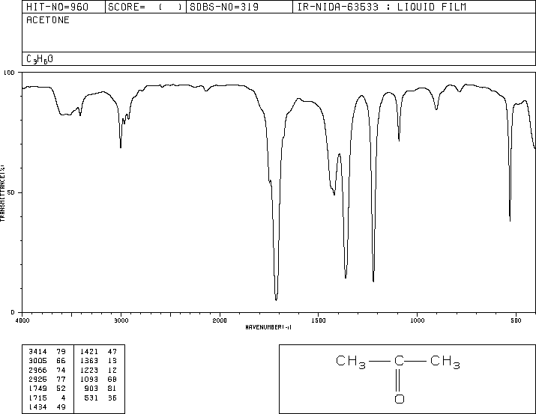
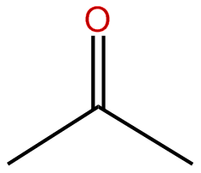
C=O
propanone

Slide 18
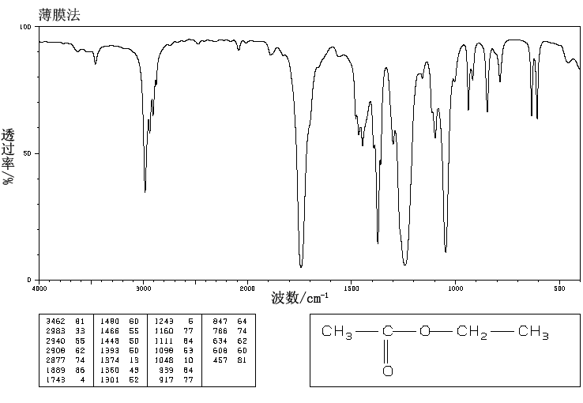
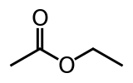
C=O
ethyl ethanoate

Slide 19
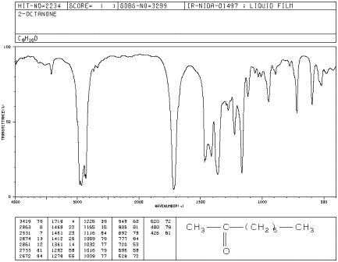
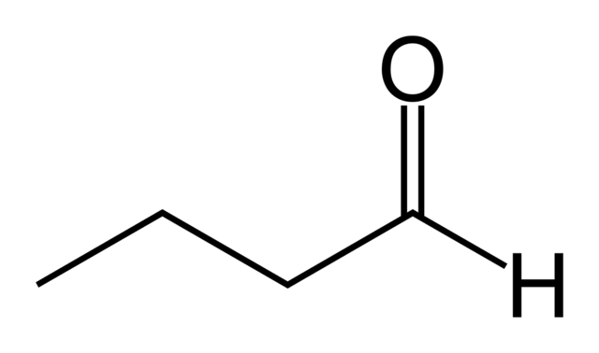
C=O
butanal

Slide 20
Identify the
Functional Groups
© www.chemsheets.co.uk AS 1087 12-Jul-15

Slide 21

Alcohol O-H

Slide 22
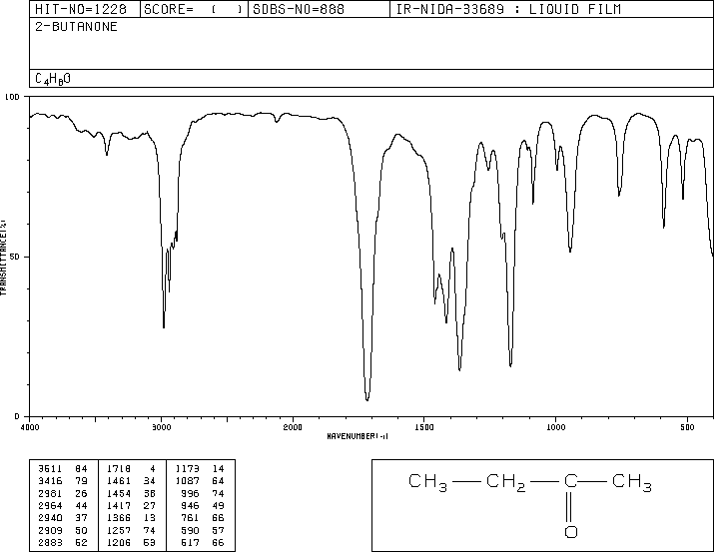
C=O

Slide 23

C=O
acid O-H

Slide 24

Alcohol O-H

Slide 25
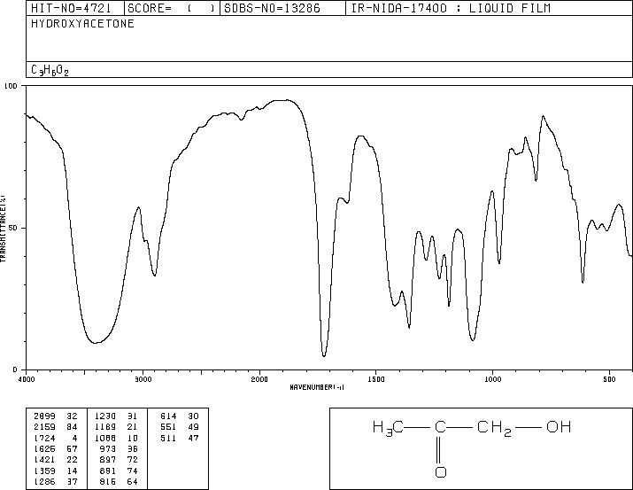
C=O
alcohol O-H

Slide 26
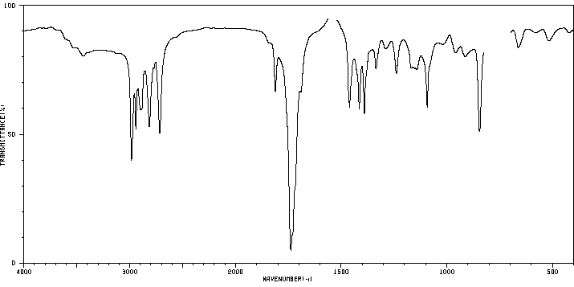
C=O

Slide 27
C=C

Slide 28
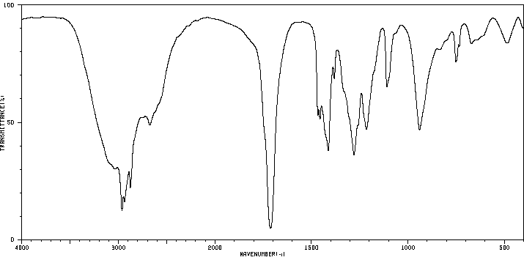
C=O
acid O-H

Slide 29
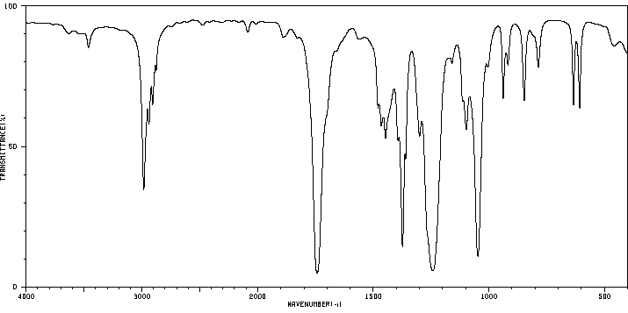
C=O

Slide 30
C=C

Slide 31
IR Problems 1
© www.chemsheets.co.uk AS 1087 12-Jul-15

Slide 32
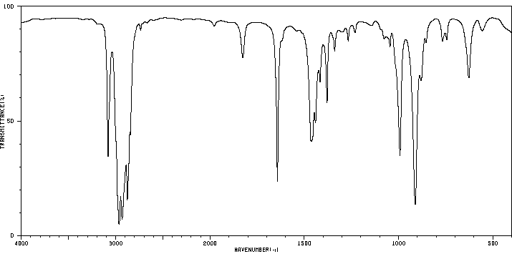
P

Slide 33
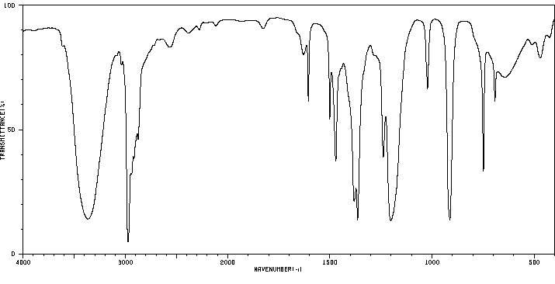
Q

Slide 34
R

Slide 35
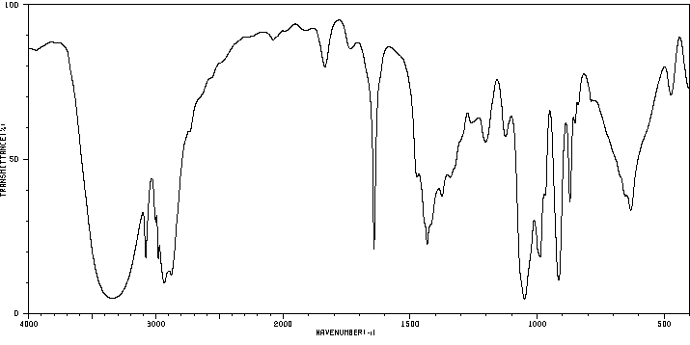
S

Slide 36
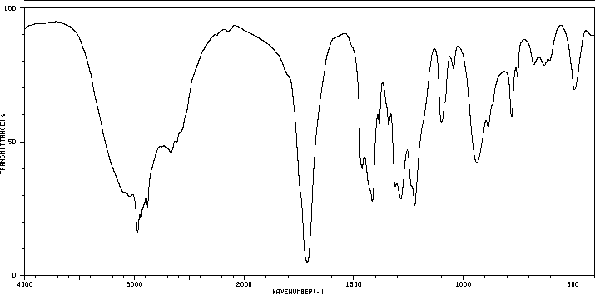
T

Slide 37
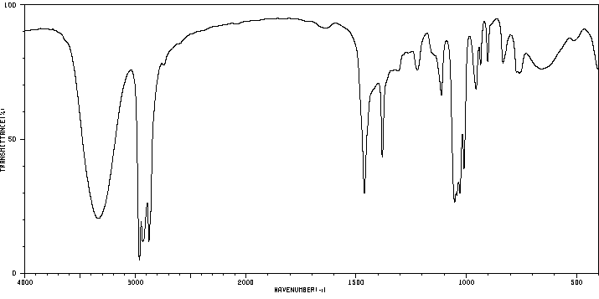
U

Slide 38
IR Problems 2
© www.chemsheets.co.uk AS 1087 12-Jul-15

Slide 39
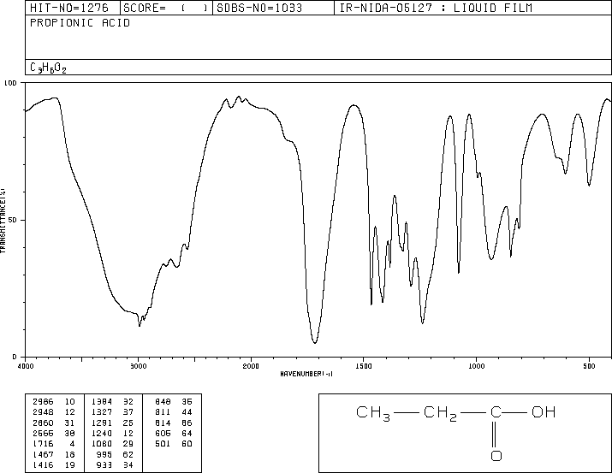
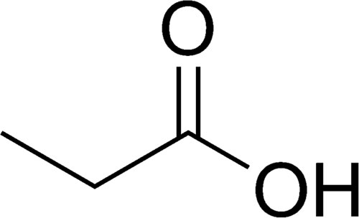
propanoic acid, butanone, 2-methylbut-2-ene, 1-hydroxypropanone, butan-2-ol
1
propanoic acid

Slide 40
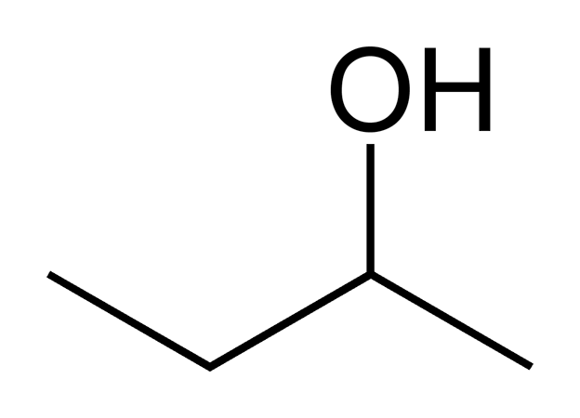
propanoic acid, butanone, 2-methylbut-2-ene, 1-hydroxypropanone, butan-2-ol
2
butan-2-ol

Slide 41
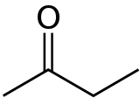
propanoic acid, butanone, 2-methylbut-2-ene, 1-hydroxypropanone, butan-2-ol
3
butanone

Slide 42

propanoic acid, butanone, 2-methylbut-2-ene, 1-hydroxypropanone, butan-2-ol
4
1-hydroxypropanone

Slide 43
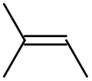
propanoic acid, butanone, 2-methylbut-2-ene, 1-hydroxypropanone, butan-2-ol
5
2-methylbut-2-ene

Slide 44
IR Problems 3
hex-2-ene
pentane
methylpropan-1-ol
2-methylpentan-3-one
butanal
butanoic acid
propyl ethanoate
nitrobenzene
© www.chemsheets.co.uk AS 1087 12-Jul-15

Slide 45
❶
❶
❷
❸
❹
❺
❻
❼
❽
❶
❷
❸
❹
❺
❻
❼
❽

Slide 46
❷
❶
❷
❸
❹
❺
❻
❼
❽
❶
❷
❸
❹
❺
❻
❼
❽

Slide 47
❸
❶
❷
❸
❹
❺
❻
❼
❽
❶
❷
❸
❹
❺
❻
❼
❽

Slide 48
❹
❶
❷
❸
❹
❺
❻
❼
❽
❶
❷
❸
❹
❺
❻
❼
❽

Slide 49
❺
❶
❷
❸
❹
❺
❻
❼
❽
❶
❷
❸
❹
❺
❻
❼
❽

Slide 50
❻
❶
❷
❸
❹
❺
❻
❼
❽
❶
❷
❸
❹
❺
❻
❼
❽

Slide 51
❼
❶
❷
❸
❹
❺
❻
❼
❽
❶
❷
❸
❹
❺
❻
❼
❽

Slide 52
❽
❶
❷
❸
❹
❺
❻
❼
❽
❶
❷
❸
❹
❺
❻
❼
❽

Slide 53
❶
propyl ethanoate
C=O
C-O
❶
❷
❸
❹
❺
❻
❼
❽
❶
❷
❸
❹
❺
❻
❼
❽

Slide 54
❷
2-methylpentan-3-one
C=O
❶
❷
❸
❹
❺
❻
❼
❽
❶
❷
❸
❹
❺
❻
❼
❽

Slide 55
❸
methylpropan-1-ol
O-H
❶
❷
❸
❹
❺
❻
❼
❽
❶
❷
❸
❹
❺
❻
❼
❽

Slide 56
❹
nitrobenzene
C-H
❶
❷
❸
❹
❺
❻
❼
❽
❶
❷
❸
❹
❺
❻
❼
❽

Slide 57
❺
pentane
C-H
❶
❷
❸
❹
❺
❻
❼
❽
❶
❷
❸
❹
❺
❻
❼
❽

Slide 58
❻
butanal
C-H
C=O
❶
❷
❸
❹
❺
❻
❼
❽
❶
❷
❸
❹
❺
❻
❼
❽

Slide 59
❼
butanoic acid
O-H
❶
❷
❸
❹
❺
❻
❼
❽
❶
❷
❸
❹
❺
❻
❼
❽

Slide 60
❽
hex-2-ene
C-H
C-H
C=C
❶
❷
❸
❹
❺
❻
❼
❽
❶
❷
❸
❹
❺
❻
❼
❽

Slide 61
IR Problems 4
© www.chemsheets.co.uk AS 1087 12-Jul-15

Slide 62
F

Slide 63
G

Slide 64
1

Slide 65
2

Slide 66
3

Slide 67
Most IR spectra are from the SBDS data base

