Slide 1
Are you ready?

Slide 2
Purpose of the Session
To give you some tips and handy hints of successful revision
To inform you of support you will receive in the lead up to your exams
To help you to fulfil your full potential in exams!

Slide 3
Sixth form entry requirements
You will need to achieve 5s in English and Maths plus another 3 subjects to sit A levels
A 5 is now a “good” pass expected by sixth forms and Universities
You will need to achieve at least a 6 in Science to do Biology or Chemistry
You will need to achieve at least a 6 in Maths to do Psychology

Slide 4
Contents of the session:
What are we aiming for (sixth form entry requirements)?
Taking control
Cornell note taking method
Planning to be successful – use of your revision timetable
Read, cover write, check with a worked example
Using consolidation cards – how to do that well
How do you assess yourself? – use of past paper questions – where can you get them, how do you use them?
GCSE Pod – what is it? How do I access it?
Revising for Science/Geography – what resources are where and how do you use them?

Slide 5
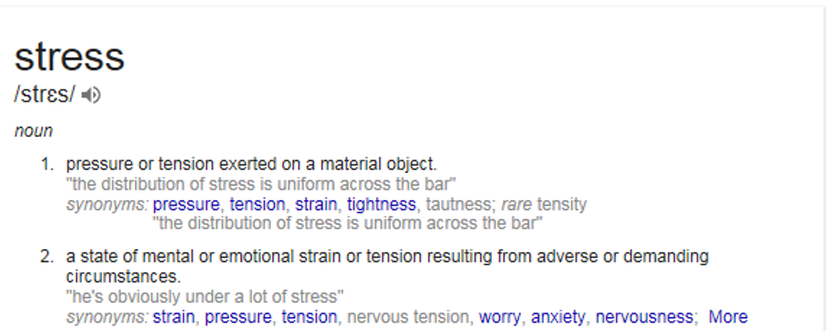

Slide 6
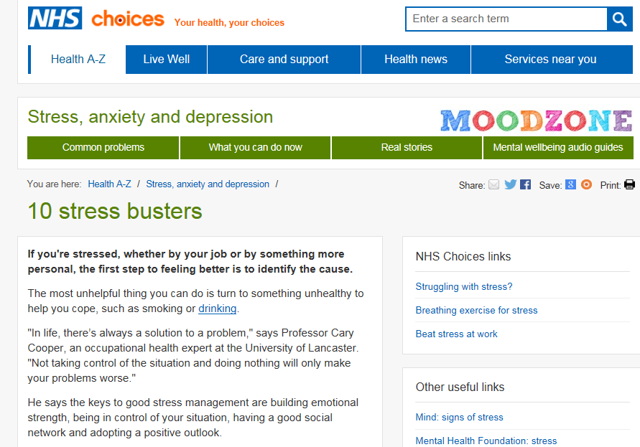
Managing Stress

Slide 7
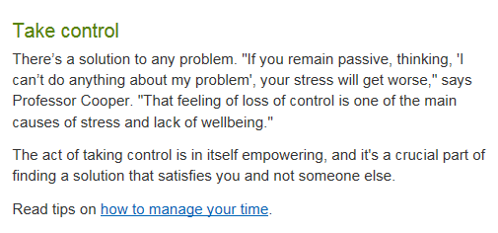
Managing Stress

Slide 8
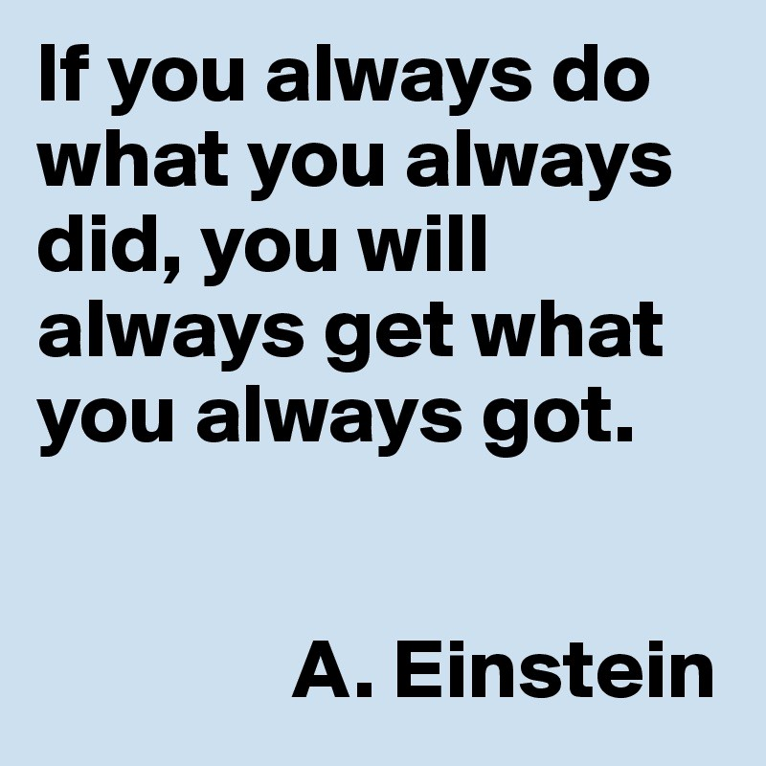

Slide 9

Taking control

Slide 10
Basics of working
No distractions – give your phone to your mum while you work
Plan in advance what you will do
FOCUS
Accept that learning is VERY HARD – if it feels easy then you’re not doing it right
Learn then test, repeat
45 minute sessions then 5 minute break

Slide 11
How do you know what to revise?
Checklists
(PLCs – personal learning checklists)
Learning objectives

Slide 12
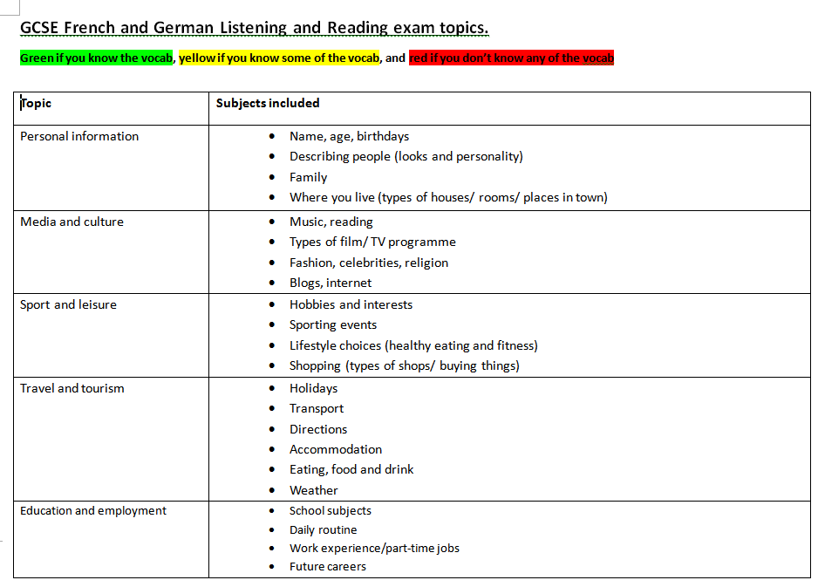
French and German

Slide 13
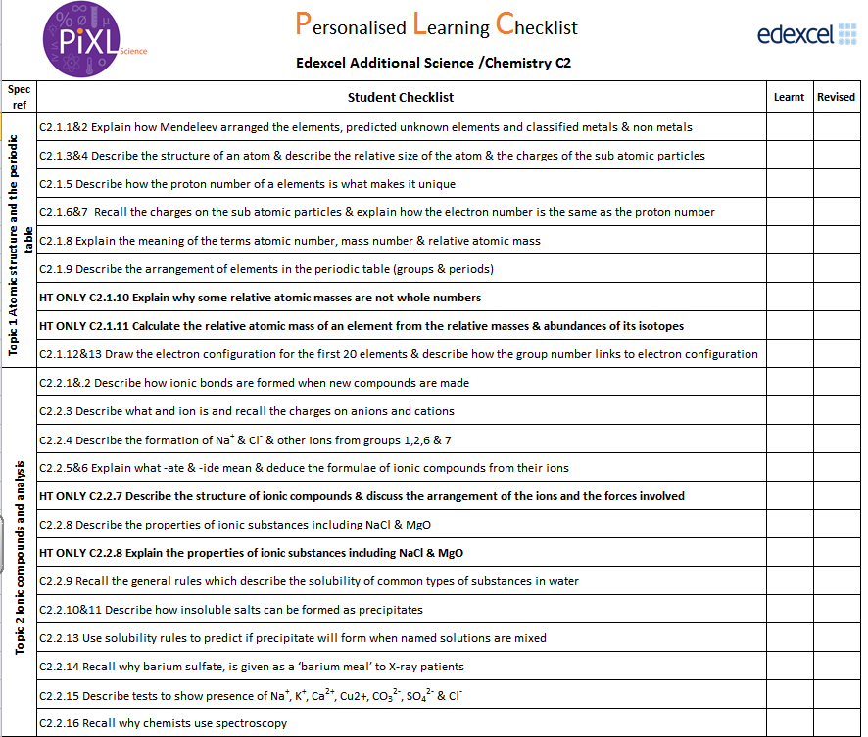

Slide 14
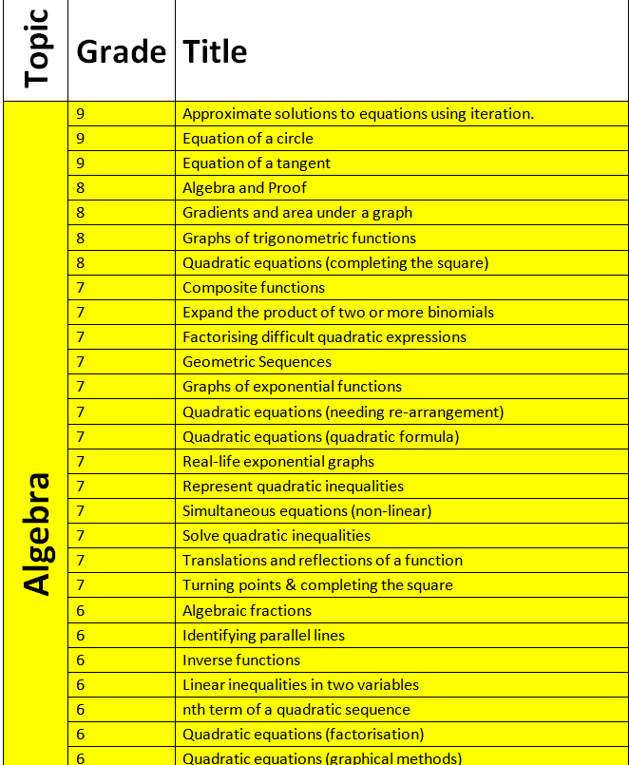
Maths

Slide 15
How to revise
PROPERLY

Slide 16
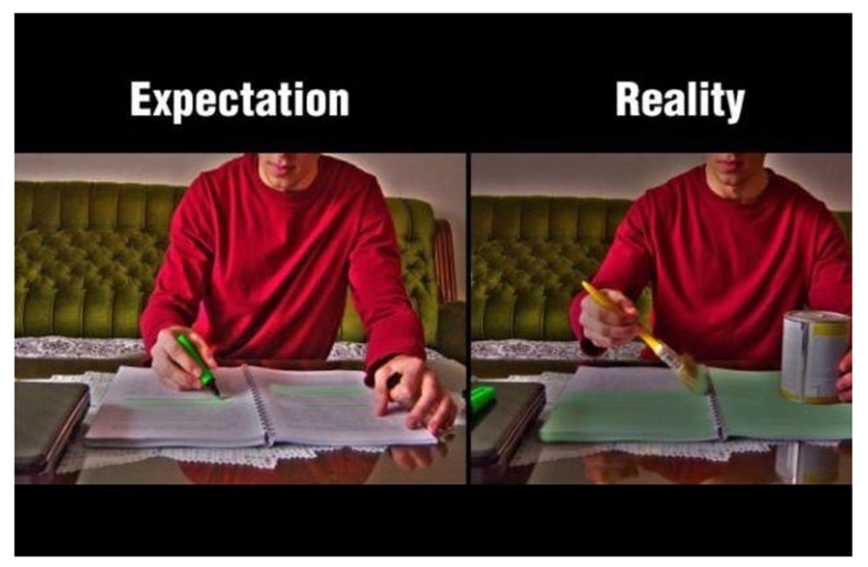
Highlighting

Slide 17
Ineffective Revision Strategies
Three commonly used revision techniques that appear to have very little impact on learning are:
Highlighting texts
Re-reading
Summarising text

Slide 18
Why do students enjoy doing this?
They are very low demand, make you feel as if you are ‘doing revision’ and for highlighting and summarising, you have made something – yellow colour, revision cards

Slide 19
The forgetting curve
Key words:
Mid-terms – exams in the middle of the term
Lecture – a lesson
Stellar – AMAZING

Slide 20
The Curve of Forgetting
https://www.youtube.com/watch?v=GVXDcFKz7DA

Slide 21
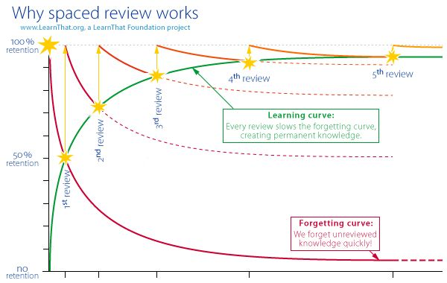
Key messages
You should REVISE regularly the work covered in class – it will save time
Could you do this every weekend?

Slide 22
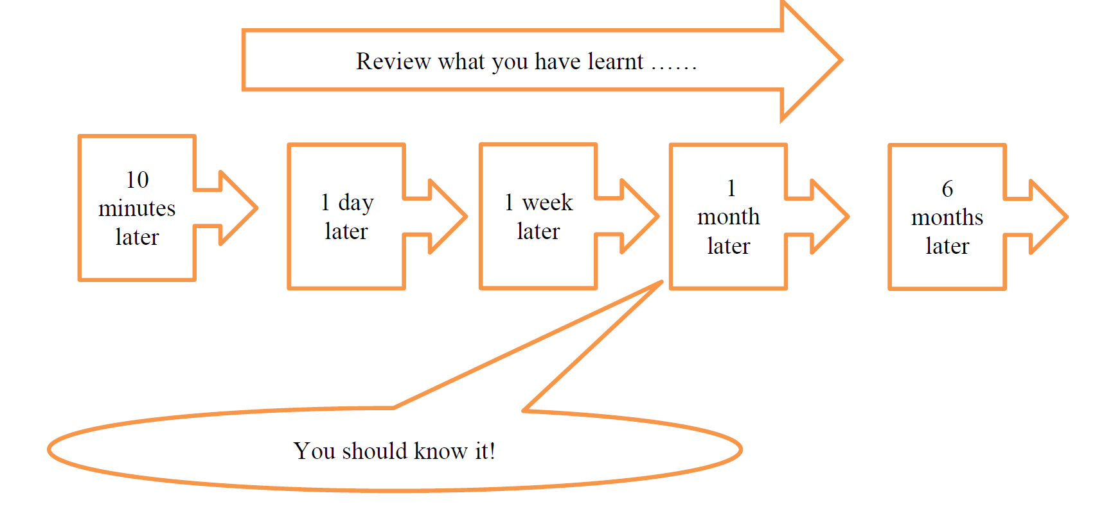

Slide 23
Cornell note taking method

Slide 24
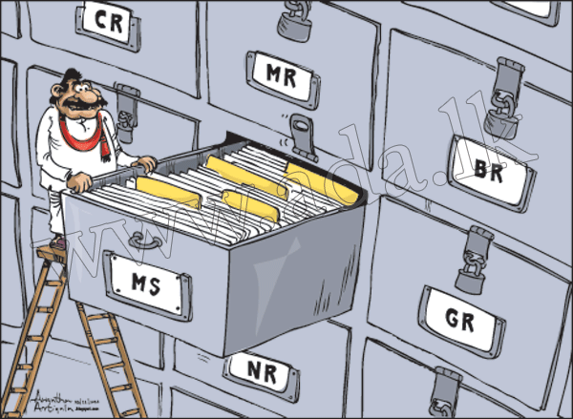
Cornell Note Taking

Slide 25
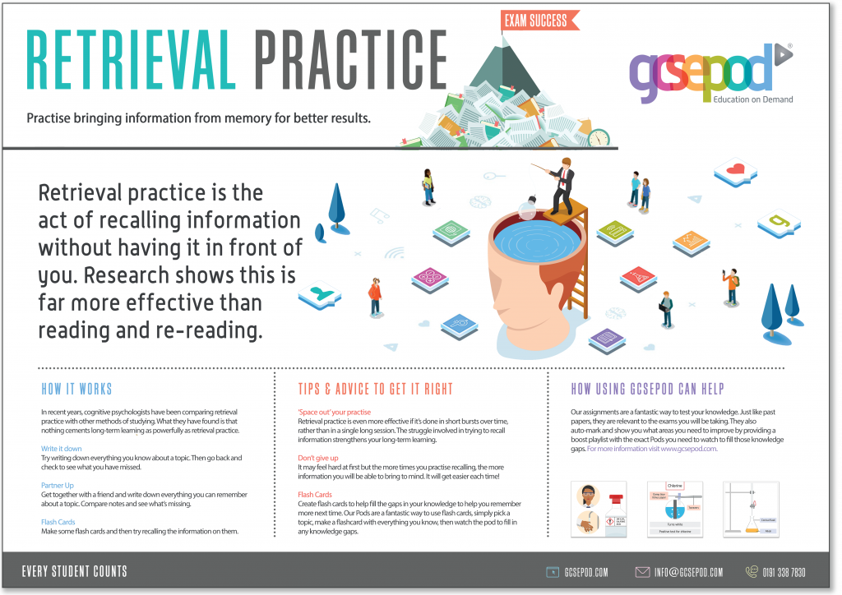

Slide 26
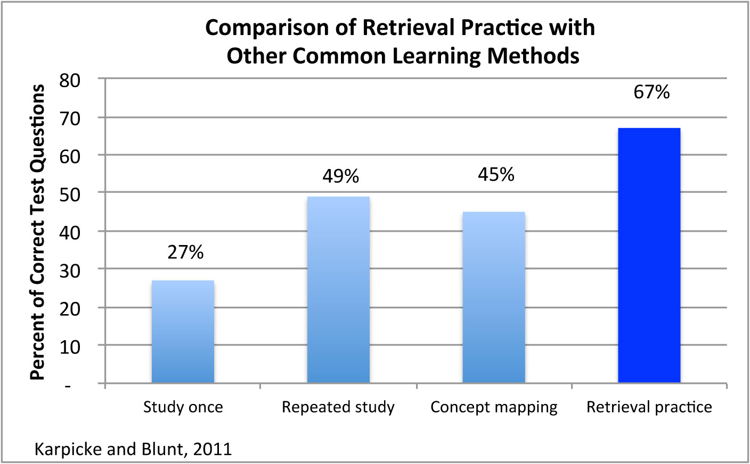

Slide 27
Cornell note taking method
This is something that you would do IN the lesson or that SAME day
It’s not revision but a strategy that will help you when you are revising.
Helps with active revision and not just ‘reading of your notes’
.

Slide 28
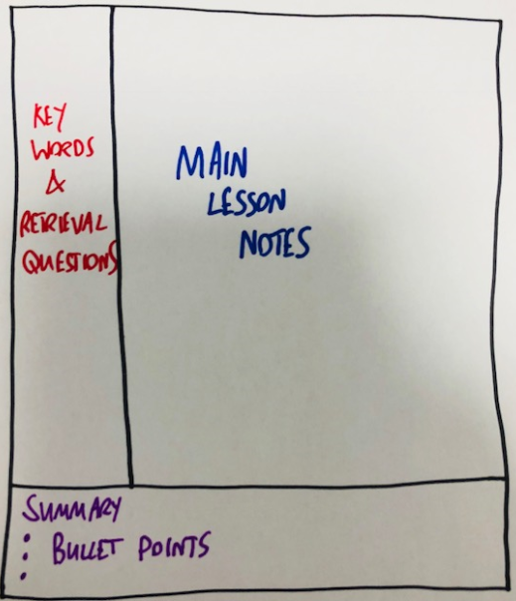
You should get into the habit of having three sections to your notes

Slide 29
Here you would record the notes as normal in the lesson.
Things you would be expected to copy off the board , PowerPoint, from the textbook etc.
Just the usual note taking!

Slide 30
Imagine yourself revising these notes 3 to 6 months later…………
What questions could you ask yourself to see if you remember the work?
Write these questions here whilst it is still fresh in your memory (in the lesson or that same afternoon)
You could also list keywords here so when you are revising you would have to recall the meanings of these words
Notes:
The idea is when they come to revise (a significant time after the notes were produced), rather than just passively re-reading their notes, they go to the left hand column and either try to retrieve the definition of the key words from memory, or answer the retrieval questions. Thus, supporting retrieval practice. This is a far more effective use of their time, compared to simply re-reading notes, which is not very challenging, doesn’t require much thinking and is unlikely to support learning.

Slide 31
Eg. if you had just learned about respiration you could write
What is the difference between aerobic and anaerobic respiration?
What is the equation of each?
Why is respiration important?
Notes:
The idea is when they come to revise (a significant time after the notes were produced), rather than just passively re-reading their notes, they go to the left hand column and either try to retrieve the definition of the key words from memory, or answer the retrieval questions. Thus, supporting retrieval practice. This is a far more effective use of their time, compared to simply re-reading notes, which is not very challenging, doesn’t require much thinking and is unlikely to support learning.

Slide 32
In this section summarise the key points of the lesson, in 3 bullet points. This must be done in the lesson or the same day (no later)
The bullet points can be used later for self-testing.
When revising you could re-read the notes and then write down three key points and then check with the bullet points you wrote originally in the ‘summary’ section, to check if they were the same.

Slide 33
Main notes
Questions / keywords | Summary points

Slide 34
Organising your Revision

Slide 35
How Long Should You Revise?
Studying for hours upon hours will not result in a positive outcome
Prioritising one subject will put pressure on your for the others – timetable revision for all subjects
Generally half an hour for a subject is ideal to enable you to be able to concentrate
Also, build in a “review” session in your timetable. This enables you to know whether your revision has worked

Slide 36
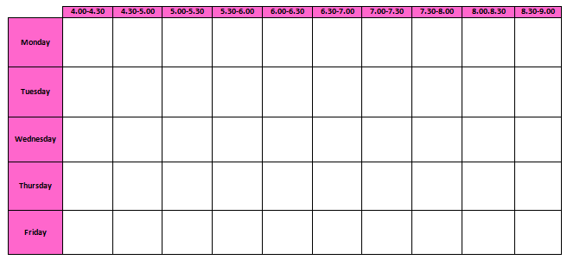
Revision Timetable Template

Slide 37
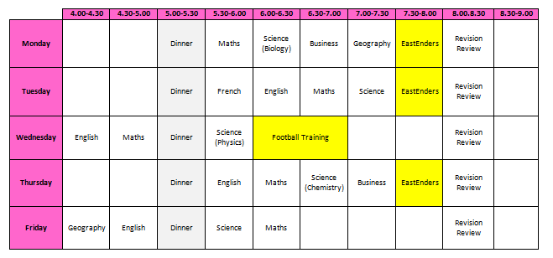
Example

Slide 38
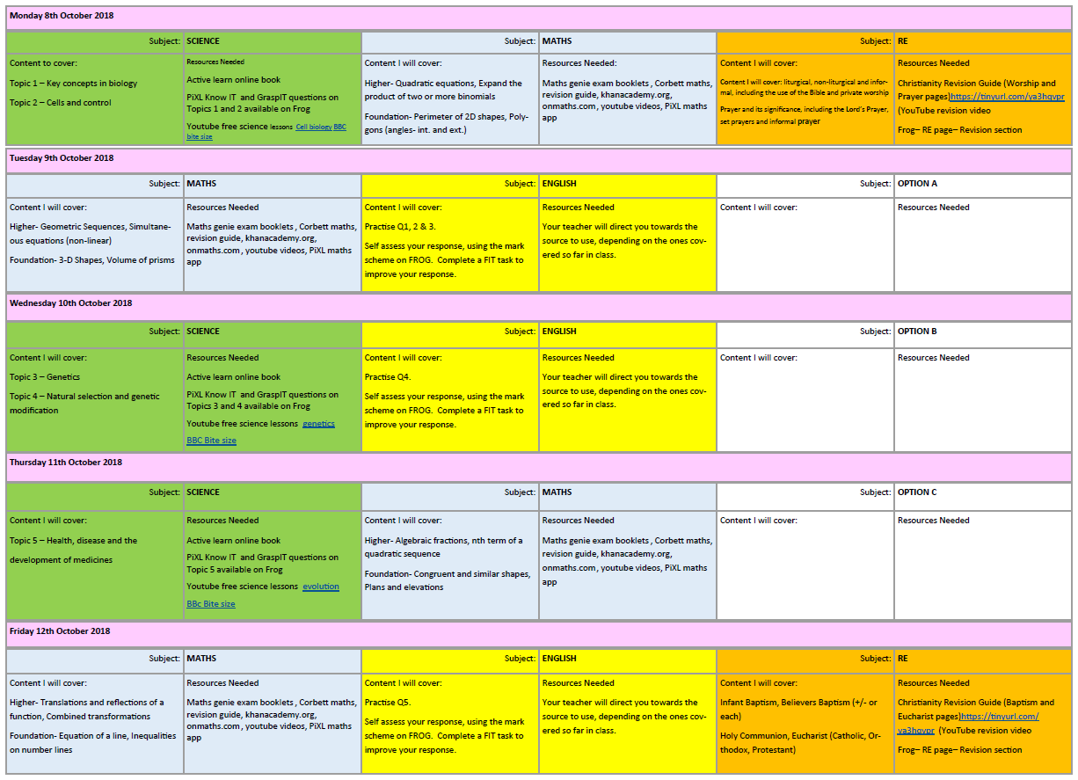
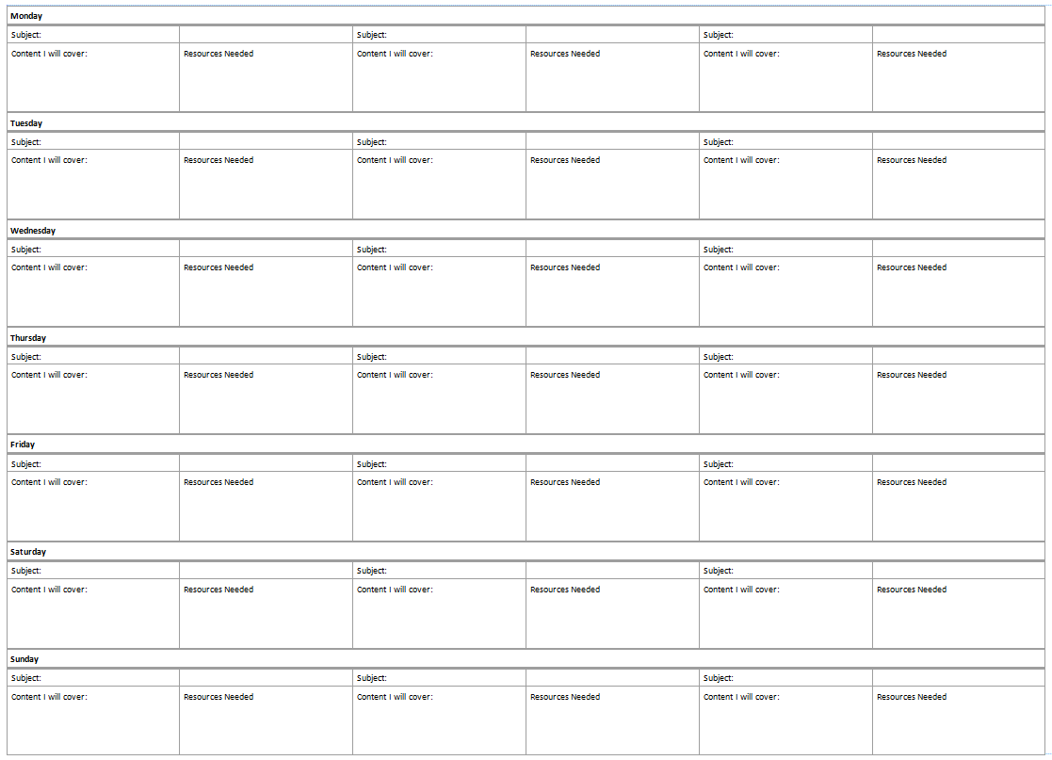
How Do You Plan to Use the Time?
Deciding when you are going to revise is just the first step.
You then need to plan what it is you are going to revise and what you need

Slide 39

Remember
All the work you do now will mean: -
  Revision resources will already be prepared
  Long term memory will be developed
  Happier with the exam season

Slide 40
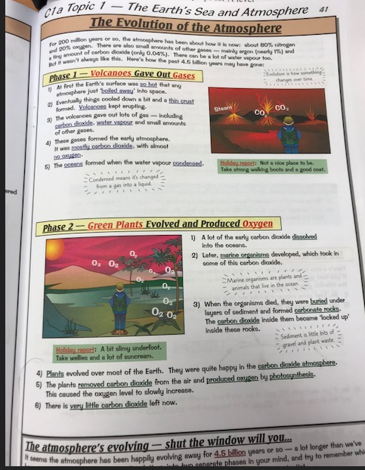
How do you get information into your head?
Read – is there anything you don’t understand?? Look it up
or make a note to ask your teacher
Concentrate very hard, get information into your brain
Turn over the information so you can’t see it
Take a piece of blank paper and write out what you can
remember
Go back to the information
Add in what you missed
Repeat with a blank piece of paper
You will have remembered what you forgot the first time

Slide 41
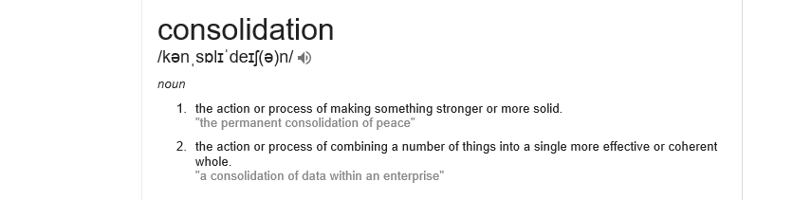
Consolidation

Slide 42
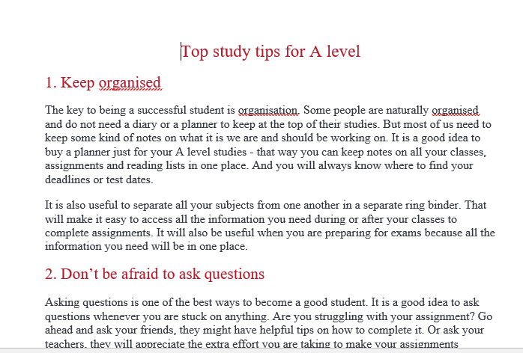
Consolidate this….

Slide 43
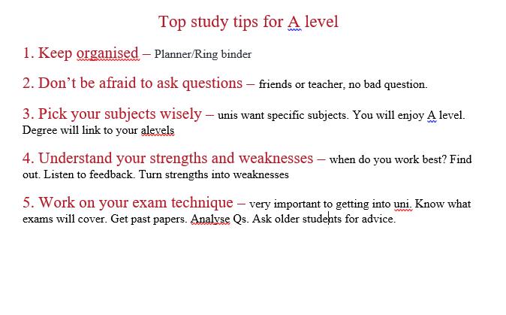
Information - consolidated

Slide 44
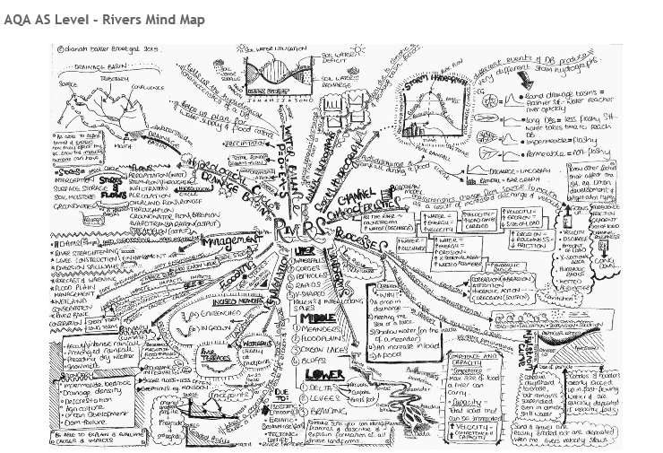
Mind maps

Slide 45
Making a mind map
1. Put a topic or a key question from spec in the middle of a page. e.g. for Geog – Why are some locations more at risk from tectonic hazards?
2. Write as many things as you can remember which link to this area of the spec without looking at your notes – this will then show them what you already know.
3. Students look back at their PLC and see what knowledge is missing from the mind map – this can then be added in a different colour.
4. This is then the information that they will need to focus on further, with more reading, posters, consolidation cards, youtube videos, exam qs etc.
5. After more revision has occurred the process can be repeated to check if new knowledge has been retained.

Slide 46
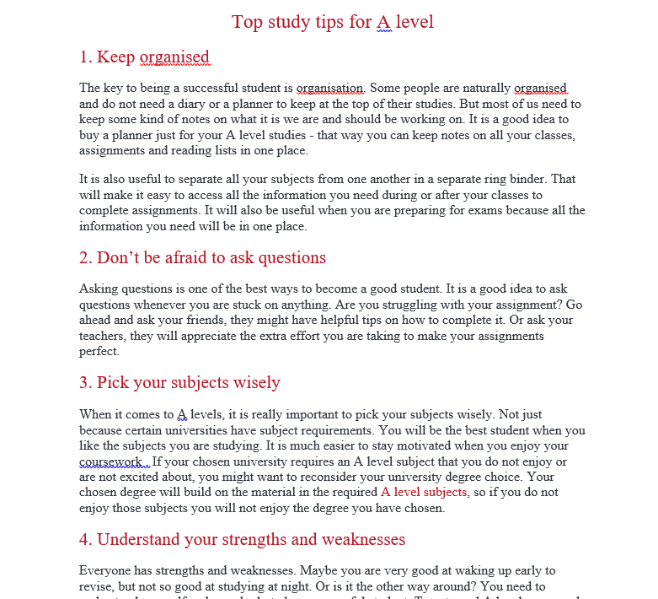
Let’s Try! Break this information down into key points on your consolidation card

Slide 47
Has Your Revision Worked?

Slide 48
Has Your Revision Worked?
Generally a student does not know whether or not their revision has worked until they receive their result
However, there are a number of ways in which you can check your learning

Slide 49


Online Tests
There are a number of online tests you can complete which are quick, easy and mark themselves

Slide 50
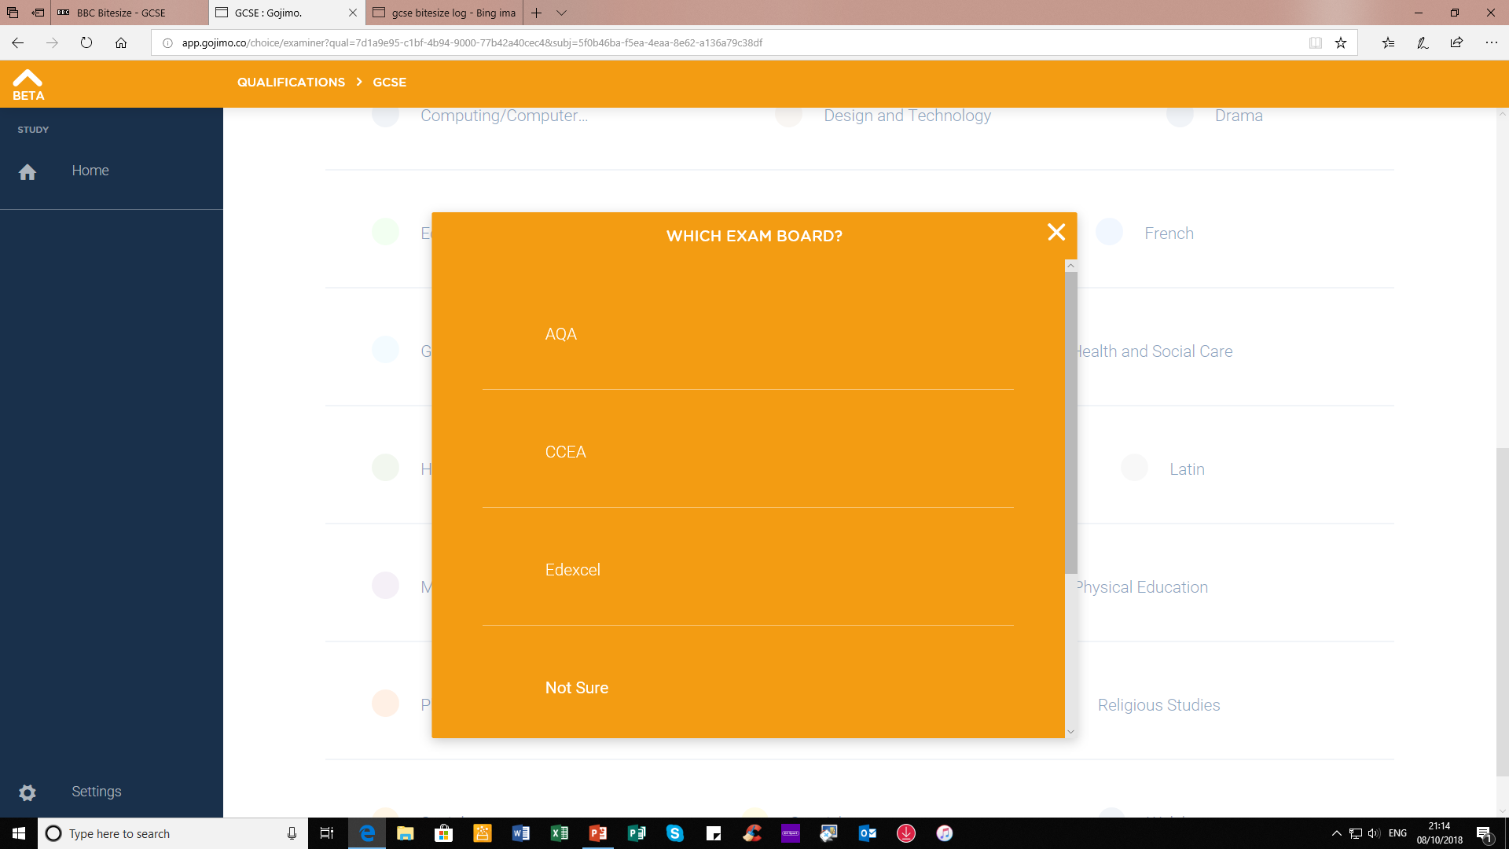
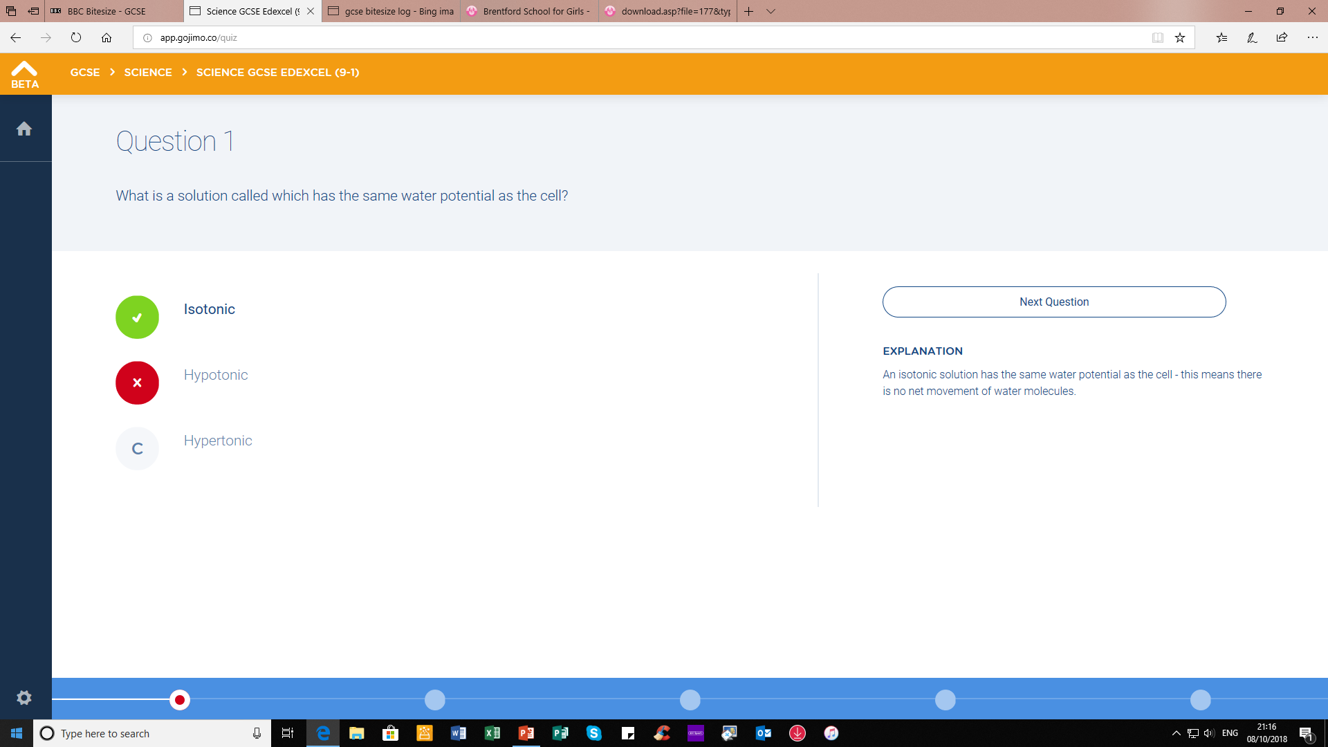
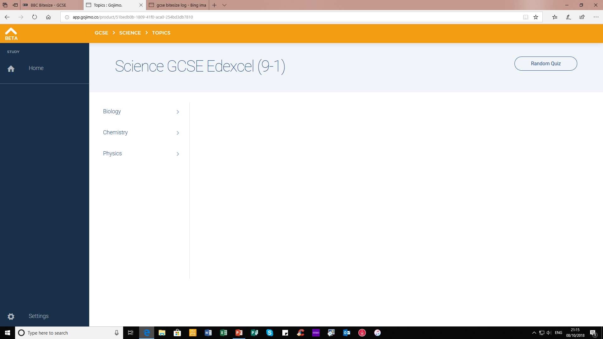
Gojimo

Slide 51
Past Exam Papers
A vital way to prepare for exams is to look at past exam papers
In most cases, your teacher will source these for you
However, you can find them yourselves by accessing the exam board website
IMPORTANT FACT: YOUR SUBJECTS WILL NOT ALL BE USING THE SAME EXAM BOARD

Slide 52
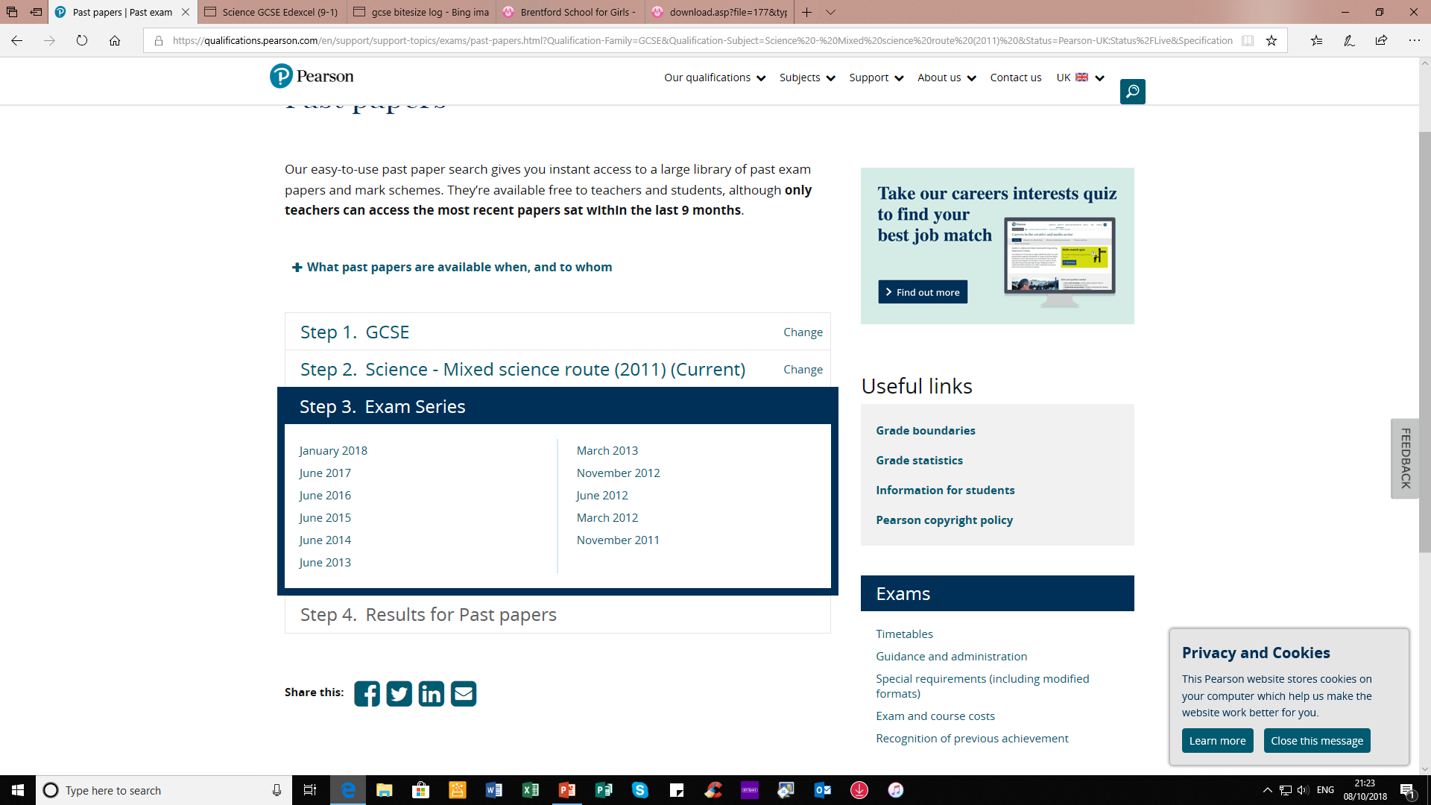
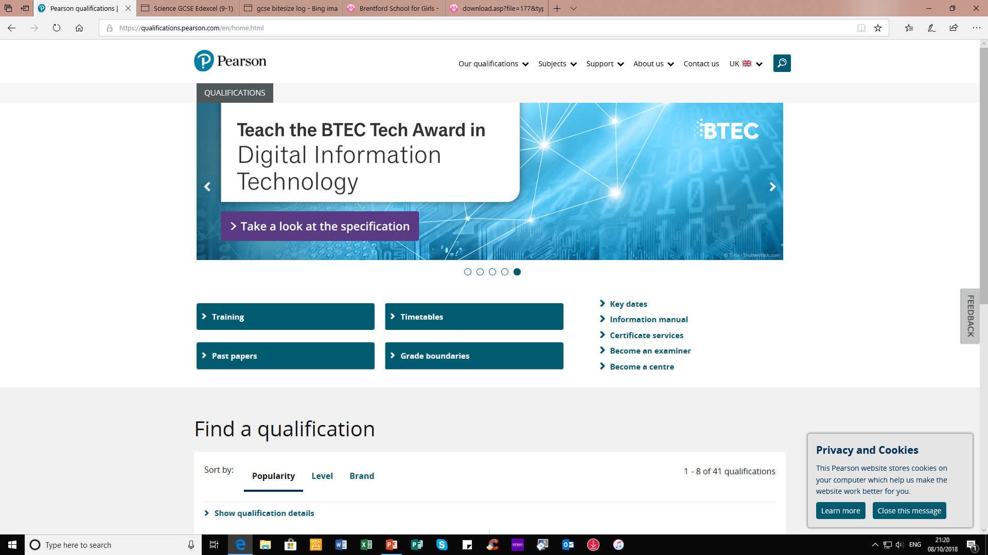
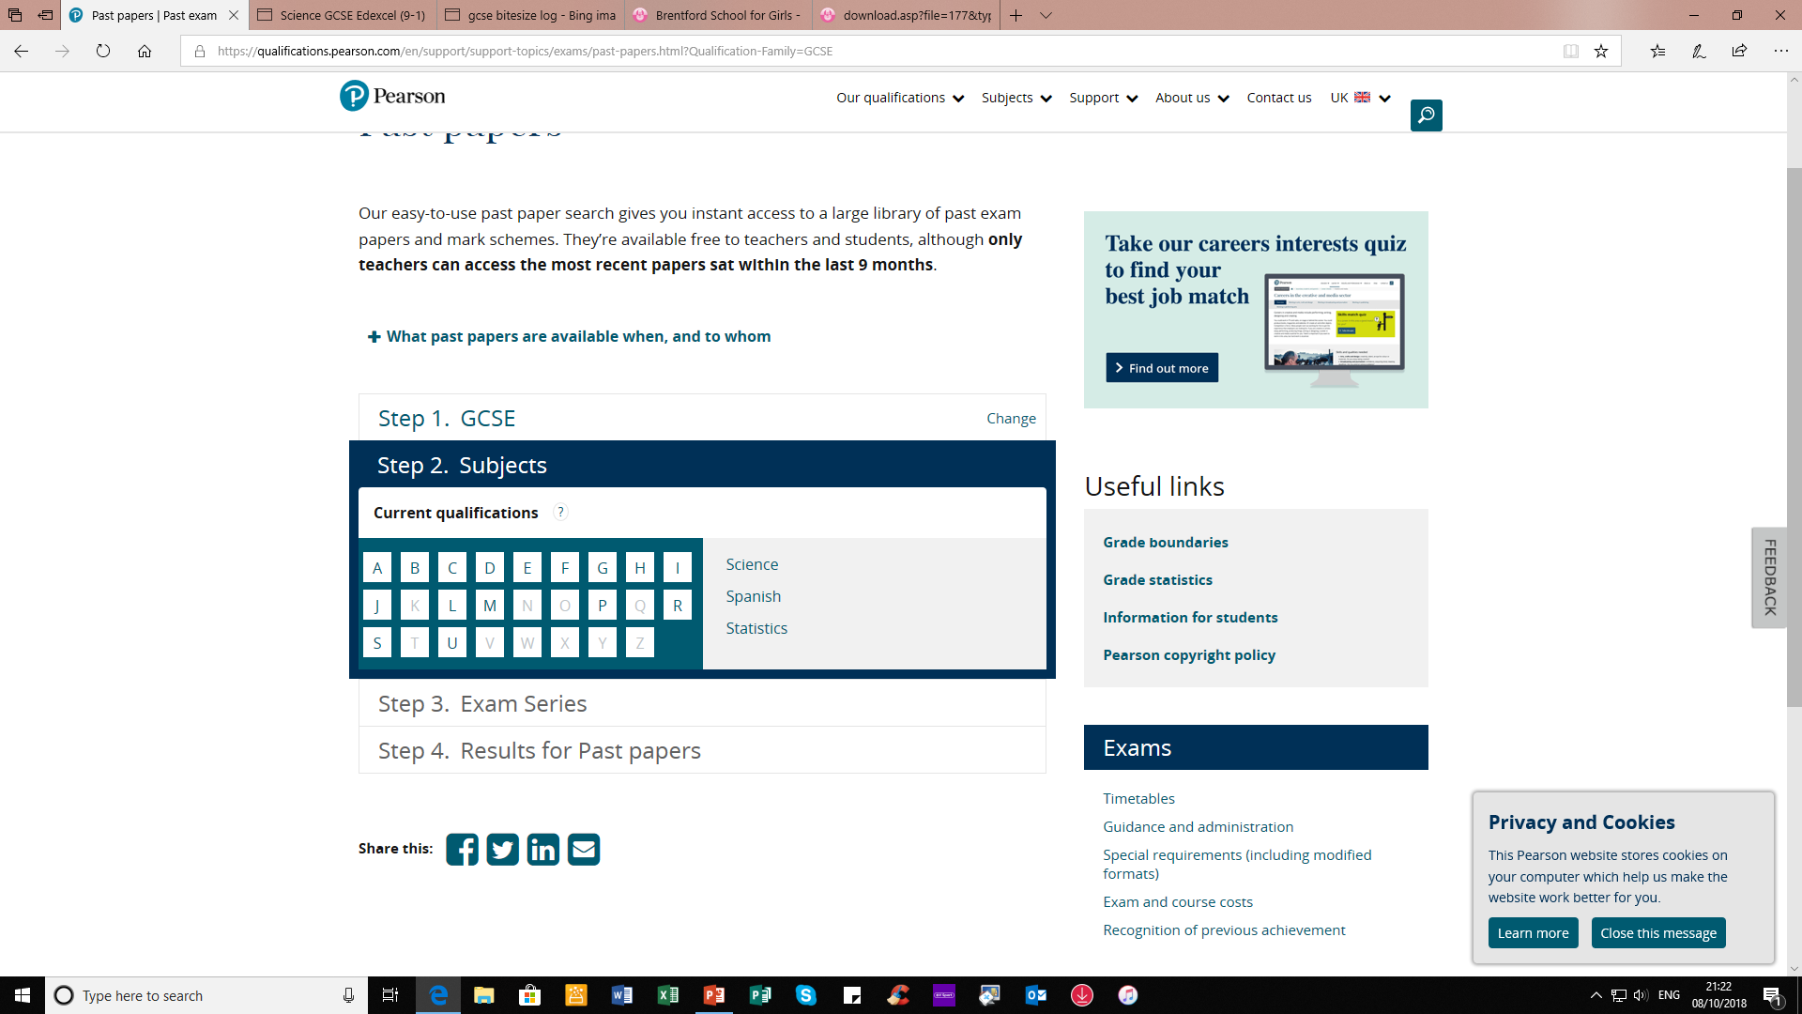
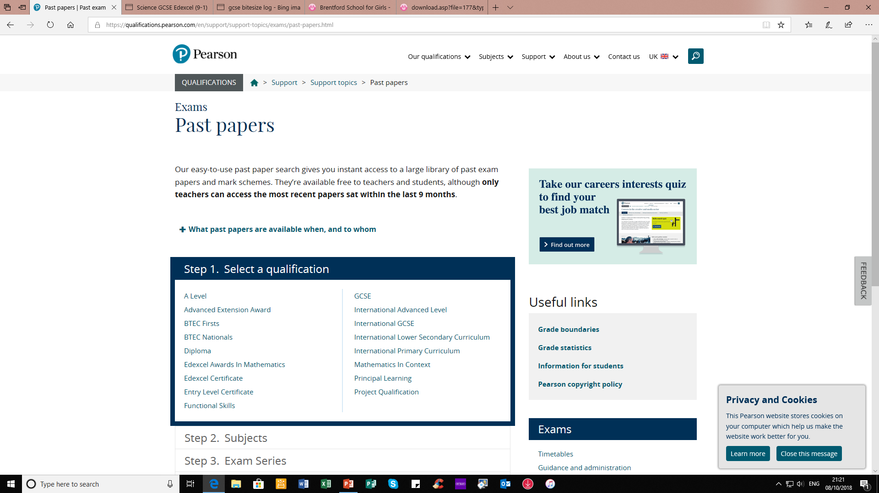
Accessing Papers Using Edexcel as an Example

Slide 53
Mark Schemes
Even more important than accessing exam papers is looking at and understanding mark schemes
Each subject area will be able to advise on the AOs for their subject

Slide 54
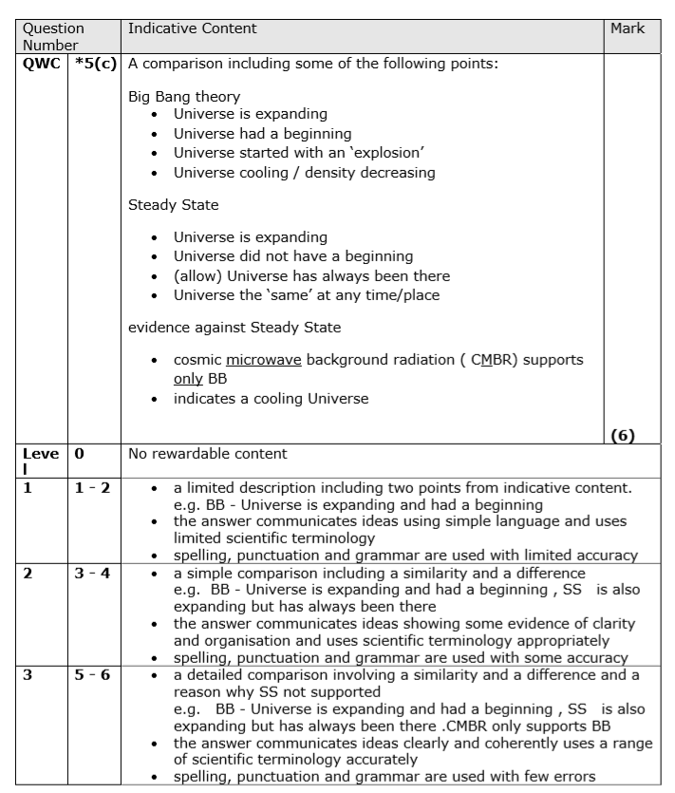
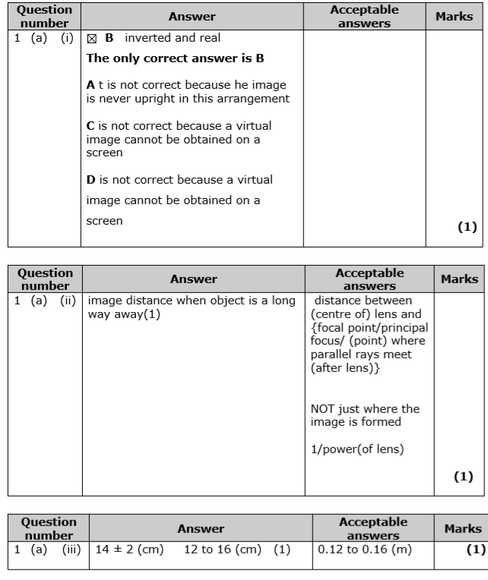

Slide 55
Advice
Mark harshly rather than generously
Take note of the way the exam board want answers structured and the key words that they are looking for
Make sure you understand the key words
Consider the examiners reports

Slide 56
GCSE POD

Slide 57

What is GCSEPod?
GCSEPod provides highly concentrated 3-5 minute bursts of audio-visual, expert-written learning which can help to reinforce and consolidate key GCSE topics covered in lessons.

Slide 58
On average, the Best GCSEPod Users, achieved 0.51 progress 8 scores higher than the lowest users.

Slide 59

Students use GCSEPod to revise on any device.

Slide 60
So, how do you use GCSEPod?

Slide 61




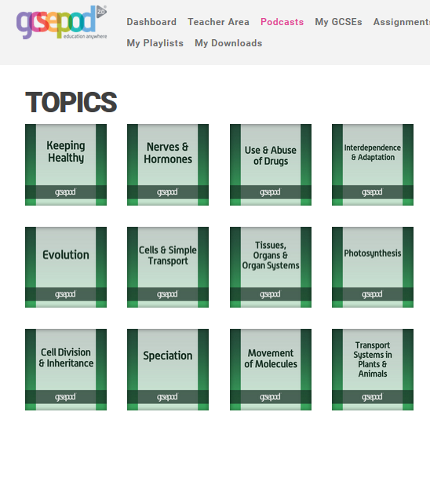

Revise by searching for a TOPIC
Pick your subject
Choose a topic
Start revising

Slide 62
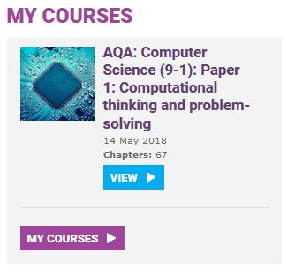
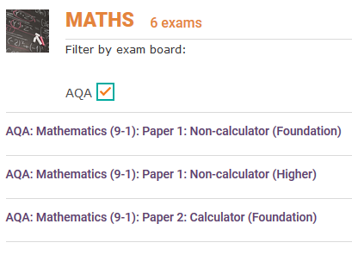
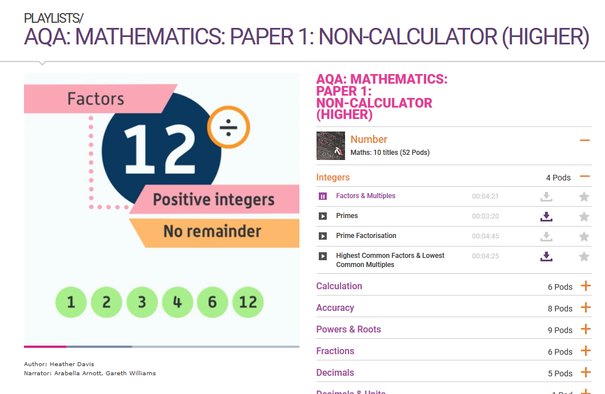
Revise by searching for an EXAM
Go to ‘My Courses’
Choose an exam
Start revising

Slide 63
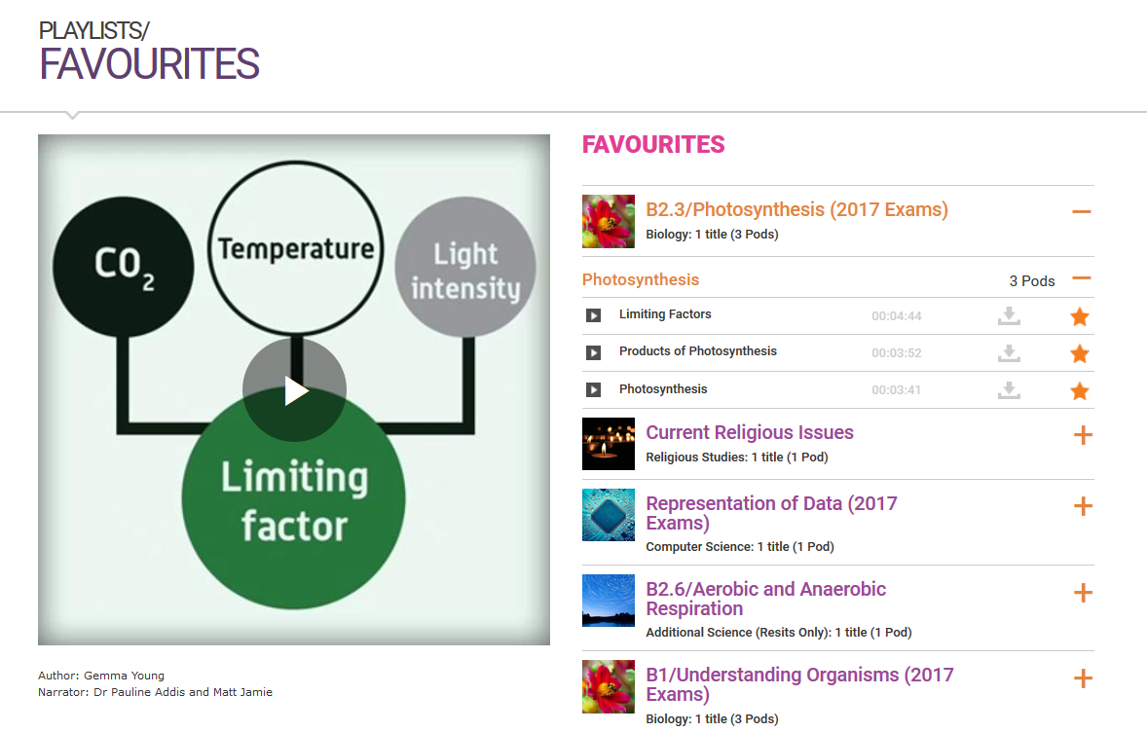
Organise your revision
Click the orange star next to a video to save it to your favourites playlist.
Choose topics you find tricky to focus on them.

Slide 64

What Now?
Sign up and explore!

Slide 65
Good Luck!

