Slide 1
Family Life - part 4
Family, adjectives of personality
Adapted from English File Intermediate 3rd Edition, Christina Latham-Koenig and Clive Oxenden, Oxford University Press 2013

Slide 2
Think about the first story from the last lesson, ‘The Younger Brother’ (don’t look at it!). Read the adjectives below and try to remember which brother they describe. Move the word to the right place. ‘tidy’ has been done for you.
Tim (the younger brother) | Jeff (the older brother)
tidy
responsible
sensible
untidy
rebellious
emotional

Slide 3

Read the stories again and check your answers.

Slide 4
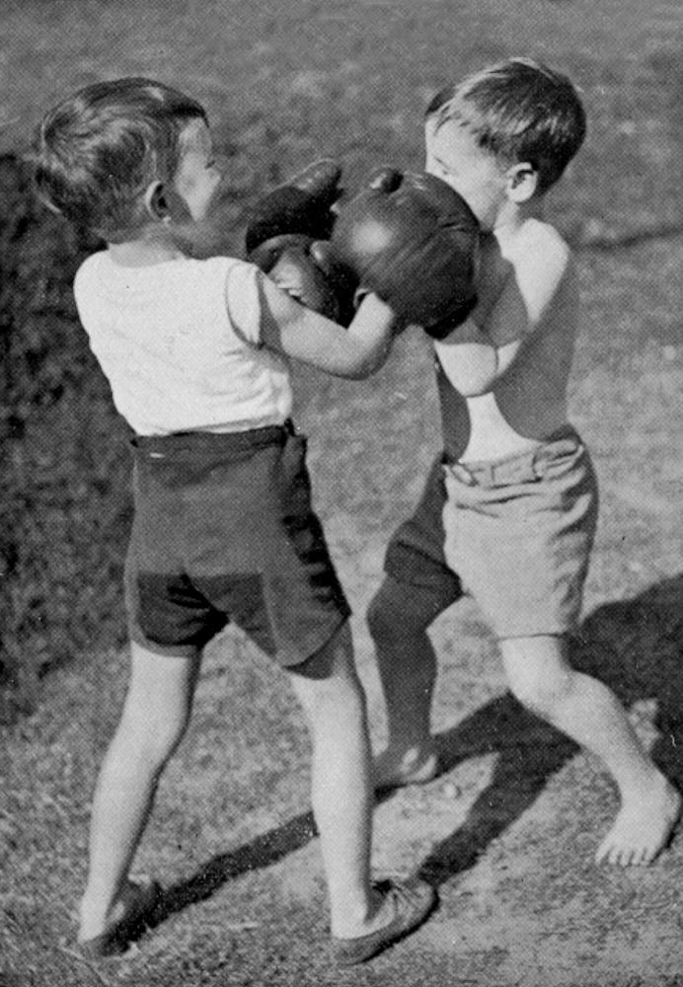
Younger brother or only child - how was it for you?
THE YOUNGER BROTHER
Novelist Tim Lott
Rivalry between brothers is normal, but there was a special reason for the problems between us. I was very ill when I was born, and spent three months in hospital with my mother. My brother did not see her at all during that time, as he went to stay with an aunt. When our mother returned home, it was with a sick newborn baby who took all the attention. No wonder he hated me (although if you ask Jeff, he will say that he didn’t - we remember things differently).
My brother and I were completely different. We shared the same bedroom, but he was tidy, and I was really untidy. He was responsible, I was rebellious. He was sensible, I was emotional. I haven’t got any positive memories of our childhood together, though there must have been good moments. Jeff says we used to play
Cowboys and Indians but I only remember him trying to suffocate my under the bed covers.
My relationship with Jeff has influenced my attitude towards my own four
daughters. If the girls fight, I
always think that the
younger child is innocent.
But the good news about
brothers and sisters is that
when they get older, they
value each other more. Jeff
is now one of my best
friends, and I like and
admire him greatly. For
better or for worse, we
share a whole history. It is
the longest relationship in
my life.

Slide 5
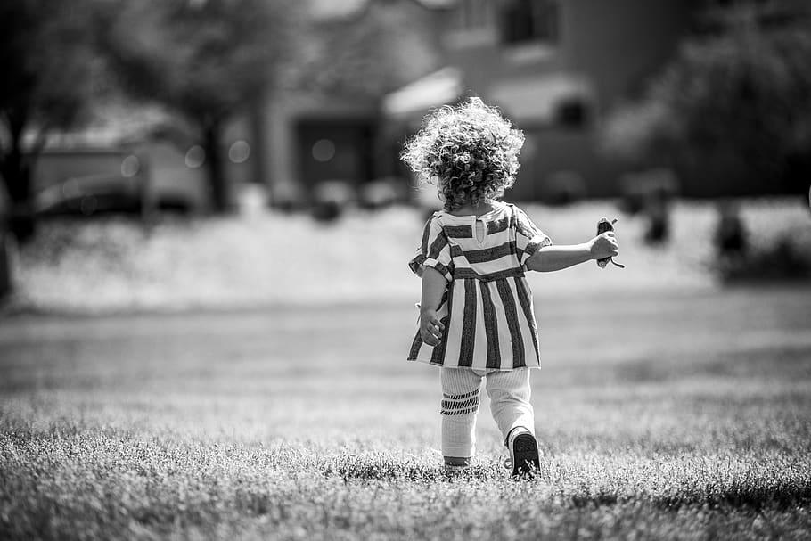
Younger brother or only child - how was it for you?
THE ONLY CHILD
Journalist Sarah Lee
I went to boarding school when I was seven, and the hardest thing I found was making friends. Because I was an only child, I just didn’t know how to do it. The thing is that when you’re an only child you spend a lot of your time with adults and you’re often the only child in a gathering of adults. Your parents go on living more or less the way they have always lived, only now you are there too.
I found being an only child interesting because it gave me a view of the world of adults that children in a big family might not get. And I know it has, at least partly, made me the kind of person I am - I never like being one of a group, for example. If I have to be in a group, I will always try to go off and do something on my own, or be with just one other person - I’m not comfortable with being one of a gang.
My parents are divorced now and my mother lives in the US and my father in the UK. I feel very responsible for them - I feel responsible for their happiness. I’m the closest relative in the world to each of them and I’m very aware of that.

Slide 6
The answers...
Tim (the younger brother) | Jeff (the older brother)
untidy
tidy
rebellious
responsible
emotional
sensible

Slide 7
What do you think these words mean? Write in the boxes below. The first one has been done for you.
Word | Someone who...
tidy | ...likes to keep things in the right place
responsible
sensible
untidy
rebellious
emotional

Slide 8

The answers...
Tick the words that describe you.
Word | Someone who...
tidy | ...likes to keep things in the right place
responsible | ...can be trusted
sensible | ...makes good choices
untidy | ...doesn’t keep things in the right place
rebellious | ...doesn’t follow rules
emotional | ...shows their feelings easily or often

Slide 9
Complete the definitions of people’s personalities with the adjectives. Number 1 has been done for you.
_selfish_ people think about themselves and not about other people.
A _________ person always wants to win.
___________ children behave badly because they are given everything they want.
An __________ person gets angry quickly and likes fighting and arguing.
___________ people have an attractive personality and make people like them.
A ___________ person has common sense and is practical.
A ___________ person is friendly and enjoys being with other people.
___________ people are often worried or stressed.
A ___________ person is happy one minute and sad the next, and is often bad-tempered.
____________ people like doing things on their own, without help.
A ___________ person likes giving orders to other people.
An ___________ person shows that they love or like people very much.
A ___________ person wants what other people have.
A ___________ person can be easily upset.
An ___________ person wants to be successful in life.
A ___________ person is someone you can trust.
A _________ person doesn’t like obeying rules.
A ___________ person never changes his or her opinion about something.
Selfish
Spoilt
Charming
Competitive
Stubborn
Rebellious
Bossy
Aggressive
Sensible
Moody
Independent
Emotional
Reliable
Ambitious
Sociable
Anxious
Jealous
Sensitive

Slide 10

The answers...
_selfish_ people think about themselves and not about other people.
A competitive person always wants to win.
spoilt children behave badly because they are given everything they want.
An aggressive person gets angry quickly and likes fighting and arguing.
charming people have an attractive personality and make people like them.
A sensible person has common sense and is practical.
A sociable person is friendly and enjoys being with other people.
anxious people are often worried or stressed.
A moody person is happy one minute and sad the next, and is often bad-tempered.
independent people like doing things on their own, without help.
A bossy person likes giving orders to other people.
An affectionate person shows that they love or like people very much.
A jealous person wants what other people have.
A sensitive person can be easily upset.
An ambitious person wants to be successful in life.
A reliable person is someone you can trust.
A rebellious person doesn’t like obeying rules.
A stubborn person never changes his or her opinion about something.
Listen to the recording. Pause after each one and practice saying the adjective.

Slide 11
Read the adjectives below. Write their opposite in the space.
Adjective Opposite
Clever ______________
Generous ______________
Insecure ______________
Lazy ______________
Quiet ______________
Shy ______________
Listen and check your answers.

Slide 12
The answers...
Adjective Opposite
Clever stupid
Generous mean
Insecure self-confident
Lazy hard-working
Quiet talkative
Shy outgoing
Listen again and practice saying the words.

Slide 13


Which adjectives say something good about a person? Move the words to the right place in the table. One has been done for you.
Positive
Negative
reliable
untidy
outgoing
talkative
lazy
insecure
emotional
stubborn
clever
mean
stupid
tidy
generous
shy
quiet
self-confident
moody
charming
bossy
ambitious
aggressive
jealous
rebellious
sensitive
sociable
competitive
selfish
anxious
affectionate
sensible
independent
sociable
reliable
spoilt

Slide 14
The answers...
Orange adjectives are negative
Green adjectives are positive
White adjectives could be positive, negative or neutral
untidy
outgoing
talkative
lazy
insecure
emotional
stubborn
clever
mean
stupid
tidy
generous
shy
quiet
self-confident
moody
charming
bossy
ambitious
aggressive
jealous
rebellious
sensitive
sociable
competitive
selfish
anxious
affectionate
sensible
independent
sociable
reliable
spoilt

Slide 15
Negatives
With some adjectives of personality the opposite is a completely different word (clever/stupid, lazy/hard-working).
For others, we add a prefix (tidy/untidy, kind/unkind, responsible/irresponsible).
‘un-’ is the most common negative prefix (but can be positive too: ‘unselfish’)
‘im-’ is used before adjectives beginning with p or m (e.g. impossible)
‘ir- ‘ is used before adjectives beginning with r (e.g. irregular)

Slide 16
Write the prefix un-, dis-, im-, ir- or in- to make the negative of these adjectives. The first one has been done for you.
unambitious
___friendly
___honest
___imaginative
___kind
___mature
___organised
___patient
___reliable
___responsible
___selfish
___sensitive
___sociable
___tidy

Slide 17
The answers...
_unambitious
_unfriendly
_dishonest
_unimaginative
_unkind
_immature
_disorganised
_impatient
_unreliable
_irresponsible
_unselfish
_insensitive
_unsociable
_untidy

Slide 18
Use the adjectives you have learned to:
Write a description of someone you like and admire.
Write a description of someone you dislike.
I like and admire my friend because...
B. I dislike this person because...

Slide 19
Which of the two people you described do you think will be more successful in life? Why?

