Slide 1
Family Life - part 3
Family, adjectives of personality
Adapted from English File Intermediate 3rd Edition, Christina Latham-Koenig and Clive Oxenden, Oxford University Press 2013

Slide 2
Do you have brothers and sisters, or are you an only child?
Do you think it is good to have brothers and sisters? Why? Why not?

Slide 3
Draw a line to match the word to the right definition. The first one has been done for you.
attention
suffocate
influence
attitude
innocent
admire
to think good things of someone
watching , listening to, or thinking about something carefully
Stop someone from being able to breathe
not done anything wrong
change how someone thinks, feels or behaves
how you think or feel about something and how this makes you behave

Slide 4
The answers
attention
suffocate
influence
attitude
innocent
admire
to think good things of someone
watching , listening to, or thinking about something carefully
stop someone from being able to breathe
done nothing wrong
change how someone thinks, feels or behaves
how you think or feel about something and how this makes you behave

Slide 5

Read the stories on the next two slides.

Slide 6
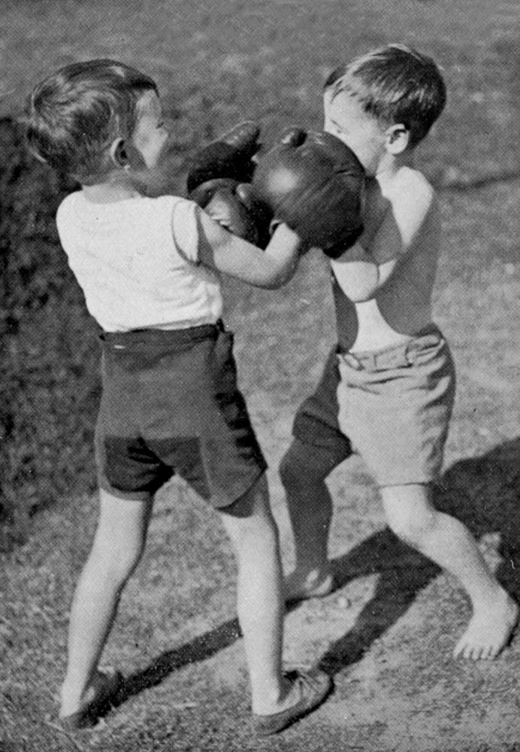
Younger brother or only child - how was it for you?
THE YOUNGER BROTHER
Novelist Tim Lott
Rivalry between brothers is normal, but there was a special reason for the problems between us. I was very ill when I was born, and spent three months in hospital with my mother. My brother did not see her at all during that time, as he went to stay with an aunt. When our mother returned home, it was with a sick newborn baby who took all the attention. No wonder he hated me (although if you ask Jeff, he will say that he didn’t - we remember things differently).
My brother and I were completely different. We shared the same bedroom, but he was tidy, and I was really untidy. He was responsible, I was rebellious. He was sensible, I was emotional. I haven’t got any positive memories of our childhood together, though there must have been good moments. Jeff says we used to play
Cowboys and Indians but I only remember him trying to suffocate my under the bed covers.
My relationship with Jeff has influenced my attitude towards my own four
daughters. If the girls fight, I
always think that the
younger child is innocent.
But the good news about
brothers and sisters is that
when they get older, they
value each other more. Jeff
is now one of my best
friends, and I like and
admire him greatly. For
better or for worse, we
share a whole history. It is
the longest relationship in
my life.

Slide 7
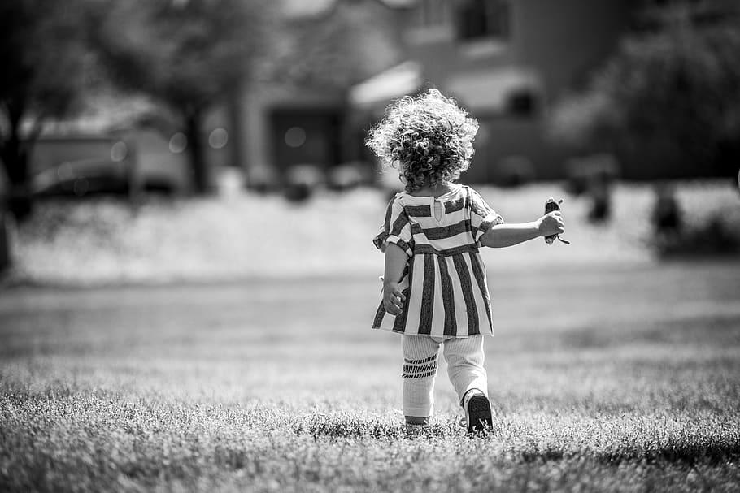
Younger brother or only child - how was it for you?
THE ONLY CHILD
Journalist Sarah Lee
I went to boarding school when I was seven, and the hardest thing I found was making friends. Because I was an only child, I just didn’t know how to do it. The thing is that when you’re an only child you spend a lot of your time with adults and you’re often the only child in a gathering of adults. Your parents go on living more or less the way they have always lived, only now you are there too.
I found being an only child interesting because it gave me a view of the world of adults that children in a big family might not get. And I know it has, at least partly, made me the kind of person I am - I never like being one of a group, for example. If I have to be in a group, I will always try to go off and do something on my own, or be with just one other person - I’m not comfortable with being one of a gang.
My parents are divorced now and my mother lives in the US and my father in the UK. I feel very responsible for them - I feel responsible for their happiness. I’m the closest relative in the world to each of them and I’m very aware of that.

Slide 8
Who do you think was a happier child, Tim or Sarah? Why?

Slide 9
Read the stories again and look at the highlighted words.
Match them with the definitions below:
____________ ill
____________ it’s no surprise that
____________ competition between two people
____________ the time when you were a child
____________ a meeting of people e.g. family
____________ people who are fully grown
____________ know about something
____________ a school where children can live
____________ think that someone or something is important
____________divided something between two or more people
____________ try to hurt someone else
____________ a group of friends
rivalry
aware of
sick
a gang
no wonder
a gathering
shared
adults
childhood
fight
boarding school
value

Slide 10
Read the stories again and look at the highlighted words.
Match them with the definitions below:
Sick ill
No wonder it’s no surprise that
Rivalry competition between two people
Childhood the time when you were a child
A gathering a meeting of people e.g. family
Adults people who are fully grown
Aware of know about something
Boarding school a school where children can live
Value think that someone or something is important
Shared divided something between two or more people
Fight try to hurt someone else
A gang a group of friends

Slide 11
Do you think the last few weeks have been different for people who do / don’t have brothers or sisters? How?

