Slide 1
Family Life - part 4
Family, adjectives of personality
Adapted from English File Intermediate 3rd Edition, Christina Latham-Koenig and Clive Oxenden, Oxford University Press 2013

Slide 2
The words 1 - 5 are the names of different groups of words. Draw a line to match the group to one of the descriptions A - E. Number 1 has been done for you.
Noun
Verb
Adjective
Adverb
Preposition
describe the relationship between things, often in terms of place, time or movement. They include words such as at, in, on, across, behind, for.
the ‘name’ of a person, animal or thing.
an ‘action’
describe a noun
used to add more information about an adjective or verb

Slide 3
The answers...
Noun
Verb
Adjective
Adverb
Preposition
describe the relationship between things, often in terms of place, time or movement.
the ‘name’ of a person, animal or thing.
an ‘action’
describe a noun
used to add more information about an adjective or verb

Slide 4
Put the words in the right place. ‘glasses’ has been done for you.
noun | verb | adjective | adverb | preposition
glasses
funny
quietly
boy
at
small
glasses
on
bridge
for
under
nice
walk
carefully
listen
quickly
jump

Slide 5
The answers...
noun | verb | adjective | adverb | preposition
glasses
listen
nice
carefully
on
bridge
small
quickly
at
walk
under
boy
jump
funny
quietly
for

Slide 6
Think about the first story from the last lesson, ‘The Younger Brother’ (don’t look at it!). Read the adjectives below and try to remember which brother they describe. Move the word to the right place. ‘tidy’ has been done for you.
Tim (the younger brother) | Jeff (the older brother)
tidy
responsible
sensible
untidy
rebellious
emotional

Slide 7

Read the stories again and check your answers.

Slide 8
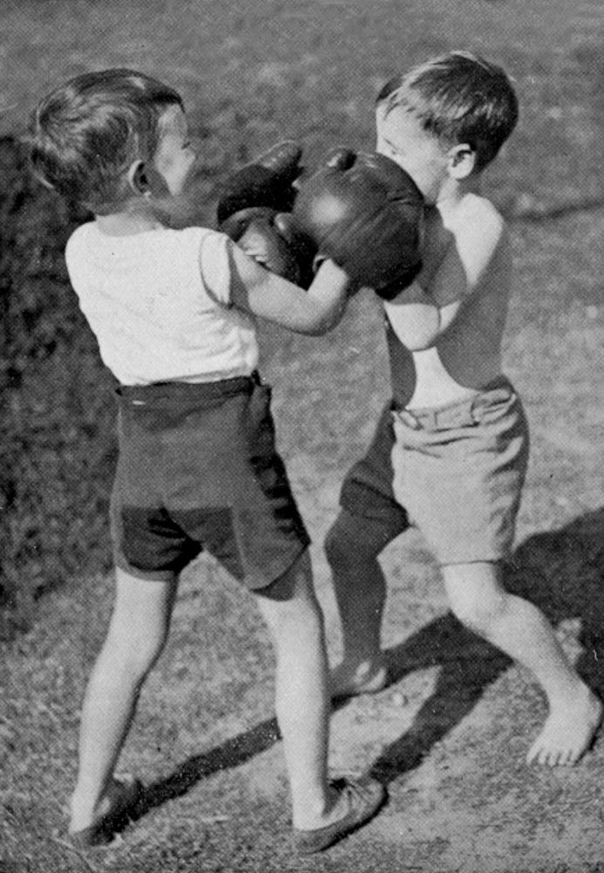
Younger brother or only child - how was it for you?
THE YOUNGER BROTHER
Novelist Tim Lott
Rivalry between brothers is normal, but there was a special reason for the problems between us. I was very ill when I was born, and spent three months in hospital with my mother. My brother did not see her at all during that time, as he went to stay with an aunt. When our mother returned home, it was with a sick newborn baby who took all the attention. No wonder he hated me (although if you ask Jeff, he will say that he didn’t - we remember things differently).
My brother and I were completely different. We shared the same bedroom, but he was tidy, and I was really untidy. He was responsible, I was rebellious. He was sensible, I was emotional. I haven’t got any positive memories of our childhood together, though there must have been good moments. Jeff says we used to play
Cowboys and Indians but I only remember him trying to suffocate my under the bed covers.
My relationship with Jeff has influenced my attitude towards my own four
daughters. If the girls fight, I
always think that the
younger child is innocent.
But the good news about
brothers and sisters is that
when they get older, they
value each other more. Jeff
is now one of my best
friends, and I like and
admire him greatly. For
better or for worse, we
share a whole history. It is
the longest relationship in
my life.

Slide 9
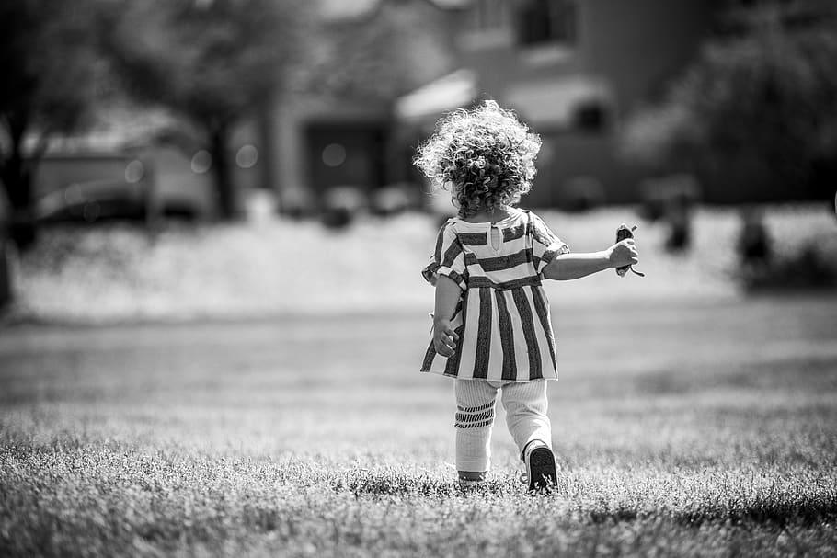
Younger brother or only child - how was it for you?
THE ONLY CHILD
Journalist Sarah Lee
I went to boarding school when I was seven, and the hardest thing I found was making friends. Because I was an only child, I just didn’t know how to do it. The thing is that when you’re an only child you spend a lot of your time with adults and you’re often the only child in a gathering of adults. Your parents go on living more or less the way they have always lived, only now you are there too.
I found being an only child interesting because it gave me a view of the world of adults that children in a big family might not get. And I know it has, at least partly, made me the kind of person I am - I never like being one of a group, for example. If I have to be in a group, I will always try to go off and do something on my own, or be with just one other person - I’m not comfortable with being one of a gang.
My parents are divorced now and my mother lives in the US and my father in the UK. I feel very responsible for them - I feel responsible for their happiness. I’m the closest relative in the world to each of them and I’m very aware of that.

Slide 10
The answers...
Tim (the younger brother) | Jeff (the older brother)
untidy
tidy
rebellious
responsible
emotional
sensible

Slide 11
What do you think these words mean? Write in the boxes below. Read the stories again if you need to. The first one has been done for you.
Word | Someone who...
tidy | ...likes to keep things in the right place
responsible
sensible
untidy
rebellious
emotional

Slide 12

The answers...
Tick the words that describe you.
Word | Someone who...
tidy | ...likes to keep things in the right place
responsible | ...can be trusted
sensible | ...makes good choices
untidy | ...doesn’t keep things in the right place
rebellious | ...doesn’t follow rules
emotional | ...shows their feelings easily or often

Slide 13
Complete the definitions of people’s personalities with the adjectives. Number 1 has been done for you.
_selfish_ people think about themselves and not about other people.
A _________ person always wants to win.
An __________ person gets angry quickly and likes fighting and arguing.
___________ people have an attractive personality and make people like them.
A ___________ person is friendly and enjoys being with other people.
A ___________ person is happy one minute and sad the next, and is often bad-tempered.
____________ people like doing things on their own, without help.
A ___________ person likes giving orders to other people.
An ___________ person shows that they love or like people very much.
A ___________ person wants what other people have.
An ___________ person wants to be successful in life.
A ___________ person is someone you can trust.
A ___________ person never changes his or her opinion about something.
Selfish
Charming
Competitive
Stubborn
Bossy
Aggressive
Moody
Independent
Affectionate
Reliable
Ambitious
Sociable
Jealous

Slide 14

The answers...
_selfish_ people think about themselves and not about other people.
A competitive person always wants to win.
An aggressive person gets angry quickly and likes fighting and arguing.
charming people have an attractive personality and make people like them.
A sociable person is friendly and enjoys being with other people.
A moody person is happy one minute and sad the next, and is often bad-tempered.
independent people like doing things on their own, without help.
A bossy person likes giving orders to other people.
An affectionate person shows that they love or like people very much.
A jealous person wants what other people have.
An ambitious person wants to be successful in life.
A reliable person is someone you can trust.
A stubborn person never changes his or her opinion about something.
Listen to the recording. Pause after each one and practice saying the adjective.

Slide 15


Which adjectives say something good about a person? Move the words to the right place in the table. One has been done for you.
Positive
Negative
reliable
moody
charming
bossy
ambitious
aggressive
jealous
rebellious
stubborn
competitive
selfish
untidy
affectionate
tidy
independent
sociable
reliable

Slide 16
The answers...
Orange adjectives are negative
Green adjectives are positive
White adjectives could be positive or negative
moody
charming
bossy
ambitious
aggressive
jealous
rebellious
stubborn
competitive
selfish
untidy
affectionate
tidy
independent
sociable
reliable

Slide 17
Use the adjectives you have learned to write a description of one of your best friends:

Slide 18
How are you and your friend the same? How are you different?

