Slide 1
New title
Hopefully you have now chosen your new photographer to work on and have started your research page! Leave space to shoot!
I am aware that many of you have now run out of space in your sketchbook so will need to swap over to PowerPoint. We can print pages for sketchbooks when we return- don’t worry. As you will now be moving into your own specialised areas you will need to decide what your new Title is! On the next slide is a list of titles that have been set by AQA in the past. REMEMBER it must still relate to what you have put on your developed ideas page as well as your most recent photographer – for example if you have chosen to continue exploring buildings/architecture then your title needs to fit into that topic E.g. Manufactured Structures

Slide 2
Yes, you have seen these before!
Unusual portraiture
Manufactured structures
Everyday Objects
Sensory Experience
Signs
Towns and cities
Choose a title that best reflects what you are continuing with.

Slide 3
Task 1. Create a new mind map for your topic using PowerPoint
Task 2. Create a new moodboard for your topic using PowerPoint
Task 3. Choose a new photographer

Slide 4
1. Unusual portraiture
You do not have to use photographers provided in this PowerPoint- you can do your own research
Photographers have occasionally chosen to represent their subjects in unusual ways.
Examples can be seen in the jumping portraits of Philippe Halsman, the ‘Crying Men’ series by Sam Taylor-Wood and the carefully arranged work of Tim Tadder. Investigate appropriate
examples and techniques and produce your own response to unusual portraiture.

Slide 5
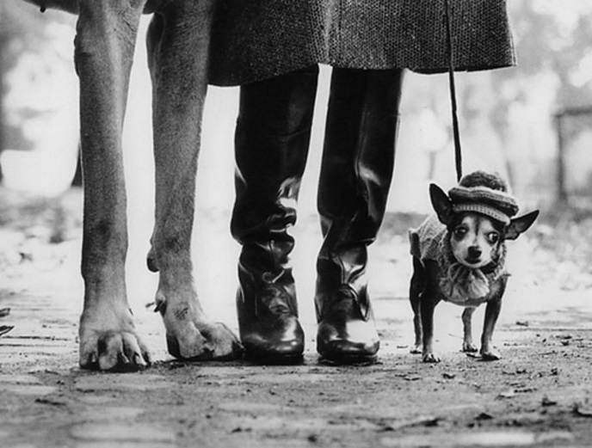
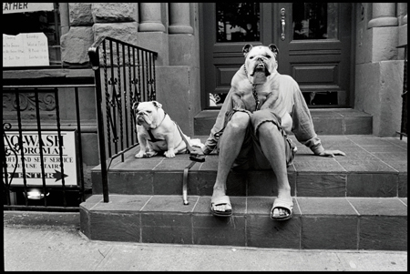
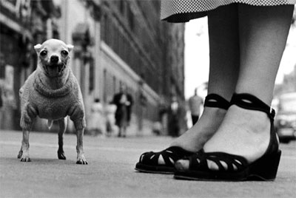
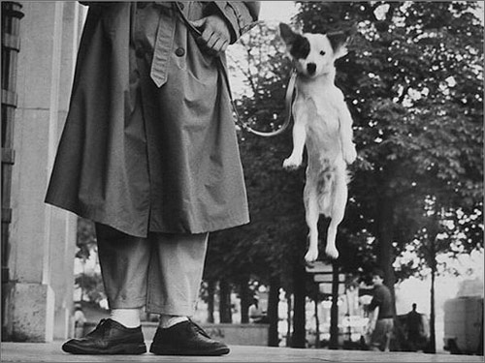
Elliott Erwitt (b. 26 July 1928 Paris, France) is an advertising and journalistic photographer known for his black and white candid shots of ironic and absurd situations within everyday settings -- the master of the "indecisive moment".
Erwitt studied the relationship between dogs and their owners.

Slide 6
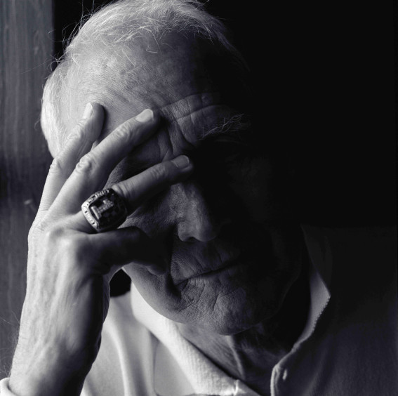
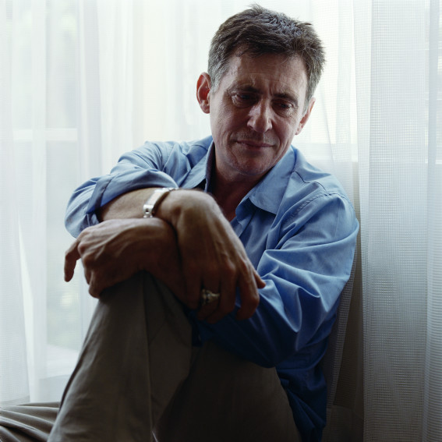
Sam Taylor-Wood

Slide 7
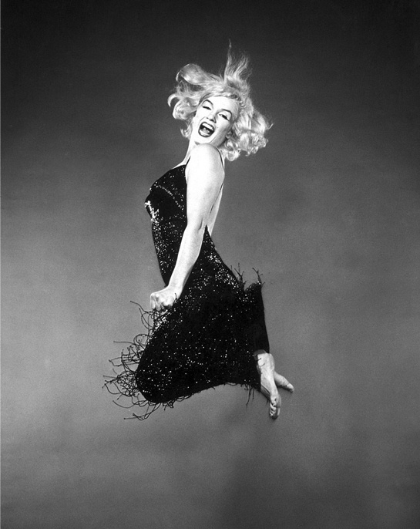
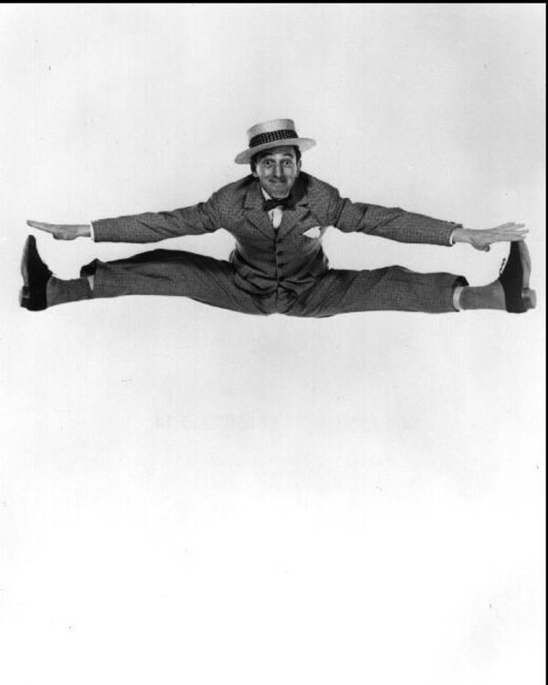
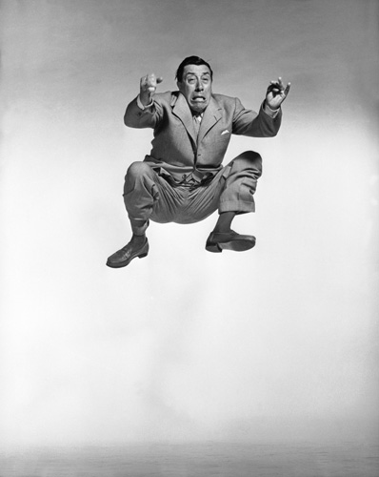
Philippe Halsman

Slide 8
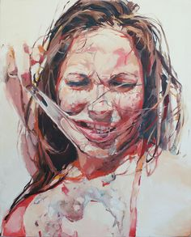
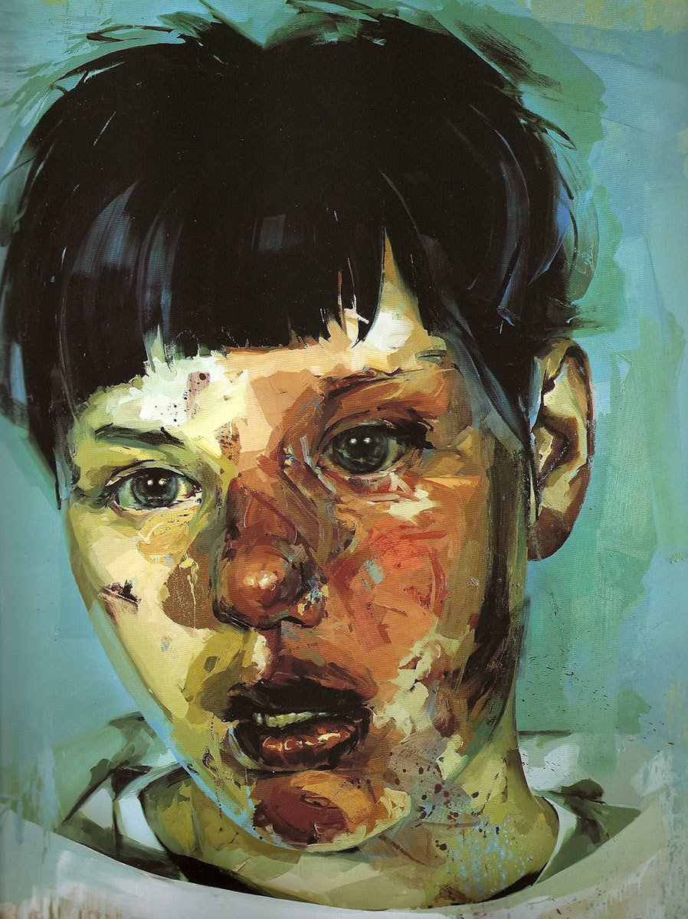
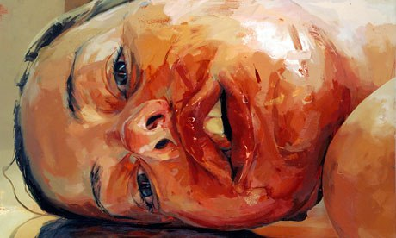
Jenny Saville

Slide 9
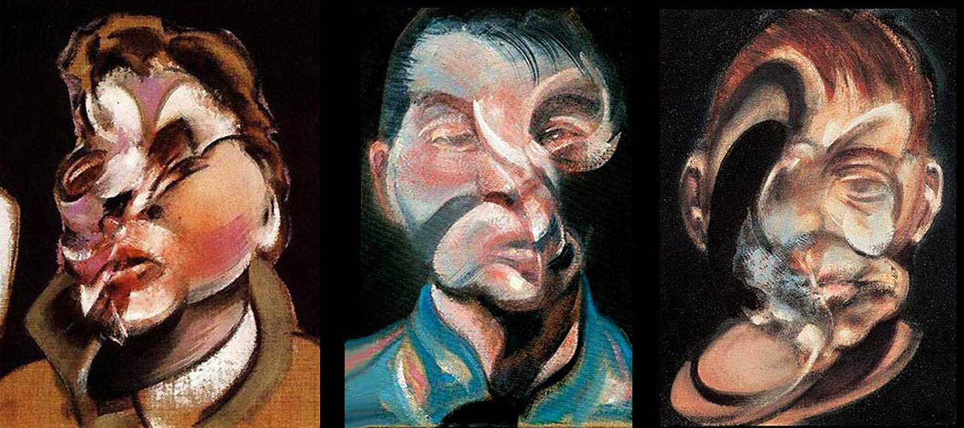
Francis Bacon

Slide 10
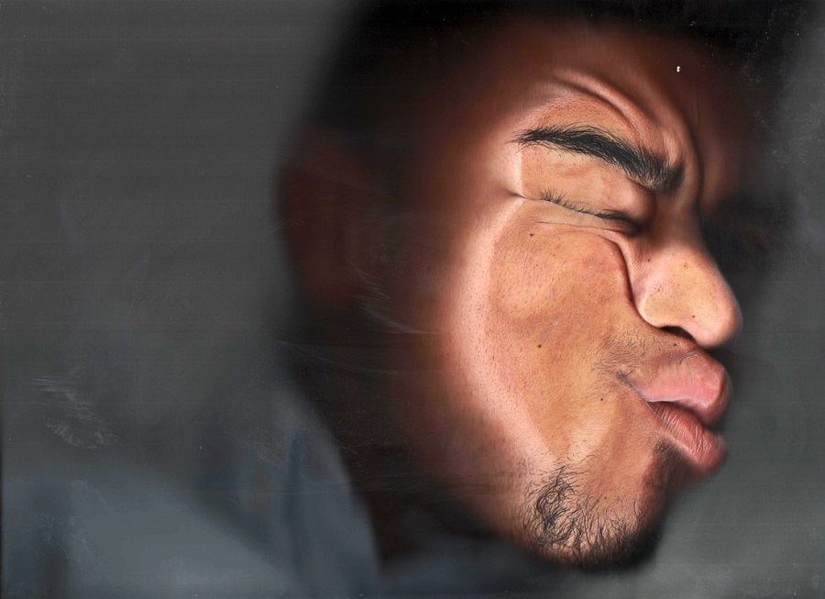
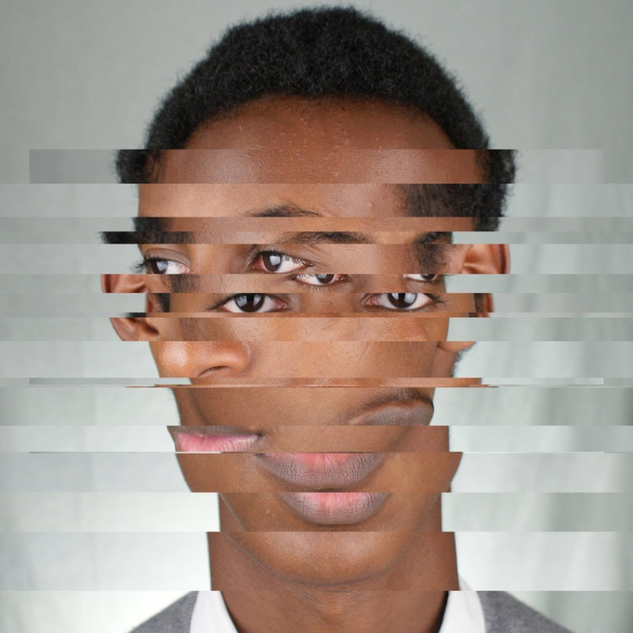
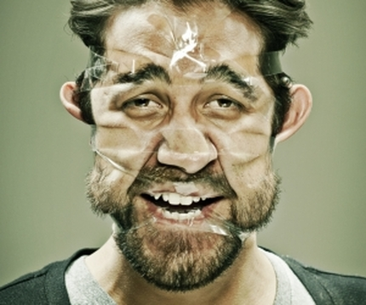
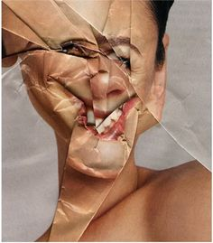
Distortion- Portraits

Slide 11
2. Manufactured Structures
Many photographers and film makers have been inspired to record manufactured structures in various ways. Different approaches can be seen in the work of Paul Strand, who carefully considered composition , in the work of Lewis Baltz who observed deserted structures, in the constructed images of the urban landscapes by Andreas Gursky, and in the recording of architectural facades by Markus Brunetti. Respond in your own way, making reference to appropriate work by others.
Paul Strand
Lewis Baltz
Andreas Gursky
Markus Brunetti

Slide 12
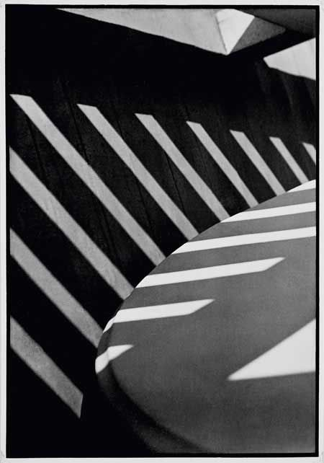
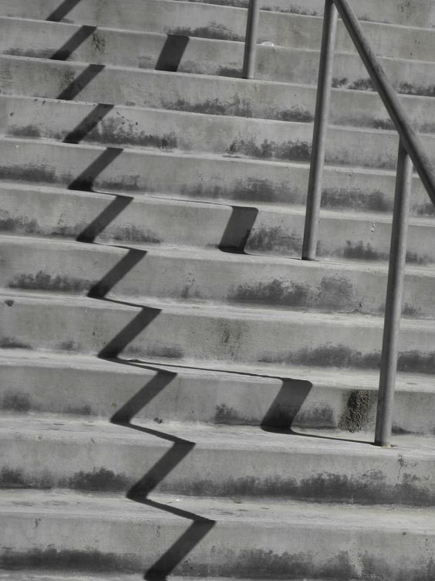
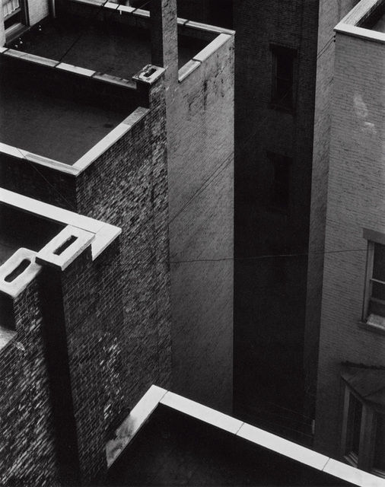
Paul Strand
Paul Strand was an American photographer and filmmaker who, along with fellow modernist photographers like Alfred Stieglitz and Edward Weston, helped establish photography as an art form in the 20th century

Slide 13
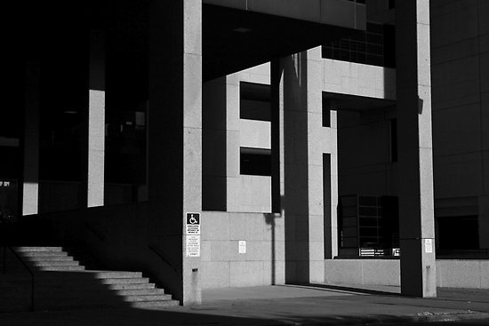
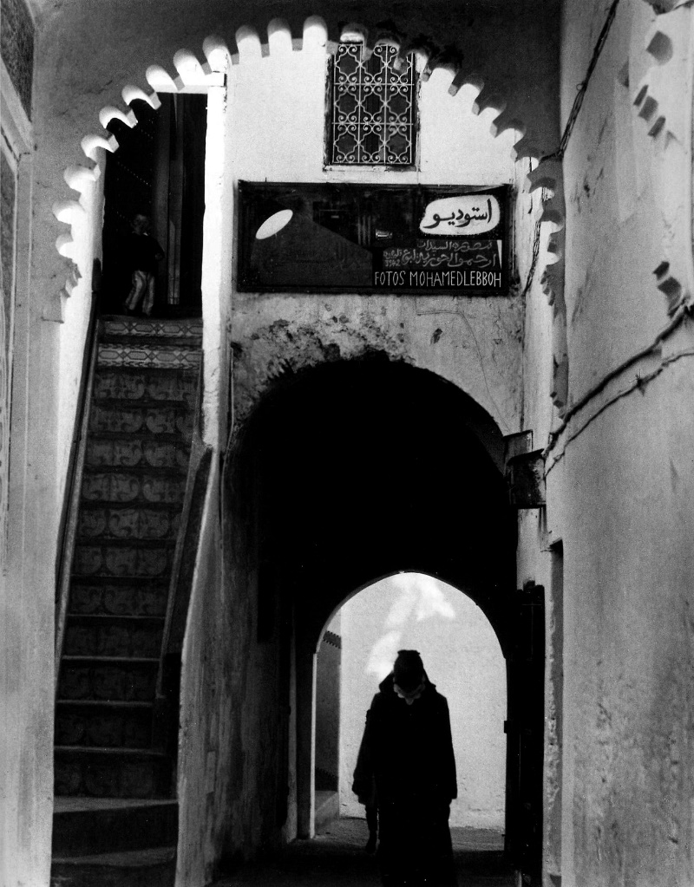
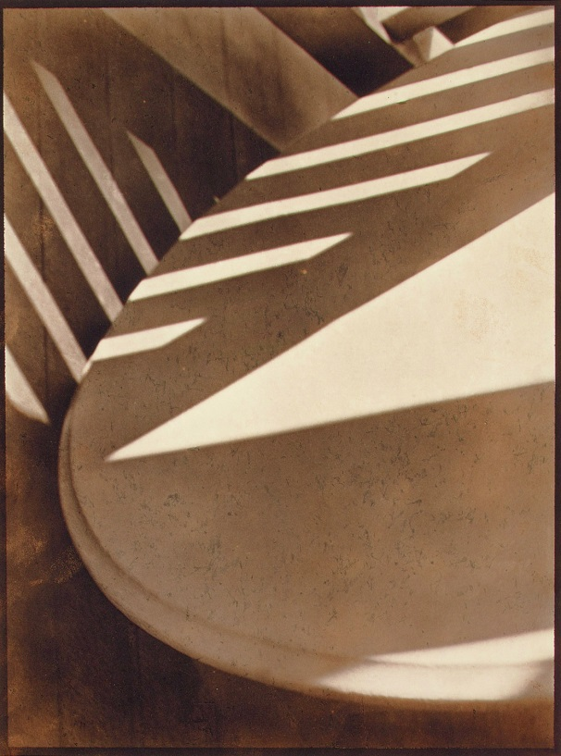

Slide 14
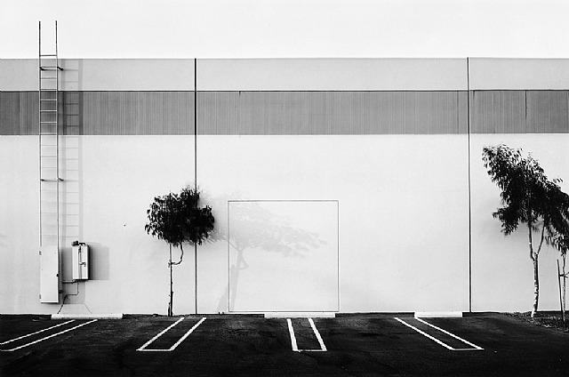
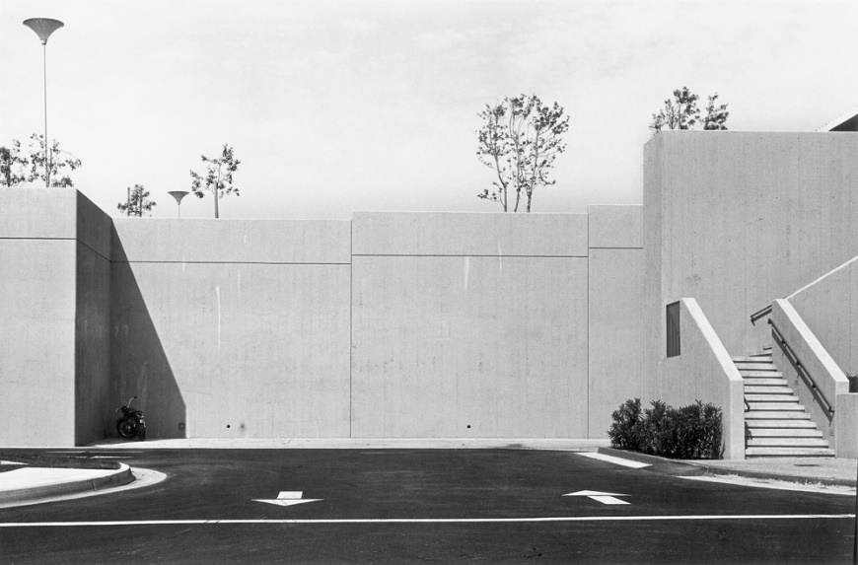
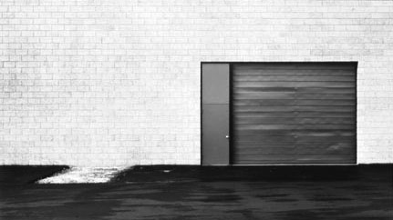
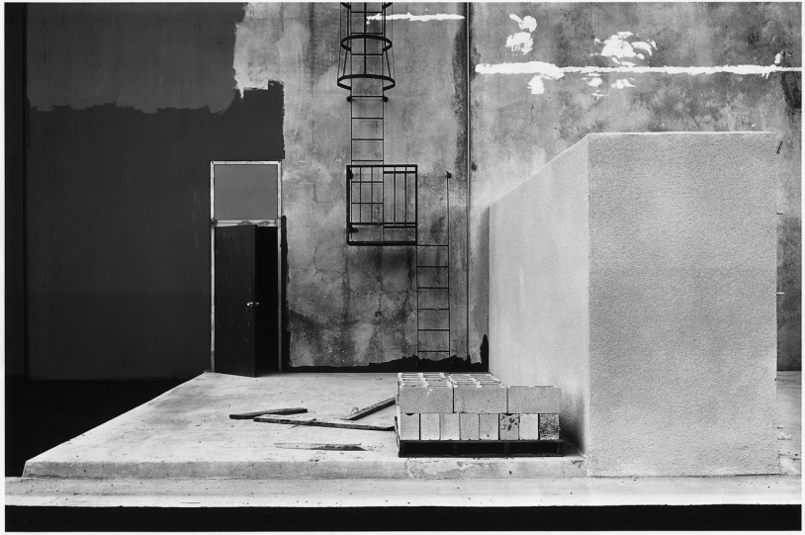
Lewis Baltz
Lewis Baltz was a visual artist and photographer who became an important figure in the New Topographics movement of the late 1970s

Slide 15
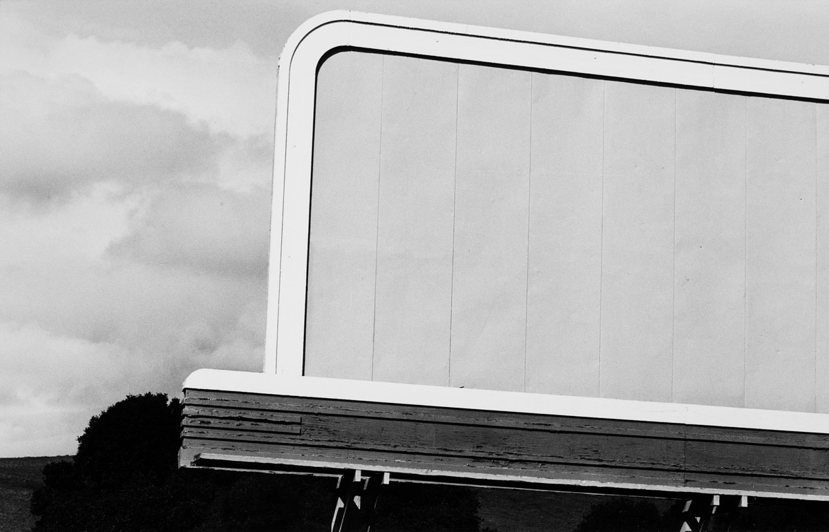
Baltz's photo series document the side effects of industrial civilization on the landscape, focusing on places that lie outside the bounds of canonical reception: urban wastelands, abandoned industrial sites, warehouses. His photographs uncover the correspondences between spatial forms that occur in the everyday world and advanced forms found in art. Baltz's strategies imply a reflexive knowledge of the history of photography in that they deploy the photographer as a teacher of seeing who makes things visible through reductive gestures

Slide 16
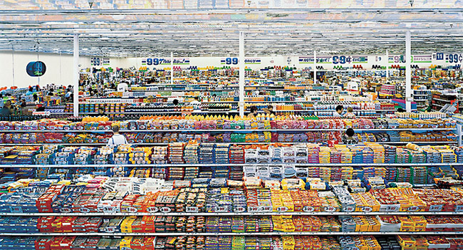
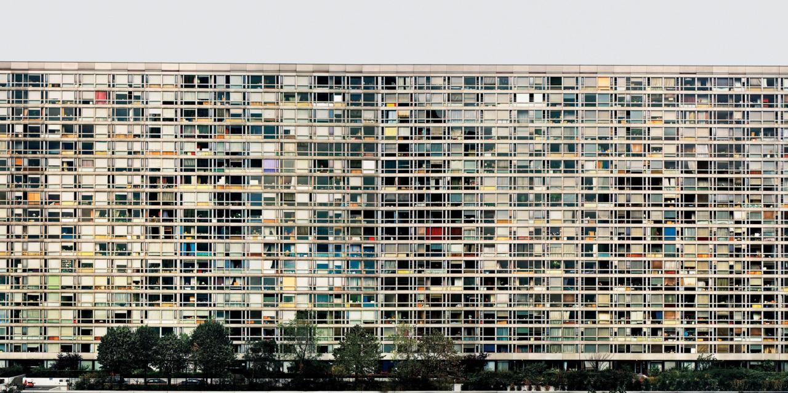
Andreas Gursky
In his large-scale photographs, Andreas Gursky captures the modern world, and its landscapes, people, architecture, and industries, in detail. Shot from an elevated perspective and produced on an epic scale, Gursky’s images show the individual or granular—supermarket products, soccer players, windows on a building, or islands in the sea—subsumed by the masses or the environment.

Slide 17
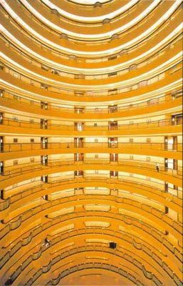
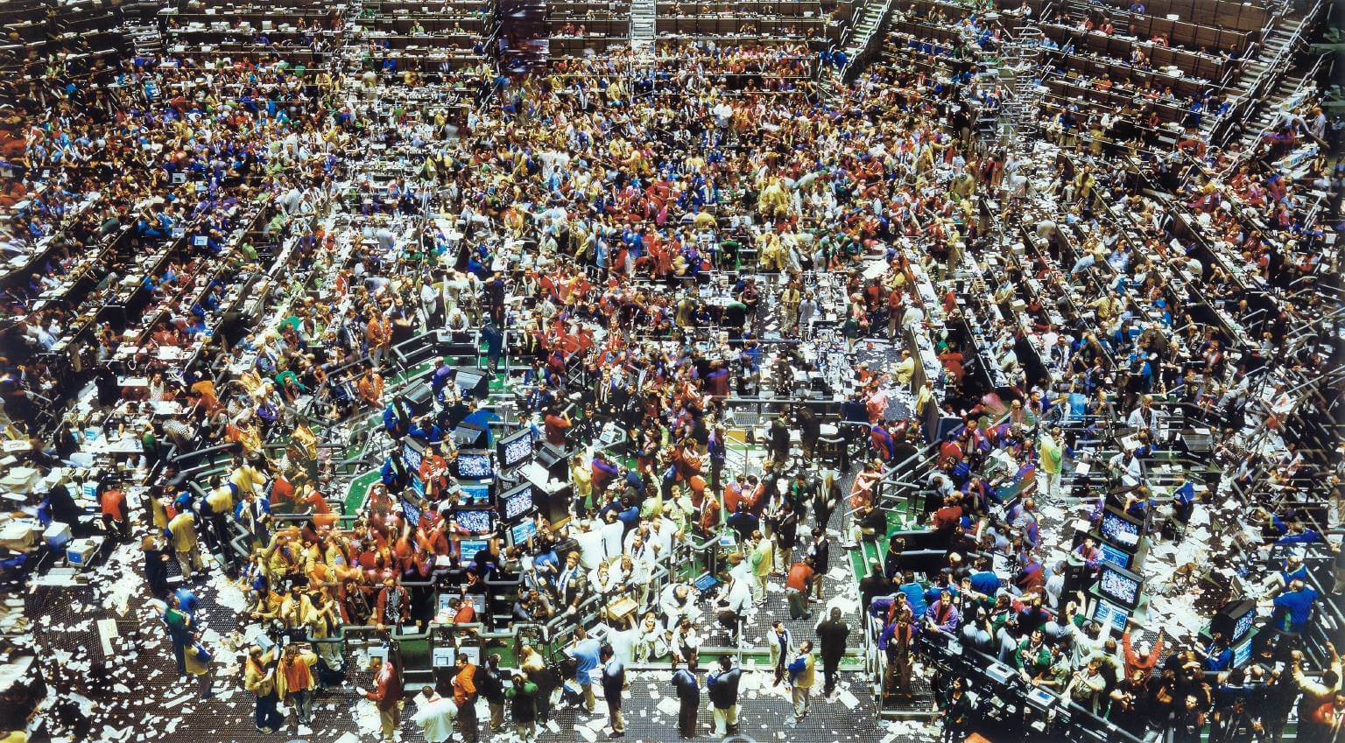
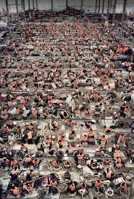

Slide 18
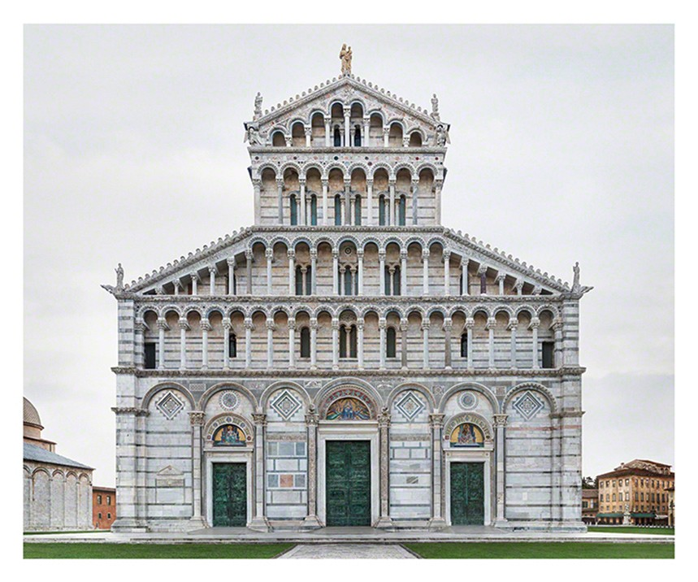
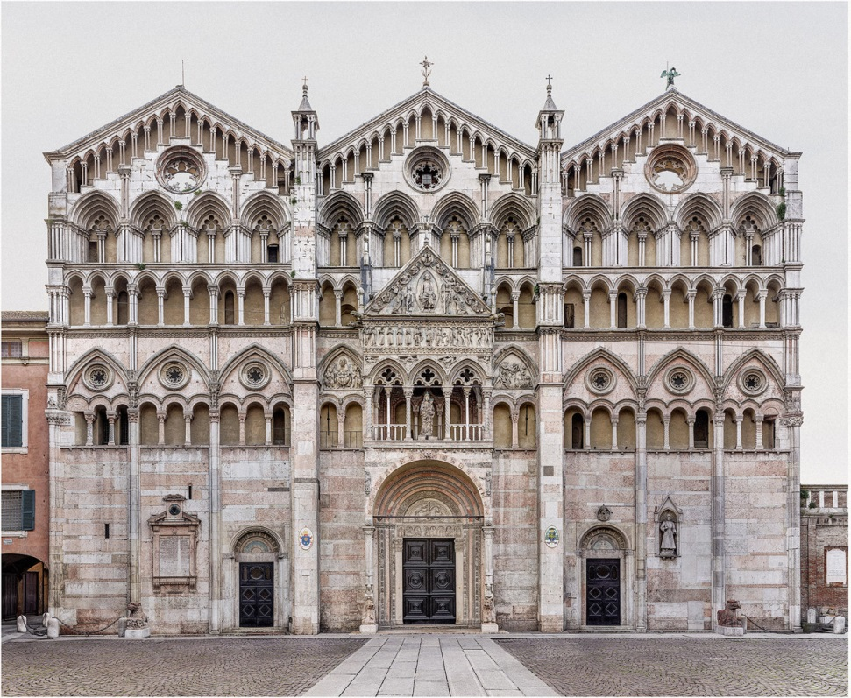
Markus Brunetti
Over the last ten years, German artist Markus Brunetti has traveled Europe, capturing stunningly detailed images of churches, cathedrals, and cloisters across the continent and the British Isles. The resulting series is currently on display at Yossi Milo Gallery in New York in the exhibition “Facades,” the artist’s first solo show in the U.S.

Slide 19
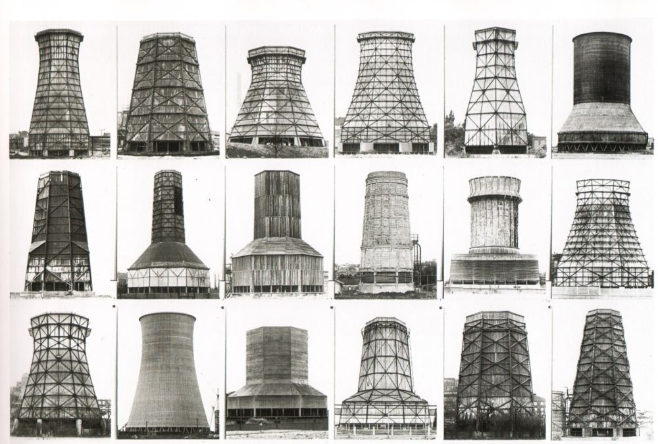
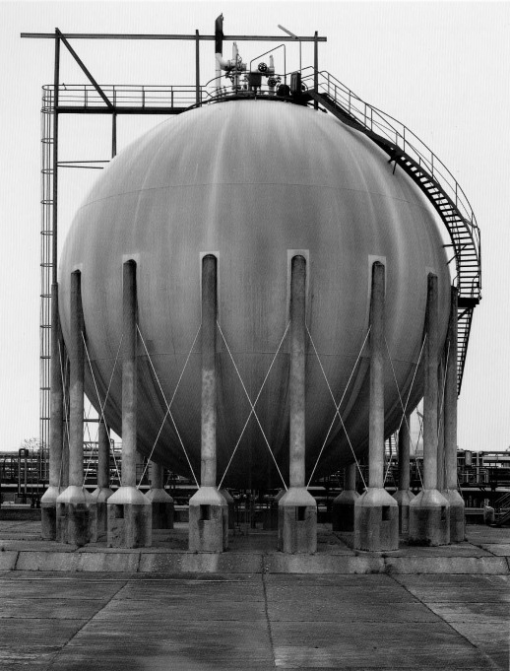
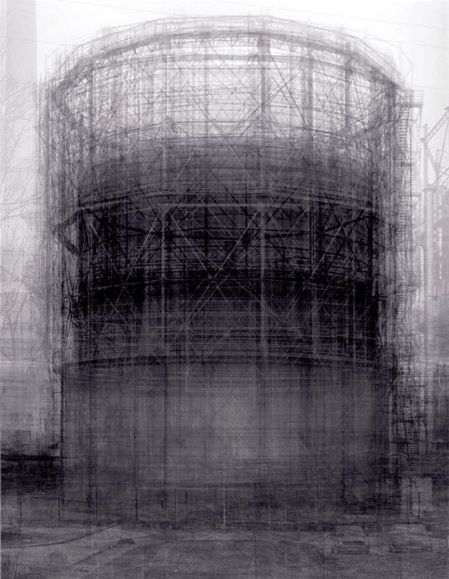
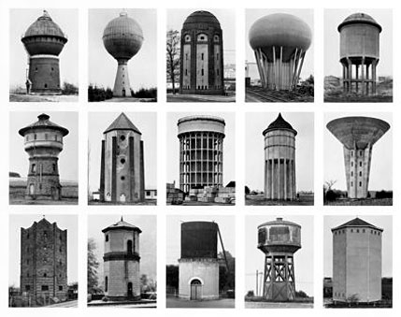
The German artists Bernd (1931 - 2007) and Hilla Becher (1934 -) who began working together in 1959 and married in 1961, are best known for their ‘typologies’ - grids of black and white photographs with variant examples of a single type of industrial structure.

Slide 20
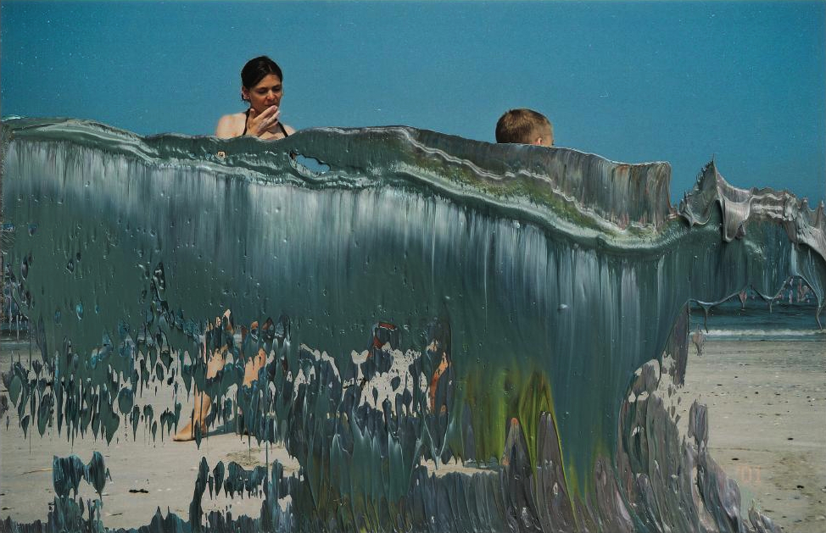
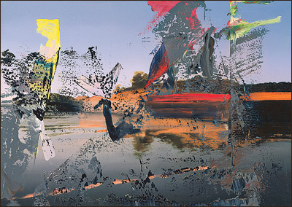
Gerhard Richter- overpainted photographs
Fragmentation
Small format
Working with his own photographs printed as 10 x 15 cm quick prints as anyone would get from a commercially developed roll of film, he uses left over paint from a day's work scraped from canvasses and applies it to the photographs via pallete knives and doctor's blades. The application is done in an instant, the works are completed with spontaneity and with irreversible gestures. Those judged unsuccessful are immediately destroyed. This exercise, for lack of a better term, has produced over one thousand images from which 400 are reproduced.

Slide 21
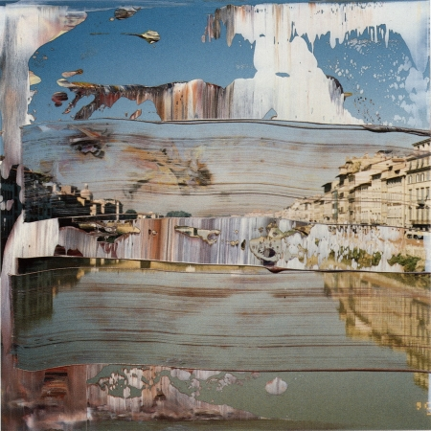
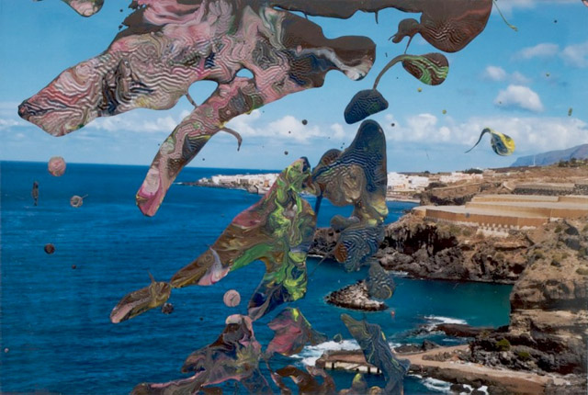
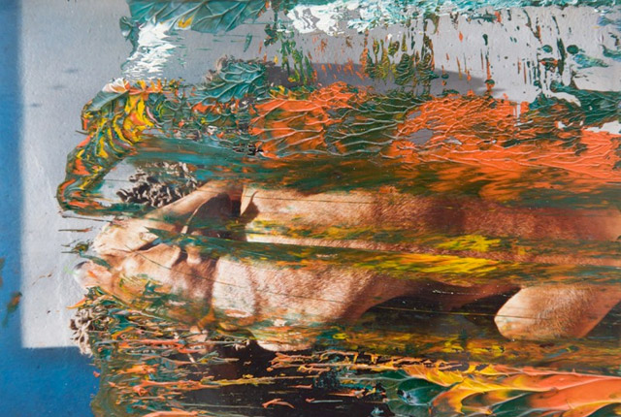
https://www.gerhard-richter.com/en/art/overpainted-photographs

Slide 22
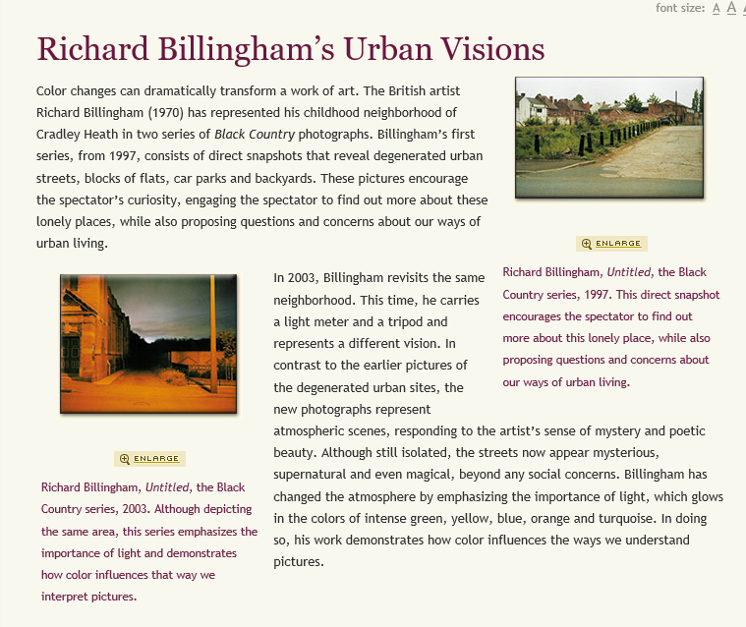
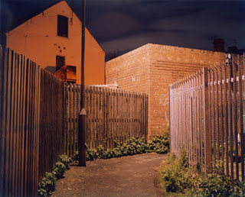
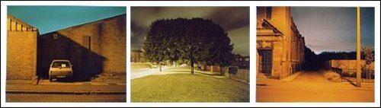

Slide 23
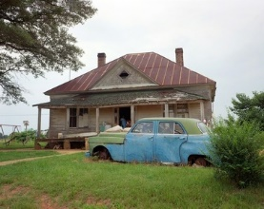
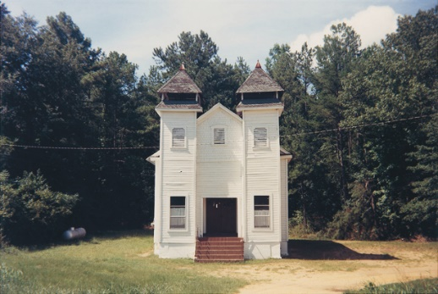
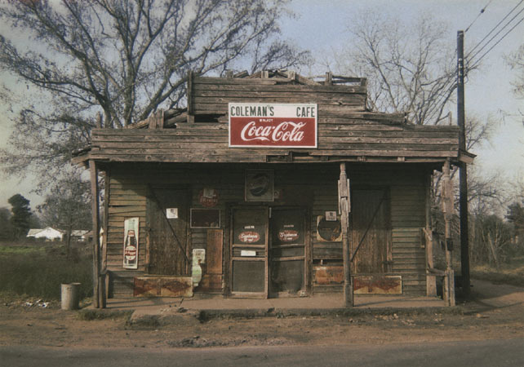





William Christenberry, was a pioneer of American colour photography. His richly hued images of the vernacular architecture of the deep south – wooden churches, shacks and dilapidated houses.
Patrick Keiller is a British film-maker, writer and lecturer
Jane Wilson and Louise Wilson are British artists who work together as a sibling duo. Jane and Louise Wilson's art work is based in video, film and photography. They are YBA artists who were nominated for the Turner Prize in 1999.

Slide 24





Martin Parr
Martin Parr on documentary photography
Parr uses bright colours and exaggerated close-ups to explore the excesses of contemporary capitalism
Frank Gross
Hélène Binet is a Swiss-French architectural photographer based in London, who is also one of the leading architectural photographers in the world.

Slide 25
Lewis Baltz
Lewis Baltz was a visua artist and photographer who became an important figure in the New Topographics movement of the late 1970s

Slide 26
3. Everyday Objects
Everyday objects can be given a new significance when brought together and photographed. Both natural and manufactured forms have inspired many photographers. Andre Kertesz has used strong shadows to emphasise space, Peter Keetman explored detail and structure, and Irving Penn experimented with found objects. Respend in your own way, making reference to appropriate work by others.
Andre Kertesz
Peter Keetman
Irving Penn

Slide 27



Andre Kertesz

Slide 28



Peter Keetman
No blog about Volkswagens and photography would be complete without a look at the work of Peter Keetman who spent a week in 1953 documenting the Volkswagenwerk in Wolfsburg, Germany

Slide 29


Irving Penn
Although best known for his fashion photography, Irving Penn also created modernist still life works of metal and found objects. While these works certainly have an affinity with European still life masters, Penn's unique ability as a photographer marks these experimental and witty images apart.

Slide 30
5. Sensory Experience
Ashvini Ray
Joel Meyerowitz
Robert Adams

Slide 31









Joel Meyerowitz- Temperature of spaces
Ashvini Ray
Robert Adams- sounds
A segregation that was never black and white: Gordon Parks’s photographs of 50s Alabama

Slide 32


7. Signs
Stephan Gill- Photographed the reverse side of billboard advertisements as a component on modern life.
Stephen Shore- South of Klamath Falls, Oregon July 21, 1973
Rob Hann- Photographed road signs to highlight colour
Marion Post- handwritten sign seen on banners or shopfronts.
Stephan Gill

Slide 33





Stephen Shore-
Rob Hann-

Slide 34



Marion Post-

Slide 35



6. Towns and cities
Carl Andre- Quincy Explored his home town. Natural surfaces
Jacques Tati- Playtime Daily routines of city life
Peter Mitchell- How aliens might view the city of Leeds- A New Refutation of the Viking 4 Space Mission
Carl Andre-

Slide 36




Jacques Tati-
https://www.youtube.com/watch?v=ZO3SIkso0QQ
In the mid-seventies, the Viking Landers were the first to land on planet Mars. Though the alien landscape was magnificent, there were no canals or skeletons or wind-blown ruined dwellings. Today, not a single trace remains of Viking Landers 3 and 4.
But myth (and conspiracy theories) have it that an alien survey was commissioned of planet Earth.
Peter Mitchell-

