Slide 1
The Appeal of Nazism and communism

Slide 2
Key Questions
What can you remember about Hitler and the Nazi party?
What was the appeal of Nazism?
Who supported the Nazis?
What else contributed to Nazi success during this time?
What were the strengths and weaknesses of the communists?

Slide 3
What can you remember?
Create a spider diagram – if you have forgotten any details, use your notes to complete this
Who founded the party and when?
What was outlined in the 25 point programme?
What happened during the Munich Putsch
How were they affected by the Great Depression?
The Nazi Party

Slide 4
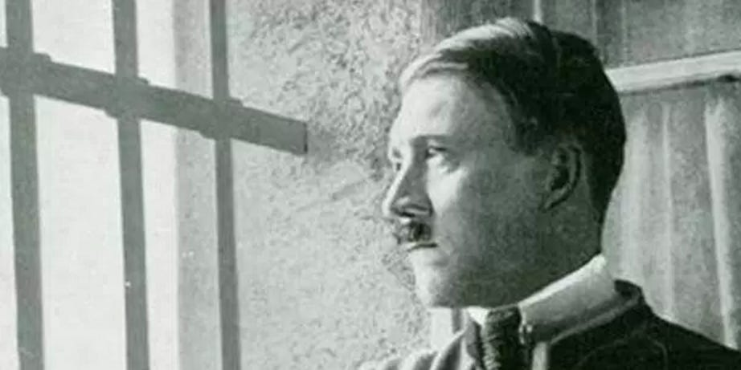
The Nazi party 1924 onwards…
After the Munich Putsch Hitler was arrested and put on trial in Feb- March 1924
Hitler used his trial as a platform for Nazi propaganda and ran rings around the prosecutor
He was found guilty but only given a sentence of 5 years
He was released on parole after less than a year
Whilst in prison he wrote Mein Kampf (my struggle). It was more than 750 pages and outlined many of the Nazi beliefs.
The trial was important in gaining publicity for the Nazi party and it made Hitler a nationally known figure in Germany
Before the trial, Hitler saw himself as someone who was helping to prepare for a saviour to rise up and restore Germany’s greatness, after this trial he believed he was that saviour. This would give him the impetus he needed to attempt to gain power through more legal means this time

Slide 5
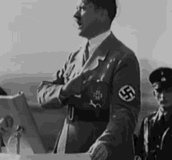
Time for Hitler to regain control over the party…
Whilst in prison the NSDAP was in disarray, they had been banned by law from campaigning, leaders were scattered and disagreements broke out between those who remained especially between Hitler’s Munich based group and the anti-capitalist north German wing of the party led by Gregor Strasser
Hitler’s first priority was to unify the party under his control
He did this at the Bamberg conference in 1926. 60 of the top NSDAP leaders endured a 2 hour rant in which Hitler demanded obedience and acceptance of his authority.
He also announced that there would be no changes to the Nazi policy along the anti-capitalist lines favoured by Strasser
Strasser accepted and was rewarded by being given the role of propaganda chief
He tightened his grip over the party even more by insisting that at every level of the party hierarchy individuals at each level must show obedience to all their superiors. Hitler was at the top of the hierarchy he had complete authority and was answerable to no one within the party
From 1926 onwards NSDAP party members would use the Hitler salute when greeting each other

Slide 6
A new political strategy…
After the failure of the Munich Putsch Hitler decided to abandon the putsch as a way of taking control, instead they would try to gain control ‘legally’
This essentially meant trying to get into the Reichstag by wining votes
This did not however mean that they stopped using violence all together, nor did it mean that the Nazis now believed in democracy
The SA were now given a new role: to attack communist paramilitaries on the streets – to weaken the Weimar Republic by showing that they couldn’t maintain law and order
The Nazi idea of gaining control ‘legally’ involved the use of violence alongside participation in the electoral process
Hitler also ordered a reorganisation of the NSDAP – the party was divided into 35 areas or Gaue with borders that corresponded to the 35 electoral districts. Each area had its own leader or Gauleiter who was responsible for political activity within that area. All Gauleiters were accountable to Hitler
He did this to improve their chances of gaining votes and having electoral success

Slide 7
Did this all work?
Despite all the hard work 1928 was a huge disappointment – the Nazis were still a minor fringe party
Between September 1930 and July 1932 the Nazi party more than doubled their electoral support
1930 was the breakthrough year – 107 seats (second biggest party in Reichstag)
By July 1932 it had over one third of the votes and was the biggest single party in the Reichstag
It had become the main party of protest, winning support across the country
However, the party never gained a majority in elections and that even in July 1932 63.7% of the people voted for other parties
Election / year | Total votes for party (millions) | % of votes for party
1928 Reichstag elections | 0.81 | 2.6
1930 Reichstag elections | 6.40 | 10.6
1932 Presidential elections (1st ballot) | 11.30 | 36.8
1932 Presidential elections (2nd ballot) | 13.40 | 36.8
July 1932 Reichstag elections | 13.75 | 37.3
The rest of this lesson will look who was voting for the Nazis and how they managed to gain all these extra votes

Slide 8
Who voted for the Nazis and why?
Look at the sources on the ‘who voted for the Nazis sheet’. What do they tell you about who was supporting the Nazis?
Gender?
Geographical Location?
Religion
Class?
Occupation?
Age?

Slide 9
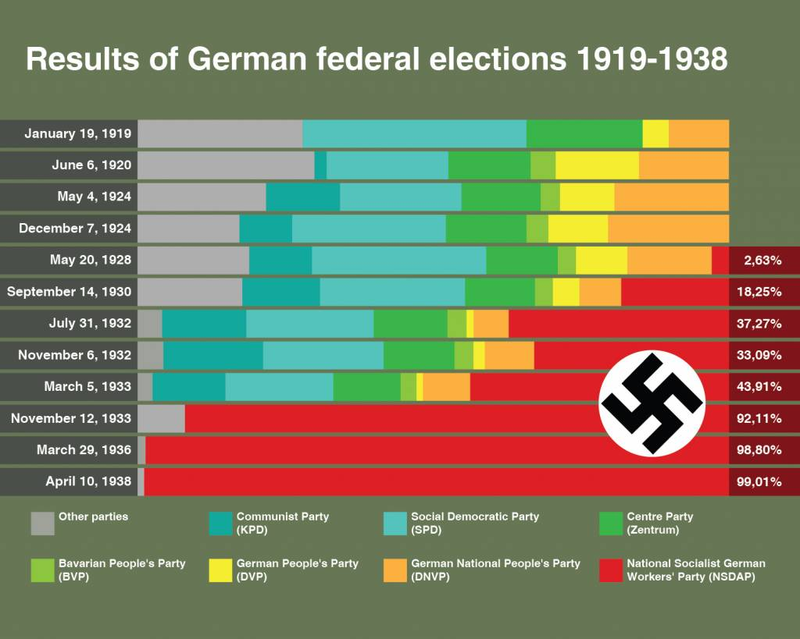
Who voted for the Nazis and why?
Complete the worksheet using the scanned in information
(labelled ‘who voted Nazis information’

Slide 11
Who voted for the Nazis and why?
Look at the Nazi posters for each one identify the group of people it is targeting.
Explain how they are trying to get this group to vote for the Nazis

Slide 12
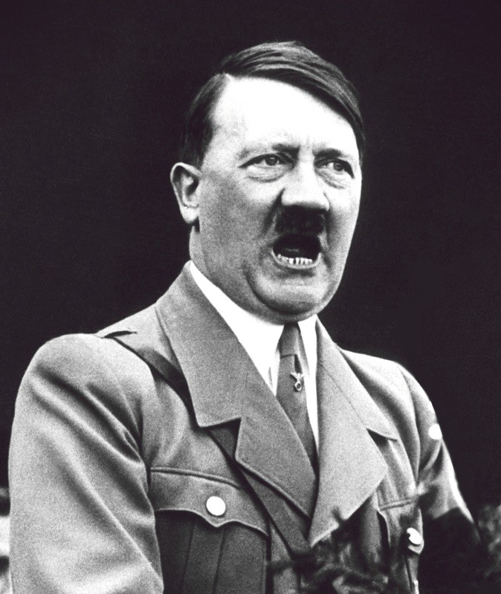
From what you have just learnt do you agree with what Hitler is saying here?
The NSDAP is not the movement of any particular class or of a particular status group or profession… instead it is in the highest sense of the word a German national party. It aims to encompass all elements of the nation and to embrace all occupational groups, to address each and every German of good will

Slide 13

Nazi ideology
Hopefully you remember the basis of Nazi ideology from when we looked at the 25 point programme
Nationalism – wanted to restore Germany’s former glory, eradicate treaty of Versailles, lebensraum
Authoritarian – there should be one strong leader in charge of Germany. Do not believe in democracy
Socialism – do not agree with capitalism, hostile towards big businesses and sympathised with small businessmen
Racism – some races are more superior than others, extremely anti-Semitic

Slide 14
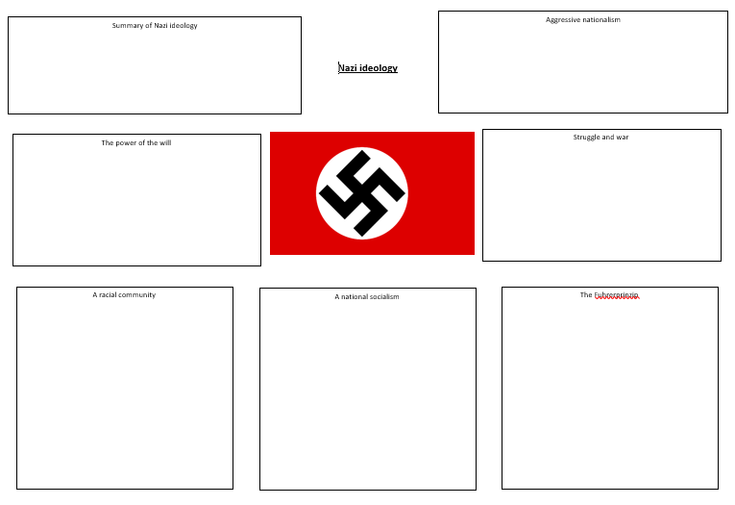
Nazi ideology
Using p75-78 fill in the sheet about the core elements of Nazi ideology
(If you can’t print the sheet, type straight on to the document or just make notes on the different areas)

Slide 15
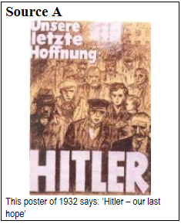
The growing appeal of the Nazis
Source B
[Hitler's policies] were half-baked, racist clap-trap... but among the jumble of hysterical ideas Hitler showed a sure sense of how to appeal to the lowest instincts of frightened masses.
Tony Howarth, a modern historian
Source C
He was holding the masses, and me with them, under an hypnotic spell by the sheer force of his beliefs. His words were like a whip. When he spoke of the disgrace of Germany, I felt ready to attack any enemy.
Karl Ludecke, an early follower of Hitler (1924).
Source D
Of course, I was ripe for this experience. I was a man of 32, weary with disgust and disillusionment, a wanderer seeking a cause, patriot seeking an outlet for his patriotism.
Karl Ludecke (1924).
What do these sources suggest are the reasons for the growth in support for the Nazis?

Slide 16
What other factors helped to increase support for the Nazi party?
Hitler
Party organisation
Anti-Semitism
The SA and violence
Propaganda
Use the scanned information & p78-80 to make notes in your table. You need to explain how all these different factors contributed to an increase in support for the Nazis. Aim for 5-10 bullet points on each one

Slide 17
Most important factor so far?
Hitler
Party organisation
Anti-Semitism
The SA and violence
Propaganda
The Great Depression
Nazi ideology
All of these factors contributed to the success of the Nazi party. You need to rank them in order of important 1 being the most important in your opinion and 7 being the least important. You have to explain your choice. Think about whether any of them link? This will help with your next essay so make sure you think this through properly.

Slide 18
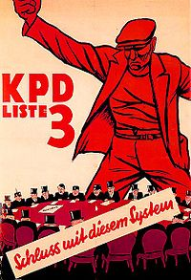
The appeal of communism
Read P80-81 an complete the worksheet about the communist parties
After you have made all of your notes you should be able to add ‘fear of communism’ as a reason for Nazi success.

Slide 19
Source practice
Complete the planning sheets for both of the sources.
Write up an answer for the first source and send it to me to be marked. If you would like to do both sources and send them to me you can do.
Remember if there are any words you don’t understand in the sources you need to look this up and build up your vocabulary.

Slide 20
Essay practice
Fear of communism was the main reason why increasing numbers of Germans voted for the Nazis in the years 1930-32. Assess the validity of this view
Hitler
Party organisation
Propaganda
Anti-Semitism
The SA and violence
Nazi ideology
The Great Depression
Fear of communism
Remember you need stated factor + 2. Which of these factors do you think are the most important and should be included in your essay?

