Slide 1
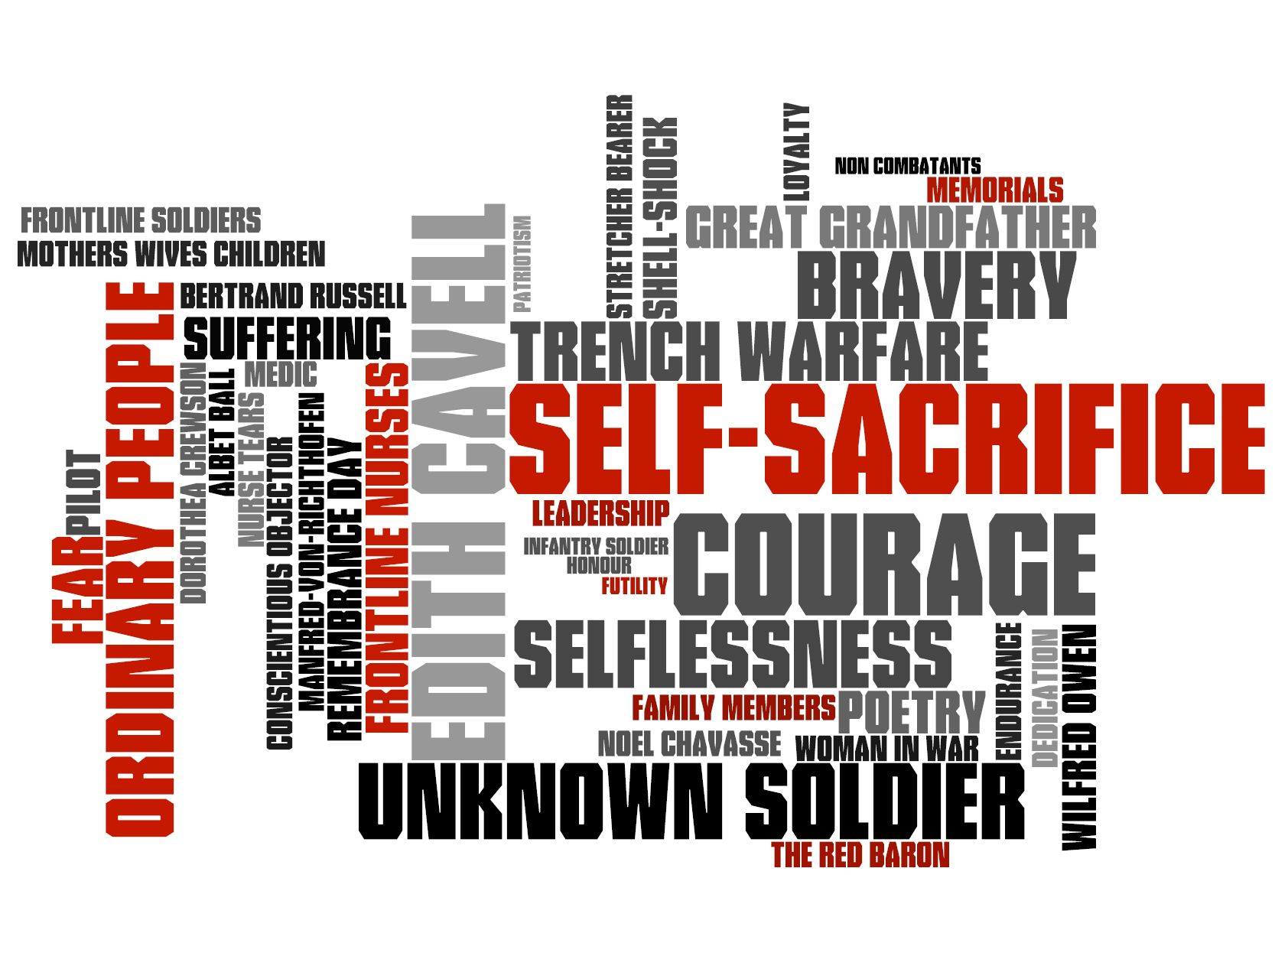
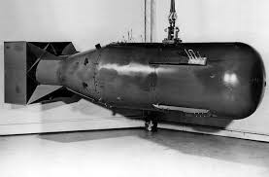
Nuclear war and weapons of mass destruction.
Phase 4 - Year 10

Slide 2
Learning Objectives:
Know about different types of weapons of mass destruction
Explore how the atom bomb (a WMD) was used in 1945
Analyse christian arguments against WMD
BE CAREFUL
THE USE OF WMDs IS VERY DIFFERENT TO WAR.

Slide 3
Keywords - write a definition for the key words
Nuclear weapons
Weapons of mass destruction
Chemical weapons
Biological weapons

Slide 4
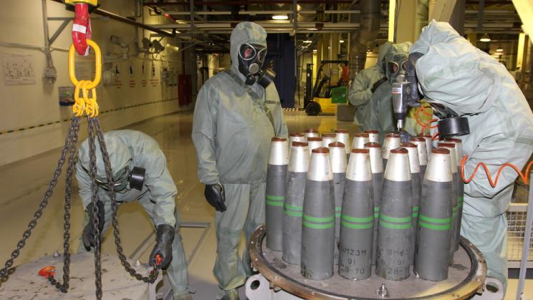
Lo - different types of weapons of mass destruction
Chemical weapons
These contain lethal chemicals and when released will cause many deaths.
1993 - Chemical Weapons Convention made it illegal everywhere to make and use these weapons.
Since then they have been believed to be used in Syria and Iraq

Slide 5
Lo - different types of weapons of mass destruction
Biological weapons
These weapons release viruses and harmful bacteria into the air.
If they were put in the food or water chain they would they could cause death on a massive scale.
They are illegal.
It is illegal to use these weapons in conflict as viruses are indiscriminate; it will kill anyone that comes in contact with it.

Slide 6
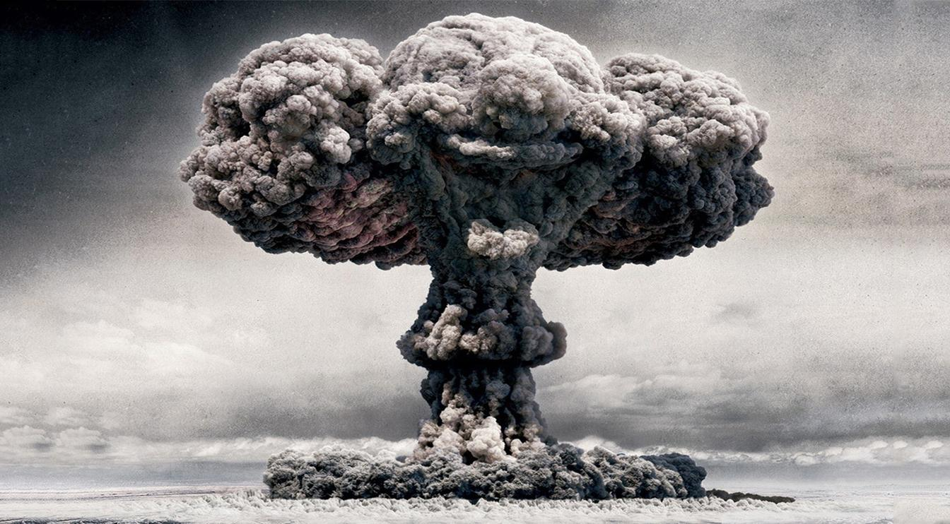
Lo - how was the atom bomb (a WMD) used in 1945
Watch the following: https://www.youtube.com/watch?v=3wxWNAM8Cso
T
This is a small glimpse into the devastation that was caused when the US forces dropped an atom bomb (an early form of a nuclear bomb) on HIroshima. Three days later the US dropped their second atom bomb on Nagasaki.
Watch the two clips
Make notes
Hiroshima: A Newsround Special - CBBC Newsround

Slide 7
Lo - christian response to WMD
THERE ARE SOME CHRISTIANS WHO BELIEVE THAT HAVING A NUCLEAR WEAPON IS ACCEPTABLE AS THEY SECURE PEACE.
THEY POINT OUT THAT WE HAVE HAD RELATIVE PEACE IN EUROPE SINCE THE 2ND WORLD WAR.
DETERRENT
Something that is intended to discourage someone / something from doing something.

Slide 8
Lo explore a Christian response to WMD
Christians believe in that humans are ‘made in the image of God’ and therefore killing innocent civilians cannot ever be justified. Innocent civilians pose no threat to anyone.
One of the commandments says ‘ Thou shalt not kill.’ Exodus chapter 20 v 13. Any weapon of mass destruction would knowingly kill innocent people. Thus Christians would never use or condone use of weapons of mass destruction as it breaks a fundamental commandment.
Challenge:
Some may argue that God said ‘Any eye for an eye and a tooth for a tooth.’ The original purpose of this law was to create proportion. This means that the law stopped someone killing a person who had punched them; it was to create a justice system rather than a revenge system. Weapons of mass destruction can never be proportional; this backs up the belief that weapons of mass destruction are wrong.

Slide 9
In order to check you have understood everything try and answer the questions below in full sentences.
Name three different types of WMDs? 3 marks
Give one reason why biological weapons are so dangerous? 2 marks
Who dropped the atom bombs on Hiroshima and Nagasaki? 1 mark
When was it made illegal to make and use chemical weapons? 1 mark
Explain two contrasting religious beliefs about WMDs? 5 marks (Don’t forget you must use sacred text in order to get 5/5.)

Slide 10
Deeper learning / optional work
RESEARCH Christian Campaign for Nuclear Disarmament
Take notes on what they believe, who they work with and what they hope to achieve.
You could use this link to start you off:
https://www.globalconnections.org.uk/vocations/organisations/christian-campaign-for-nuclear-disarmament

