Slide 1
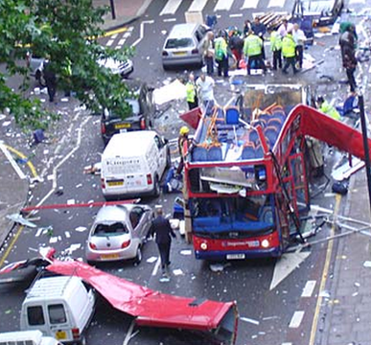
Attitudes towards terrorism
LO: To understand the causes of terrorism and the Christian responses to it
Starter
1) What are the names of two prophets in Islam?
2) Give 3 of the six articles of faith for Sunni muslims
3) Give 2 other names for the Eucharist
4) Give 2 of the seven sacraments
Challenge: Compare two religious beliefs on same-sex marriage

Slide 2
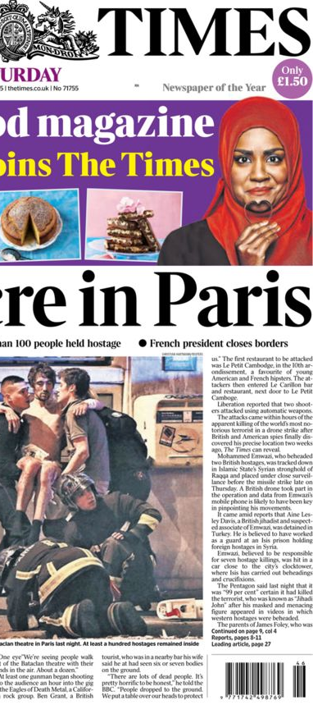
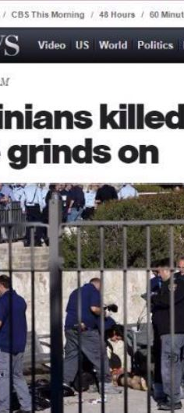

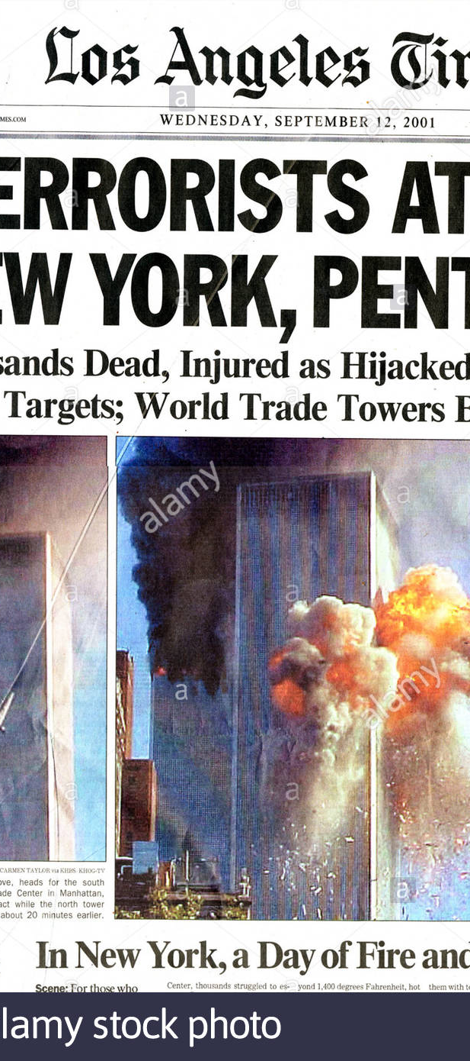
Always in the news…….

Slide 3
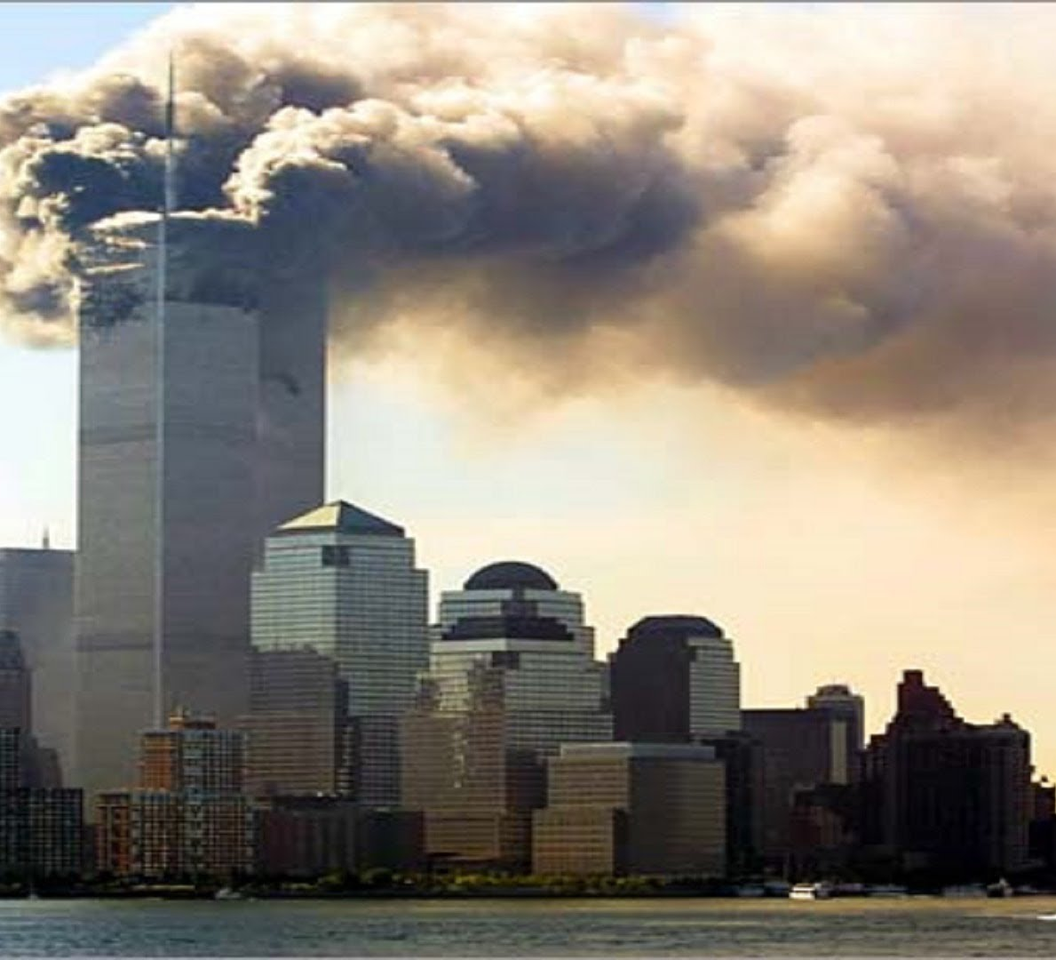
Days that shook the world
Unfortunately, terrorist attacks have had huge effects….
Can you think of the effects on people/countries that terrorist acts can have?
(hyperlink in picture)

Slide 4
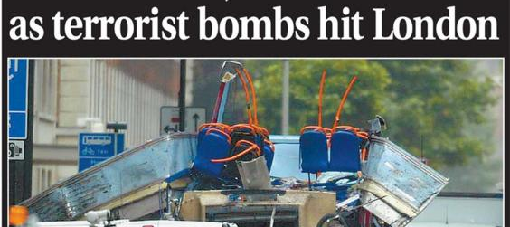
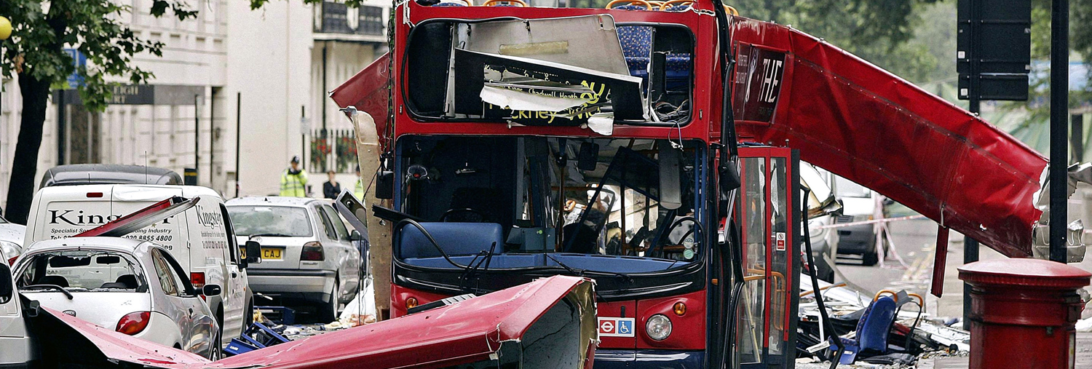
Terrorist attacks
In the modern world there have been many recorded acts of terrorism
Al Qaeda’s attack on the World Trade Center Twin Towers (11 sept. 2001) and the London Underground (7 July 2005) are just two of the many recorded examples of suicide bombers around the world
Discussion point -
Why do terrorists carry out attack?

Slide 5
Terrorism
Terrorism is an act of violence which is intended to create fear
A terrorist is anyone who plans or carries out such an act
The United Nations Security Council regards terrorist attacks as criminal:
Acts intended to cause death or serious bodily harm to civilians or non-combatants with the purpose of intimidating a population or compelling a government or an international organisation to do or abstain from doing any act
1) What is meant by the term terrorism – write a brief answer (no more than 15 words) to this answer
TASK - Write the answer on paper or in your book

Slide 6
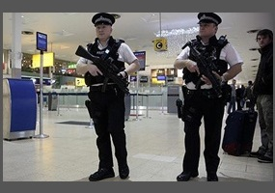
Impact and influence
Instances of terrorist attacks may influence countries to fight back against countries which they feel are responsible for terrorism
It may also mean the introduction of stricter security measures
However, many people, including religious believers, see terrorism as an opportunity to try to strengthen friendships between different groups of people and work for peace
They do not wish to let terrorism result in an endless circle of violence
In your books brainstorm how terrorism can influence people personally and publically?
Why don’t you ring a friend and brainstorm together? Or use google classroom to chat about the answer!
TASK 2

Slide 7
Why do terrorists carry out attacks?
They are fighting against social and political injustice, where a group of people are being denied their human rights
They are fighting against poverty
They are fighting to assert their religious beliefs, especially where they feel these are denied to them
When people are fighting for a cause they believe in, some are prepared to go to any lengths to have their voice heard
It has been said that, ‘One man’s terrorist is another man’s freedom fighter’
There are many examples where a person was classed as a terrorist, but later seen as a legitimate leader – for example Martin McGuiness in Northern Ireland and Nelson Mandela in South Africa
Challenge: Research the life of either Martin McGuiness or Nelson Mandela.
TASK 3
Using the information above, explain some reasons why terrorists are motivated to carry out their attacks. (Try and write a paragraph! Remember it’s lockdown so ring a friend and chat about it or email a teacher!)

Slide 8
Important point on terrorism (source: zigzag education)
Much terrorism in the contemporary world has been associated with Islam, particularly with suicide bombers who say they are Muslim
These suicide bombers may not feel that Allah endorses mass killing, but may feel that they are serving Islam in some way through their actions
However, the vast majority of Muslims condemn terrorist violence
It can be argued strongly that the link between Islam and terrorism has been sensationalised and portrayed inaccurately by the media
Furthermore, there are many terrorists with no association with Islam; for example:

Slide 9
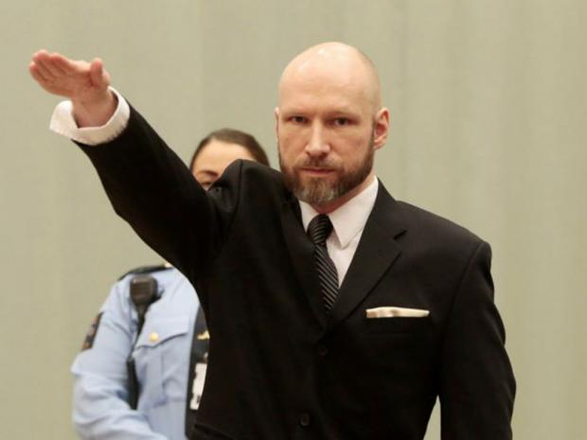
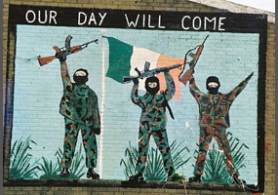
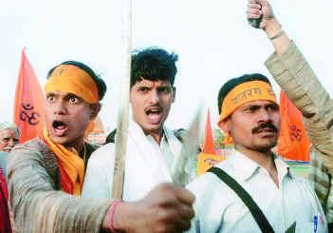
Important point on terrorism (source: zigzag education)
Anders Breivek, the Norwegian terrorist who killed many people in politically motivated attacks in 2011. he strongly opposed Islam and wanted Muslims to be deported from Europe
The Irish Republican Army (IRA), whose members identify as Roman Catholics, and fought against Irish Protestants
There has been terrorism associated with the Hindu nationalist movement (those that believe that India should be 100% Hindu). Not all Hindu nationalists are violent, but some have killed Christians and Muslims, which they justify as defence of Hinduism

Slide 10
Jesus
Christian responses to terrorist attacks
Bible
Love your neighbour as yourself
TASK 4
A. Write as much as you can in 10 minutes on how Christians would respond to terrorist attacks.
OR
B.Write out the quotations in bubble writing and annotate them. Explain what they suggest about violence.
‘Blessed are the peacekeeper’
challenge. What is the context for this? What does it really mean?
Peace
‘Those who live by the sword, die by the sword’
Justice
‘You shall not kill
Use the following key words and information provided to support your learning in this task:
Love one another

Slide 11
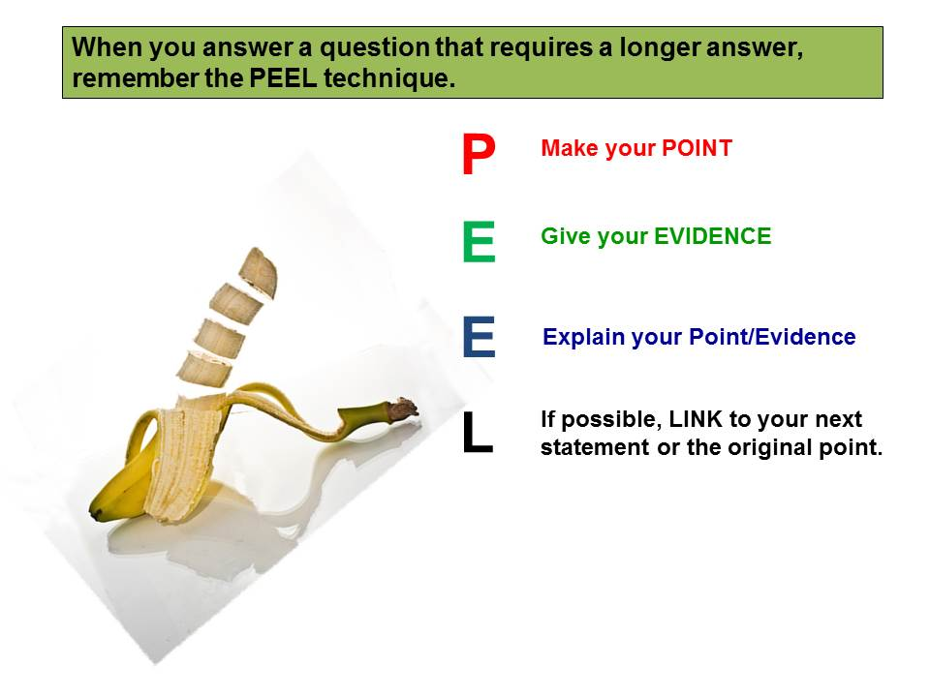
Success criteria – for Task 4 A
Your answer to the last task can be judged on how well you followed the following…
D = Disagree
R = Reason to disagree
E = in-depth explanation of that reason
A = Agree
R = Reason to agree
E = in-depth explanation of that reason
Ideally, there should be at least three reasons on each side
R = Make sure you have used a number of religious arguments
C = Conclusion – this gives your opinion, but only if it is different to what you have already said

Slide 12

To finish……
TASK -
Develop four of your own one mark multiple choice questions (based on the exam format)

Slide 13
What will progress look like today?
We will summarise our learning so far in this topic
  You will answer some one and two mark exam questions in your exercise books
We will study the definition of the term terrorism and terrorist
  You will write a definition of these terms in your exercise books to demonstrate your learning
We will research the reasons why terrorist are motivated to carry out attacks
  You will explain some of these reasons
We will discuss the effects and impact that acts of terrorism have on people and countries
  You will watch a short clip from history.com on the 9/11 terrorist attacks
  You will explain the effect and impact terrorist attacks can have
We will consider a Christian response to terrorism by reviewing our learning from this topic
  You will fully explain a Christian response by using some key evidence, quotes and terms
  You will assess your answer by considering the success criteria
We will finish by developing some questions on what we have learnt so far in this topic
  You will devise four one mark multiple choice questions on your learning so far

