Slide 1
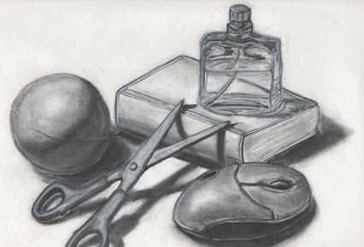
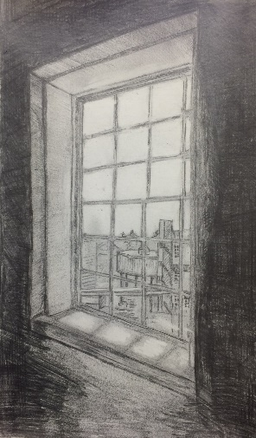
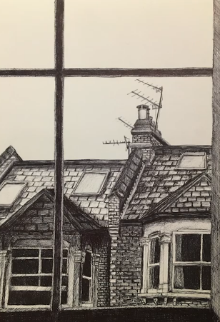

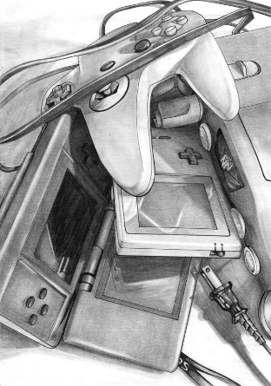
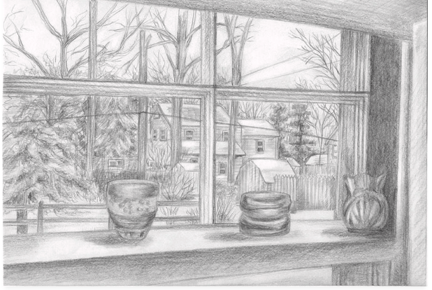
YEAR 10 ART
PHASE FOUR
CONSOLIDATION
YOUR TASK IS TO CREATE A DRAWING IN RESPONSE TO OUR THEME HABITAT. You can choose between two options:
Assemble a Still Life and draw it. | Draw the view through a window
Here are some examples: | Here are some examples:
There are helpful resources on Google Classroom.
Please photograph your work and email it to Ms Vincent cvincent@brentford.hounslow.sch.uk
YOU NEED TO SHOW THAT YOU CAN: | WWW/EBI
Choose your subject matter meaningfully.
Arrange your composition by considering your focal point and space.
Carefully use mark making by starting with soft drawing guidelines and building to texture and detail.
Create depth by considering the foreground, middle-ground and background Using perspective Using tonal range (it is common to use more than one of these. Give them all some thought)
Annotate your work Explain your choices Comment on how you used the Formal Elements
Assessment:

