Slide 1
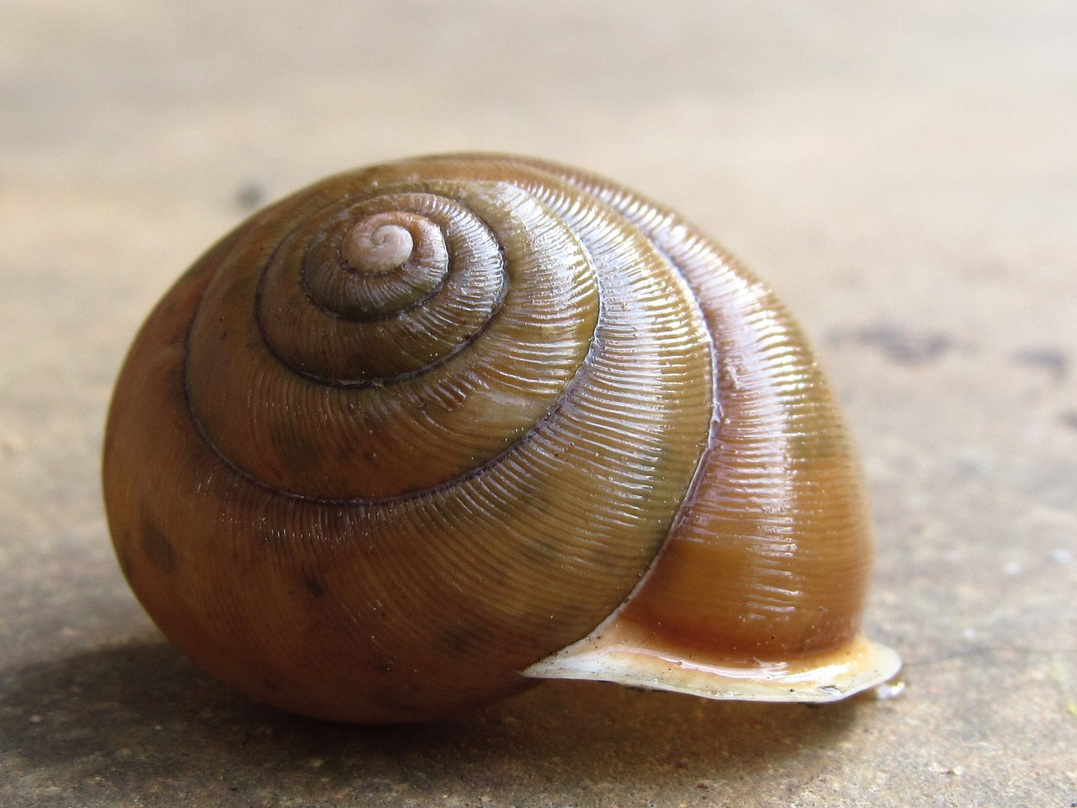
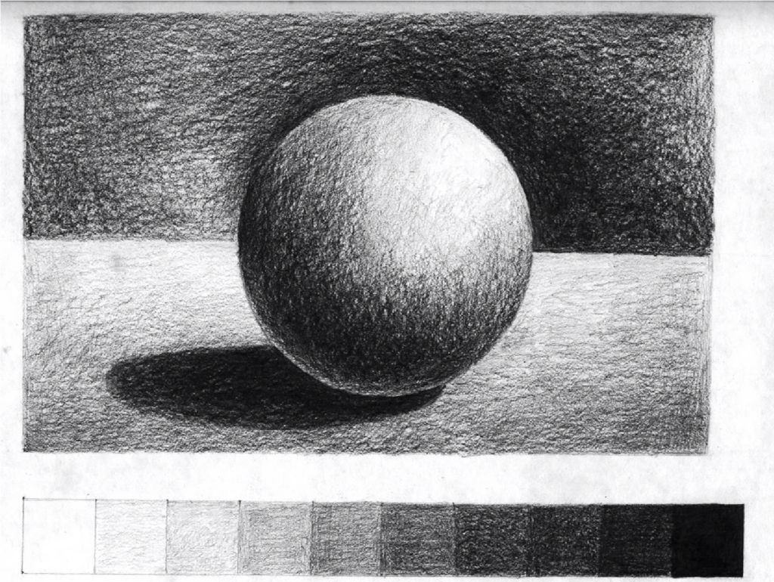
YEAR 9 ART
PHASE FOUR
CONSOLIDATION
YOUR TASK IS TO CREATE A DRAWING OF THIS SNAIL SHELL. The focus is to show your drawing and shading skills. This drawing task is part of your HABITAT PROJECT. There are helpful resources on Google Classroom.
This is your visual reference. Look closely at the proportions, details and light.
Please photograph your work and email it to Ms Vincent cvincent@brentford.hounslow.sch.uk
YOU NEED TO SHOW THAT YOU CAN: | WWW/EBI
Draw softly to first get your guidelines
Use your page space for a good composition
Use pencil marks carefully to create texture
Include a cast shadow
Build up dark and light areas to create form
Remember to create a tonal range. | ASSESSMENT

