Slide 1
Textiles Transition Work
Year 11 into 12
There is a set way of working in textiles, this transition work will introduce you to the format that you need to follow

Slide 2
How the
Visual Elements are used in Textiles
What are the Visual elements?
LINE
TONE
TEXTURE
COLOUR
PATTERN
FORM

Slide 3
FIRST TASK: LINE
Research the following artists.
Find at least three examples of their work.
Make a PowerPoint with a slide for each artist.
Cas Holmes
Niru Reid
Paula Kovarik

Slide 4
VOCABULARY WORK
List words that come to mind when you look at their work.
Think about: How would you describe it? What inspires them?
Cas Holmes
Niru Reid
Paula Kovarik
ELEMENT | KEYWORDS | ARTISTS | TECHNIQUES
Line | Solid, faint, curvy, straight, heavy or light weight, close or separate for contour effect, outlines, details, features | Cas Holmes Niru Reid Paula Kovarik | Hand embroidery Machine embroidery Monoprinting Drawing Quilting
Use these words to write a descriptive introduction for each of the artists

Slide 5
INTRODUCTION TO REFERENCING:
When you are gathering information and pictures it is very important to record where you got it from.
This is called referencing. It gives credit to the source you used. It is ethical to do this rather than taking all the credit. So you should always share what source you referred to.
Good research=lots of sources. So make a list of all the sources you used.
PS. Wikipedia is not a good source so if you use it, add other sources to improve the credibility.
Keywords:
Reference
Ethical
Credit
Source

Slide 6
Researching Cas Holmes
What to include:
Appropriately styled and clear title
Background information about the artist to help explain their choices and influences. (you don’t write a whole biography)
Description of their work.
Your mature and professional opinion
Pictures of their work.
Annotations demonstrating your observations.
Image of the artist, if available
Referencing
Here I have started to research Cas Holmes. For each piece of information I found, I copied the website.
When I have finished I can read all of it and put it in my own words.
Then at the end I will have a list of my sources. (This is called referencing)
Cas Holmes is interested in the liminal ‘in between’ spaces connecting land, place and environment. Trained in fine art, her work combines mixed media with found materials and stitch and is best described as ‘painting with cloth’.
https://casholmes.wordpress.com/
Cas Holmes is one of the UK’s best-known textile artists with works in public and private collections. The world of travel has been a constant throughout Cas’ adult life to work and study, researching in Japan, India and Canada.
As she travels, she collects, often cast-off textiles, or gifts of the old and the worn, mostly gifted from friends. These are painted, layered, collaged and stitched to capture fleeting moments in time respond to her environment, her experiences and the interaction between the urban, the human and the land.
https://www.textileartist.org/cas-holmes-conception-creation

Slide 7
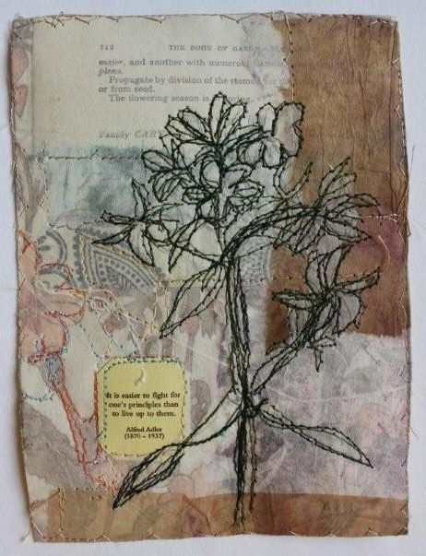
Cas Holmes Research Page
What do I need to include?
How would you recognise her works (description)
Background and influences
Techniques
Your opinion
3 pieces that are annotated

Slide 8
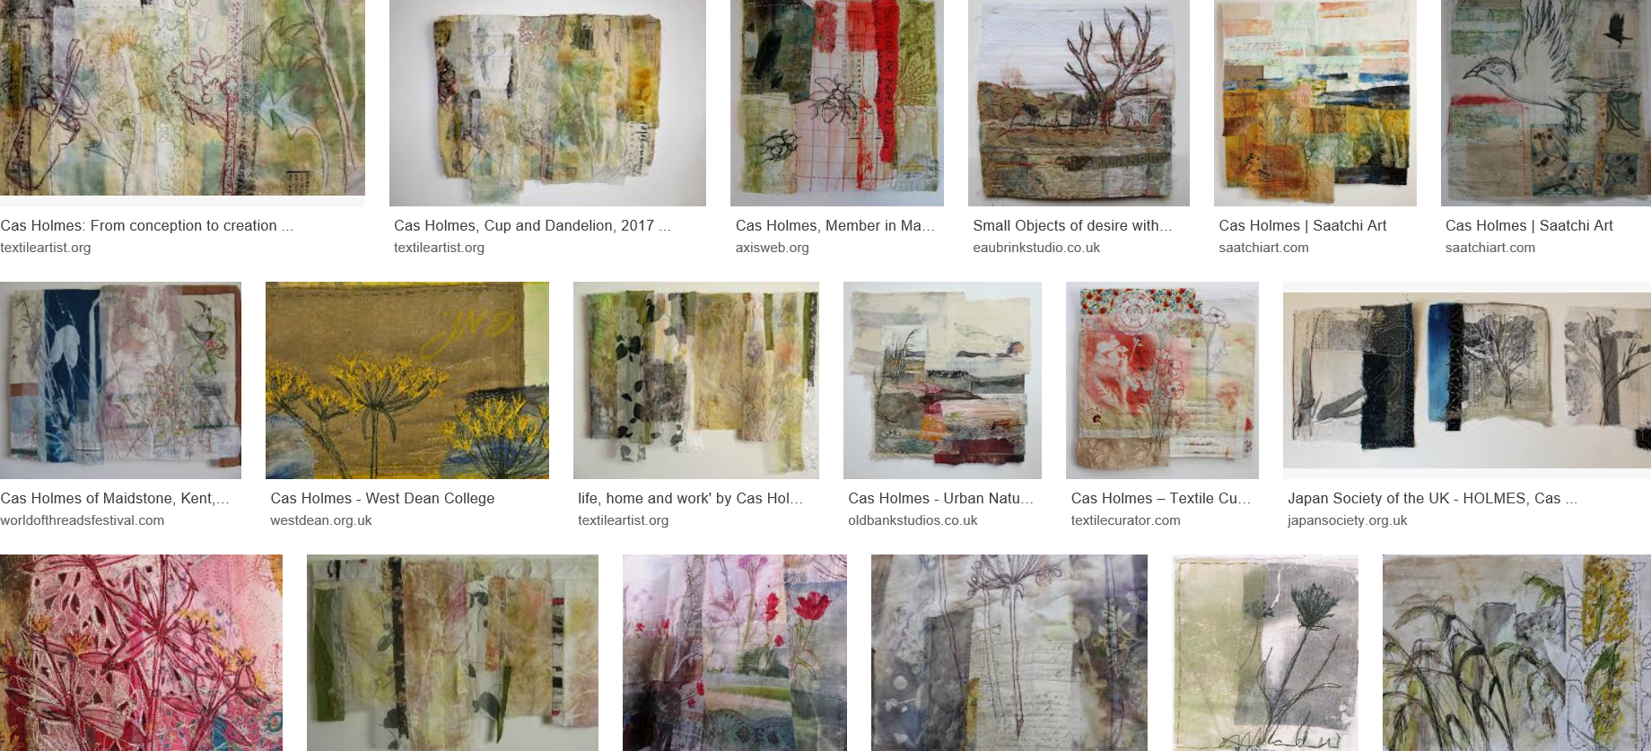
SECOND TASK:
DRAWING
Drawing is an essential part of the process, the exam board are specifically looking for evidence of drawing throughout your work
Find a Cas Holmes image that you like
Draw it with pencil
Draw it pen
Make a paper collage of the shapes

Slide 9
Responding to one of Cas Holmes’ pieces
LO: To create a piece where you explore Cas Holmes’ imagery and techniques.
Using the Cas Holmes piece that you have previously drawn, identify the areas that you want to use within your own piece
Prepare your background by patching together pieces of different fabrics. (Avoid slippery and stretchy fabrics!)
Draw your image onto the background you have made.
Sew on the images using embroidery and applique.

Slide 10
Make a double page showing how you made a Cas Holmes inspired piece.
Stick in each step.
Label it to say HOW you did it and WHY you did it.
KEYWORDS
Details
Light lines and heavy lines
Texture
Layers
Intentional
Accidental
Contrasting
Alternating
Composition
Complexity
CHOOSING A CAS HOLMES |  | PIECE AND RECREATING IT
(The picture I chose) | Why I chose it… | (card collage) | Why did I do it…
(Pencil drawing) | How did you do it… | (Final piece) What worked? Why did you make that choice? How would you improve it?
(pen drawing) | Why did I do it…

Slide 11
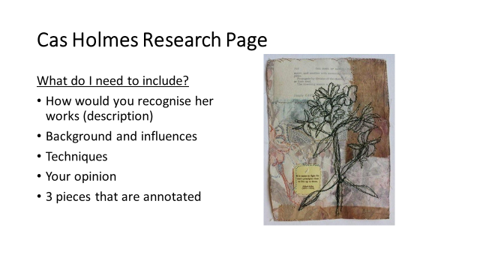

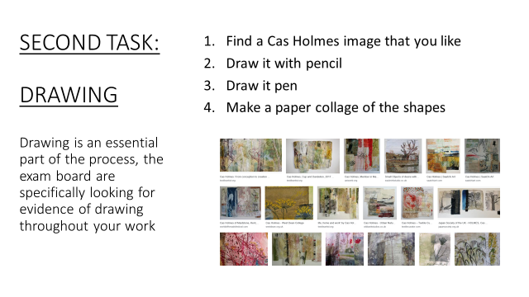
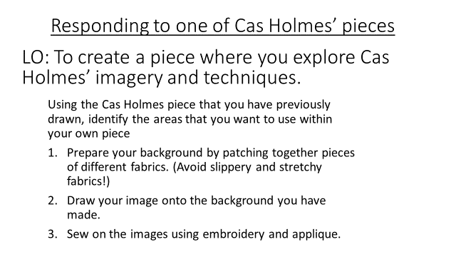
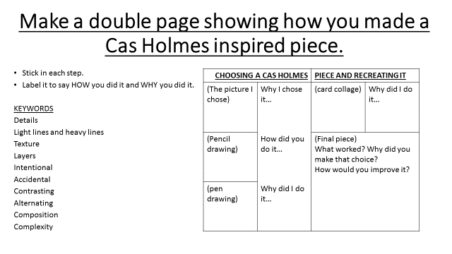
Process consolidation
Repeat this process with either Niru Reid or Paula Kovarik

