Slide 1
Family Life - part 2
Family vocabulary and future forms
Adapted from English File Intermediate 3rd Edition, Christina Latham-Koenig and Clive Oxenden, Oxford University Press 2013

Slide 2

Listen to the three dialogues between different family members.
Who is talking to who? What are they talking about?
Write your answers below.
1.
2.
3.

Slide 3
The answers...
Grandmother to grandson; they are talking about what he is going to do next year.
Father to daughter; they are talking about where she’s going and what she’s doing.
Son to mother; they are talking about if he can borrow her car.

Slide 4
Listen again. Match the sentences below to each dialogue - write 1, 2 or 3 in the orange box.
Shall I make you a cup of tea?
You’ll drive too fast.
I’m not going to go to university yet.
I’m staying the night there.
I’ll drive really slowly.
It’s going to be cold tonight.

Slide 5
The answers...
1
3
1
2
3
2

Slide 6
Move the boxes to match the words to the right definition
a plan or intention
something that you will definitely do
an arrangement
agreed details of how something will happen
a prediction
something that you are willing to do for someone else
a promise
something that you want to do
an offer
something you think will happen in the future

Slide 7
The answers...
a plan or intention
something that you want to do
an arrangement
agreed details of how something will happen
a prediction
something you think will happen in the future
a promise
something that you will definitely do
an offer
something that you are willing to do for someone else

Slide 8
Put the sentences in the right place. A has been done for you.
a plan or intention
an arrangement
Shall I make you a cup of tea?
You’ll drive too fast.
I’m not going to go to university yet.
I’m staying the night there.
I’ll drive really slowly.
It’s going to be cold tonight.
a prediction
a promise
an offer
Shall I make you a cup of tea?

Slide 9
The answers...
a plan or intention
C. I’m not going to go to university yet.
an arrangement
D. I’m staying the night there.
a prediction
B. You’ll drive too fast.
F. It’s going to be cold tonight.
a promise
E. I’ll drive really slowly.
an offer
Shall I make you a cup of tea?

Slide 10
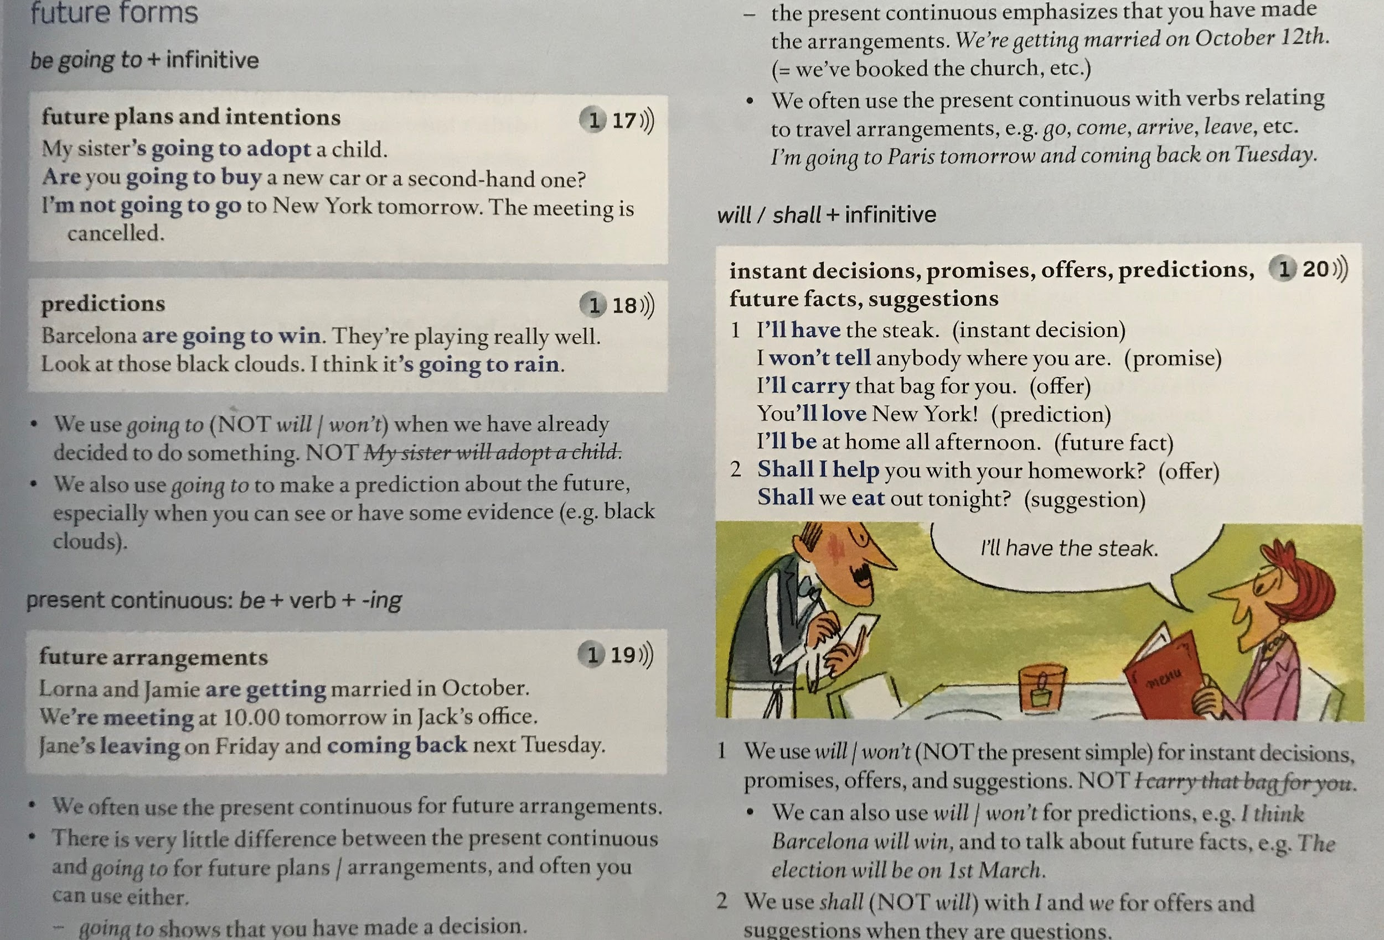
Read:
English File Intermediate Students Book, 3rd Edition, Christina Latham-Koenig and Clive Oxenden, Oxford University Press 2013
Page 133

Slide 11

Circle the correct form. Tick the sentence if both are possible.
Example: My grandparents are going to retire / will retire next year.
Will we / shall we invite your parents for Sunday lunch?
I’m going to make / I’ll make a cake for your mum’s birthday, if you want?
I’m not having / I’m not going to have dinner with my family tonight.
The exam will be / is being on the last day of term.
You can trust me. I’m not telling / I won’t tell anyone your secret.
My cousin is arriving / will arrive at 5.30pm.
I think the birth rate will go down / shall go down in my country in the next few years.
I’m not going to go / I won’t go to my brother-in-law’s party next weekend.
Shall I / will I help you with the washing up?

Slide 12
The answers...
Will we / shall we invite your parents for Sunday lunch?
I’m going to make / I’ll make a cake for your mum’s birthday, if you want?
I’m not having / I’m not going to have dinner with my family tonight.
The exam will be / is being on the last day of term.
You can trust me. I’m not telling / I won’t tell anyone your secret.
My cousin is arriving / will arrive at 5.30pm.
I think the birth rate will go down / shall go down in my country in the next few years.
I’m not going to go / I won’t go to my brother-in-law’s party next weekend.
Shall I / will I help you with the washing up?

Slide 13
Complete the replies with the correct future form. Use the verb in (brackets).
Example: A What’s your stepmother going to do about her car?
B She’s going to buy a second-hand one. (buy)
A I’m going to miss you.
B Don’t worry. I promise I _______________ every day (write)
A What are Alan’s plans for the future?
B He _____________ a degree in engineering. (do)
A Can I see you tonight?
B No, I _______________ late. How about Saturday? (work)
A What would you like for starters?
I _____________ the prawns, please. (have)
A There’s nothing in the fridge.
B OK. ________________ we ______________ a takeaway? (get)
A I don’t have any money, so I can’t go out.
B No problem, I ______________ you some. (lend)
A Shall we have a barbecue tomorrow?
B I don’t think so. On the radio it said that it _______________. (rain)
A We land at about 8 o’clock.
B _____________ I ___________________ you __________________ from the airport? (pick up)

Slide 14
The answers...
A I’m going to miss you.
B Don’t worry. I promise I will write every day (write)
A What are Alan’s plans for the future?
B He is going to do a degree in engineering. (do)
A Can I see you tonight?
B No, I am working late. How about Saturday? (work)
A What would you like for starters?
I will have the prawns, please. (have)
A There’s nothing in the fridge.
B OK. Shall we get a takeaway? (get)
A I don’t have any money, so I can’t go out.
B No problem, I will lend you some. (lend)
A Shall we have a barbecue tomorrow?
B I don’t think so. On the radio it said that it will rain. (rain)
A We land at about 8 o’clock.
B Shall I pick you up from the airport? (pick up)

Slide 15
Write a sentence for each future form about life after lockdown.
For example: ‘After lockdown, everyone will be much better at using computers’ (my prediction).
a plan or intention
an arrangement
a prediction
a promise
an offer

