Slide 1
Speciation
Edexcel biology B

Slide 2

Speciation
Starter: To what extent does the video really model the process of evolution?
Understand how reproductive isolation can lead to speciation.
Speciation
Hybridisation
Geographical isolation
Ecological isolation
Seasonal isolation
Behavioural isolation
Mechanical isolation
Allopatric speciation
Endemic
Adaptive radiation
Marsupials
Monotremes
Placental mammals
Sympatric speciation

Slide 3
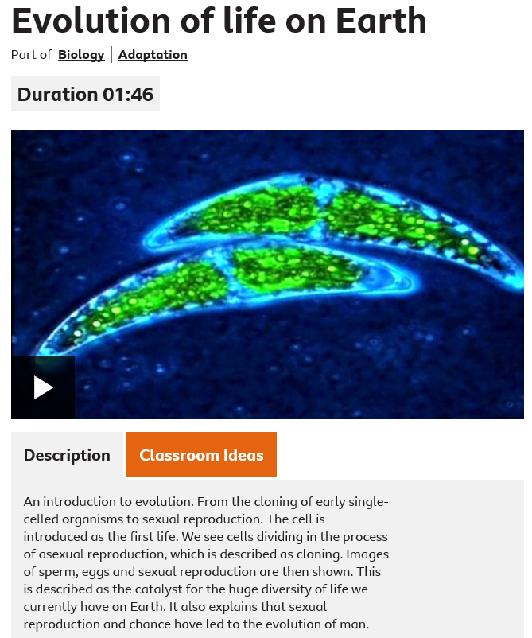
https://www.bbc.com/bitesize/clips/ztphfg8

Slide 4
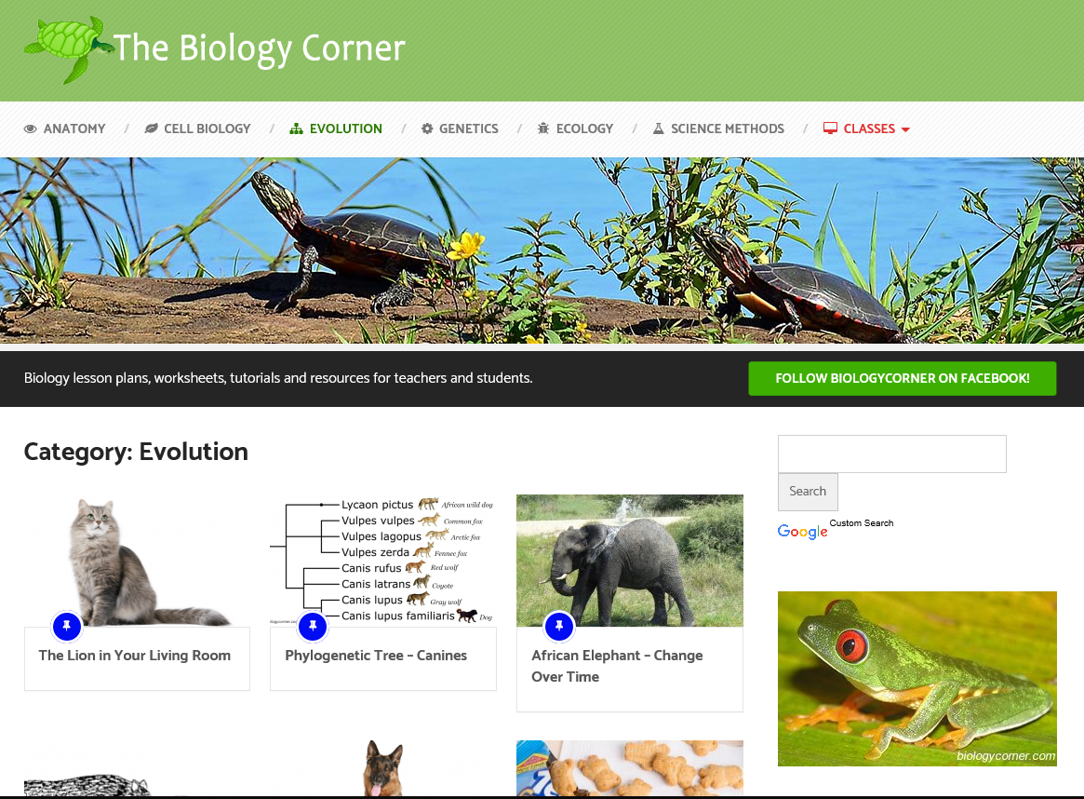
https://www.biologycorner.com/category/worksheets/evolution/

Slide 5
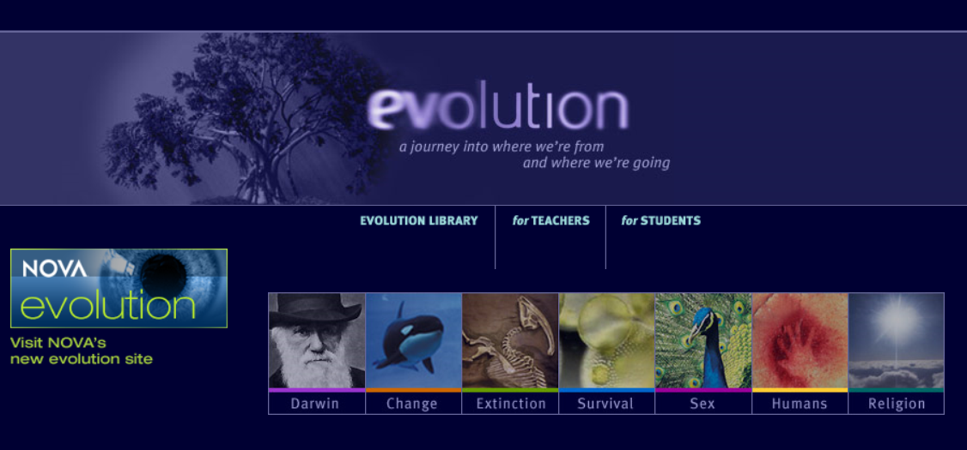
http://www.pbs.org/wgbh/evolution/

Slide 6
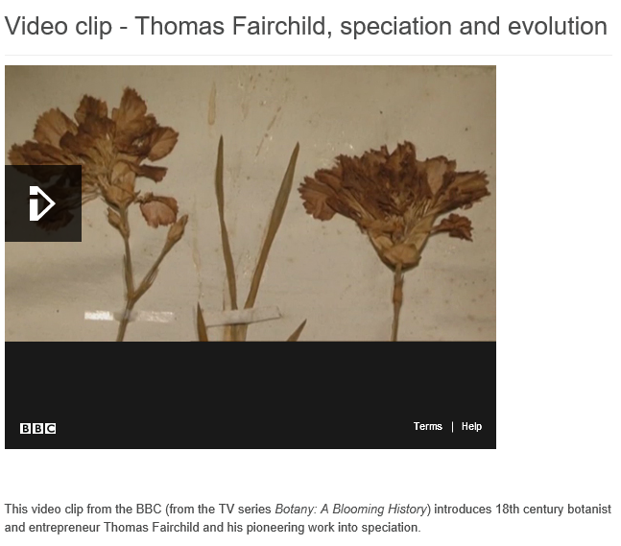
http://www.saps.org.uk/secondary/teaching-resources/814-fairchild-speciation-and-evolution

Slide 7
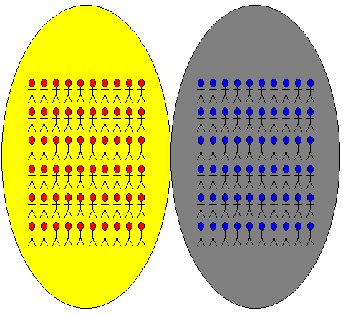
Gene Flow
What happens to gene flow if populations become reproductively isolated?

Slide 8
What is Speciation?
The formation of a new species.

Slide 9
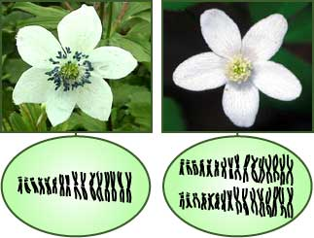
Hybrids
Explain how hybridisation can lead to the development of a new species.
Sometimes two closely related species can breed and form fertile hybrids.
The hybrid offspring cannot produce fertile offspring with either of the parents (plants usually) but can with other like hybrids.
Therefore resulting in the formation of new hybrid species.
Anemone
Ploidy

Slide 10
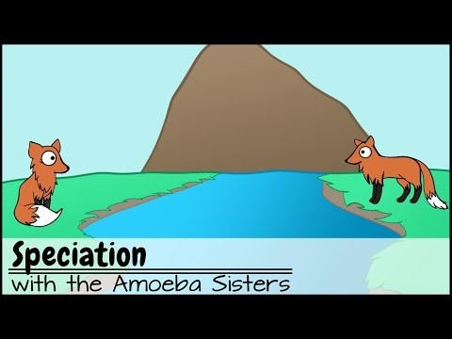

Slide 11
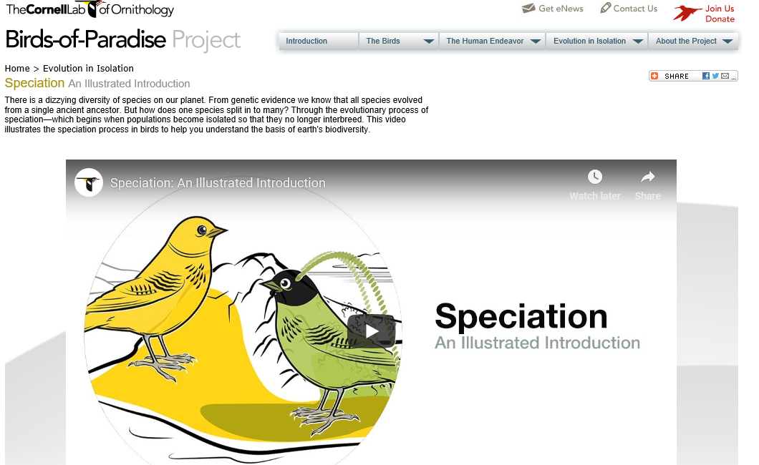
https://youtu.be/8yvEDqrc3XE http://biology.allaboutbirds.org

Slide 12
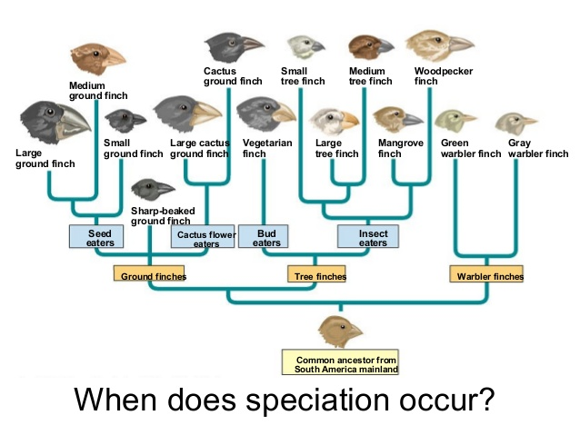

Slide 13
Isolating Mechanisms
There are various ways in which parts of populations can become isolated from each other so that they no longer interbreed.
Geographical – physical barrier
Ecological – different habitats
Seasonal – breed at different times of the year
Behavioural – different courtship rituals
Mechanical – lack of fit between reproductive organs
Gametic – gametes are incompatible

Slide 14
Geographical isolation Male/female gametes are incompatible with each other.
Habitat/ecological isolation No longer respond to each other’s reproductive displays.
Sexual/temporal isolation Reproductive organs no longer fit together.
Mechanical isolation Reproductively active at different times.
Behavioural isolation Occupy different habitats in the same area.
Gametic isolation Divided by a physical barrier.

Slide 15
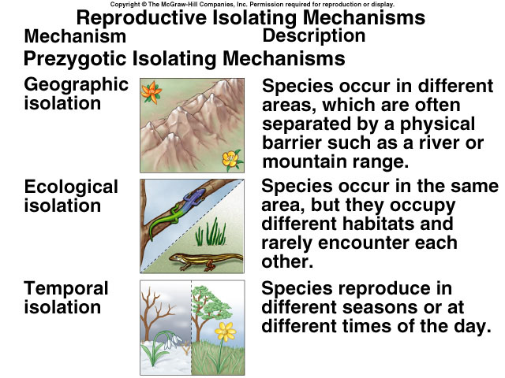

Slide 16
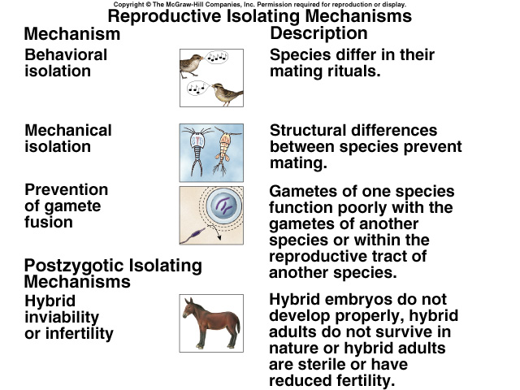

Slide 17
Reproductive Isolation
Produce a concept map on reproductive isolation to summarise the different mechanisms by which it can arise.
Research and add examples for each mechanism:
Geographical
Ecological
Seasonal/temporal
Behavioural
Mechanical

Slide 18
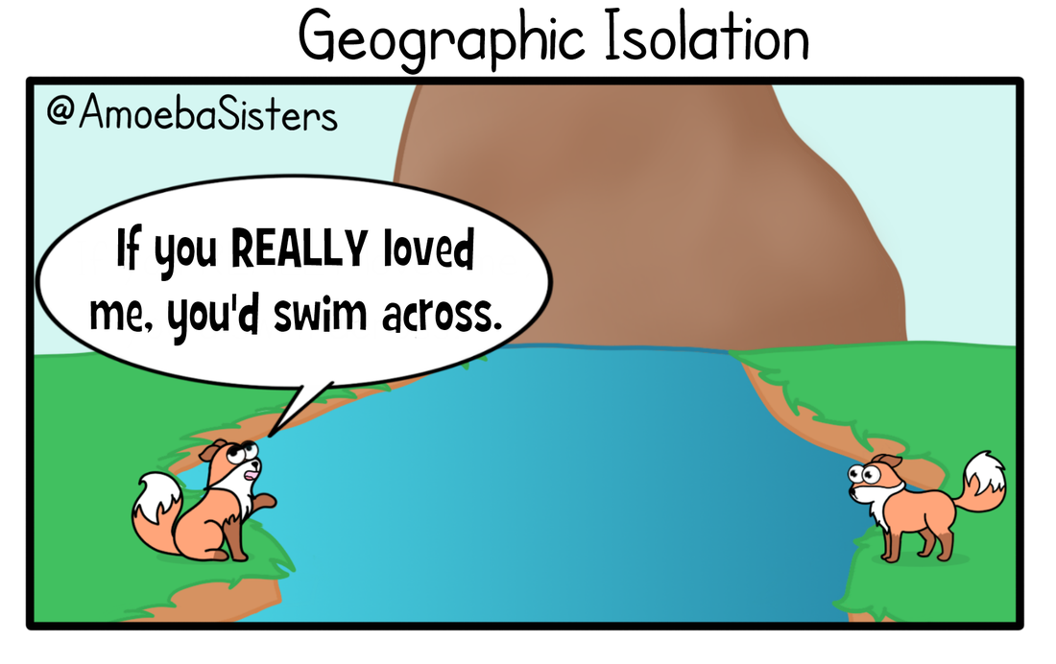

Slide 19
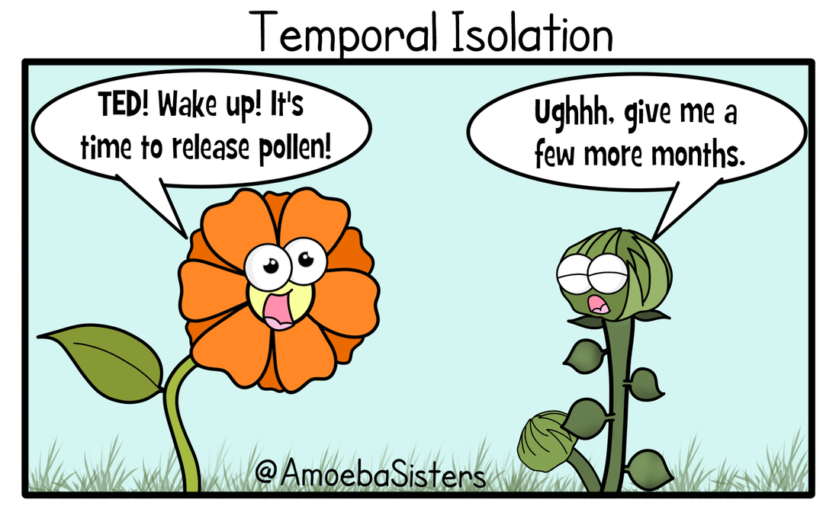

Slide 20
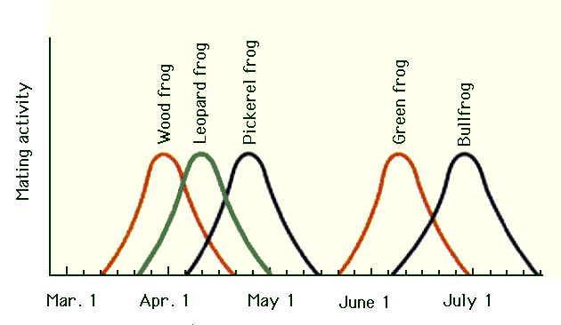
Temporal/Seasonal Isolation

Slide 21
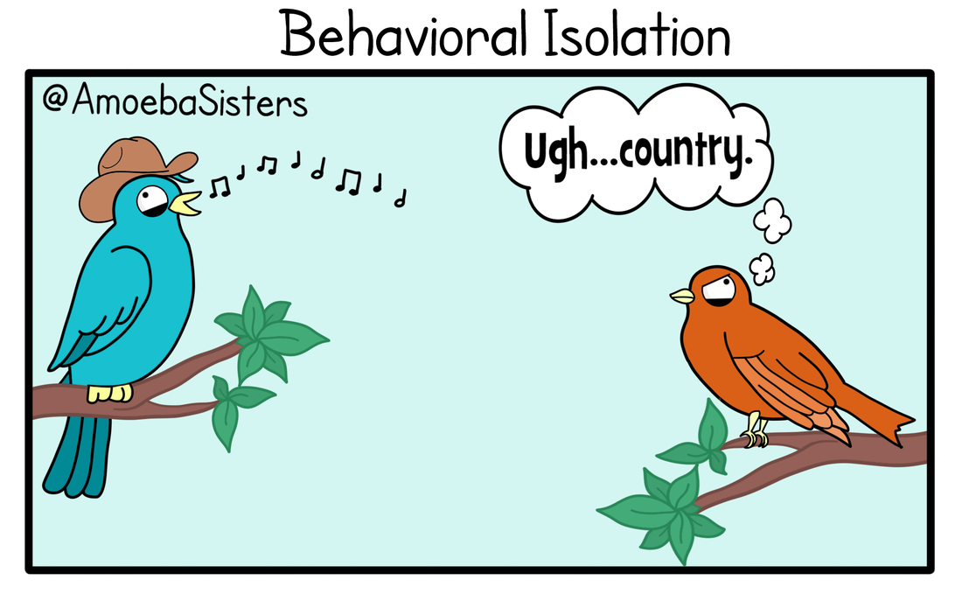

Slide 22
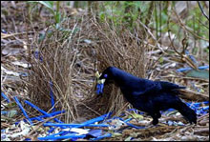
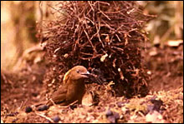
Behavioural Isolation
Courtship rituals which are not attractive to the main population of the species.
Bowerbirds construct elaborate bowers and decorate them with different colors in order to woo females.
Notes:
The Satin bowerbird (left) builds a channel between upright sticks, and decorates with bright blue objects, while the MacGregor’s Bowerbird (right) builds a tall tower of sticks and decorates with bits of charcoal. Evolutionary changes in mating rituals, such as bower construction, can contribute to speciation.

Slide 23
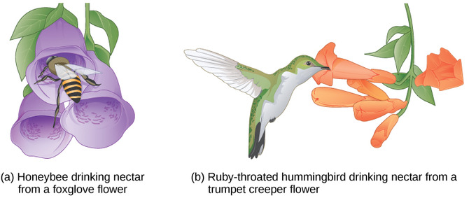
Mechanical Isolation

Slide 24

Mechanical Isolation
Lack of “fit” between sexual organs:
Damsel fly penises!

Slide 25
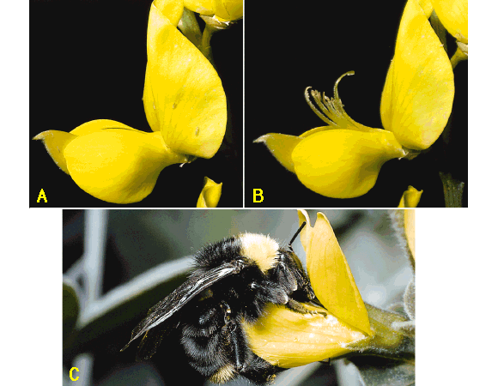
Mechanical
Isolation
Notes:
pollination of Scotch broom by a bumble bee; nectar is unavailable to lighter honeybees that cant trip release mechanism

Slide 26
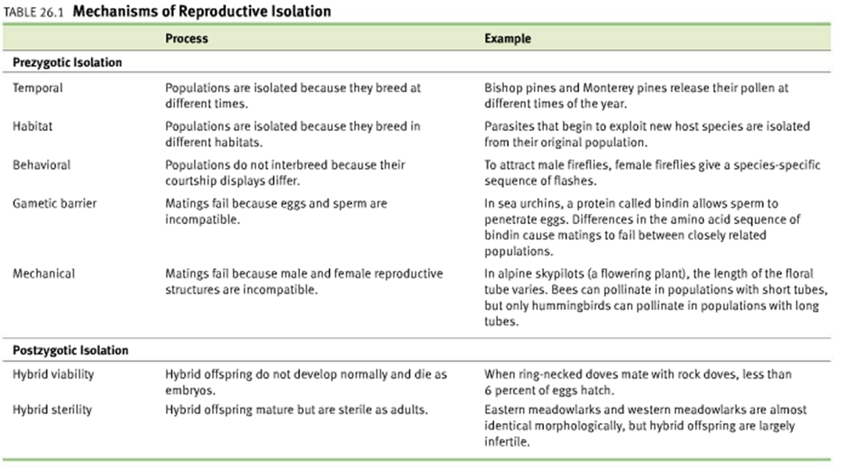
Reproductive Isolation

Slide 27
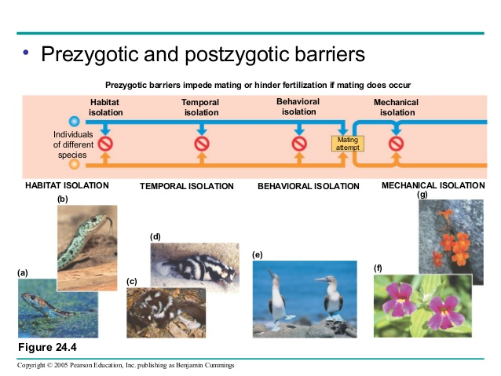

Slide 28
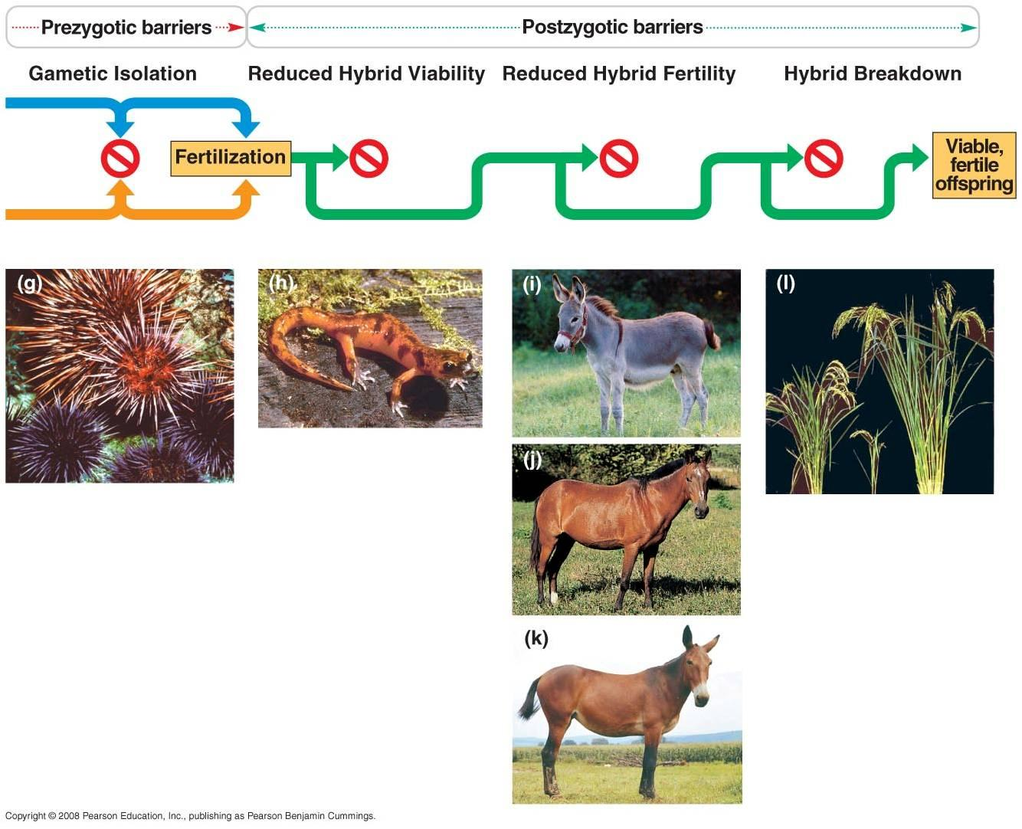

Slide 29
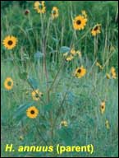
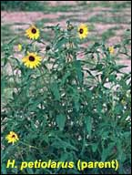
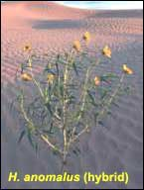
Gametic Isolation – Hybrid Species

Slide 30
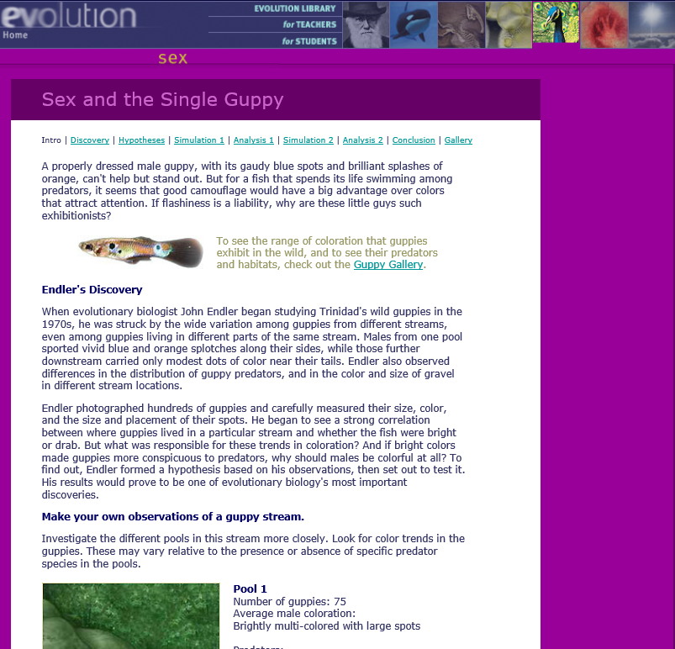
Sex and the Single Guppy
https://www.pbs.org/wgbh/evolution/sex/guppy/low_bandwidth.html
https://www.biologycorner.com/worksheets/guppy_teacher.html

Slide 31
Endemism
What is an endemic species?
A species that evolves in geographical isolation and is only found in one place.

Slide 32
Match the Key Terms
Biodiversity A. The loss of species.
Adaptive radiation B. The emergence of numerous species from a common introduced ancestor.
Extinction C. A measure of the number of species on the planet.
Answer: 1C, 2B, 3A

Slide 33
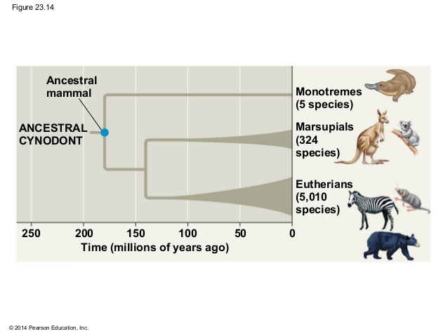
Adaptive Radiation
The emergence of numerous species from a common introduced ancestor.

Slide 34
Adaptive Radiation
Explain what marsupials are and how Australian marsupials have evolved through adaptive radiation.
Marsupials – mammals that protect their young in pouches.
When the Austrialian continent separated from the mainland the marsupials evolved into a number of different species all able to fill a range of niches.

Slide 35
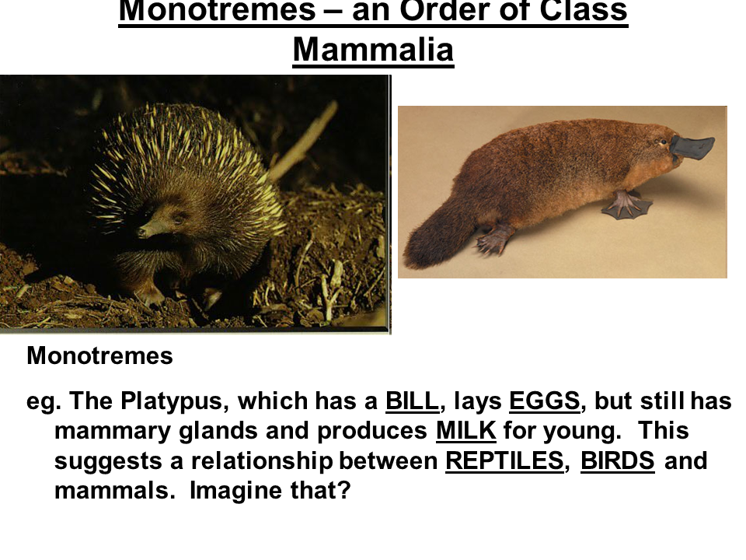

Slide 36

Allopatric
(allo = other, patric = place)
New species formed from geographically isolated populations.

Slide 37

Sympatric
(sym = same, patric = place)
New species formed within the range of the ancestral population.

Slide 38
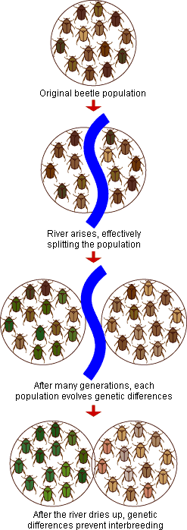

Slide 39
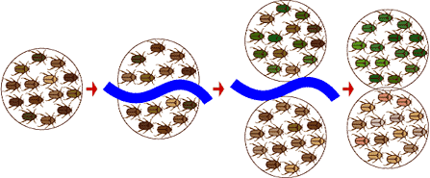
Allopatric Speciation

Slide 40
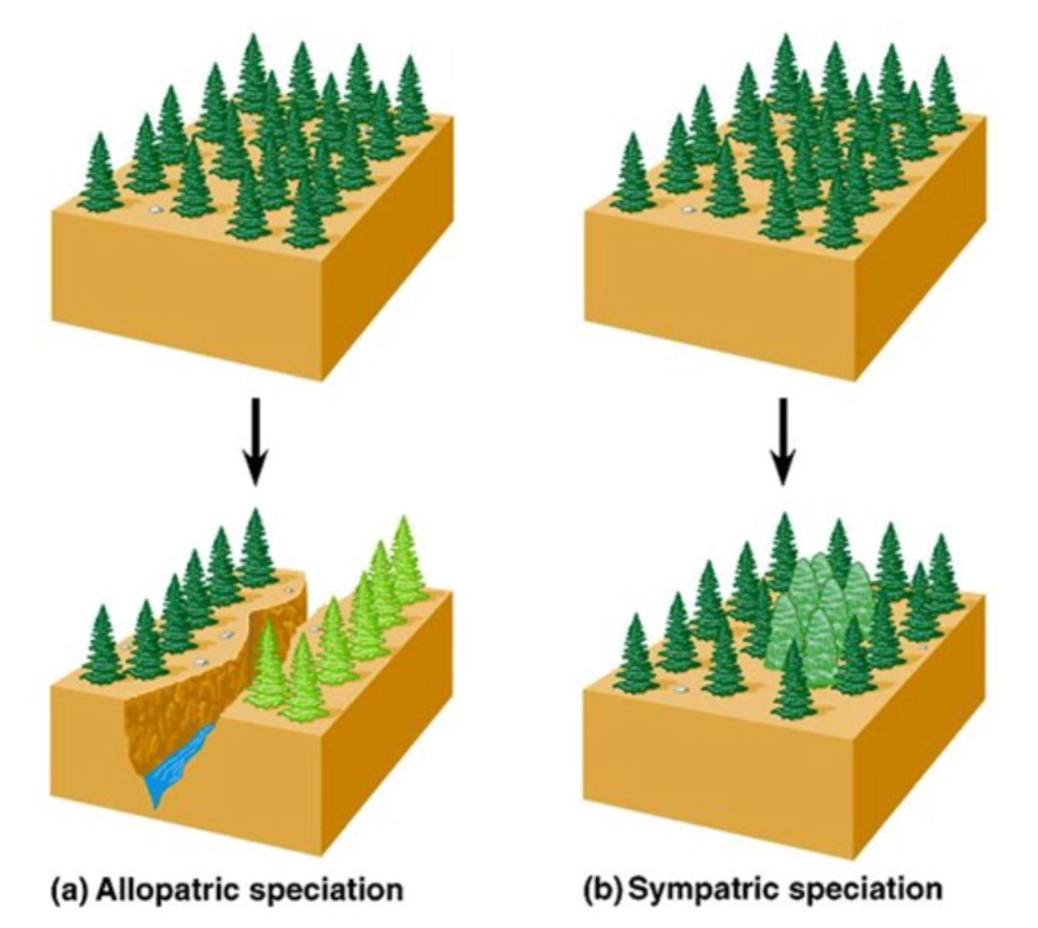
Allopatric and Sympatric Speciation
Explain what happens during allopatric speciation. (3 marks)
Some sort of physical mechanism, such as a mountain range or a river; separates two halves of a population.
If the two halves change in different ways, due to natural selection, they may become reproductively isolated and hence separate species.

Slide 41
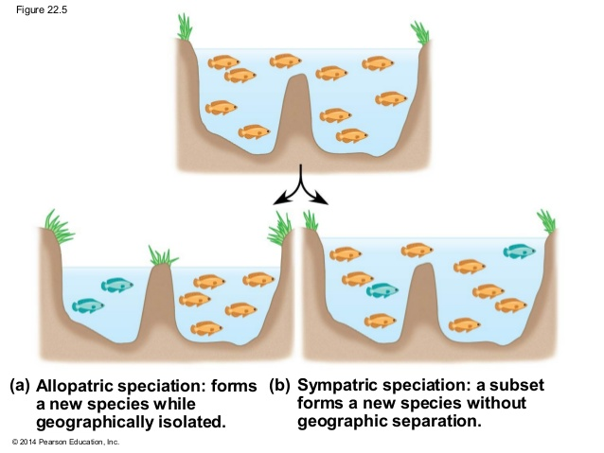

Slide 42
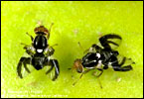
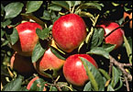
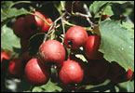
Sympatric Speciation in Apple maggot flies
Apples Hawthorns

Slide 43
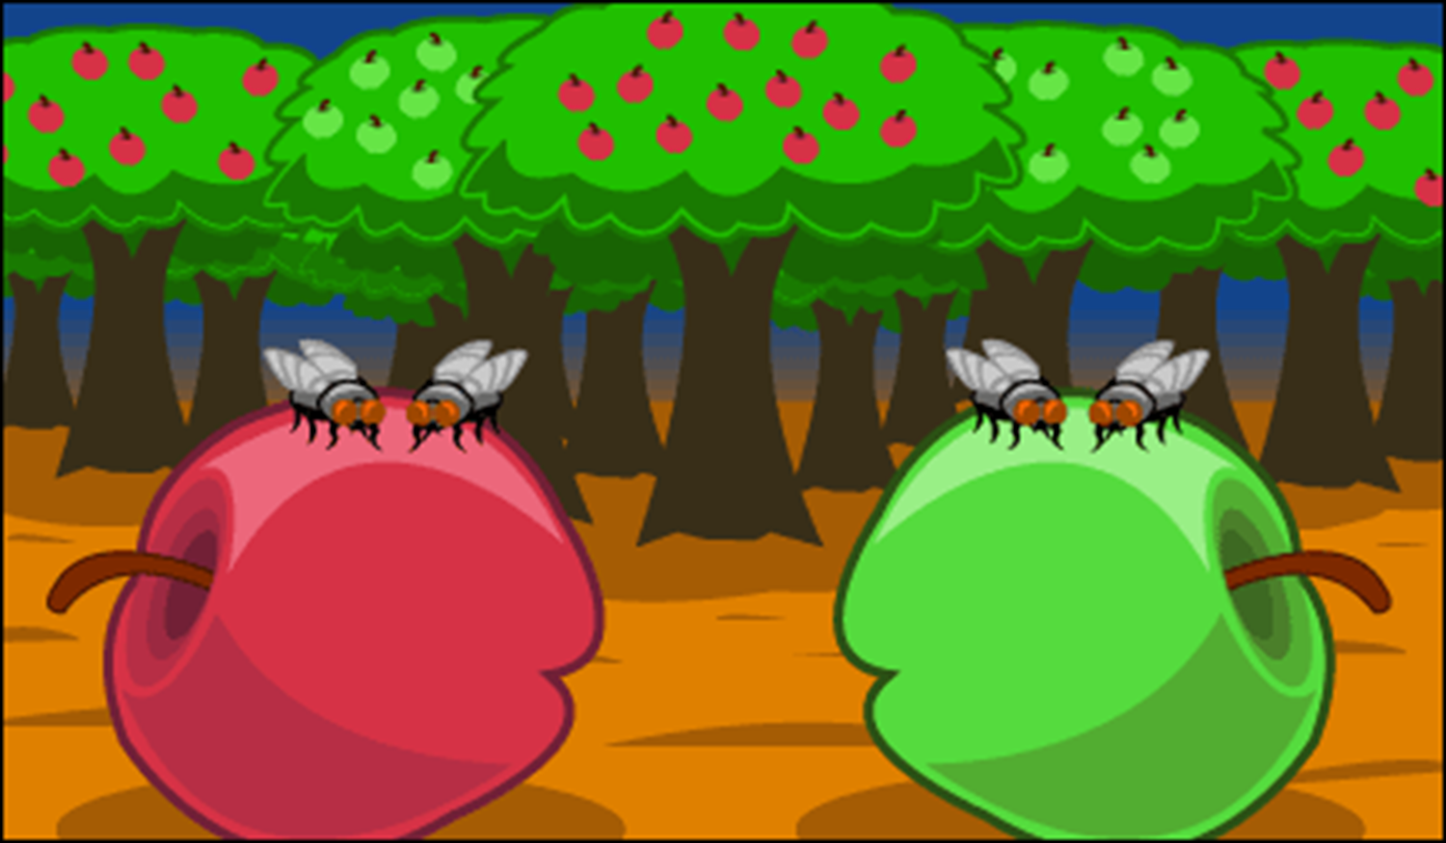
Sympatric Speciation in Apple Maggot Flies
200 years ago, the ancestors of apple maggot flies laid their eggs only on hawthorns—but today, these flies lay eggs on hawthorns (which are native to America) and domestic apples (which were introduced to America by immigrants and bred).
Females generally choose to lay their eggs on the type of fruit they grew up in, and males tend to look for mates on the type of fruit they grew up in.
So hawthorn flies generally end up mating with other hawthorn flies and apple flies generally end up mating with other apple flies.
Notes:
This means that gene flow between parts of the population that mate on different types of fruit is reduced. This host shift from hawthorns to apples may be the first step toward sympatric speciation—in fewer than 200 years, some genetic differences between these two groups of flies have evolved.

Slide 44

Gene flow has been reduced between flies that feed on different food varieties, even though they both live in the same geographic area.

Slide 45

This means that gene flow between parts of the population that mate on different types of fruit is reduced. This host shift from hawthorns to apples may be the first step toward sympatric speciation—in fewer than 200 years, some genetic differences between these two groups of flies have evolved.

Slide 46
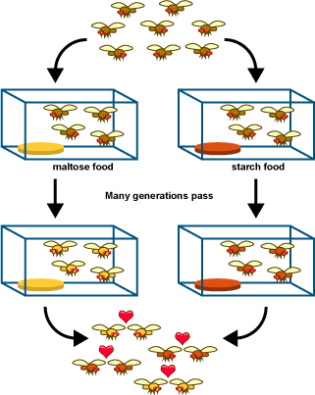

Slide 47
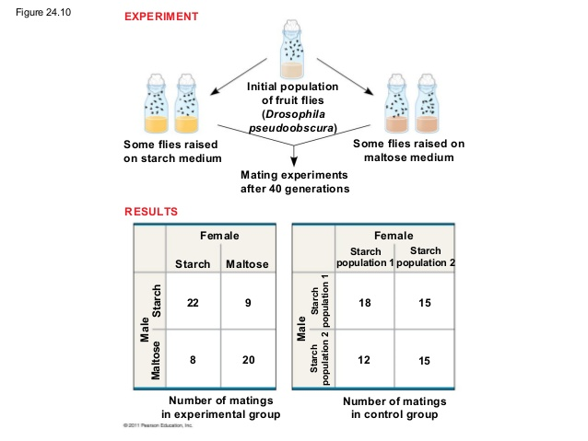

Slide 48
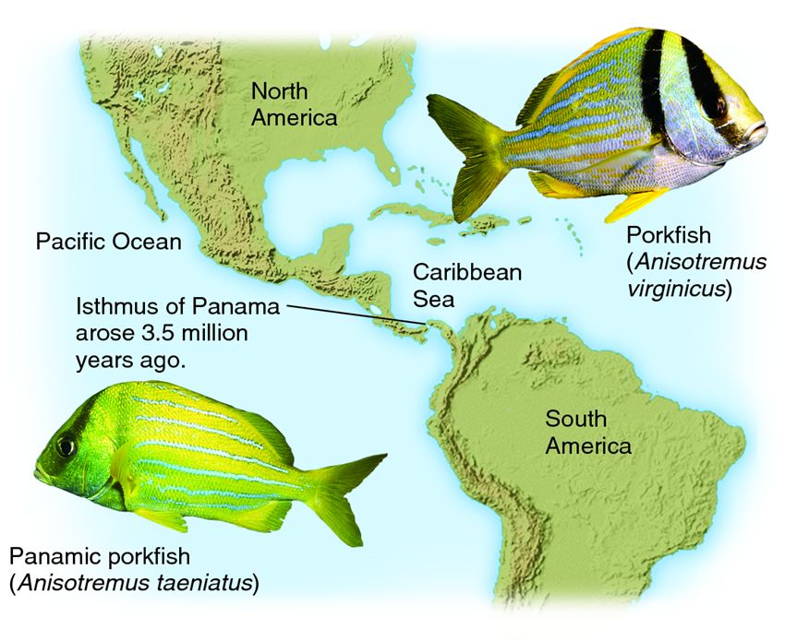

Slide 49
Allopatric and Sympatric Speciation
Explain the difference between allopatric and sympatric speciation.
Allopatric – speciation that occurs when populations are physically or geographically separated.
Sympatric – speciation that occurs when two parts of a population become reproductively isolated in the same place.
Explain what happens during allopatric speciation. (3 marks)
Some sort of physical mechanism, such as a mountain range or a river
Separates two halves of a population.
If the two halves change in different ways, due to natural selection, they may become reproductively isolated and hence separate species.

Slide 50
Which of the following shows the correct sequence describing speciation? (1 mark)
A geographical isolation - selection – reproductive isolation – allopatric speciation
B selection – geographical isolation – reproductive isolation – allopatric speciation
C geographical isolation – selection – reproductive isolation – sympatric speciation
D selection – geographical isolation – reproductive isolation – sympatric speciation
Answer: A

Slide 51
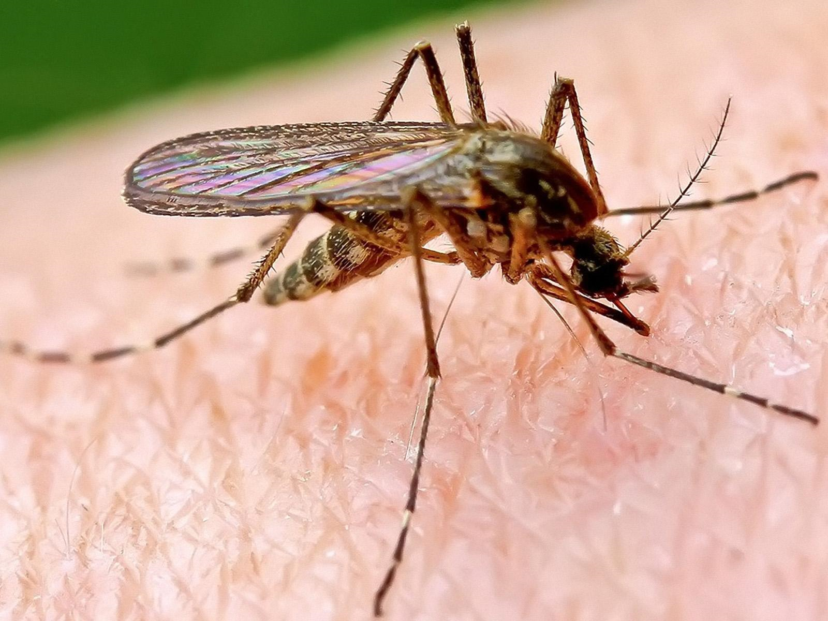
A new species of mosquito has evolved in the London Underground. Explain whether this is sympatric or allopatric speciation. (2 marks)
Sympatric because they are in the same place.

Slide 52
Allopatric and Sympatric Speciation
Compare and contrast allopatric and sympatric speciation. (4 marks)
Similarities
Reproductive isolation
One original population / from existing species / have a common ancestor
Absence of gene flow / genetic differences accumulate
Differences
Allopatric requires geographic isolation / sympatric in same geographic area
Sympatric caused by different food / behavioural / anatomical / physiological / seasonal / temporal isolation
Sympatric results from ploidy

Slide 53
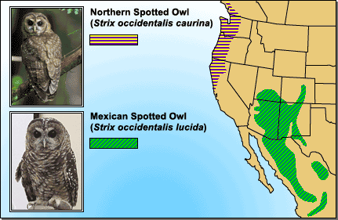
Evidence for Speciation
Notes:
Spotted owl subspecies living in different geographic locations show some genetic and morphological differences. This observation is consistent with the idea that new species form through geographic isolation.

Slide 54
The Orkneys are a group of islands in the north of the British Isles, between Scotland and Norway. There are populations of voles on several of these islands. A vole is a small mouse-like rodent. Similar voles, classified as belonging to the same species, are found on the Scottish mainland. The Orkney voles are much larger than those found on the mainland; they also have a different coat colour. Biochemical analysis of blood proteins and DNA fragments from Orkney voles and mainland voles reveals more fundamental differences between the populations.
Explain how both isolation and natural selection have produced these differences. (7 marks)
Environment on Orkney and on the mainland different; colder / windier / more exposed / less fertile / other example; fewer / different, predators on islands; larger voles are, more vulnerable to predators / less vulnerable to cold; differences between the populations arose by mutation; during meiosis; variants best fitted to survive in each environment left more offspring; Orkney voles descended from a small population; differences may have
arisen by chance; population on Orkney reproductively isolated; [7 max]

Slide 55
The Orkneys are a group of islands in the north of the British Isles, between Scotland and Norway. There are populations of voles on several of these islands. A vole is a small mouse-like rodent. Similar voles, classified as belonging to the same species, are found on the Scottish mainland. The Orkney voles are much larger than those found on the mainland; they also have a different coat colour. Biochemical analysis of blood proteins and DNA fragments from Orkney voles and mainland voles reveals more fundamental differences between the populations.
Discuss the idea that voles from Orkney and the Scottish mainland belong to different species (5 marks)
A species is a group of similar organisms; can interbreed freely; Orkney voles similar to mainland one, so should be regarded as same species; but have distinctive characteristics, so can be regarded as different species; unknown if they could produce fully fertile offspring if crossed; prefer to mate within their own population; to be certain if two species or one carry out a breeding experiment; for two generations; to see if fertile offspring are produced;

Slide 56
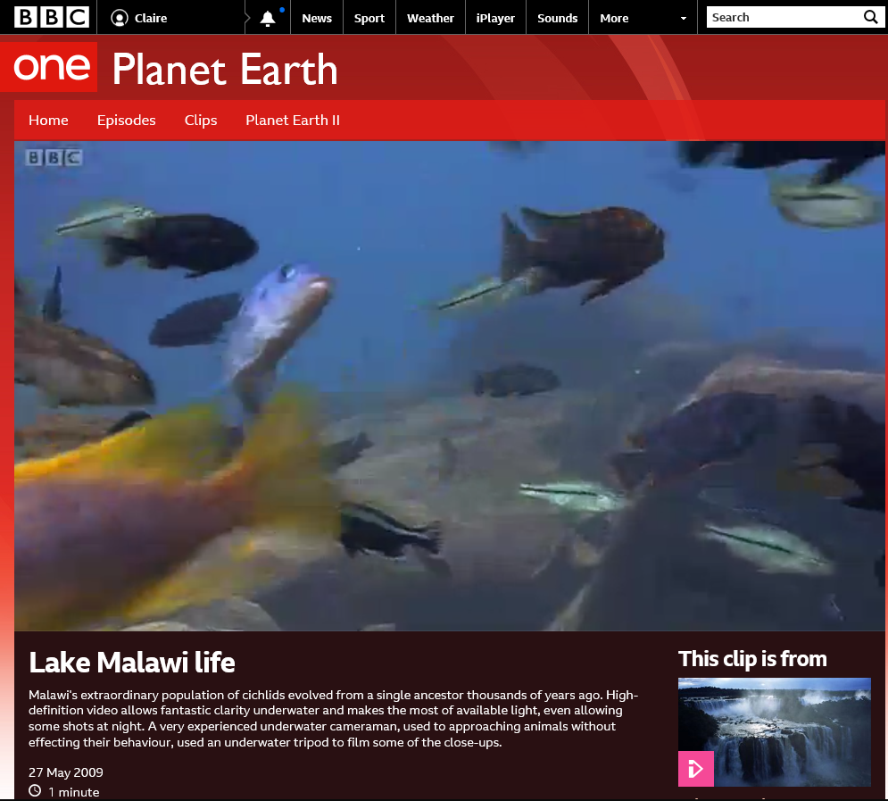
Cichlids
Sympatric speciation, allopatric speciation and adaptive radiation in cichlids in the African lakes.
https://www.bbc.co.uk/programmes/p00379zw

Slide 57
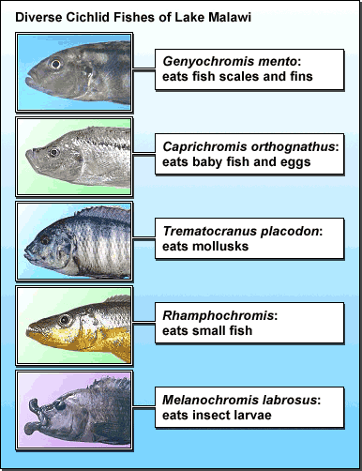
Each cichilid species has its own niche.

Slide 58
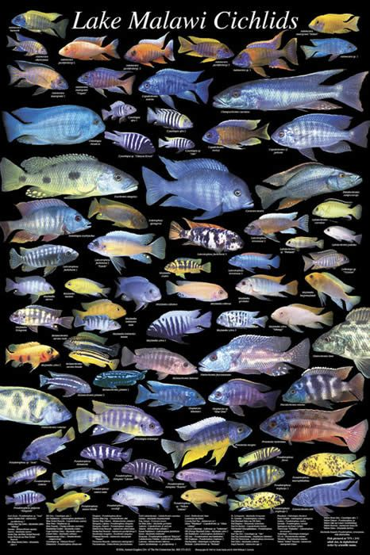
Cichlids
Divide a large piece of paper into four and label the quarters with ‘niche’, ‘allopatric speciation’, ‘sympatric speciation’ and ‘adaptive radiation’.
Read Section 3.2.5 in the Student Book on cichlid evolution or do your own research.
For each of the four key terms, you should find and describe examples that apply to cichlids in the African lakes.

Slide 59
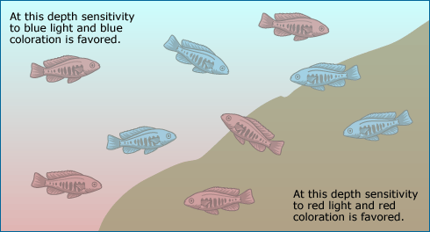

Slide 60
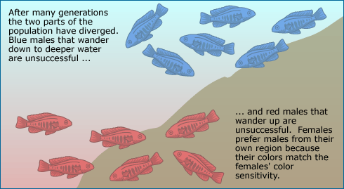

Slide 61
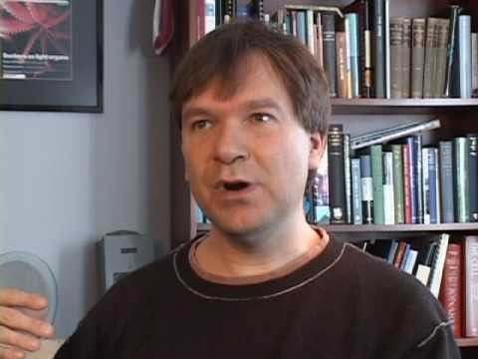

Slide 62
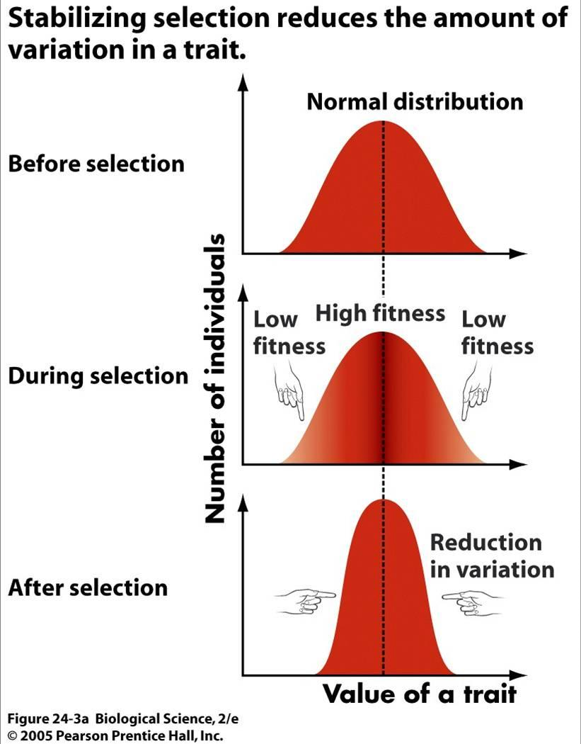

Slide 63
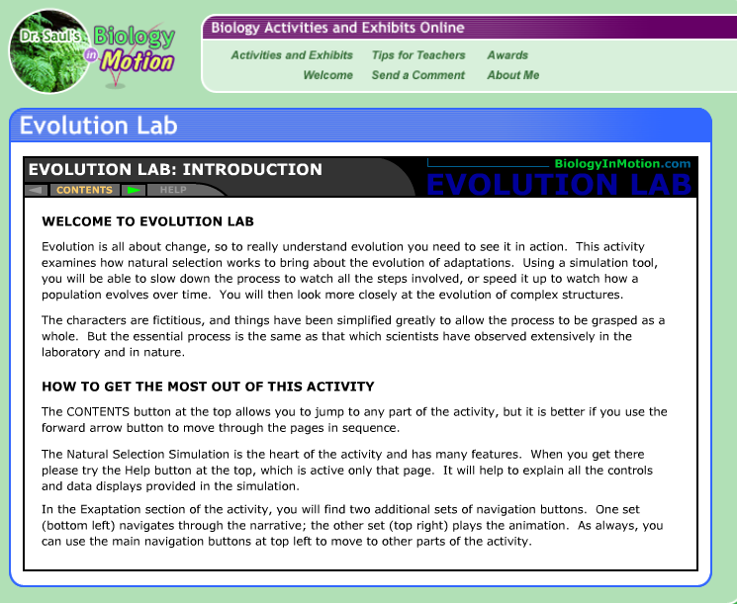
http://www.biologyinmotion.com/evol/index.html
https://www.biologycorner.com/worksheets/evolutionlab.html

Slide 64
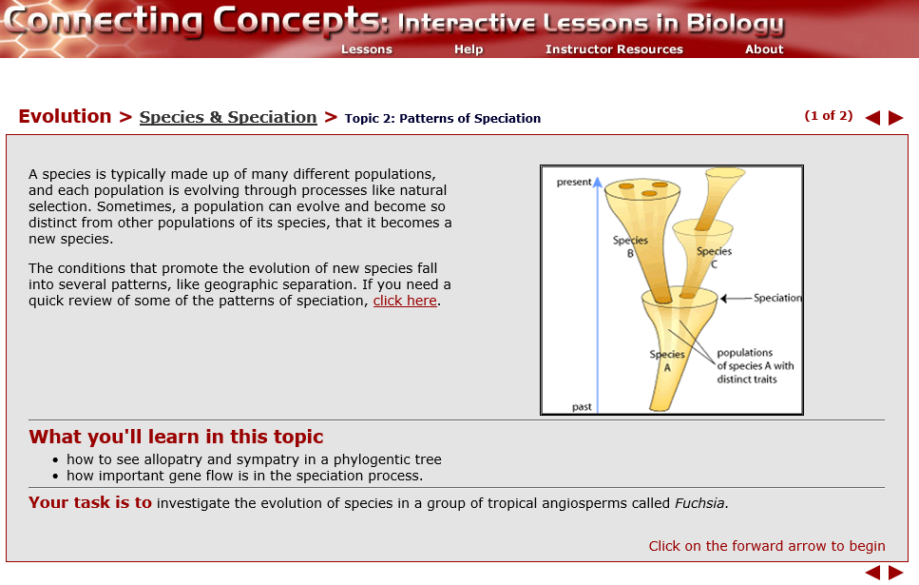
https://ats.doit.wisc.edu/biology/ev/sp/t2.htm

Slide 65

Speciation – Further Reading

Slide 66

https://evolution.berkeley.edu/evolibrary/article/evo_40

Slide 67

Explain how two species of African elephant could evolve from a common ancestor. (3 marks)
Two populations are geographically isolated from each other.
Therefore reduced gene flow between the two populations.
Which leads to allopatric speciation.
Different selection pressures leading to natural selection.

Slide 68
Natural Selection and Speciation Summary
Natural selection brings about genetic changes in _____________________ when genetic variation results in differential _________________________ success within a population.
Natural selection can be __________________________ or stabilising.
Natural selection has resulted in the development of bacterial populations that are _______________________ to one or more antibiotics.
If two or more groups from a population become reproductively isolated, natural selection can bring about _____________________________.
Reproductive __________________________________ may occur through geographical separation of groups, leading to ________________________ speciation, or without geographical separation of groups, leading to _________________ speciation.
Allopatric
Directional
Isolation
Populations
Reproductive
Resistant
Speciation
Sympatric

Slide 69
Natural Selection and Speciation Summary
Natural selection brings about genetic changes in _____populations____________ when genetic variation results in differential ___________reproductive_______ success within a population.
Natural selection can be ____________directional_______________ or stabilising.
Natural selection has resulted in the development of bacterial populations that are ___________resistant____________ to one or more antibiotics.
If two or more groups from a population become reproductively isolated, natural selection can bring about ____________speciation_________________.
Reproductive _________________isolation_________________ may occur through geographical separation of groups, leading to ___________allopatric________________ speciation, or without geographical separation of groups, leading to ______________sympatric_________ speciation.

Slide 70

Extension:
http://www.phschool.com/science/biology_place/labbench/lab11/intro.html

Slide 71
Consolidation
Produce a storyboard flowchart for an animation of the process of evolution by natural selection and resultant speciation.
Design and make a ‘Roll and move’ board game on evolution. Include factors for selection, isolation and speciation

Slide 72


Slide 73


Slide 74


Slide 75
Homework
Q4, 9BIO3, Sample (specimen) paper

Slide 76
Speciation
Understand how reproductive isolation can lead to speciation.
Plenary: ‘Jot thoughts’ activity.
Using the 5-6 mark point exam questions work individually to suggest marking points.
Then get together in 4s and select the best ones to match the question.
Finally, compare your choices to the mark scheme.
Speciation
Hybridisation
Geographical isolation
Ecological isolation
Seasonal isolation
Behavioural isolation
Mechanical isolation
Allopatric speciation
Endemic
Adaptive radiation
Marsupials
Monotremes
Placental mammals
Sympatric speciation

Slide 77


Slide 78


Slide 79


Slide 80




Slide 81


Slide 82


Slide 83


Slide 84

A

