Slide 1
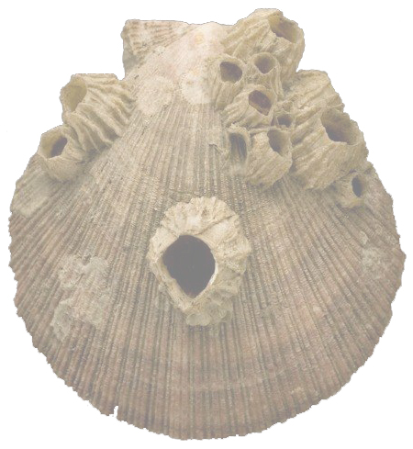


Brilliant Barnacles
Evidence for evolutionary relationships
Lesson 3
New evidence from
scanning electron
microscopy (SEM)
Cover image © The Linnean Society

Slide 2
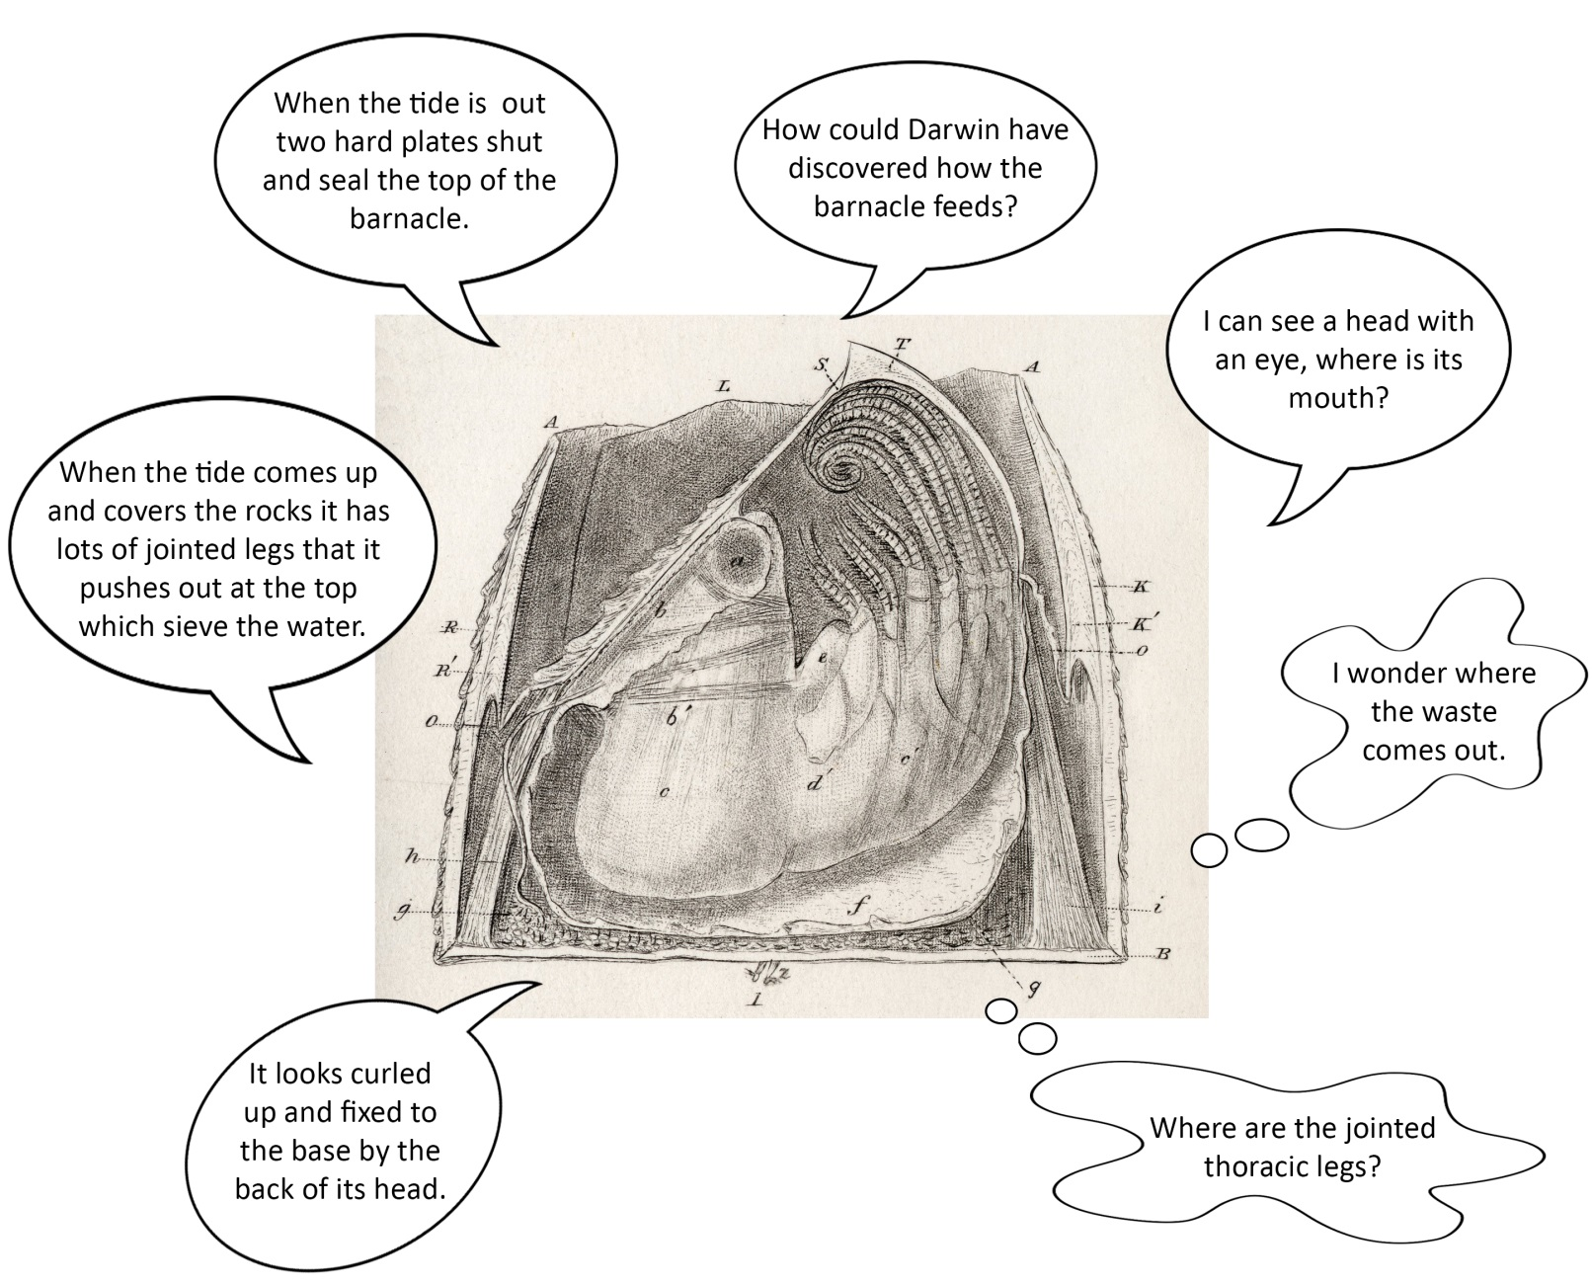
Barnacle nutrition

Slide 3
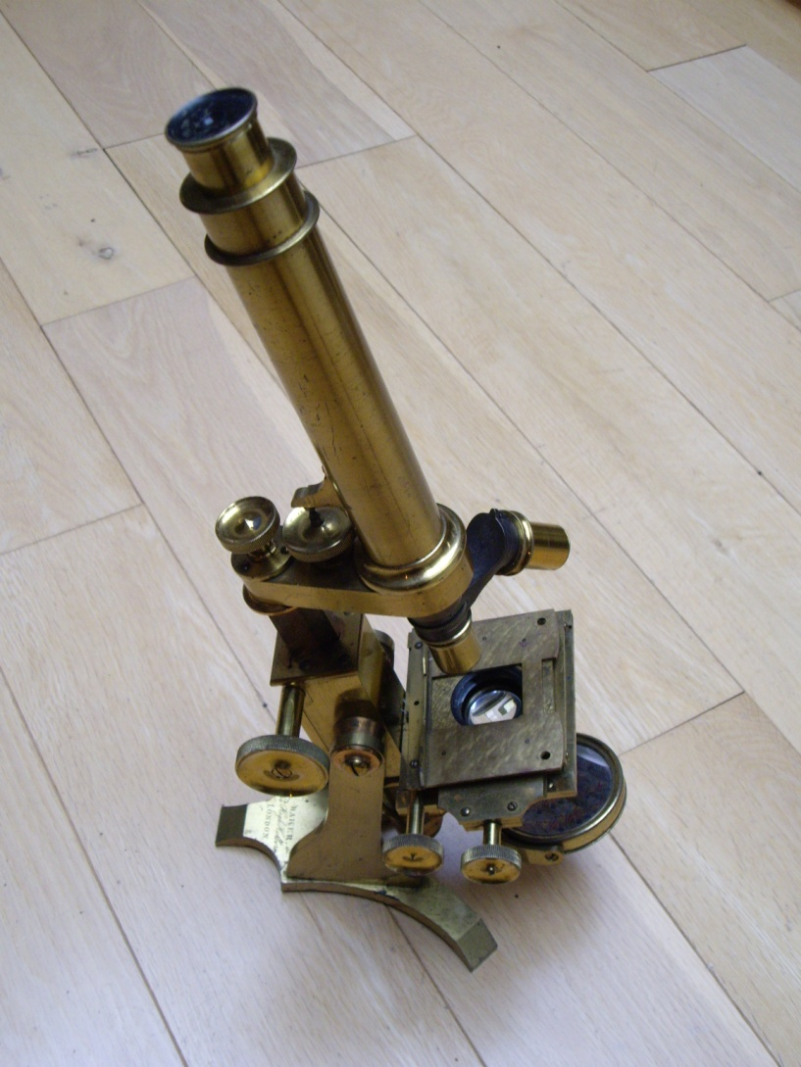
Darwin bought a compound microscope like this for his close study of barnacles
© Carol Boulter

Slide 4
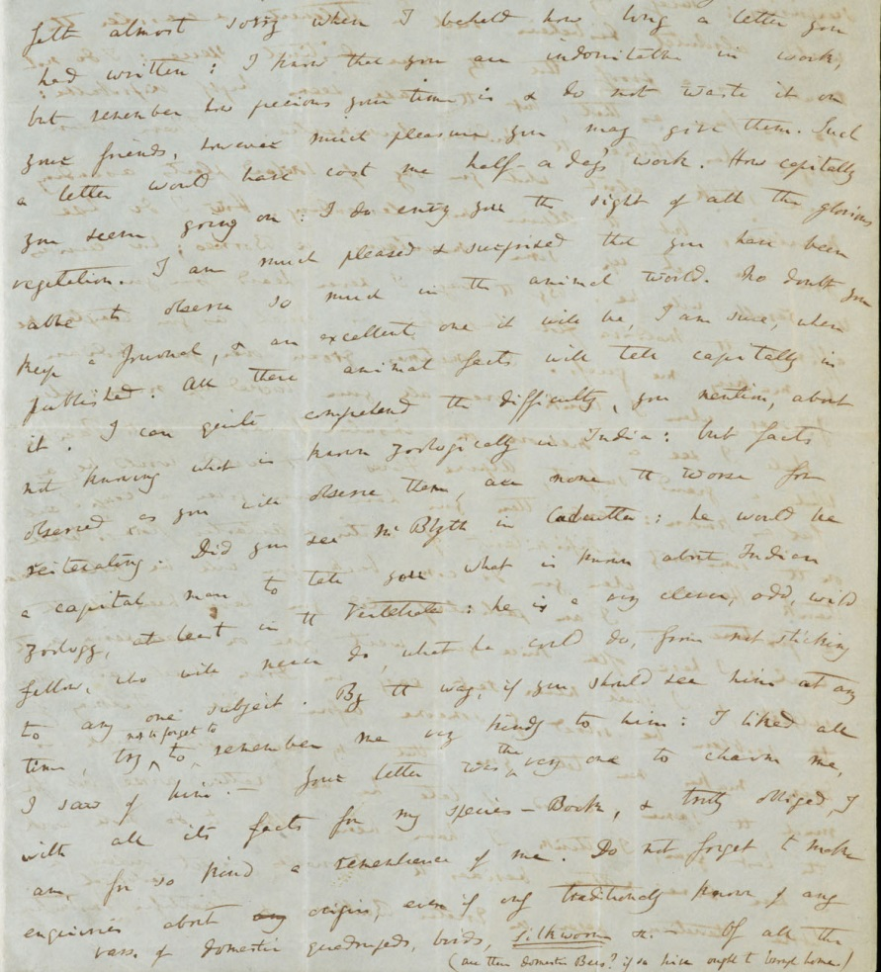
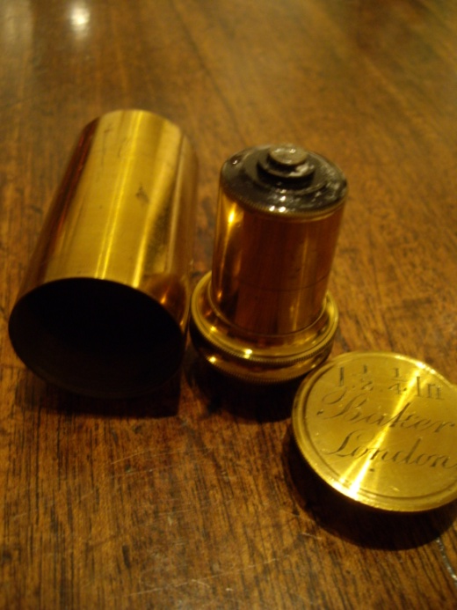
Darwin in a letter to J. D. Hooker (May 1848)
“I have got a 1/8 inch object-glass and it is grand – I have been getting on well with my beloved Cirripedia and get more skilful in dissection.”
© Carol Boulter

Slide 5
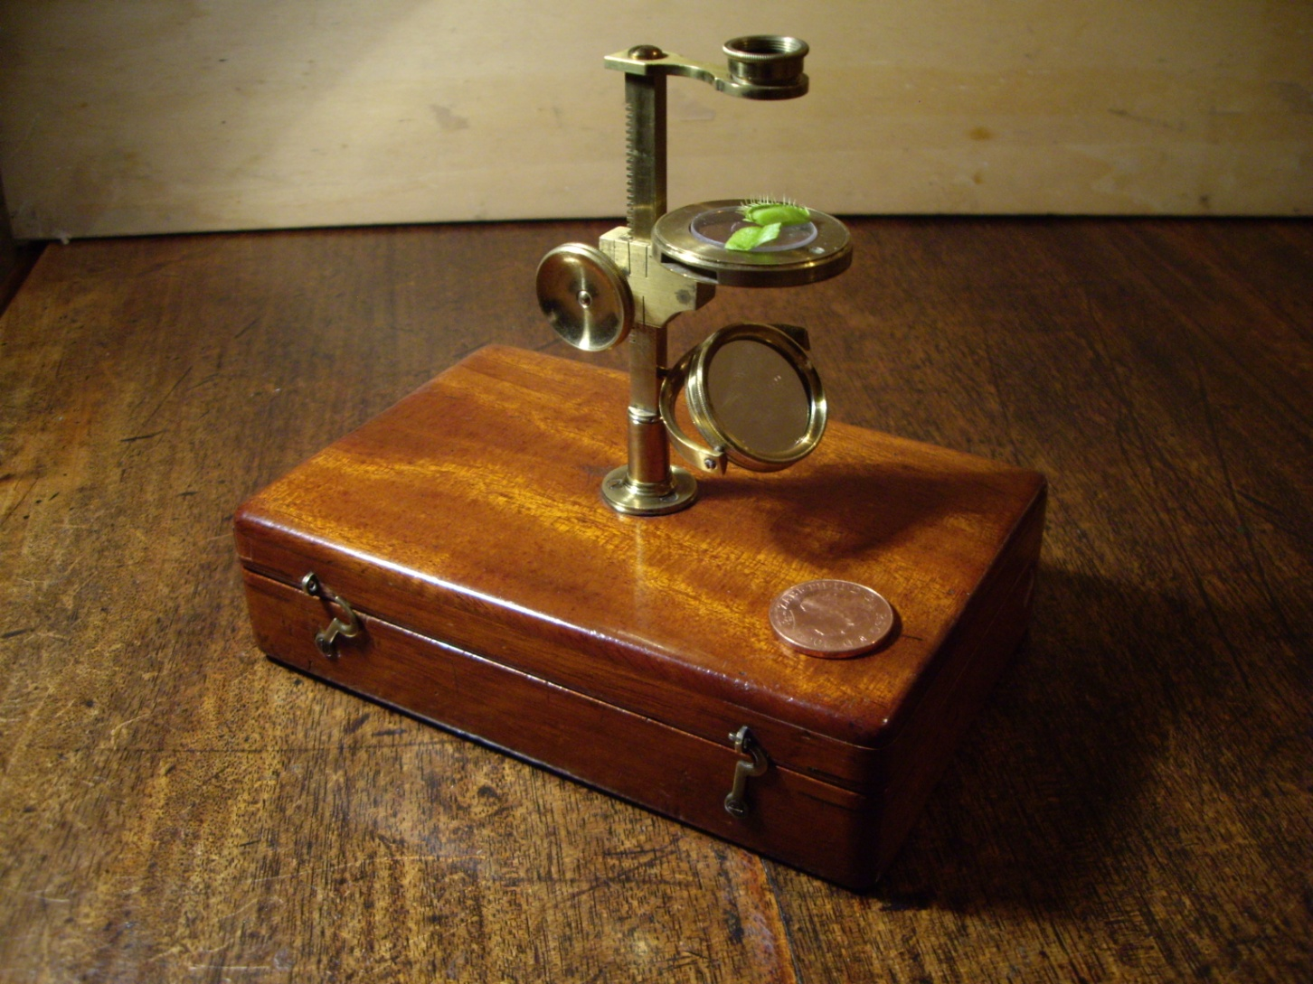
Darwin used a simple travelling microscope like this one on his Voyage of the Beagle
© Carol Boulter

Slide 6
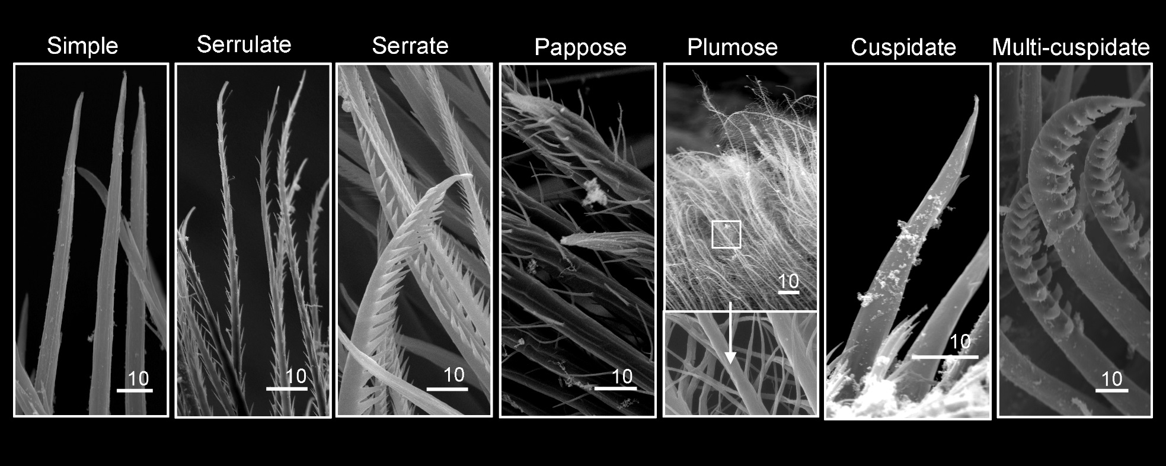
Setal types on cirri of different barnacles
Scale bars in µm
From “Setal morphology and cirral setation of thoracican barnacle cirri: adaptations and implications for thoracican evolution” (2008) Chan et al. Journal of Zoology. Vol 275 issue 3. pp 294 - 306. With author’s permission.

Slide 7
Setal type and function
Serrulate = gentle handling of prey
Serrate = rough handling of prey
Plumose = generation of water currents and creating a barrier to stop ‘food’ escaping
Pappose = generation of water currents and filter feeding
Simple = rough handling of prey
Cuspidate = rough handling of prey
Multicuspidate = rough handling of prey

Slide 8
Resolution and scale in microscopes
 | Human eye | Compound light microscope | Transmission electron microscope | Scanning electron microscope
Specimen preparation | - | Mounted alive or prepared in natural state or stained | Dry samples due to vacuum chamber Samples must be cut into very thin cross-sections | Dry samples due to vacuum chamber Samples require a coating of heavy metals
Magnification possible | - | Up to x 1,500 | 500,000x | 10x - 500,000x
Wavelength used | Light 400-750nm | Light 400-750nm | Electron beam .004nm Passes through specimen (transmitted) | Electron beam .004nm Reflects off surface of specimen
Resolution possible | 100,000nm | 200nm | 0.2nm | 0.2nm
Viewed | Directly | Viewed directly by eye/ screen based | Via micrographs or on fluorescent screen | Via micrographs or on fluorescent screen

Slide 9

Resolution and scale in microscopes
1 m = 1,000 mm (millimetres)
1 mm = 1,000 µm (micrometres)
1 µm = 1,000 nm (nanometres)
Viruses range in size from 40 - 100nm
Ribosomes are around 20nm
Bacteria range in size from 500 - 5,000nm
© Carol Boulter

Slide 10
Resolution and scale in microscopes - discuss
How many µm in 1 metre?
What fraction of a metre is 1nm?
Would it have been possible for Darwin to see bacteria and viruses with his compound light microscope?

Slide 11
The future of barnacle taxonomy
The barnacle family tree is far from settled as scientists marry morphological, physiological and molecular evidence from the known barnacles
Large groups of barnacles, such as those that attach to whales, those in deep sea vents and those in the deep ocean, have yet to be investigated

