Slide 1
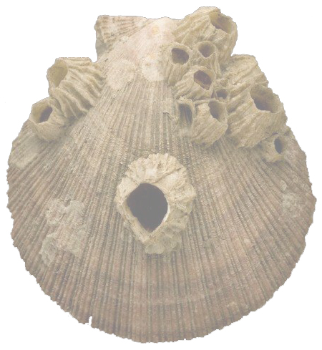


Brilliant Barnacles
Evidence for evolutionary relationships
Lesson 2
Building the tree of life –
molecular evidence
Cover image © The Linnean Society

Slide 2
Linnaeus’ hierarchical naming system
Binomial nomenclature
The use of only two words (the binomial) made it much easier to categorise and compare different plants and animals
Imagine, for instance, talking about a type of geranium using the old name:
Geranium pedunculis bifloris,
caule dichotomo erecto,
foliis quinquepartitis incisis;
summis sessilibus
The binomial is much easier to use:
Geranium maculatum

Slide 3
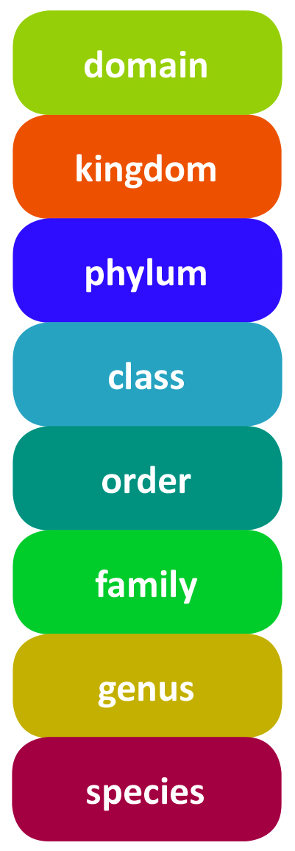
Linnaeus’ hierarchical naming system
For example, humans would be classified as follows:
Domain: Eukaryota
Kingdom: Animalia
Phylum: Chordata
Class: Mammalia
Order: Primates
Family: Hominidae
Genus: Homo
Species: sapiens

Slide 4
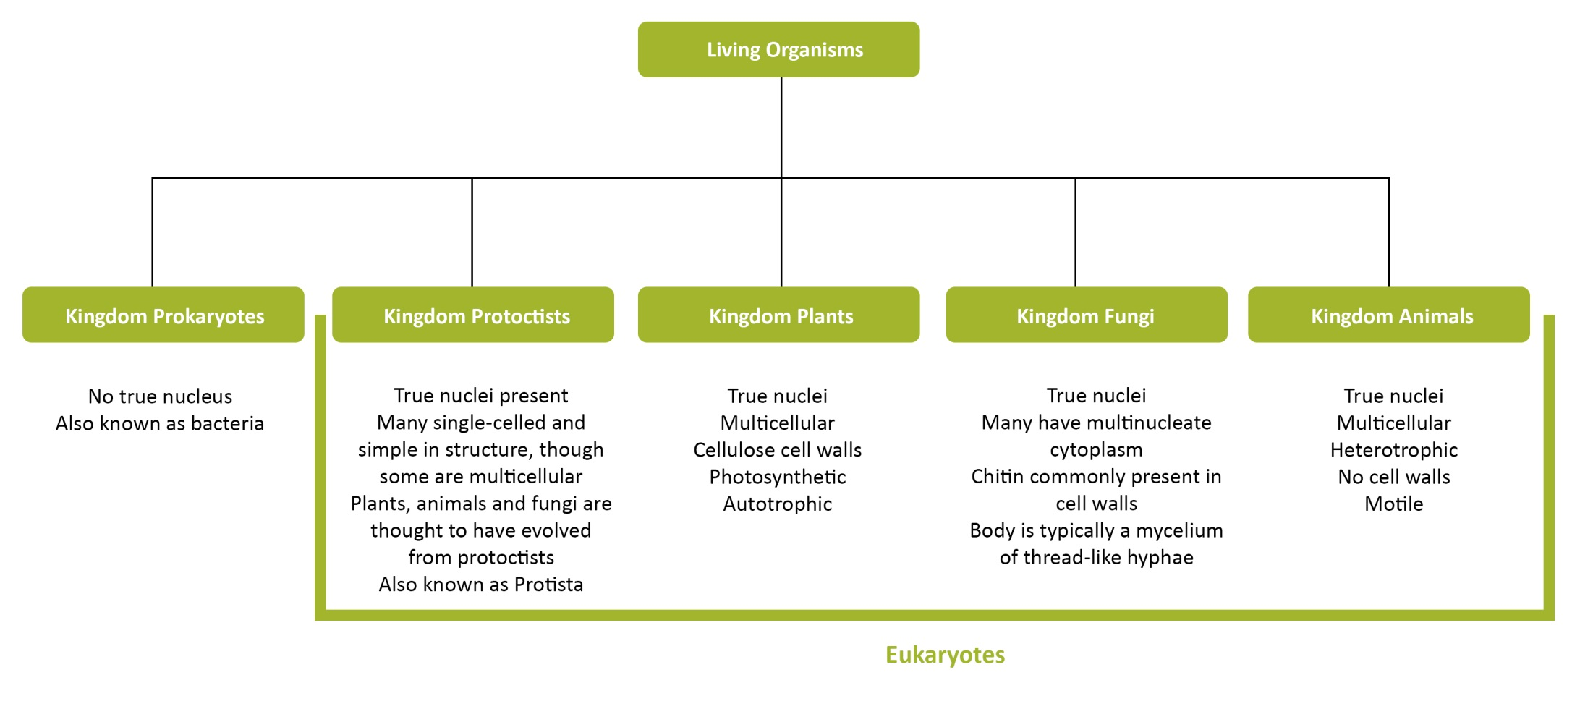
The five kingdoms of living things

Slide 5
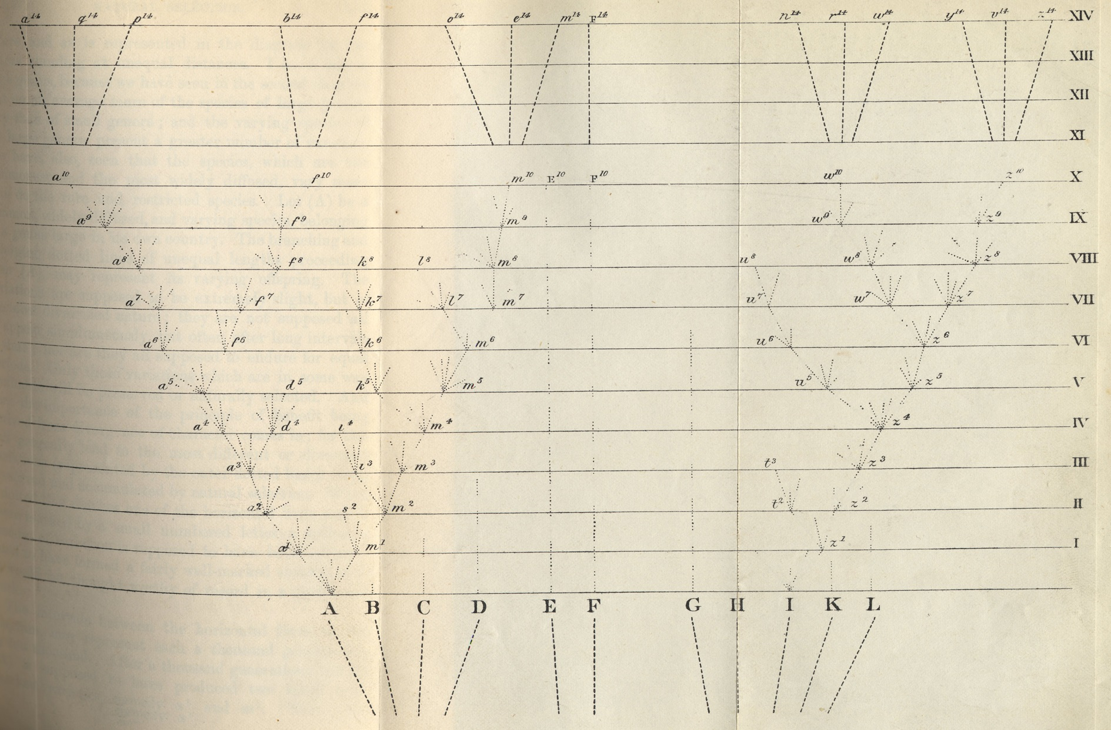
The only illustration in On the Origin of Species

Slide 6
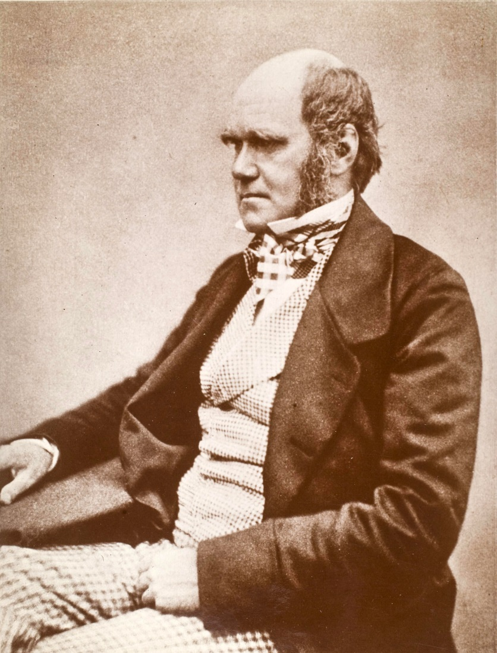
What Darwin said about his Tree of Life
“The affinities of all the beings of the same class have sometimes been represented by a great tree. I believe this simile largely speaks the truth. The green and budding twigs may represent existing species...”
“As buds give rise by growth to fresh buds and these if vigorous branch out and overtop on all sides many a feebler branch, so by generation, I believe, it has been with the great Tree of Life which fills with its dead and broken branches the crust of the earth and covers the surface with its ever branching and beautiful ramifications”.
Charles Darwin
On the Origin of Species, 1859

Slide 7
How did Darwin study barnacles?
Studying specimens he had brought back from his time on HMS Beagle
Obtaining further specimens from his worldwide network of contacts
Using simple observation
Using a simple light microscope to see barnacle anatomy in greater detail
Dissecting barnacles to look at internal morphology – paying special attention to their reproductive systems and life histories
Hatching eggs and watching as the nauplii emerged and developed, becoming cyprids before settling down to a sessile life

Slide 8
Sources of evidence
Fossils
External morphology e.g. number of plates
Internal morphology e.g. oviducts
Life histories e.g. larval stages, number of plates as adult develops
Distribution e.g. location and type of habitat

Slide 9
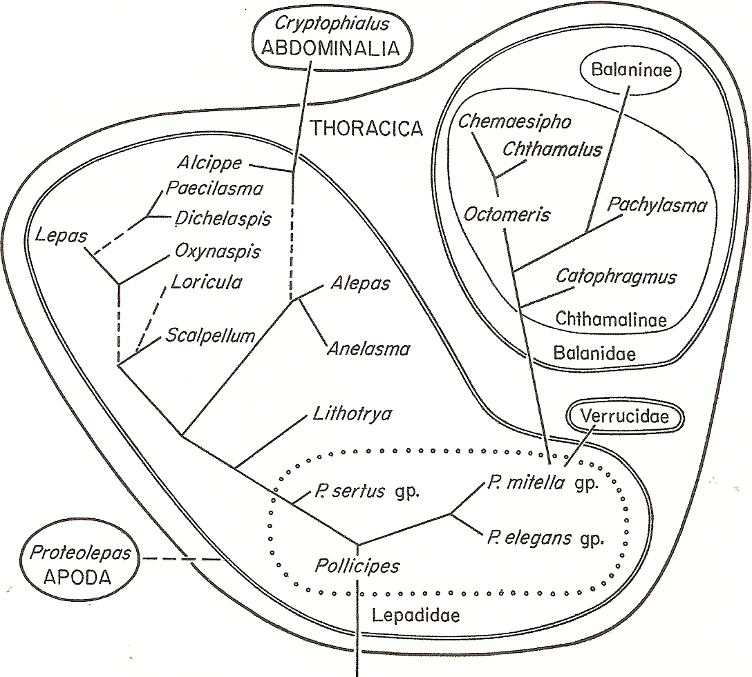
Ghiselin’s illustration of Darwin’s work
Figure from Ghiselin, M.T., Phylogenetic Classification in Darwin’s Monograph on the Sub-Class Cirripedia, Systematic Biology, 1973, Vol 22, Issue 2, p 137, by permission of Oxford University Press.

Slide 10
What Darwin didn’t know:
New evidence for building phylogenetic trees
DNA and RNA sequences
Protein sequences
Mitochondrial DNA sequences
Electron microscopy of morphological features

Slide 11
Limitations of phylogenetic trees
Based on morphology
The same morphological feature can evolve independently – convergent evolution may have occurred
Particular features, such as plates, can also be lost during evolution.
Based on molecular data
There may have been horizontal gene transfer - this would not show in the gene sequence data.

Slide 12
Definitions and key words regarding classification
Classification is a process of sorting things into groups based on shared/similar characteristics.
Taxonomy is the study of the principles behind classification
Phylogenetics is the study of evolutionary relationships between groups of organisms

Slide 13
How does classification relate to phylogeny?
Think about:
Taxonomy
Taxa
Phylogenetic trees
Common ancestors
Binomial nomenclature

