Slide 1
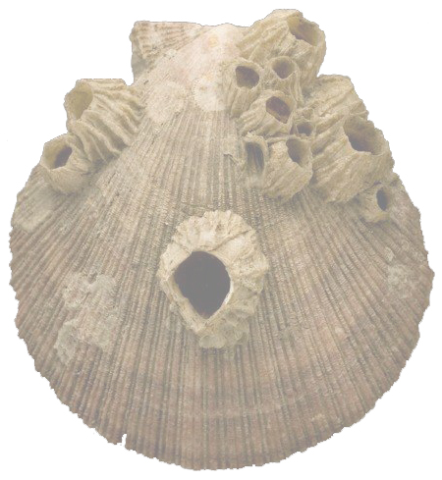


Brilliant Barnacles
Evidence for evolutionary relationships
Lesson 1
Morphology and life
histories of barnacles
Cover image © The Linnean Society

Slide 2
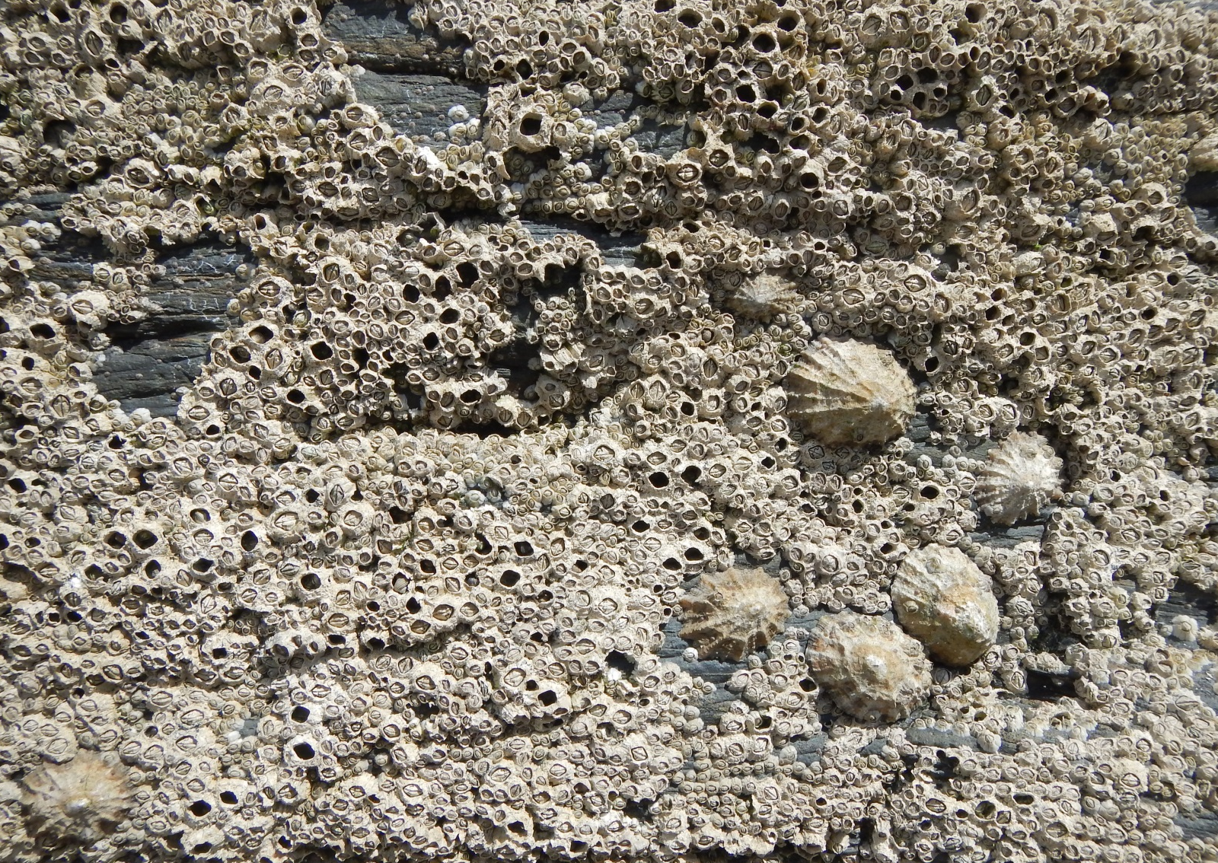
Sessile barnacles and limpets on rocks
© Mair Shepherd

Slide 3
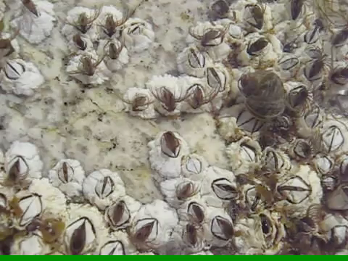
Living sessile barnacles when the tide is in
© Kim Hansen (commons.wikimedia.org)
Video URL: http://en.wikipedia.org/wiki/File:Semibalanus_balanoides_upernavik_2007-07-05.ogg

Slide 4
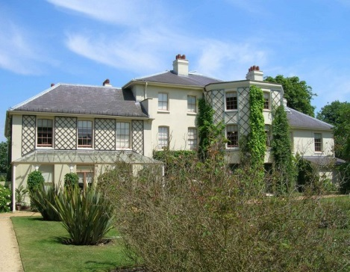
Down House in Kent where Darwin lived
(1842-1882)
© David P Howard (geograph.org.uk)

Slide 5
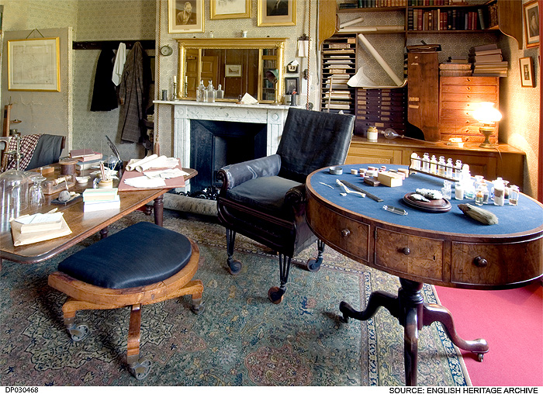
Darwin’s Study at Down House
© English Heritage

Slide 6
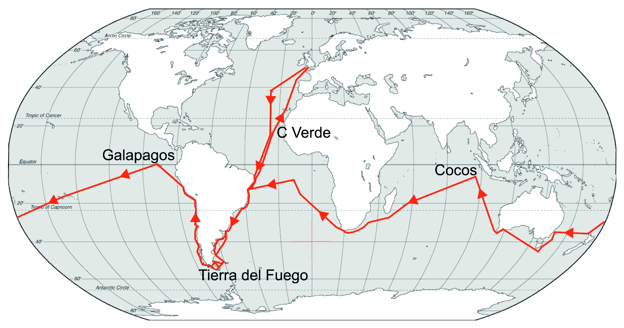
Darwin’s voyage on the Beagle (1831-1836)
Original image courtesy of Dr Eve C. Southward

Slide 7
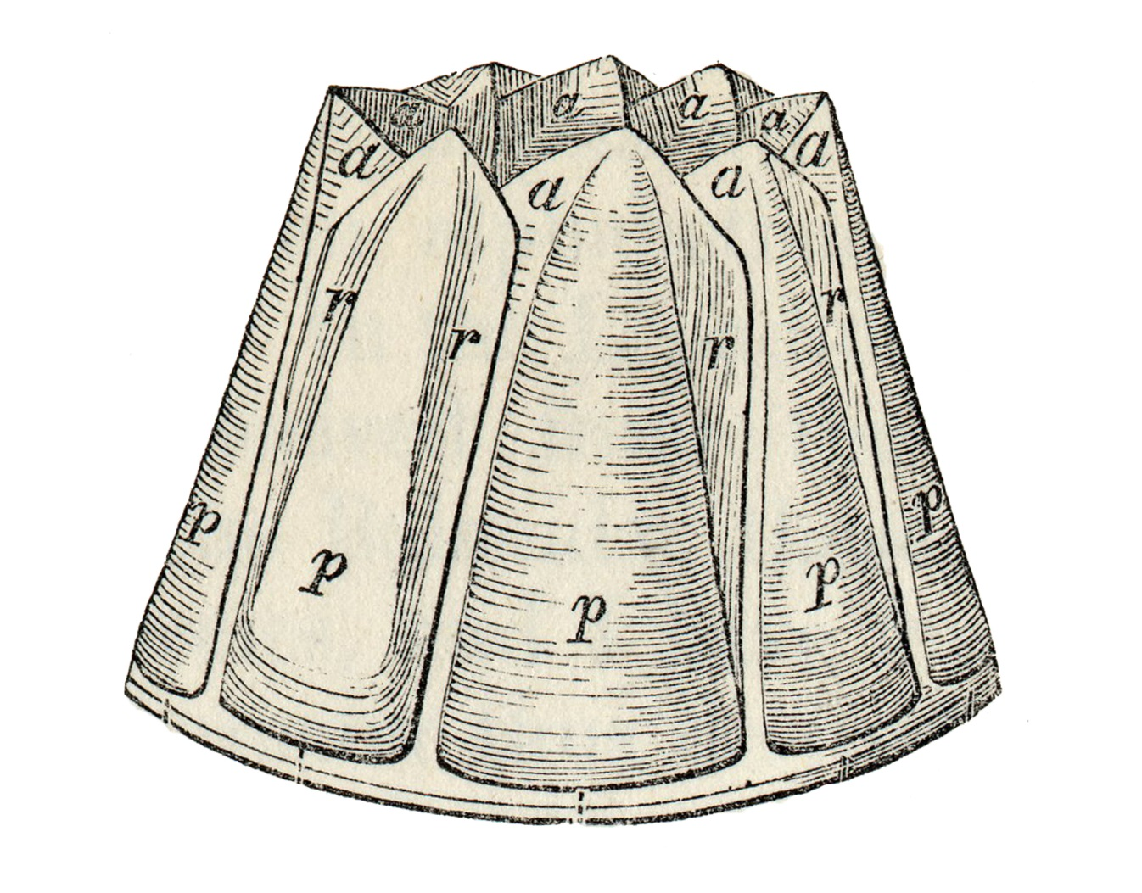
Darwin’s barnacle external: What is it?
From Living Cirripedia: The Balanidae (1854)

Slide 8
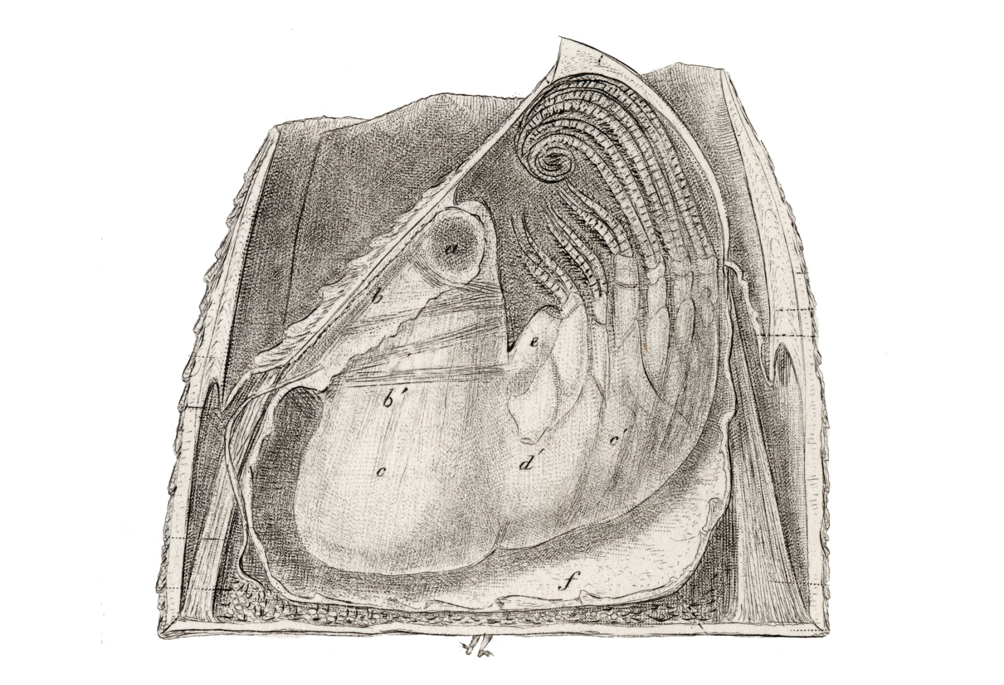
Darwin’s barnacle dissected: What is it?
From Living Cirripedia: The Balanidae (1854)

Slide 9
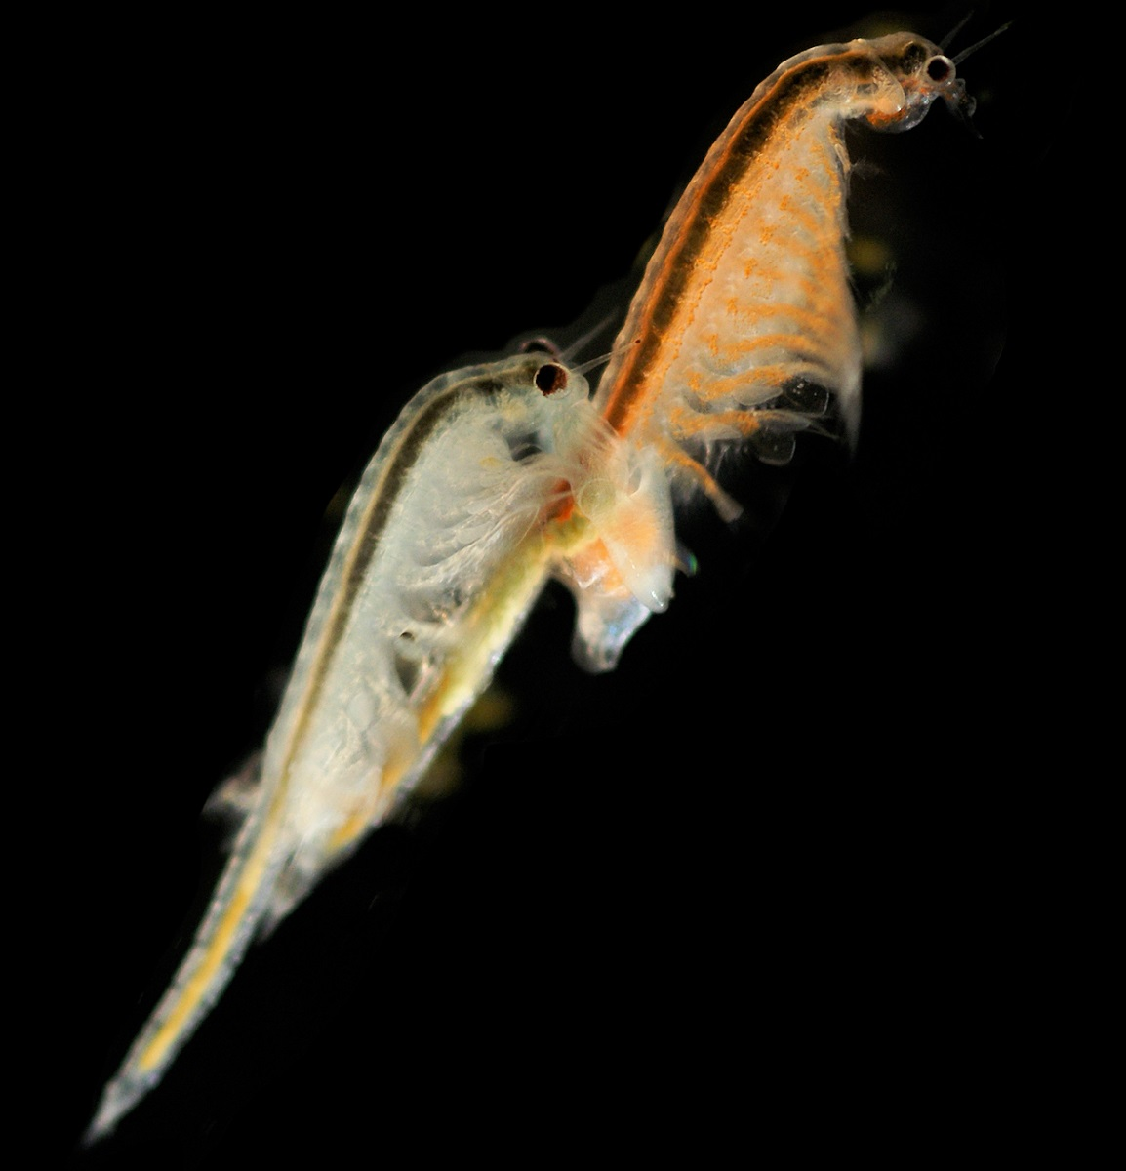
Adult brine shrimps
Artemia salina
Female adult brine shrimp
Male adult
brine shrimp
© Hans Hillewaert (commons.wikimedia.org)

Slide 10
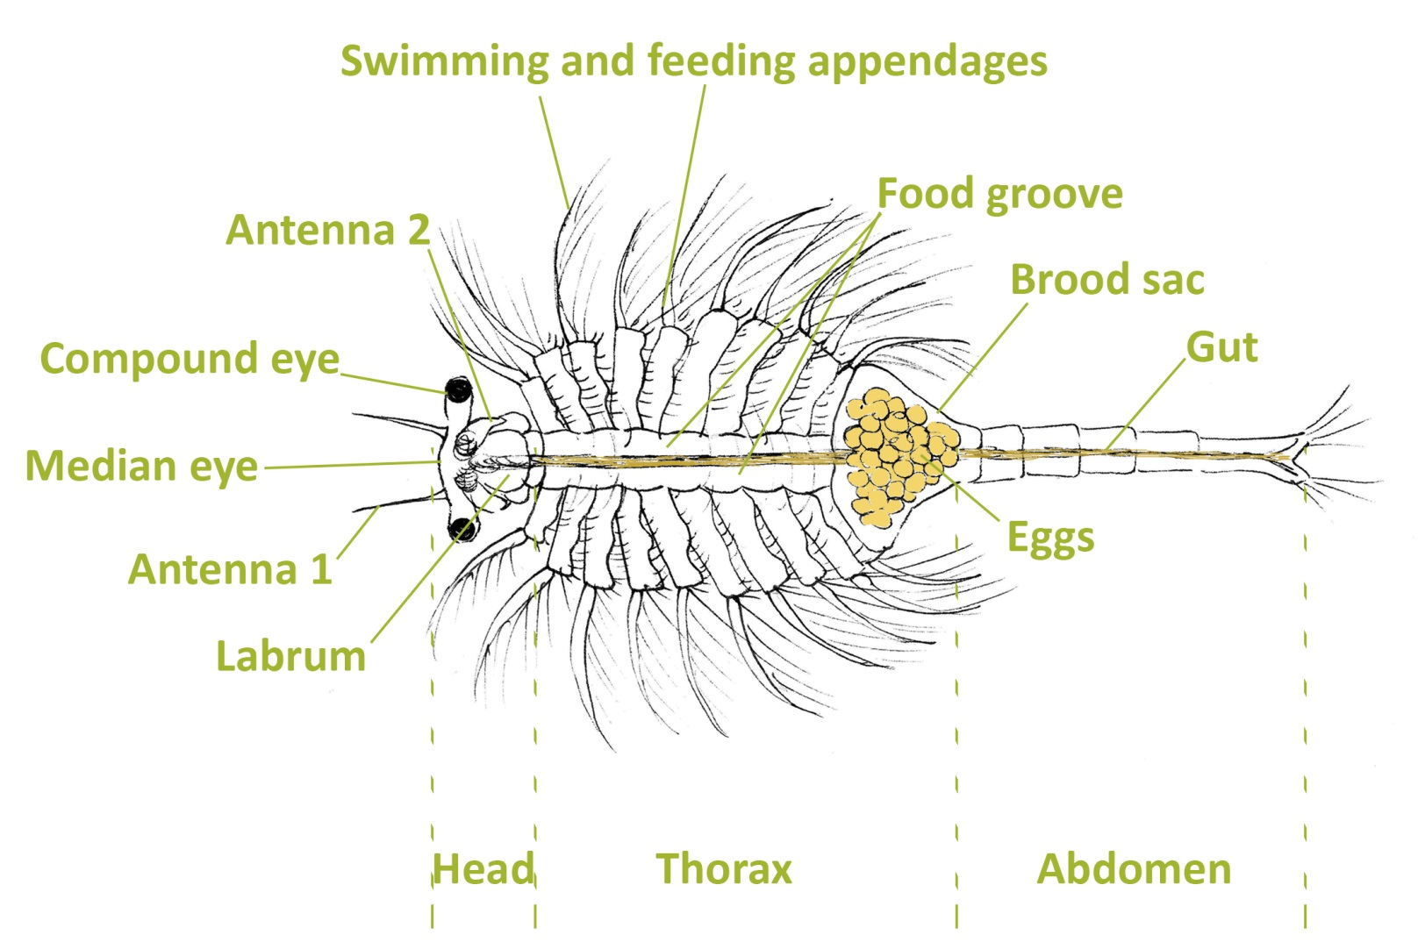
Brine shrimp structure (female)
Original drawing © Helen Cowdy

Slide 11
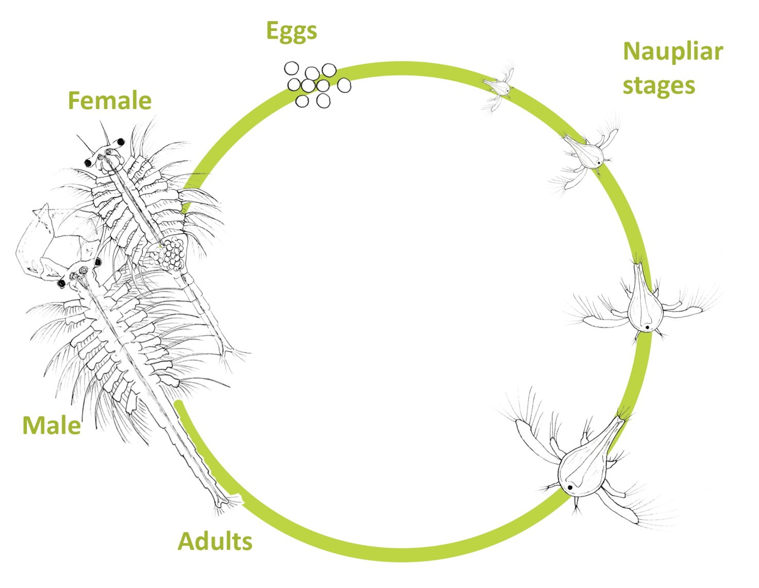
Brine shrimp life cycle
Original drawings © Helen Cowdy

Slide 12
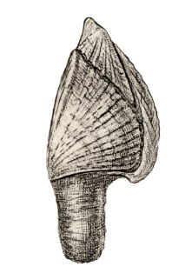
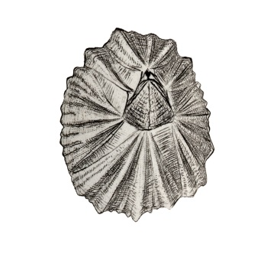
Goose barnacles and acorn barnacles
Goose barnacle
From Living Cirripedia: The Lepadidae (1851)
Acorn barnacle
From Living Cirripedia: The Balanidae (1854)

Slide 13
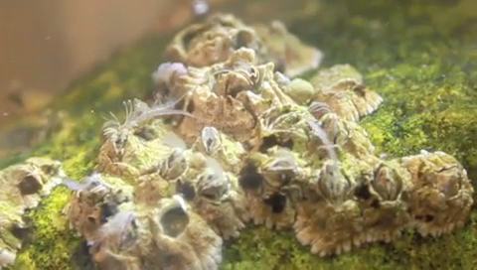
Mating barnacles
Barnacles have solved the problem of being sessile by evolving the longest penis relative to their body size of any animal. In this video the penises of several barnacles are probing the neighbourhood for mates.
Video URL: https://vimeo.com/7461478
© Stefan Siebert

Slide 14
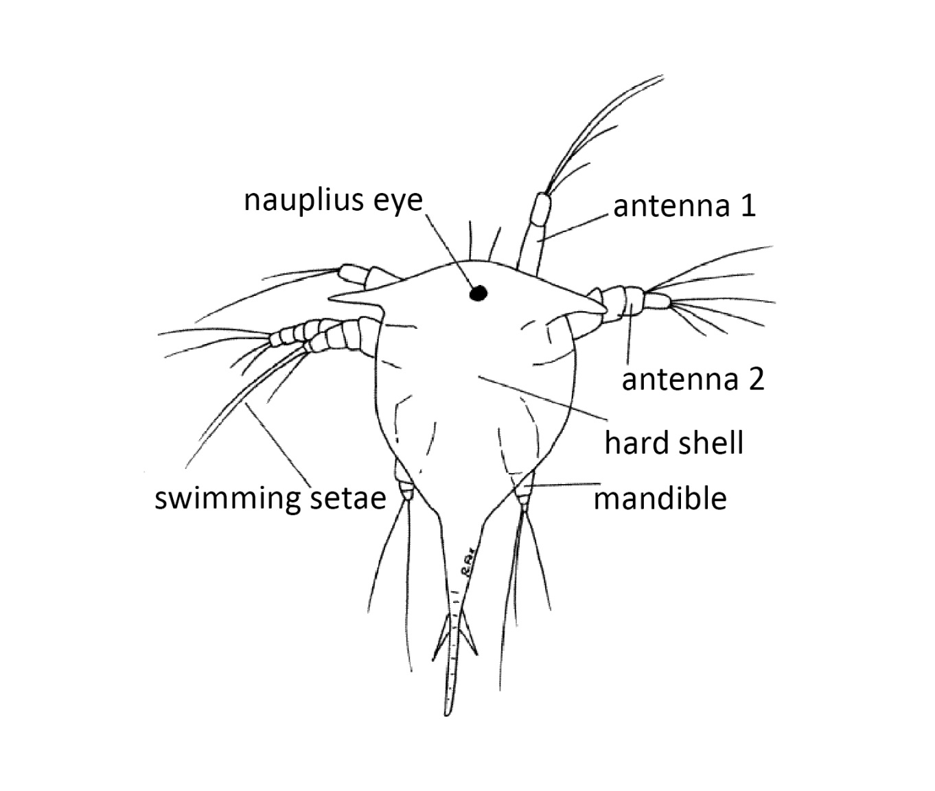
Nauplius of a barnacle
© Richard Fox

Slide 15
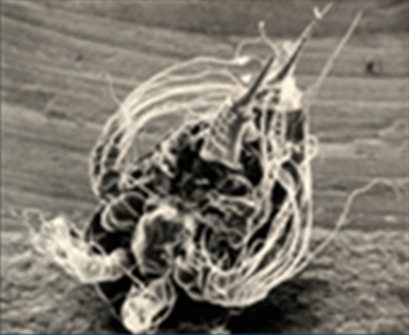
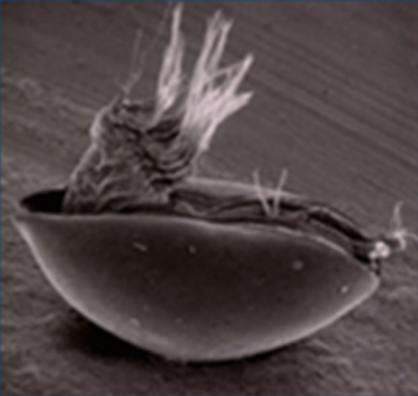
Nauplius and cypris of a barnacle
© P S Rainbow
© P S Rainbow

Slide 16
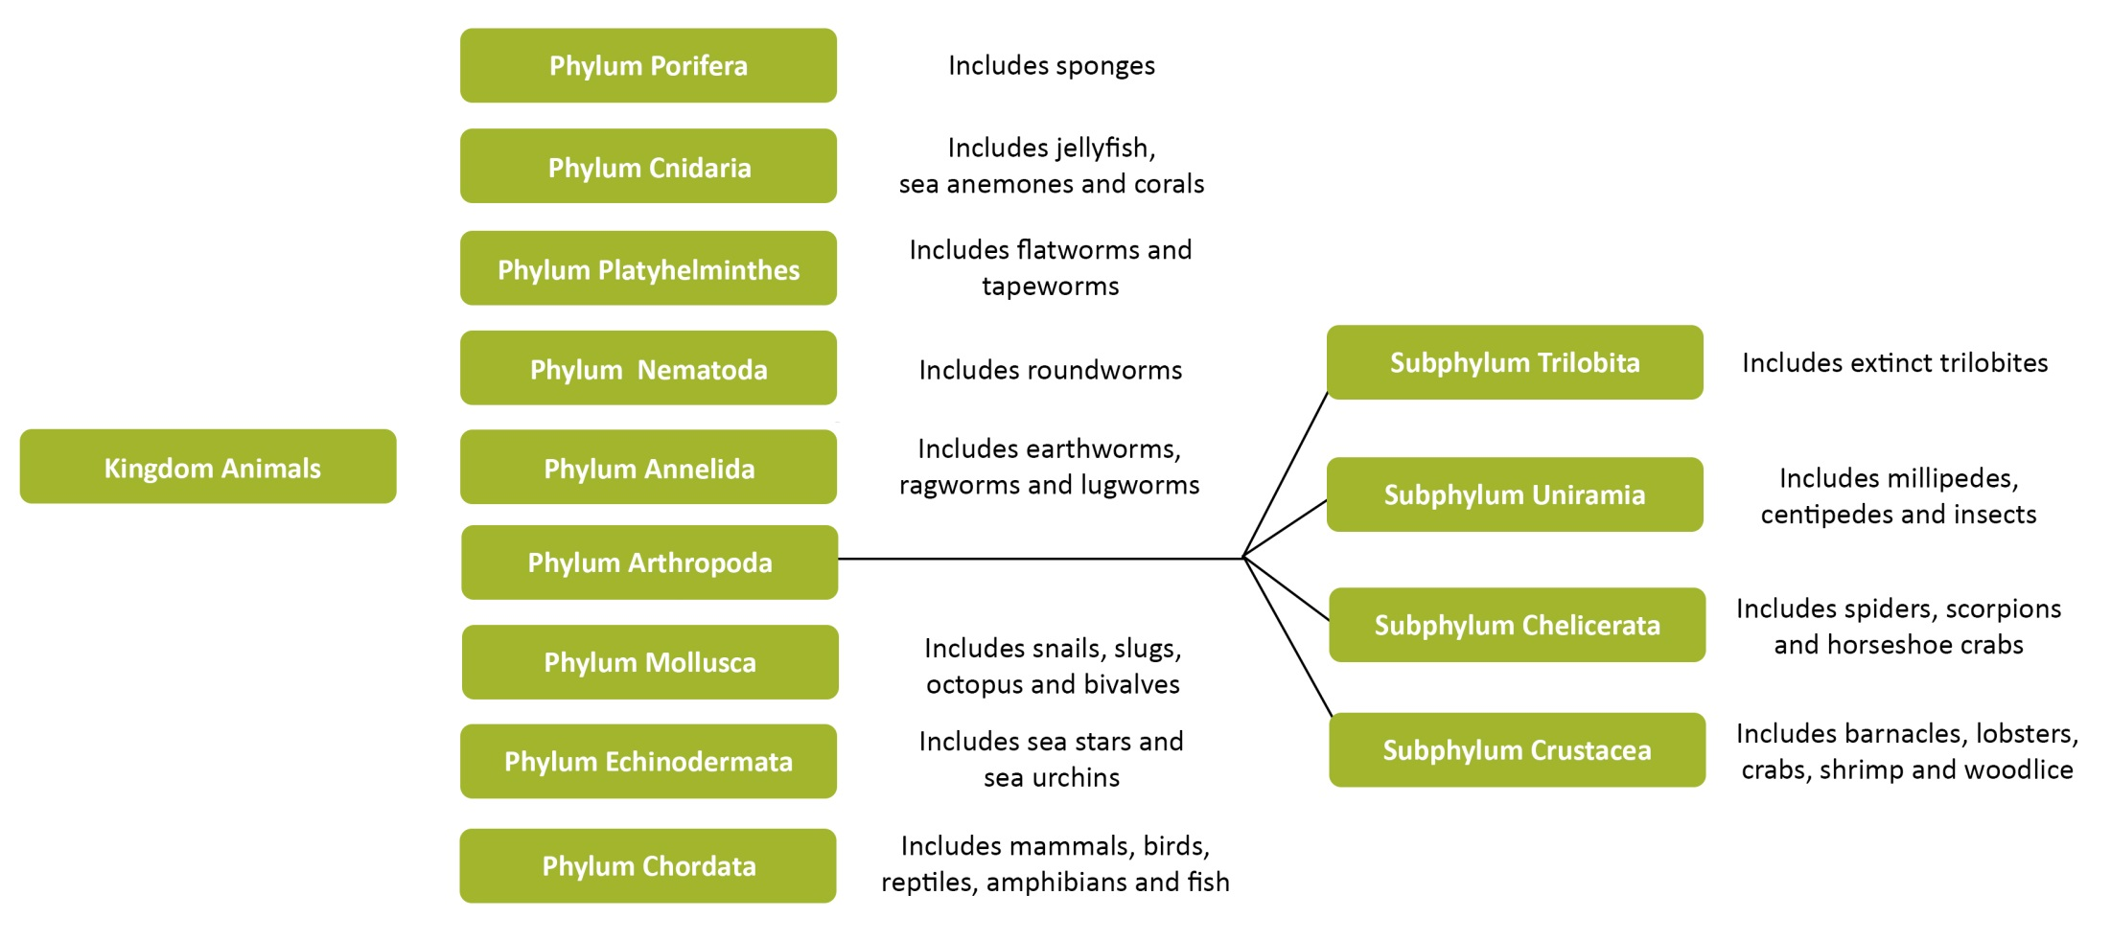
Arthropod classification

Slide 17
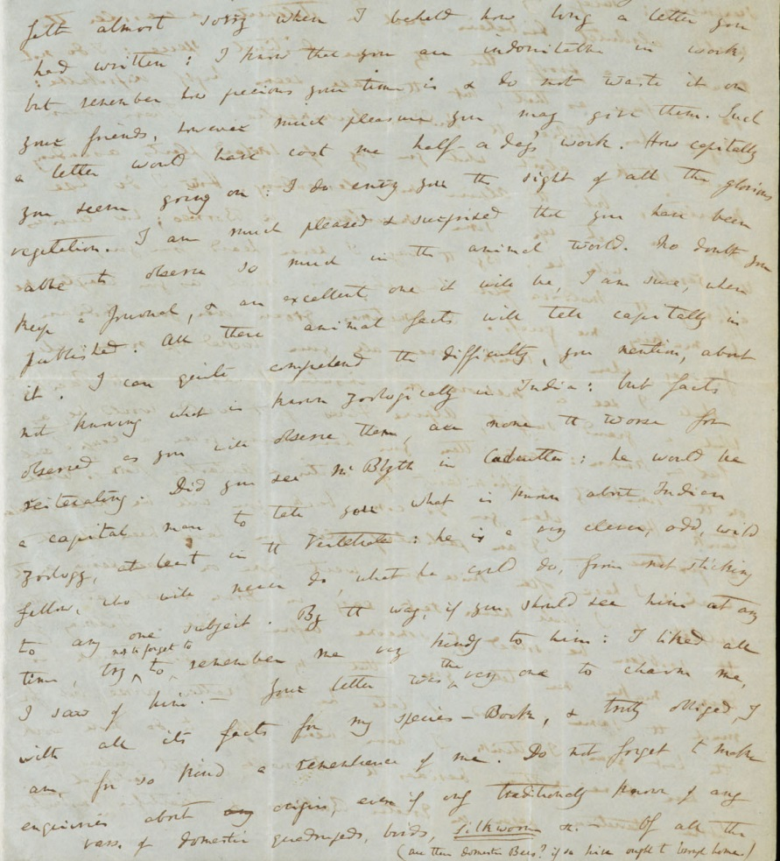
Darwin in a letter to J. D. Hooker (6 Oct 1848)
“I have been delighted of late in having
made out minutely the metamorphoses & consequently without any theory the homologies with ordinary crustacea. The shell of a Balanus, & even the whole peduncle & shell of Lepas is certainly the 3 anterior segments of the head, wonderfully modified & enlarged so as to receive the 14 succeeding cephalic, thoracic & abdominal segments; I declare I know of no more surprising metamorphosis, & it is perfectly clear & evident.—Heaven forgive me for inflicting on you such a lecture on Barnacles…”

Slide 18
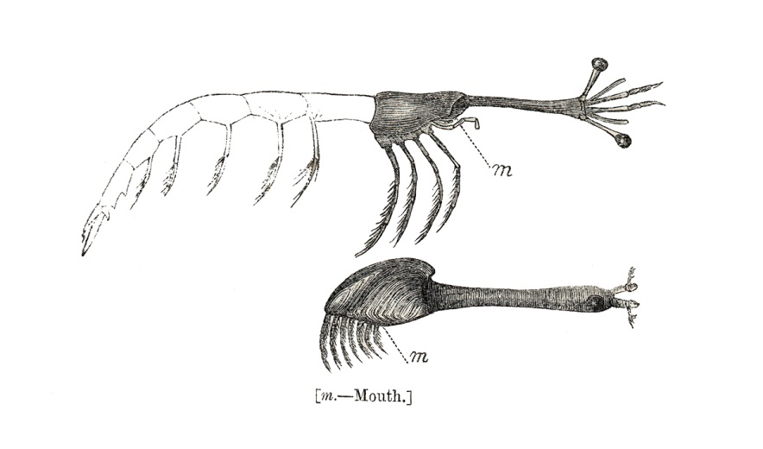
Homologies between an ancestral crustacean
and a stalked barnacle
From Living Cirripedia: The Lepadidae (1851)

Slide 19
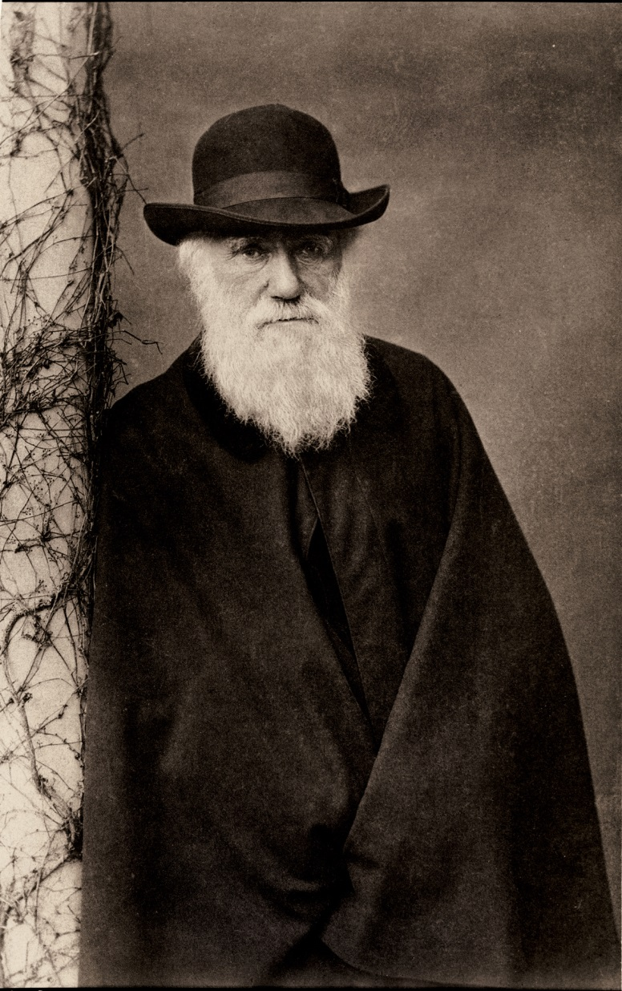
Darwin wrote about his barnacle work in old age
“In October, 1846, I began to work on ‘Cirripedia’. When on the coast of Chile, I found a most curious form, which burrowed into the shells of Concholepas, and which differed so much from all other Cirripedes that I had to form a new sub-order for its sole reception. Lately an allied burrowing genus has been found on the shores of Portugal. To understand the structure of my new Cirripede I had to examine and dissect many of the common forms; and this gradually led me on to take up the whole group. I worked steadily on this subject for the next eight years, and ultimately published two thick volumes, describing all the known living species, and two thin quartos on the extinct species.”
Charles Darwin
The life and letters of Charles Darwin, including an autobiographical chapter, Volume 1., Darwin, F (Ed.), 1887

