Slide 1
www.CHEMSHEETS.co.uk
RELATIVE RATES
© www.chemsheets.co.uk AS 1032 26-Jun-2016

Slide 2
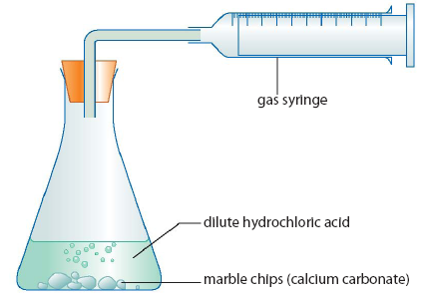
RELATIVE REACTION RATES
 | CaCO₃ | [HCl] (mol dm⁻³) | Volume HCl (cm³) | Temperature (°C)
1 | small | 2 | 100 | 20
2 | large | 2 | 100 | 20
3 | large | 2 | 50 | 20
4 | small | 4 | 50 | 20

Slide 3
 | CaCO₃ | [HCl] (mol dm⁻³) | Volume HCl (cm³) | Temperature (°C)
1 | small | 2 | 100 | 20
2 | large | 2 | 100 | 20
3 | large | 2 | 50 | 20
4 | small | 4 | 50 | 20
Volume of CO₂
4
1
2
3
Time
© www.chemsheets.co.uk AS 1032 26-Jun-2015

Slide 4
RELATIVE REACTION RATES
 | CaCO₃ | [HCl] (mol dm⁻³) | Volume HCl (cm³) | Temperature (°C)
1 | small | 2 | 100 | 20
2 | large | 2 | 100 | 20
3 | large | 2 | 50 | 20
4 | small | 4 | 50 | 20
5 | large | 1 | 100 | 20
6 | small | 2 | 200 | 40
7 | powder | 2 | 200 | 40
© www.chemsheets.co.uk AS 1032 26-Jun-2015

Slide 5
RELATIVE REACTION RATES
Volume of CO₂
4
1
2
3
5
Time
© www.chemsheets.co.uk AS 1032 26-Jun-2015

Slide 6
RELATIVE REACTION RATES
 | CaCO₃ | [HCl] (mol dm⁻³) | Volume HCl (cm³) | Temperature (°C)
1 | small | 2 | 100 | 20
2 | large | 2 | 100 | 20
3 | large | 2 | 50 | 20
4 | small | 4 | 50 | 20
5 | large | 1 | 100 | 20
6 | small | 2 | 200 | 40
7 | powder | 2 | 200 | 40
© www.chemsheets.co.uk AS 1032 26-Jun-2015

Slide 7
RELATIVE REACTION RATES
Volume of CO₂
6
4
1
2
3
5
Time
© www.chemsheets.co.uk AS 1032 26-Jun-2015

Slide 8
RELATIVE REACTION RATES
 | CaCO₃ | [HCl] (mol dm⁻³) | Volume HCl (cm³) | Temperature (°C)
1 | small | 2 | 100 | 20
2 | large | 2 | 100 | 20
3 | large | 2 | 50 | 20
4 | small | 4 | 50 | 20
5 | large | 1 | 100 | 20
6 | small | 2 | 200 | 40
7 | powder | 2 | 200 | 40
© www.chemsheets.co.uk AS 1032 26-Jun-2015

Slide 9
RELATIVE REACTION RATES
Volume of CO₂
7
6
4
1
2
3
5
Time
© www.chemsheets.co.uk AS 1032 26-Jun-2016

