Slide 1
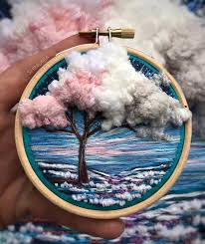
Year 12 Home learning
Complete a response for your Vera Shimunia work, it must include colour and texture, it can either be a copy of one of her pieces or it can be based on a landscape you have chosen
Annotate the work, how did you do it, how does it link to Vera Shimunia’s work.
Remember, this is your real coursework, this is not just to fill your time!

Slide 2
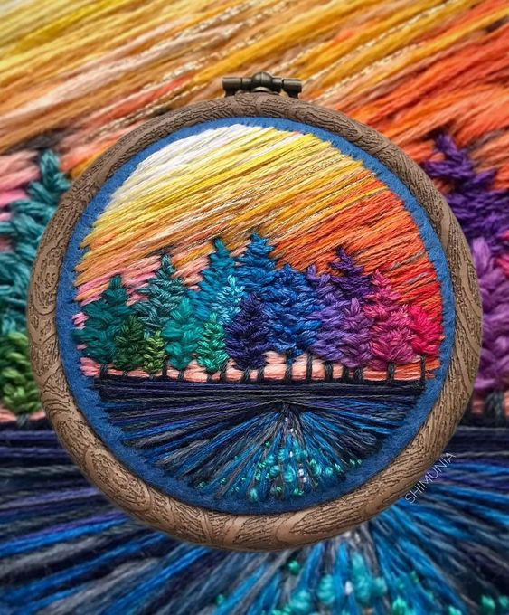
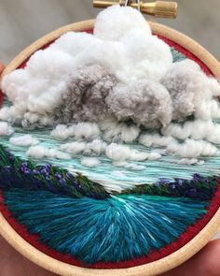
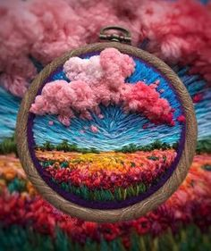
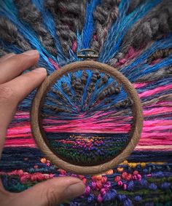
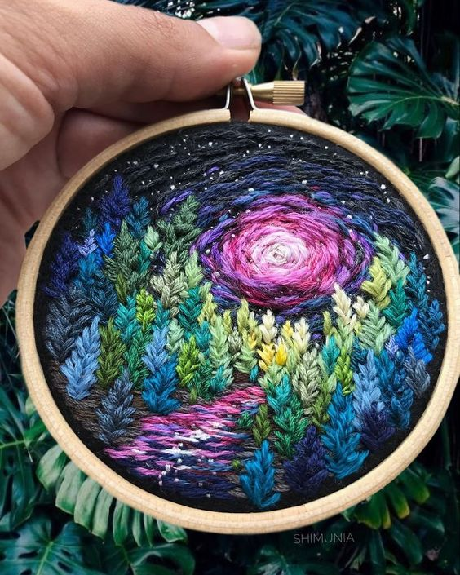
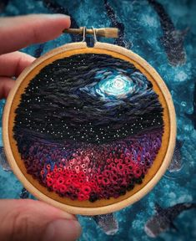
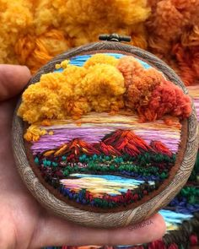
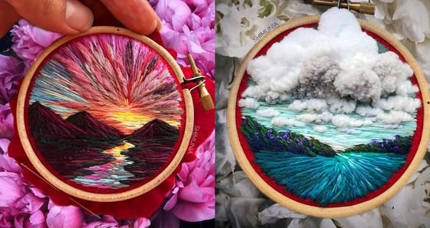
Examples of Vera Shimunia’s work

