Slide 1
Research material
MAKE SURE YOU LIVE SPACE IN YOUR BOOK FOR YOUR DEVELOPED IDEA SHOOT!

Slide 2
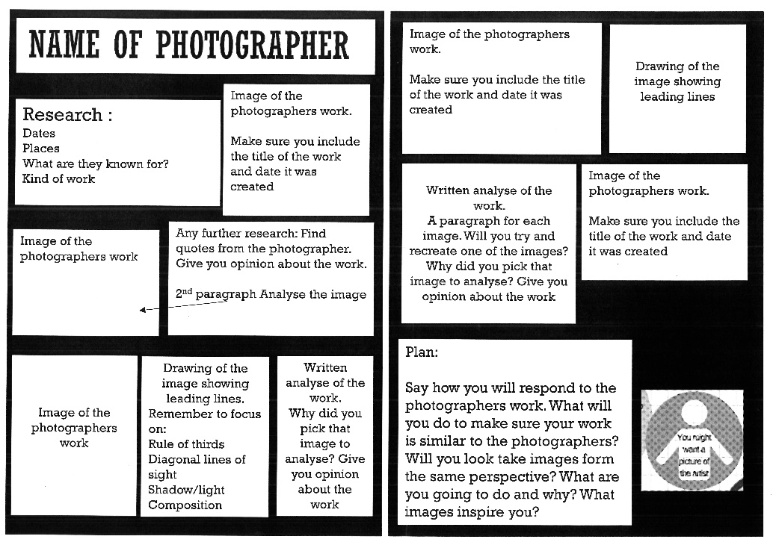
Research layout
If you run out of space in your book you will need to create a research page using PowerPoint.
Choose a photographer that most inspires you. It doesn’t have to be from the powerpoint. Feel free to do some of your own research. Remember it must relate to what you have said on you developed ideas page. Think carefully about what you can photograph before you begin. Think carefully about the resources that you have available to you!

Slide 3
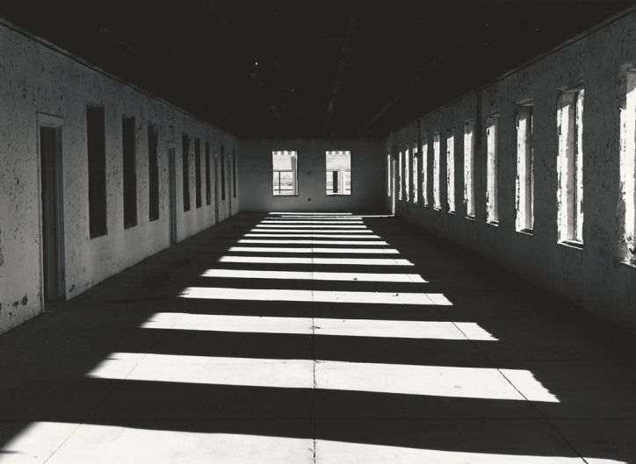
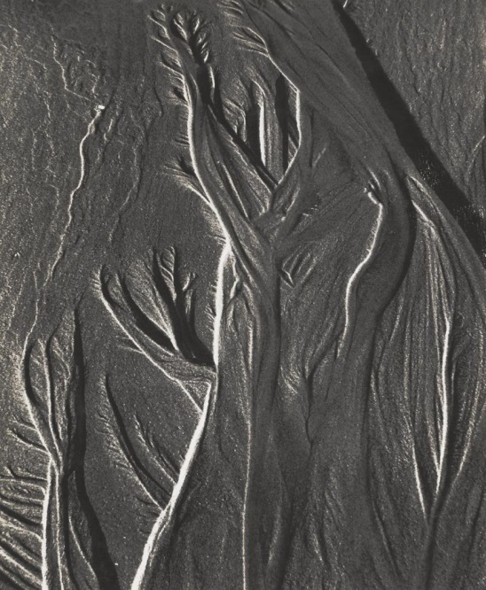
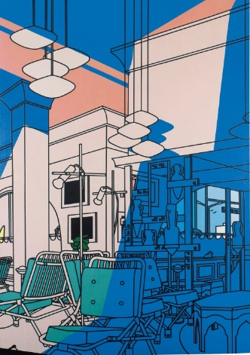
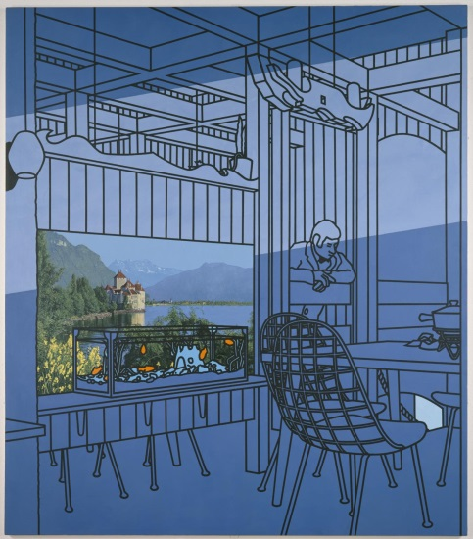
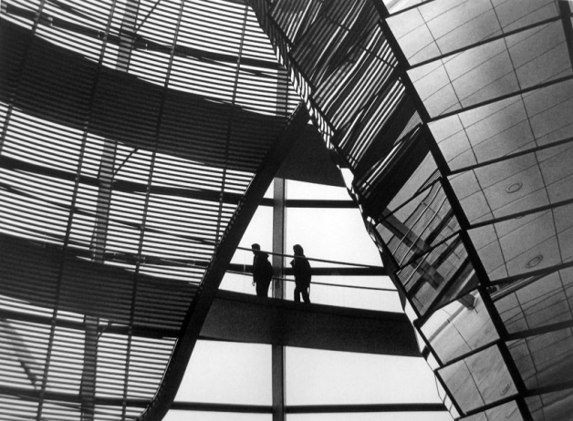
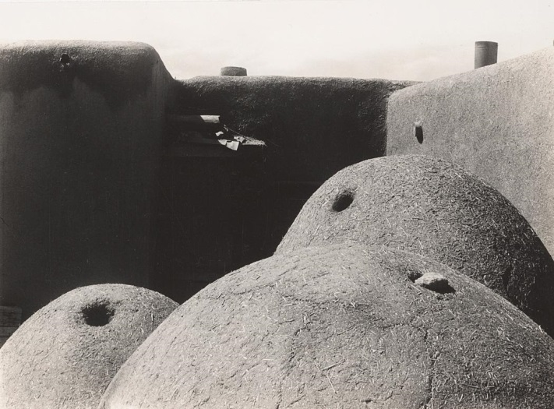
Sonya Noskowiak
Judith Turner
Patrick Caulfield
Lucy Shires

Slide 4
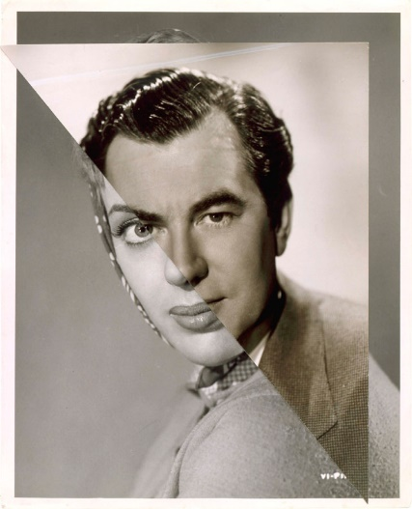
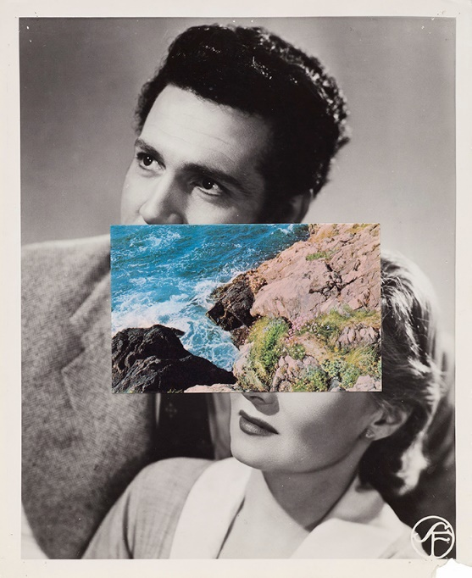
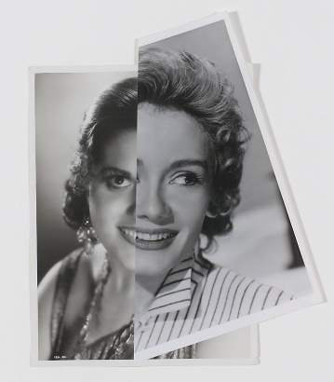
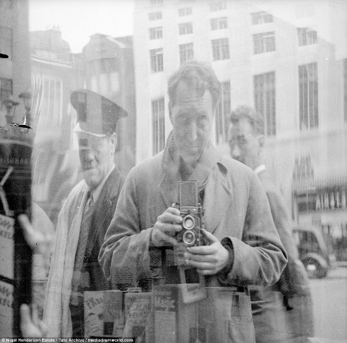
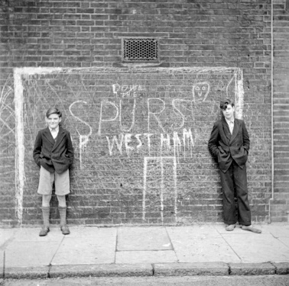
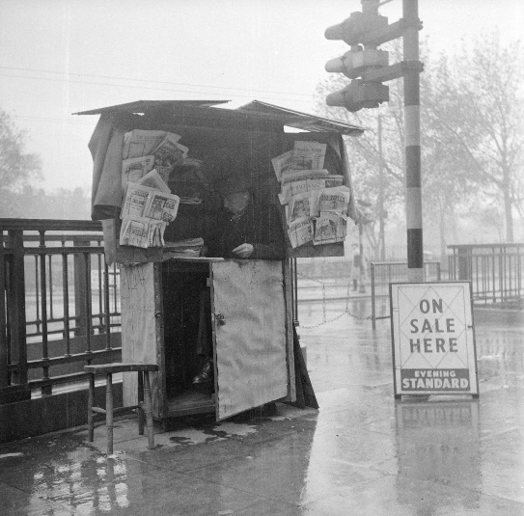
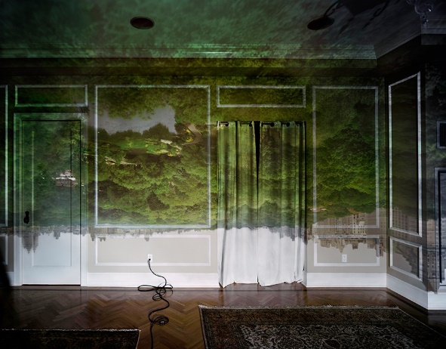
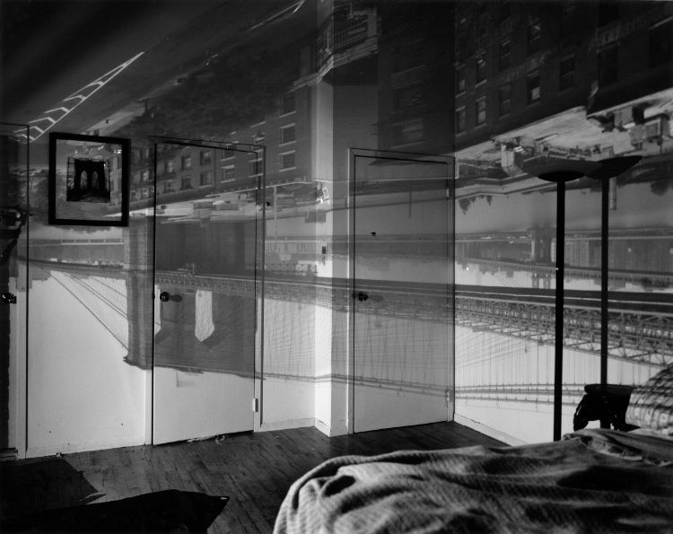
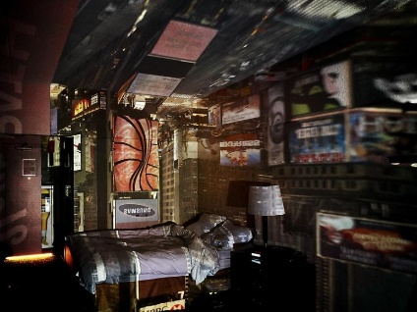
John Stezaker
Conceptual artist
Nigel Henderson
Artist
Nigel Henderson was an English documentary artist, and photographer.
Abelardo Morell is a Boston-based photographer represented by Edwynn Houk Gallery in New York City

Slide 5
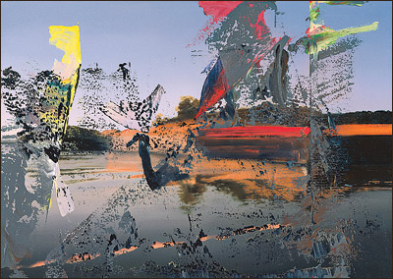
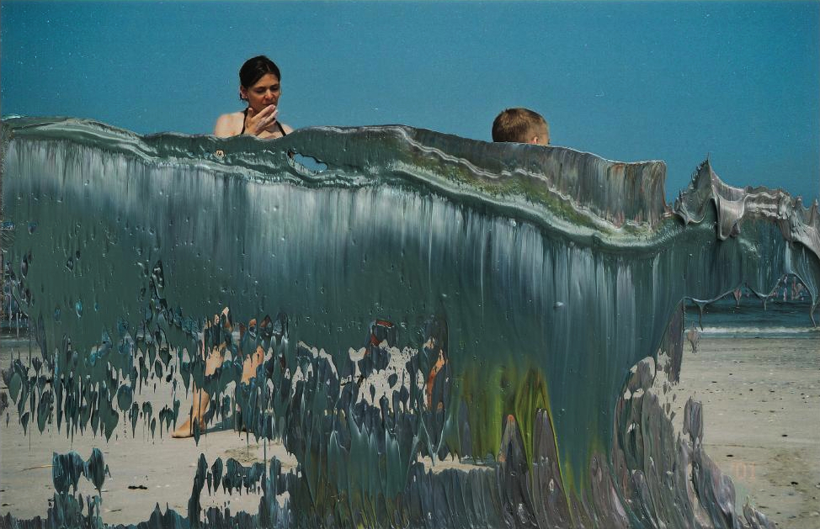
Gerhard Richter- overpainted photographs
Fragmentation
Small format
Working with his own photographs printed as 10 x 15 cm quick prints as anyone would get from a commercially developed roll of film, he uses left over paint from a day's work scraped from canvasses and applies it to the photographs via pallete knives and doctor's blades. The application is done in an instant, the works are completed with spontaneity and with irreversible gestures. Those judged unsuccessful are immediately destroyed. This exercise, for lack of a better term, has produced over one thousand images from which 400 are reproduced.

Slide 6
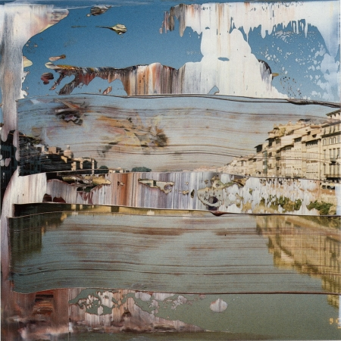
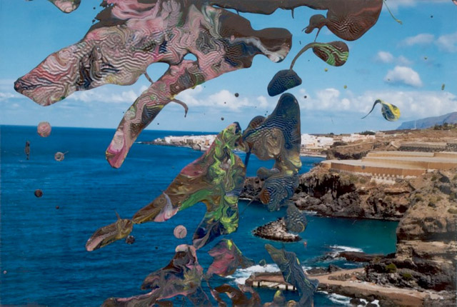
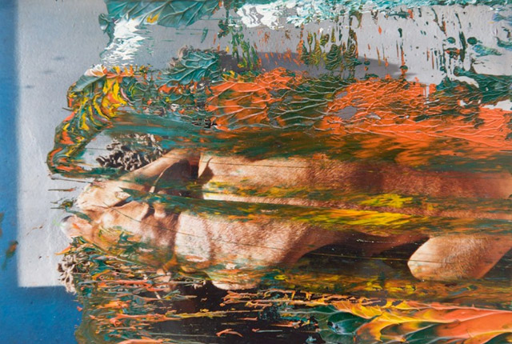

Slide 7
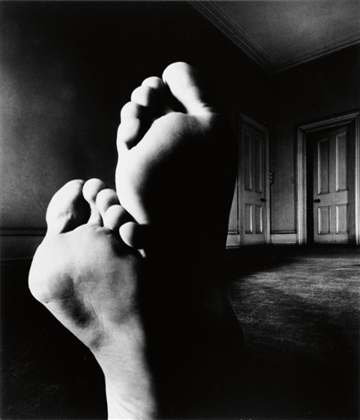
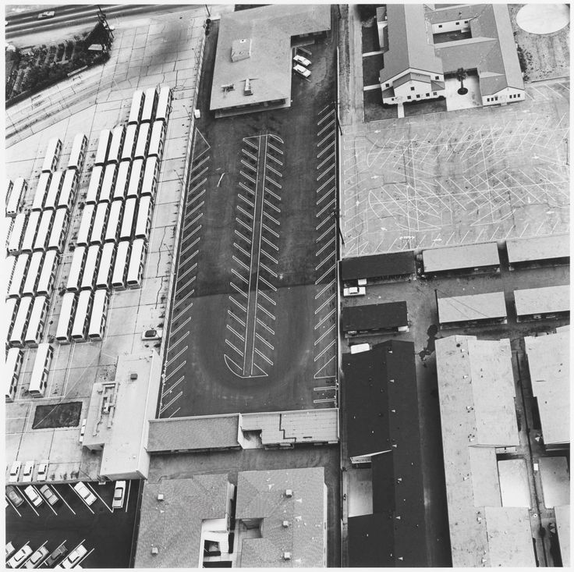
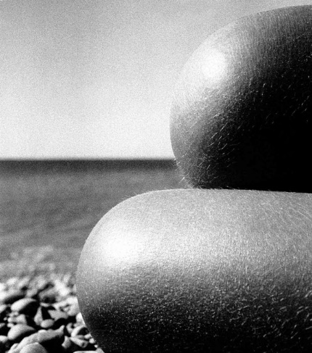
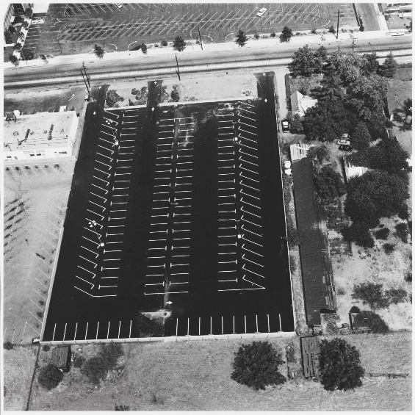
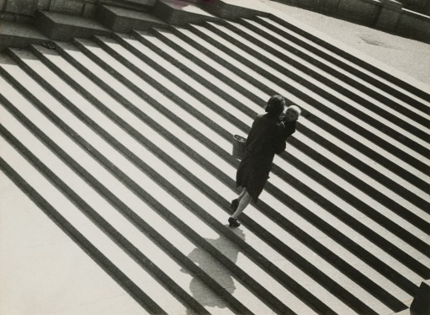
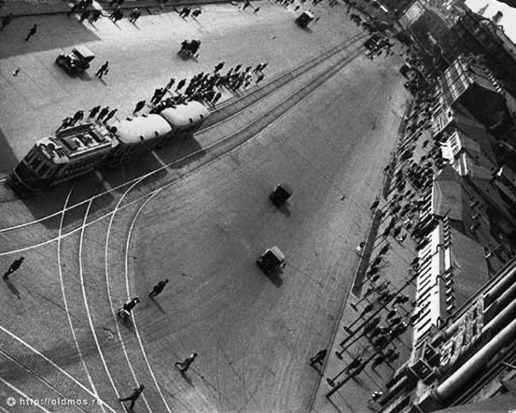
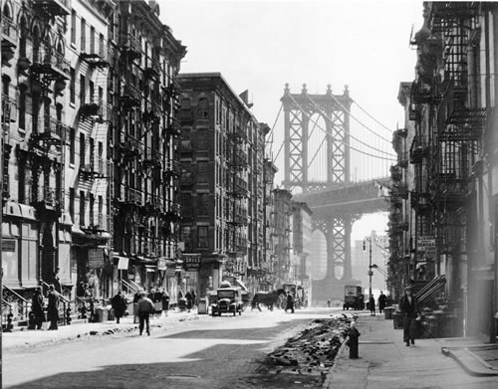
2. Unexpected Perspectives
Ed Ruscha
Alexandra Rodchenko
Bill Brandt

Slide 8
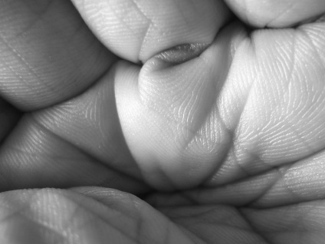
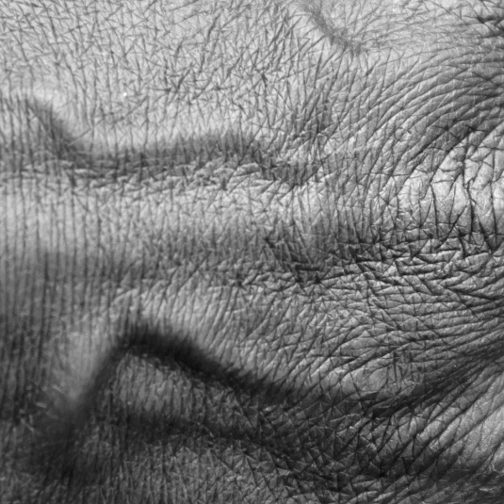
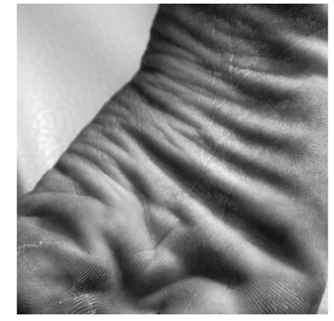
Ashvini Ray
Zooming in on hands and feet to take close-ups, the Australian-born artist constructs stunning black-and-white photographs that address the beauty in the little things.

Slide 9
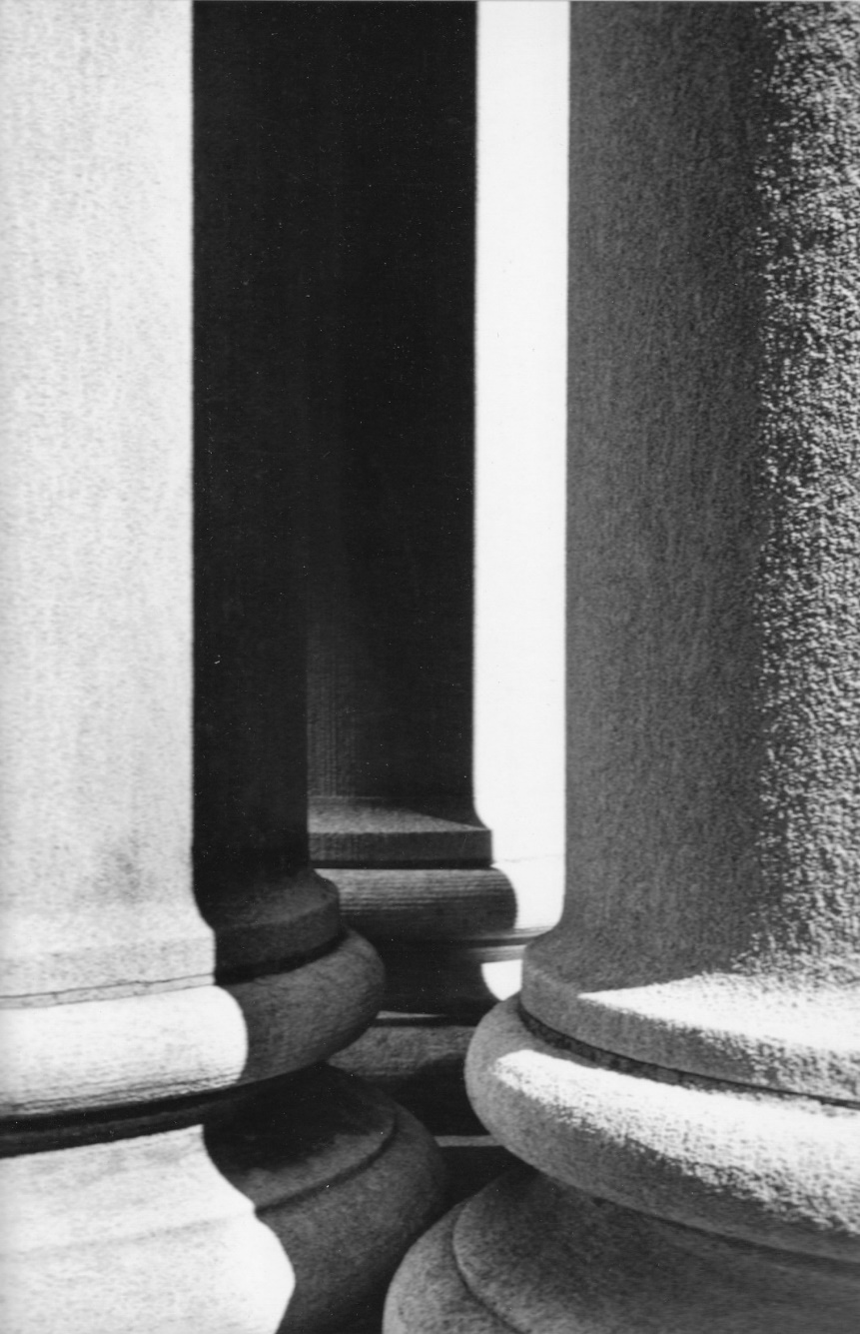
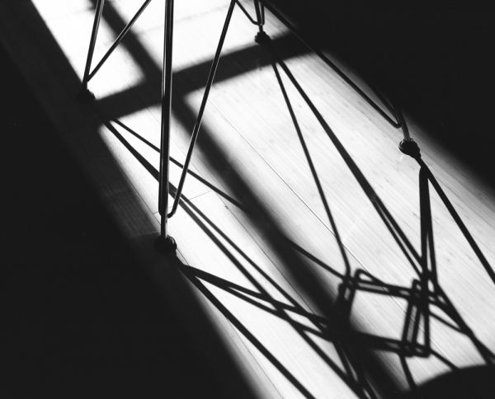
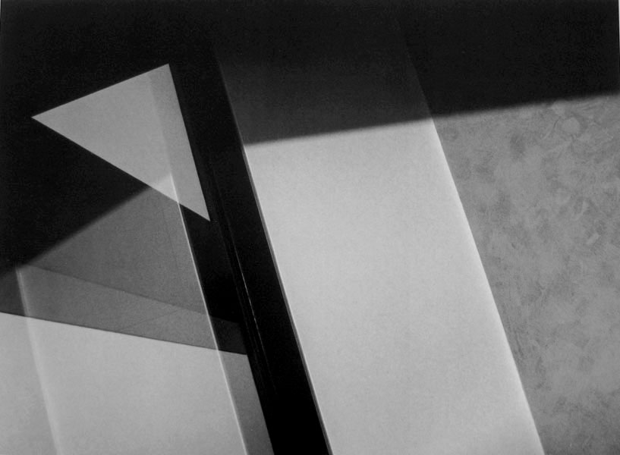
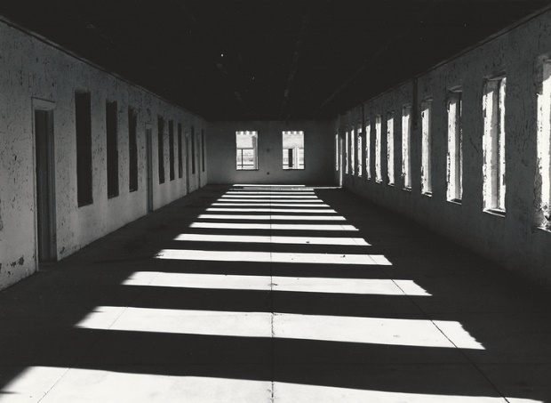
Judith TUrner
Judith Turner resides in New York City where she began taking photographs in 1972. She has had solo exhibitions in the United States, Europe, South America, Israel and Japan.

Slide 10
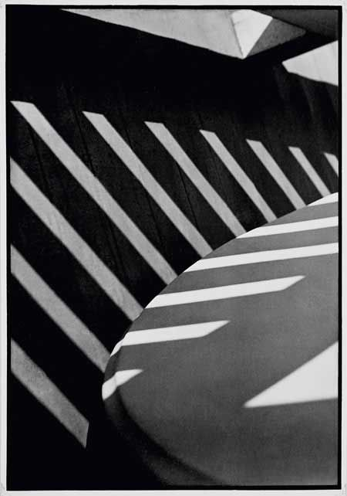
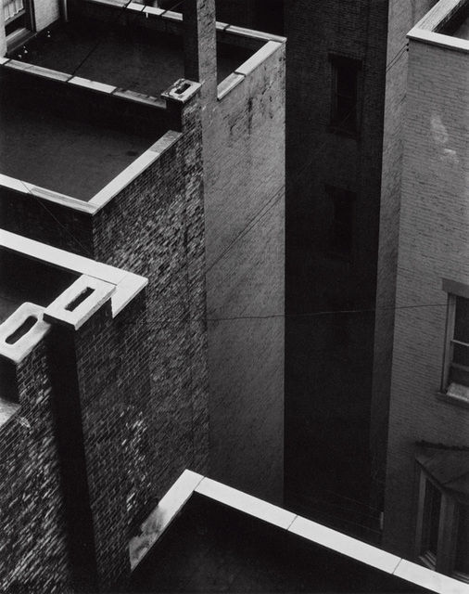
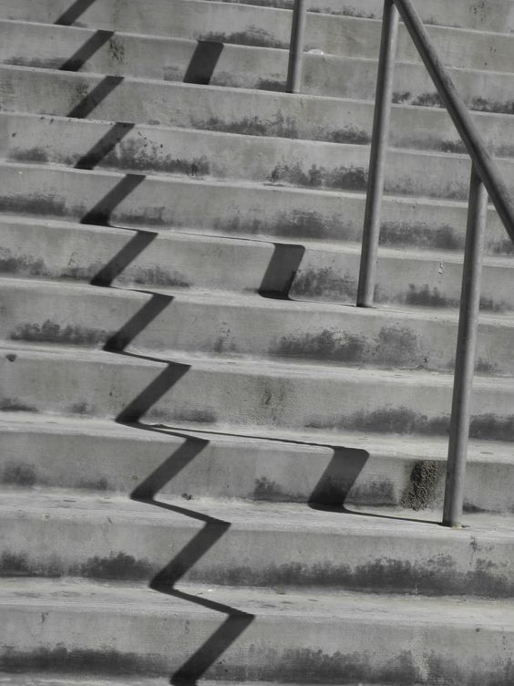
Paul Strand
Paul Strand was an American photographer and filmmaker who, along with fellow modernist photographers like Alfred Stieglitz and Edward Weston, helped establish photography as an art form in the 20th century

Slide 11
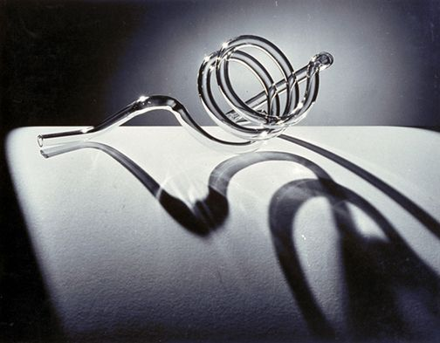
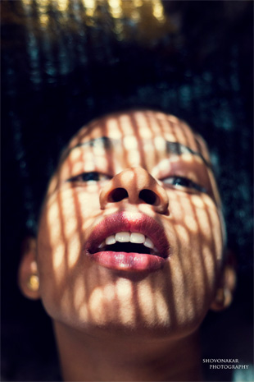
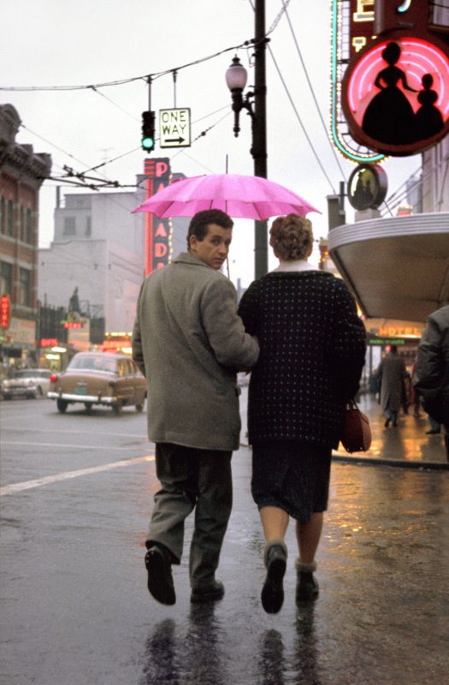
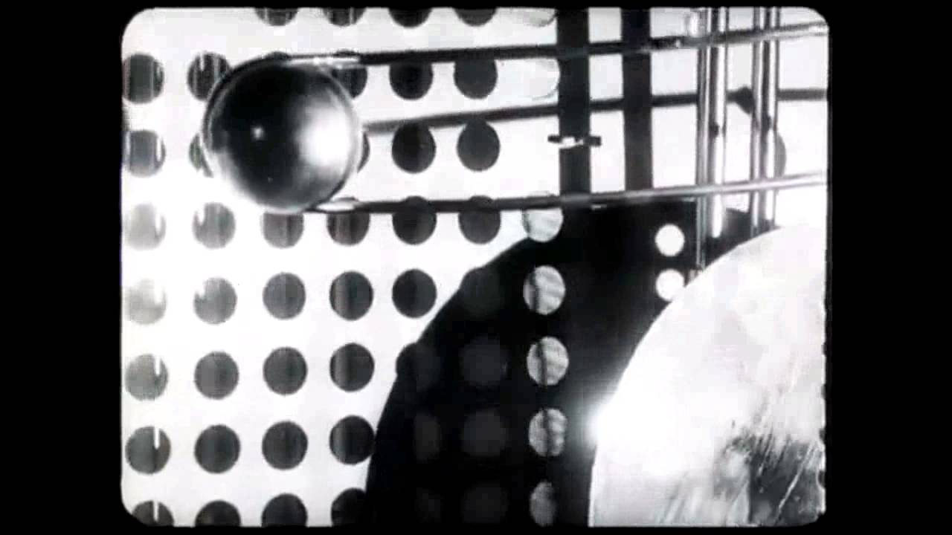
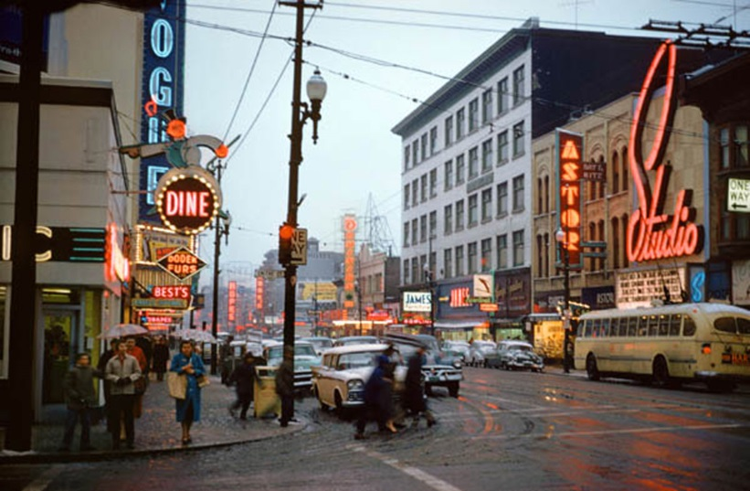
3. Shadows
Ellswell Kelly
Fred Herzog
Laszlo Moholy-Nagy
Paul Strand

Slide 12
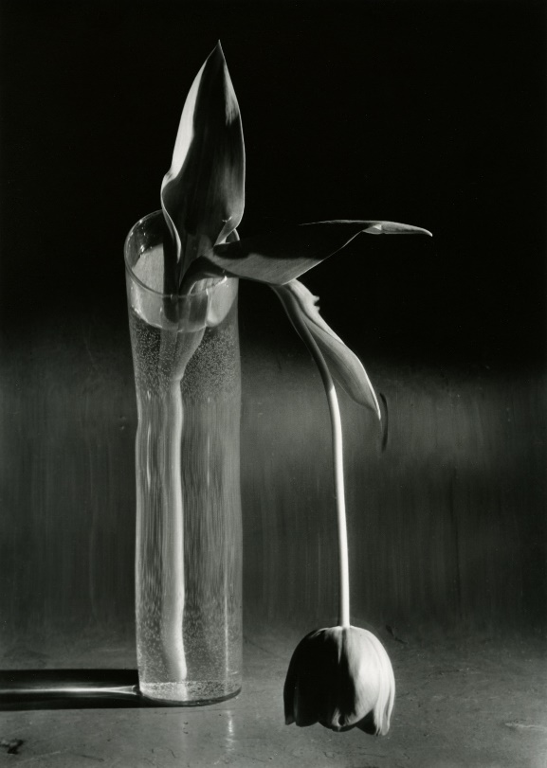
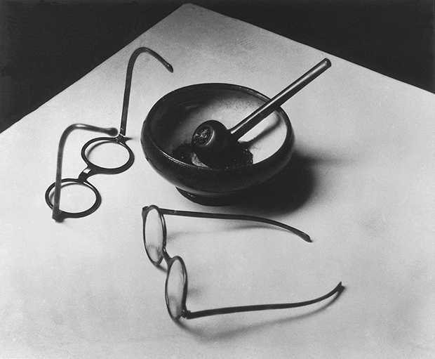
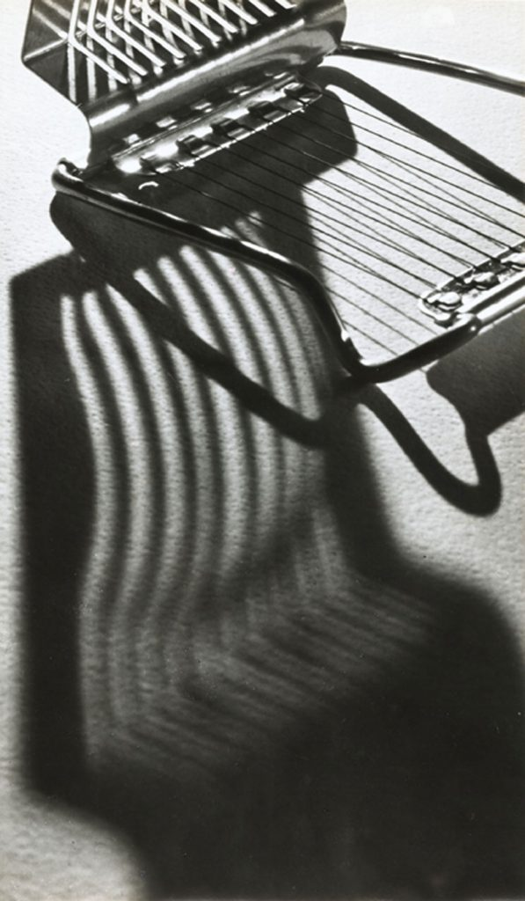
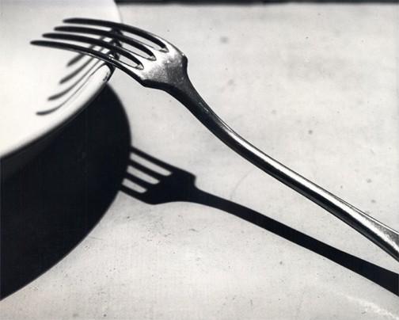
Andre Kertesz

Slide 13





