Slide 1
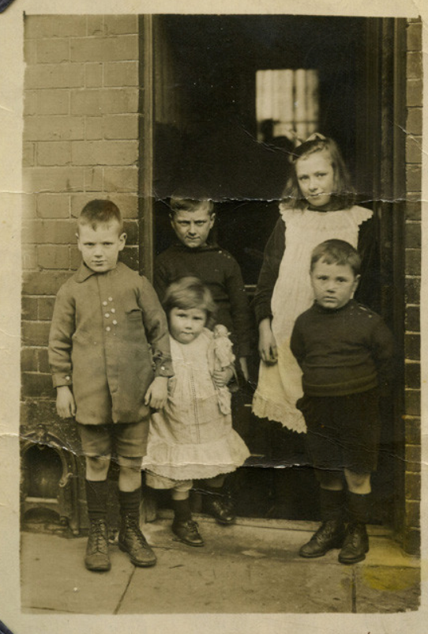
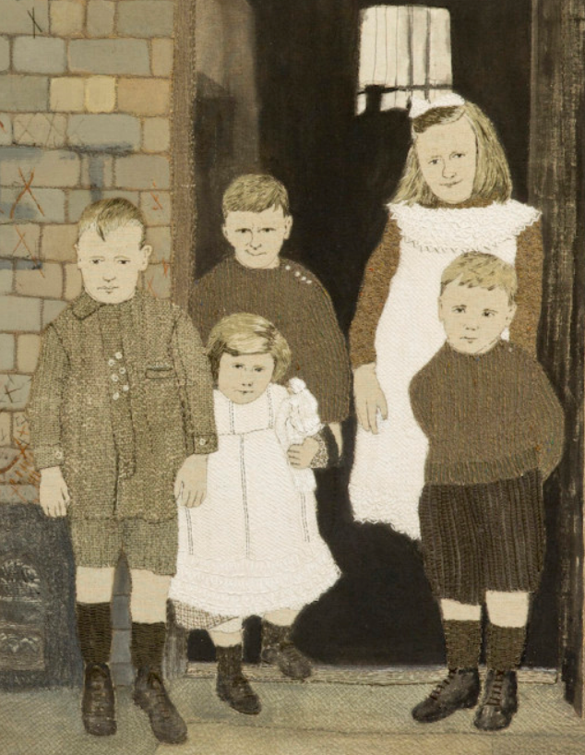
Year 10 Home learning
Produce a response to the Sue Stone work that you have researched, look at the techniques that she has used and include these in your response.
You can either copy one of her pieces of work or you can use a photograph and produce a textile piece from that
When completed, annotate your work, what techniques have you used, how did you do it, how does it link to Sue Stones work

Slide 2
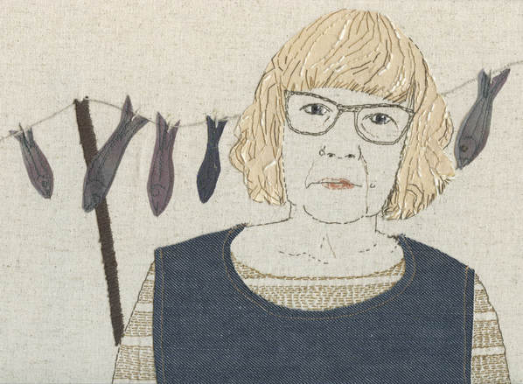
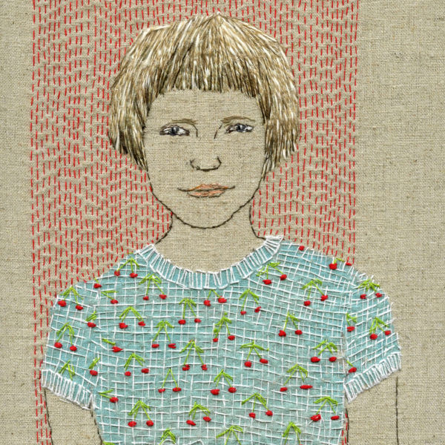
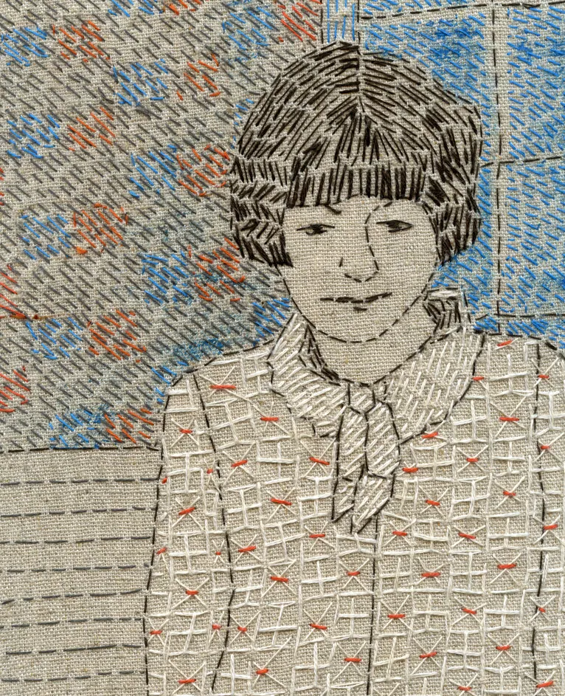
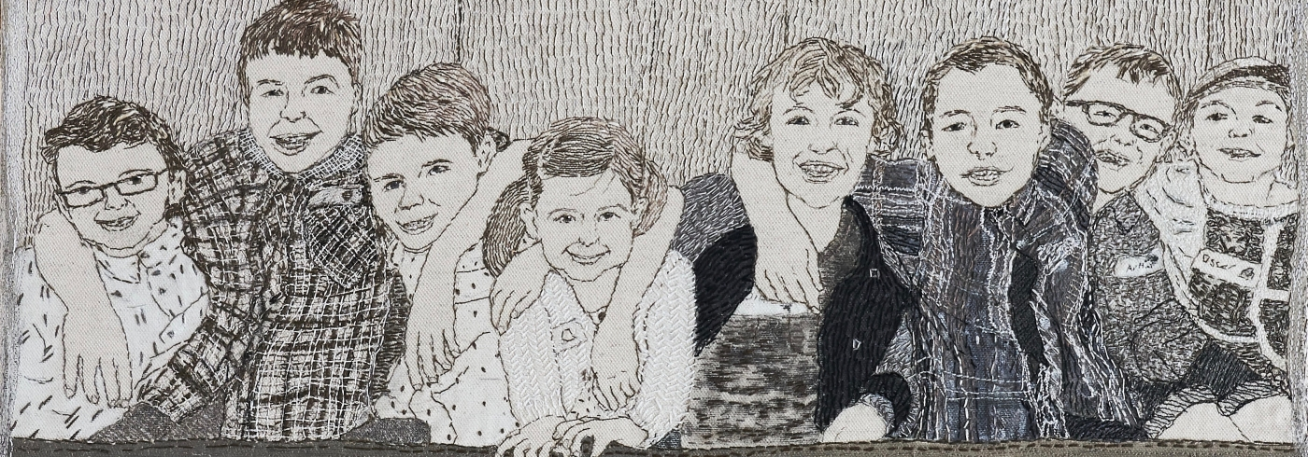
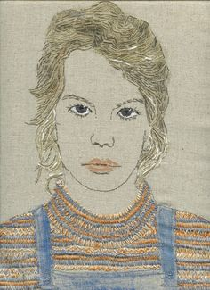
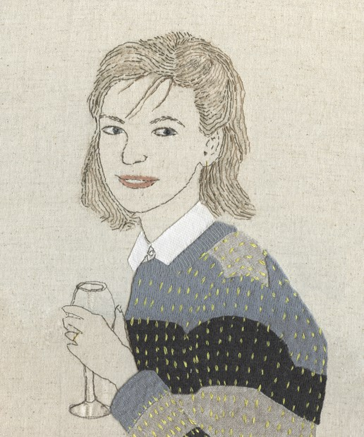
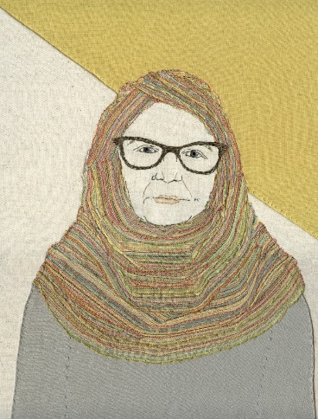
Examples of Sue Stone’s work

