Slide 1
Double bubble

Slide 2
Looking at the photographers you have looked at so far decide what ideas you would like to continue exploring.
2 minimum/ 4 maximum
Annie Leibovitz : High contrast black and white portraits
Laura Williams: Image manipulation. Adjusting scale
Hendrick Kerstens: Looking at Dutch portraiture. Use recycled materials to create garments E.g. Playing card hat
Mads Perch: Paint swipe across portrait: adjusting lighting
Man Ray- Distorted portraiture- photograph through a glass to warp the face.
TASK: Create a double bubble (developed idea) showing which photographers you are going to combine/continue with and say how you intend to do it. If a double page isn’t enough stick in extra pages on the sides as normal.

Slide 3
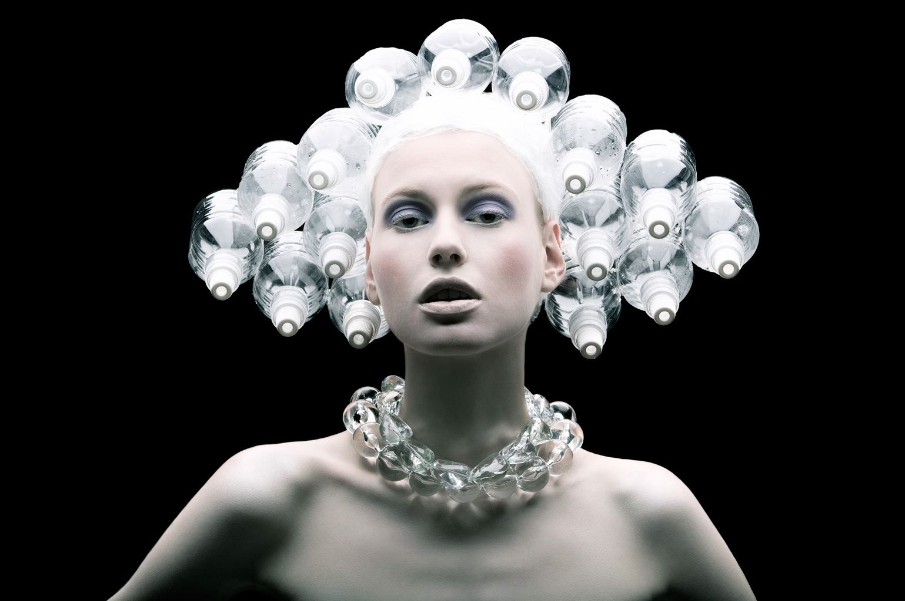
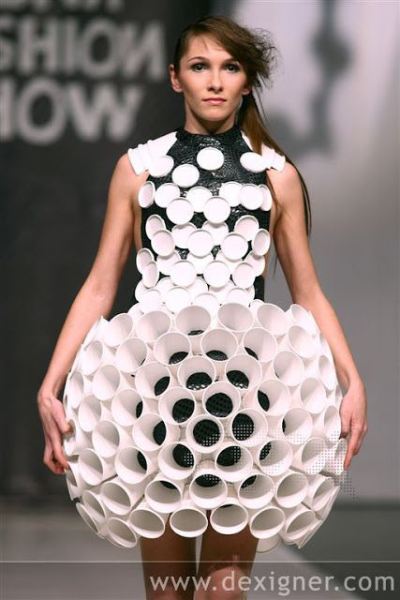
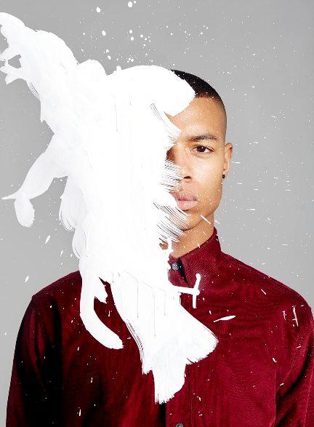
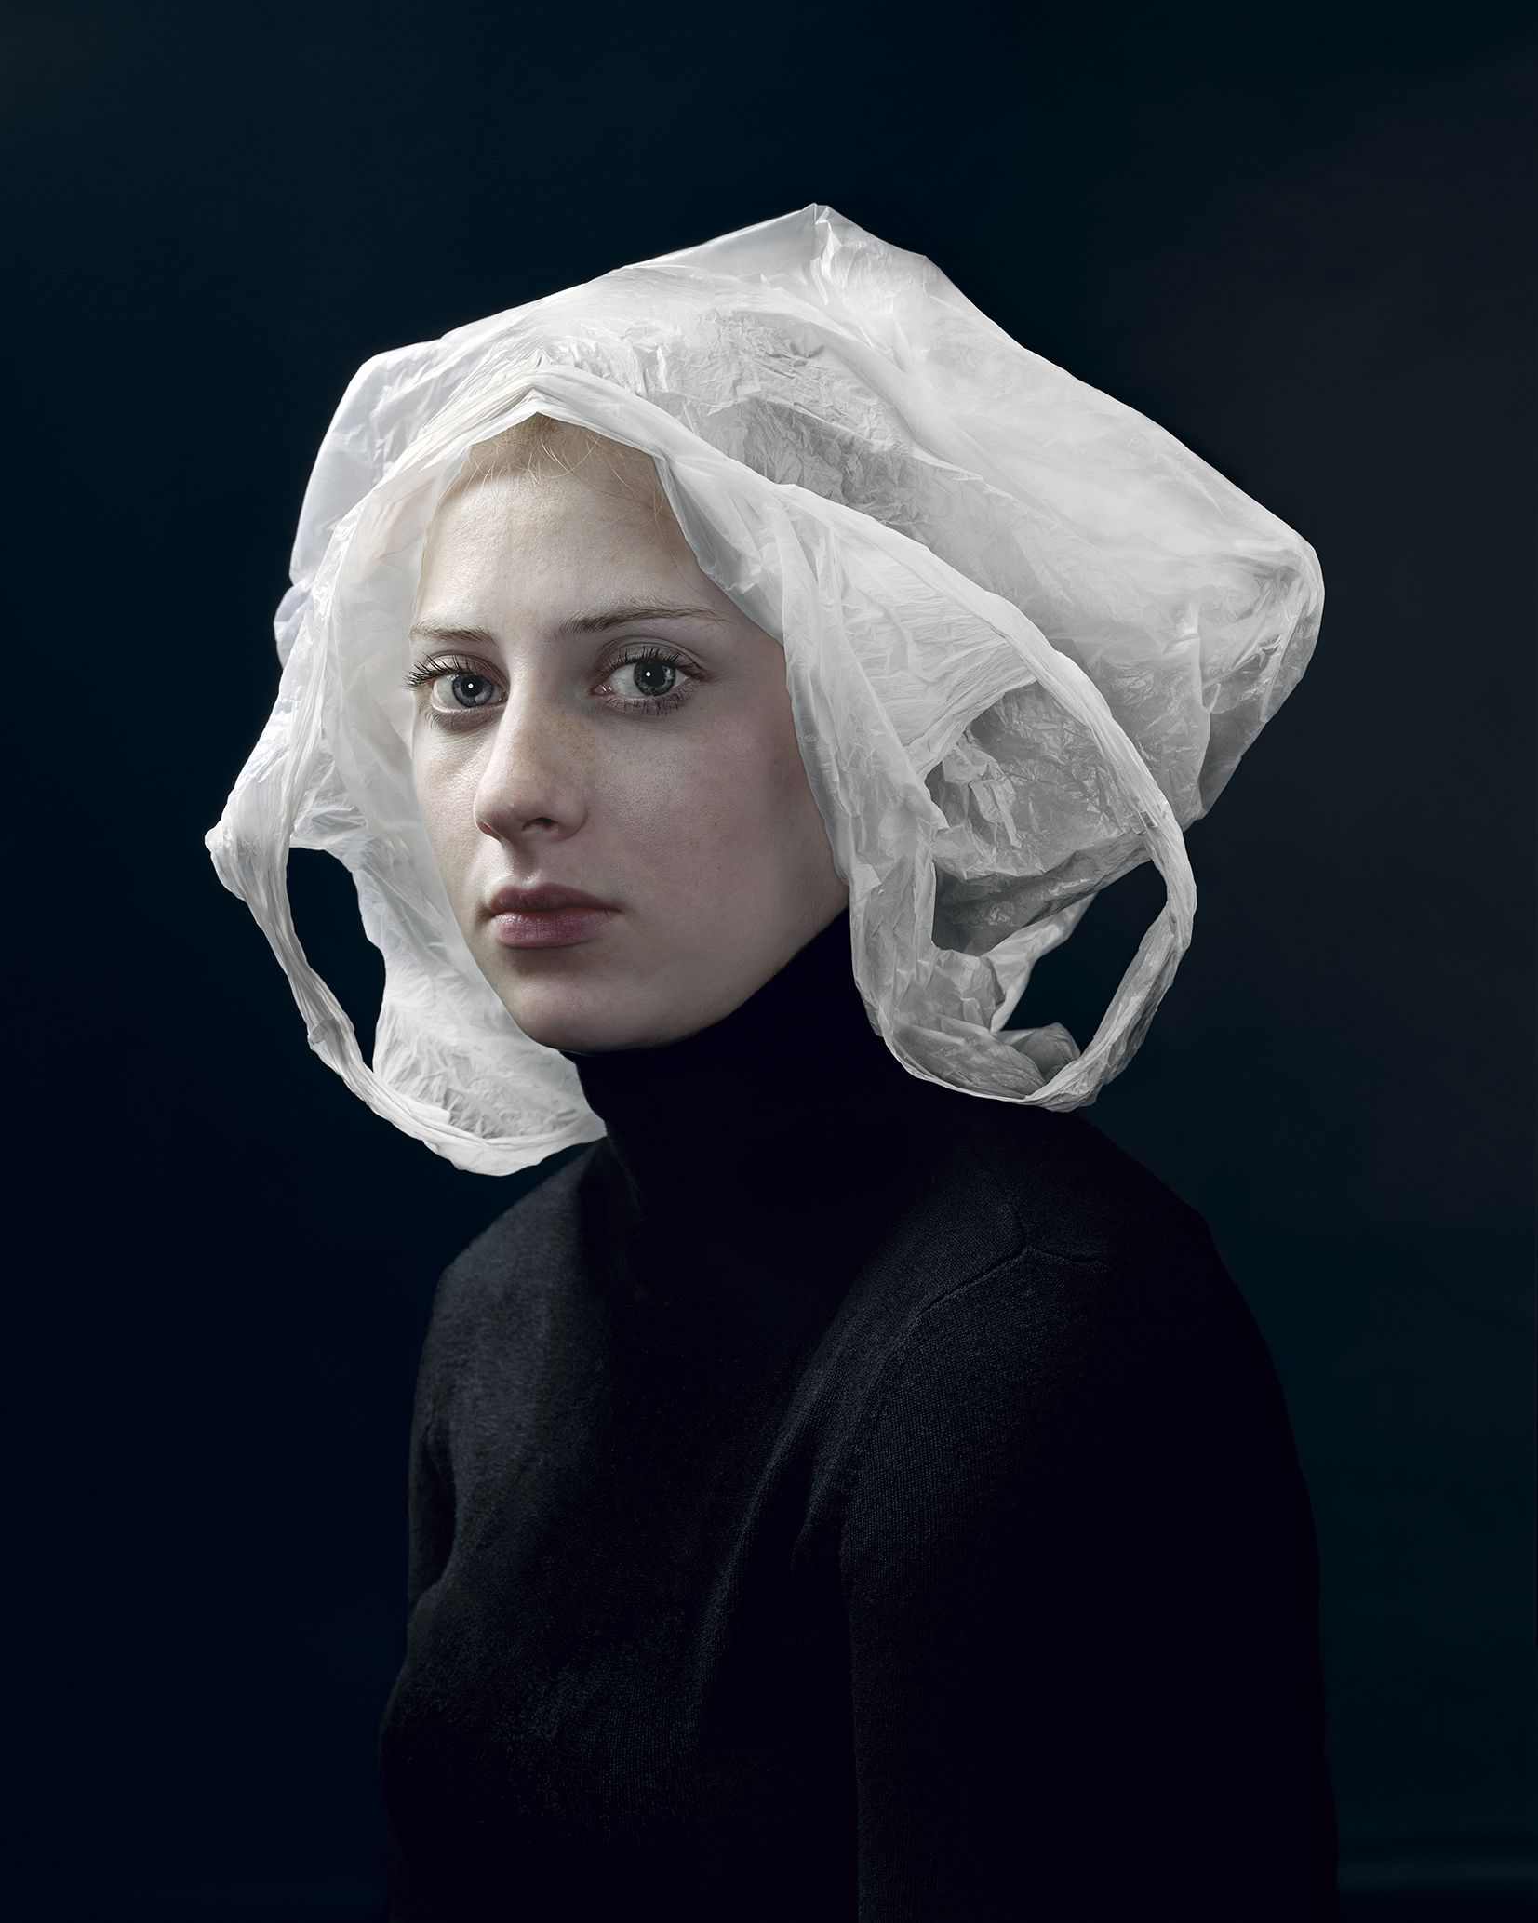
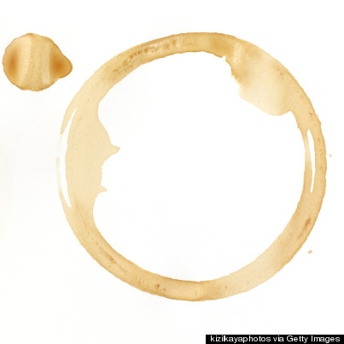
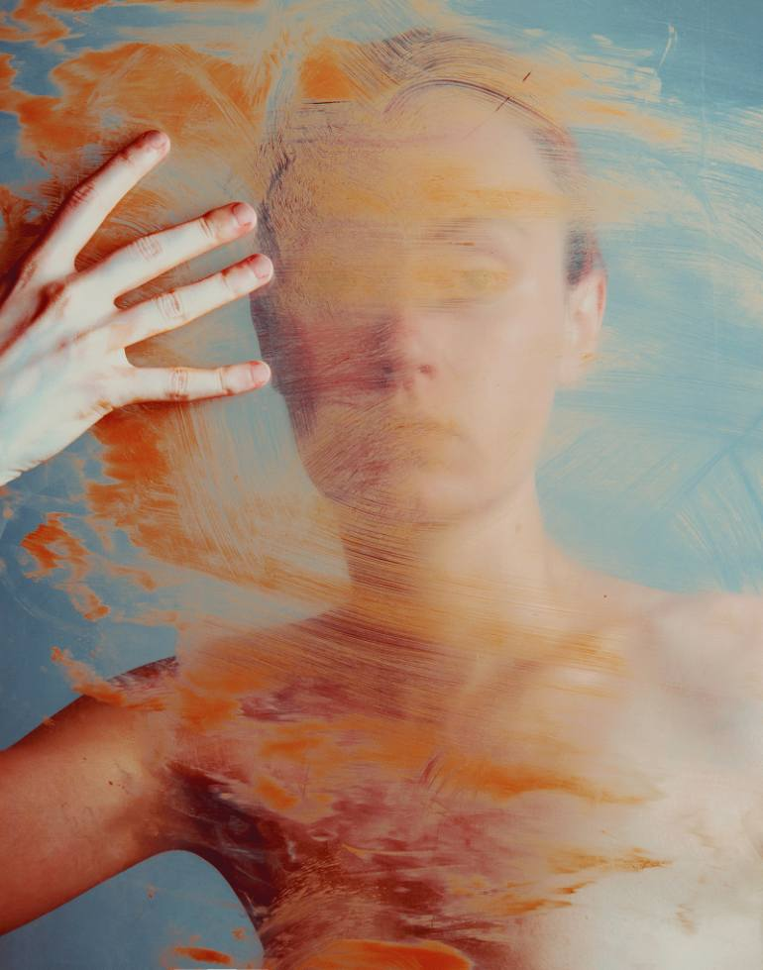
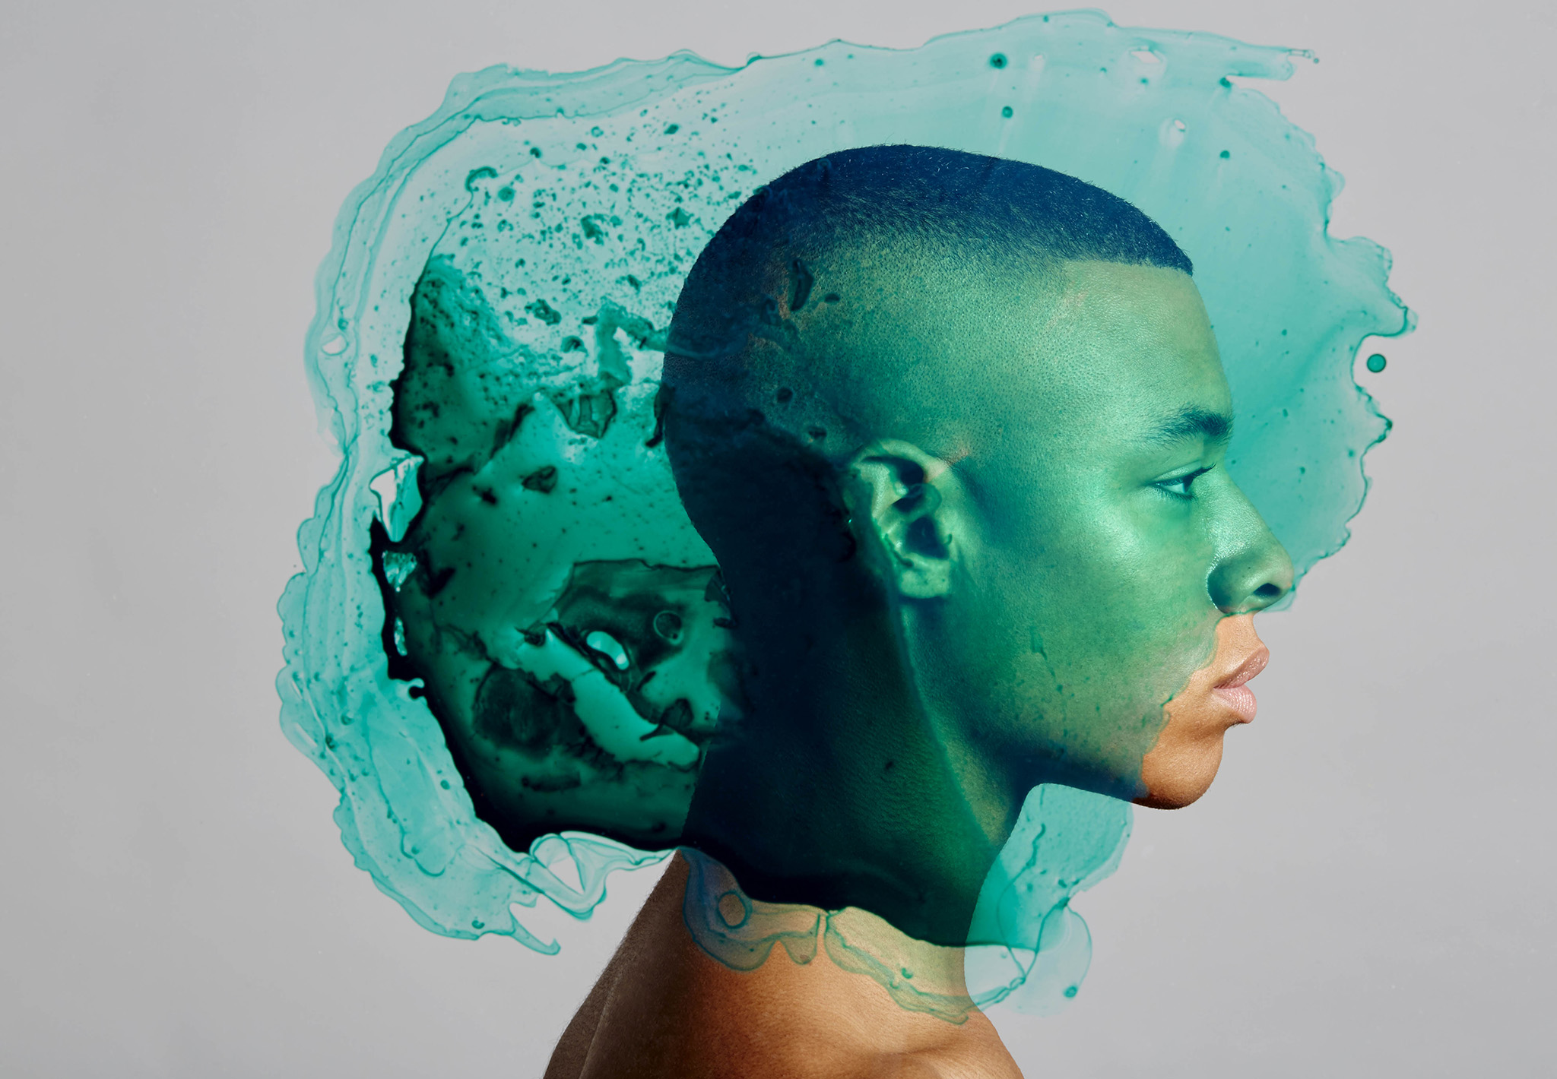
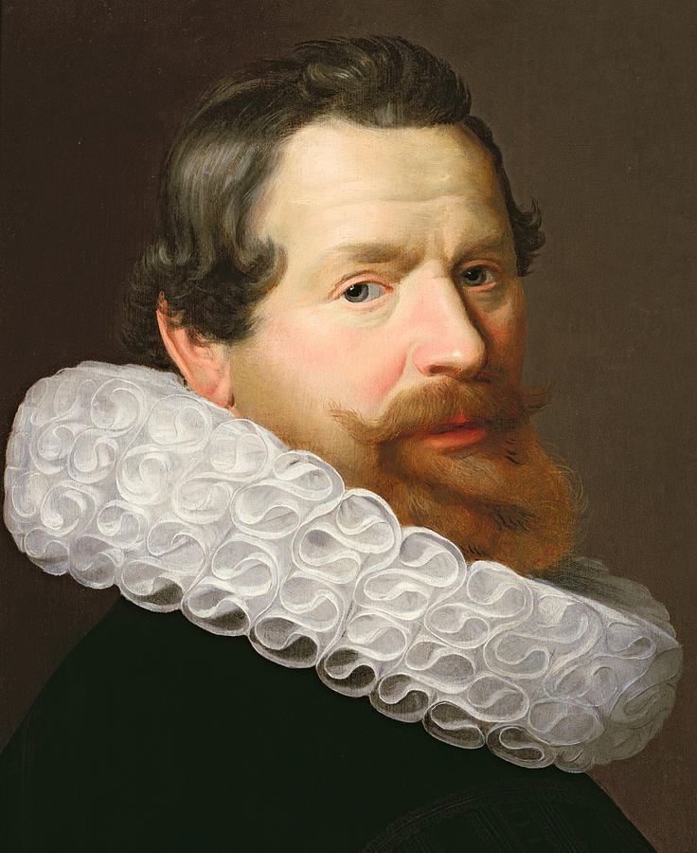
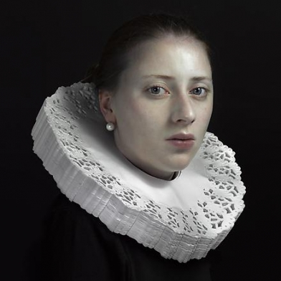
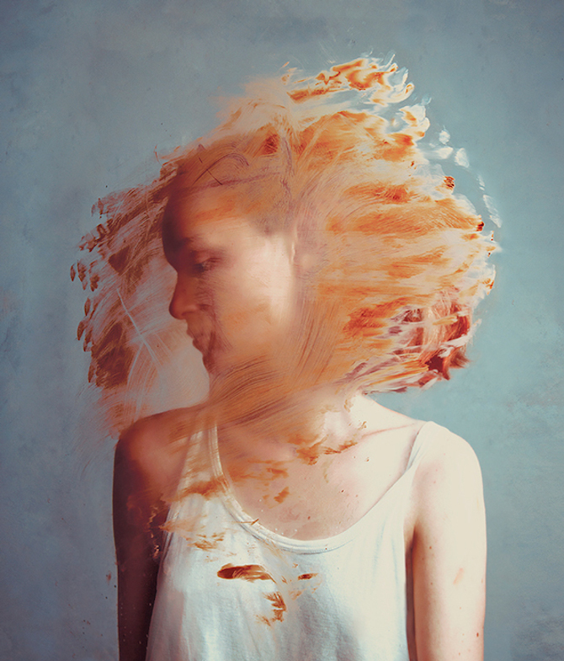
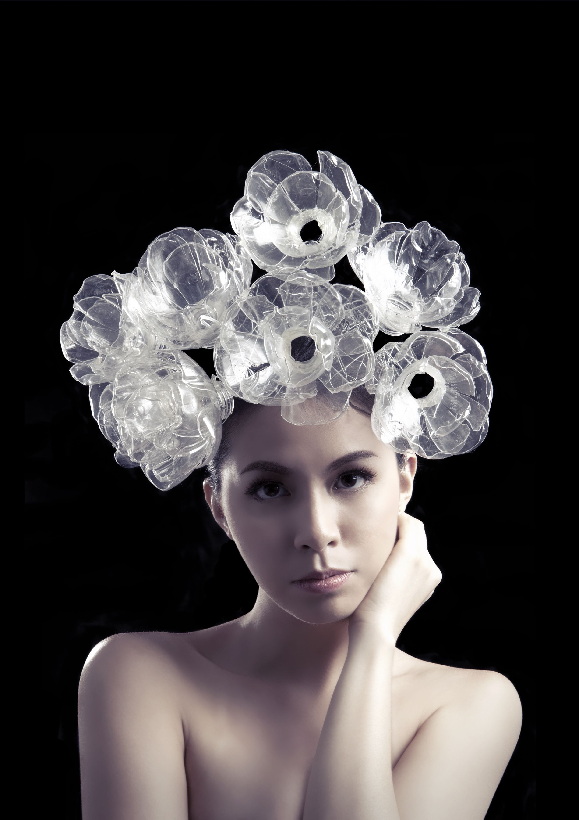
Mads Perch
Make an entire garment out of recycled materials
High contrast images
Person is front facing with painting flicked and pulled across the image. This could be done before (on plastic)or after the image was taken.
Ideas
Pull white paint across the portraits.
Print from the objects that I used to make the recycled garment
Photograph the person wearing the object behind plastic with paint pulled across it
Hold household objects in the images.
Make the opposite. Contemporary portraits with old objects
Brightly coloured images against a neutral background
Hendrick Kerstens
Recycled materials
Paper cups
Soft drink bottles
Bubble wrap
Crisp packets
In the style of old portraits
Could include the use of hands in the images
I could have two people in the images
Could use ink instead of paint
Double bubble example
On a double page in your sketchbook create a venn diagram. Combine the ideas of two of the photographers you have researched so far. How can you combine their work together? What features will you take from their work?

Slide 4
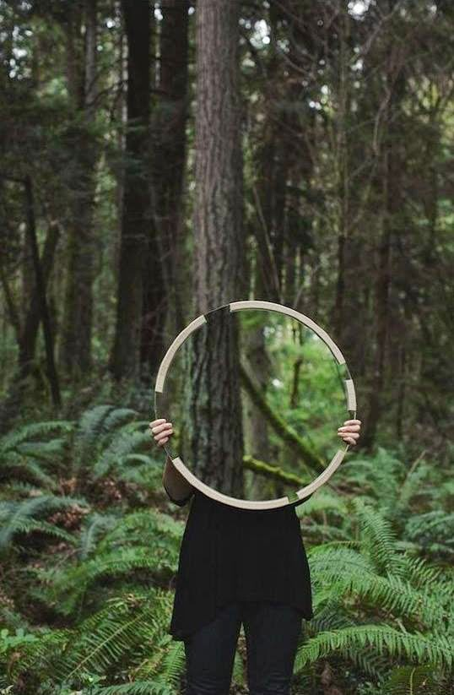

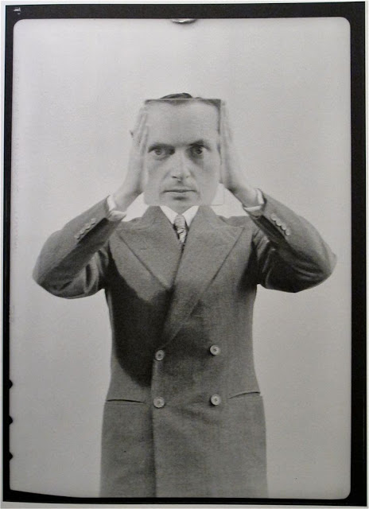
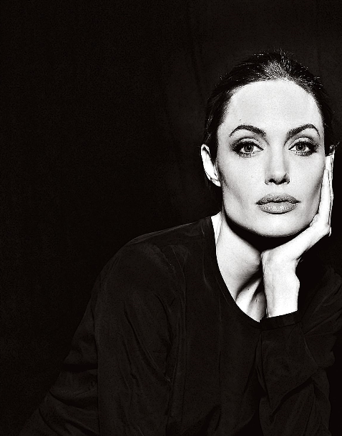
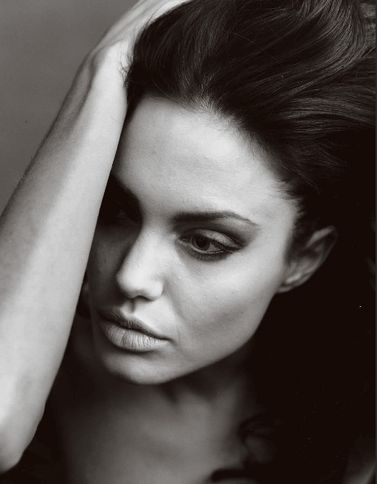
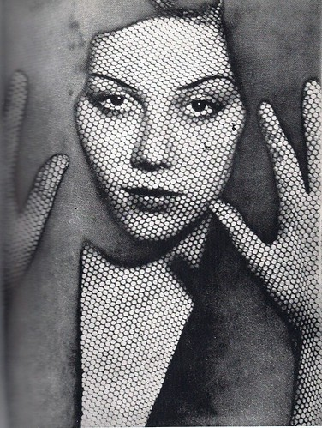
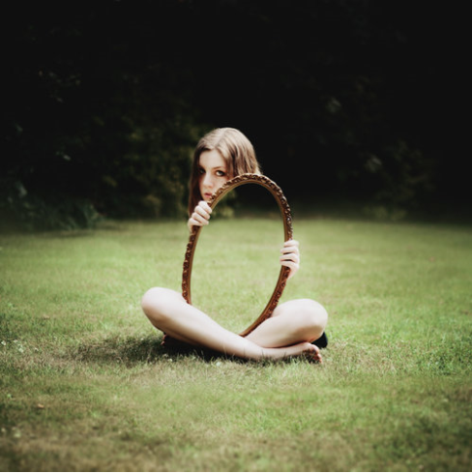
Cut out some of these images for your double bubble- only use the images that apply to the photographers you have chosen to develop. Leave space if you want to include your own outcomes

