Slide 1
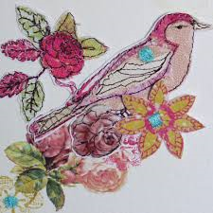
Year 9 Home learning
Complete a response to go with the research you have completed for Amanda Wood, you can either copy one of her pieces or do something of your own in the style of Amanda Wood.
Annotate your work, how did you do it, how does it link to Amanda Wood’s work?
Remember, this is your real coursework, this is not just to fill your time!

Slide 2
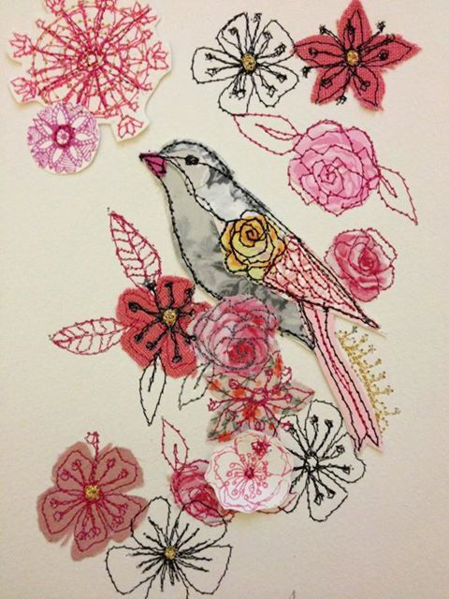
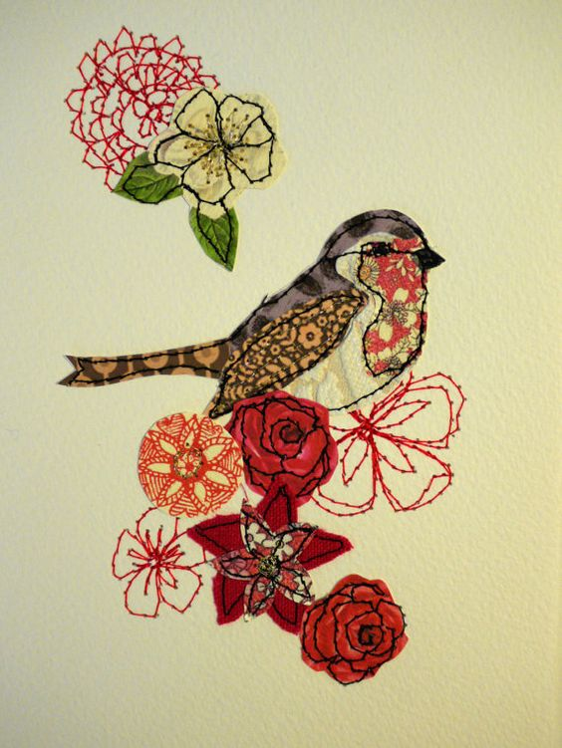
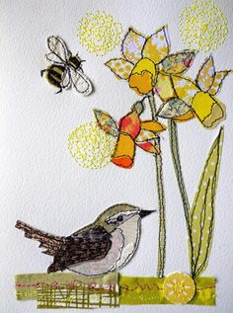
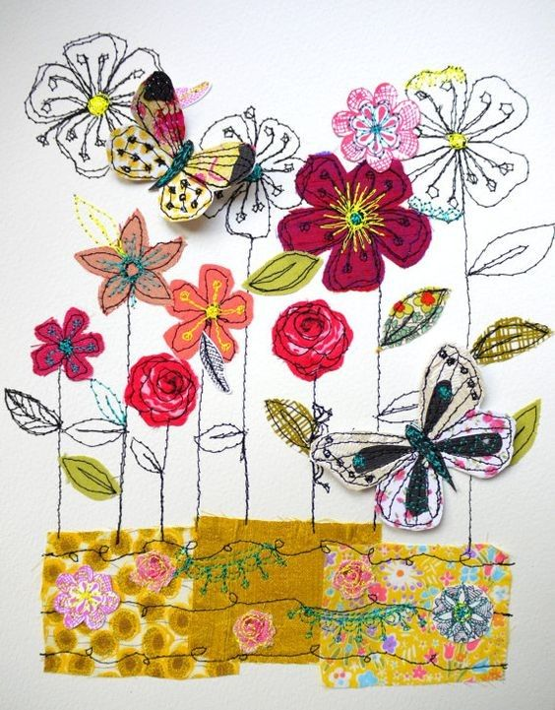
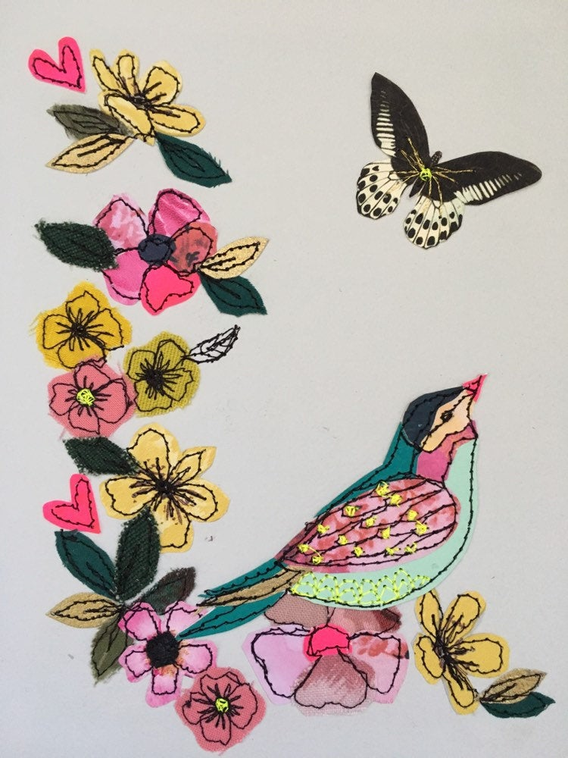
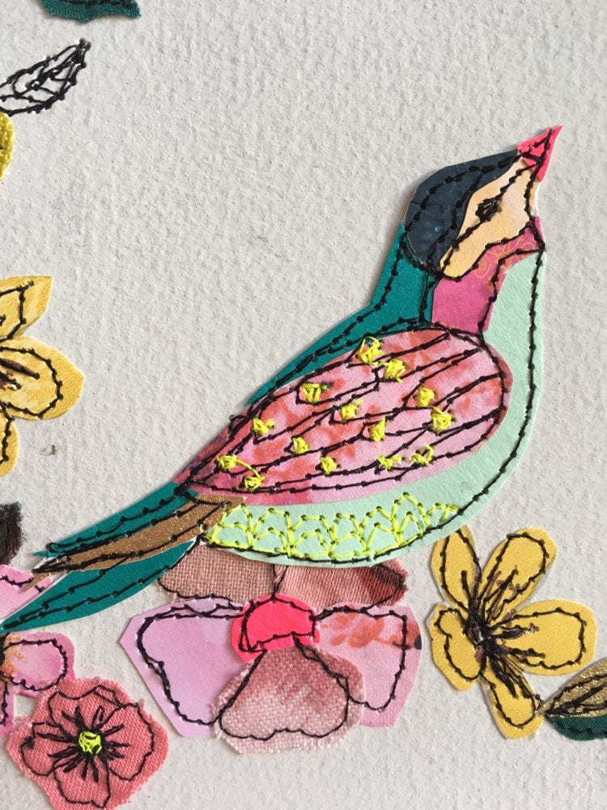
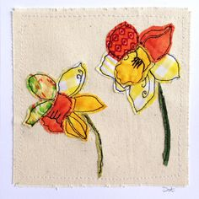
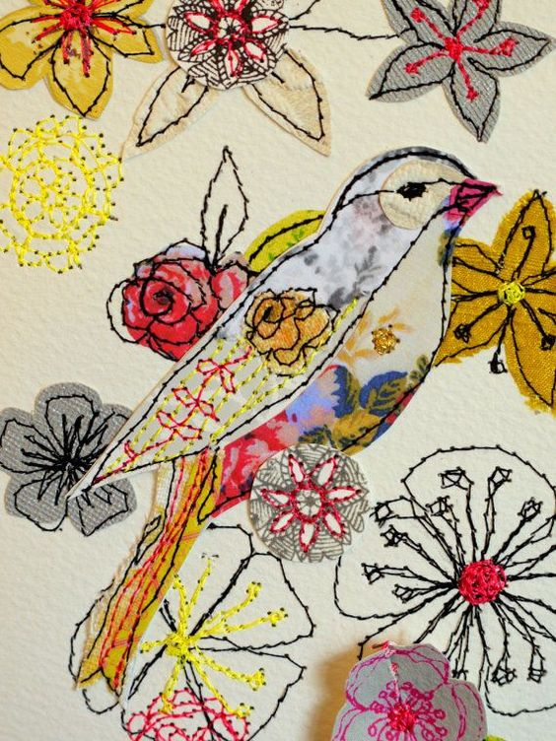
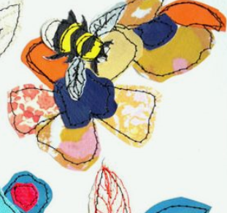
Examples of Amanda Wood’s work

