Slide 1
Joel Meyerowit
Research
Image analysis
Shoot
Edit- PIXLR

Slide 2
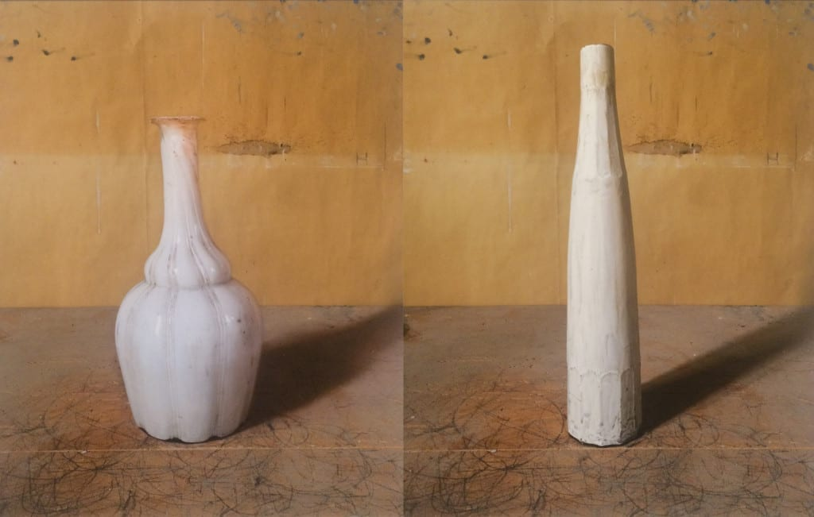
LO: To produce an effective research page.
Step by step….
Create a quick background (this should only take 5 minutes max)
First paragraph should be background information
Add your titles and dates of the images you have included.
You opinion- how would like to interpret his work in your own shoot.
Include images.
Keywords: Composition, monochrome, industrial, geometric, shadow, light, tone, form, line of sight, rule of thirds, architecture, diagonals, perspective
Task 1
Notes:
Think about the key things you need to include to make your research meaningful and effective!
At the end of class we will be looking at each other's work and ideas for presentation.
If you don’t quite finish, you will have the weekend to finish it off for next lesson. Miss Pyke will be checking it’s completed for Monday.

Slide 3
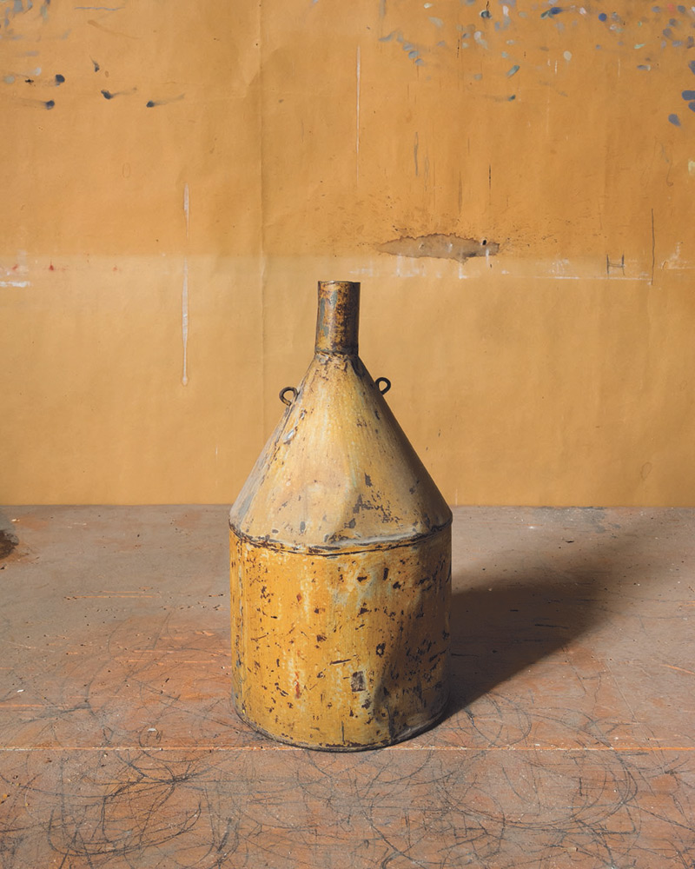
The old olive oil can with a spout like a funnel belonged to the Italian artist Giorgio Morandi (1890–1964) and it made regular appearances in his still life paintings in ensembles of bottles and jugs. It stands on a table inscribed with swirling lines used as position guides in Morandi’s studio in Bologna, where he would study its simple geometry with inexhaustible attention and patience. In its dents, abrasions and coloring, the can blends into its surroundings like a perfectly adapted life form. In spring 2015, Joel Meyerowitz spent two days in the studio photographing objects collected by Morandi—tins, decanters, vases, and shells—many of them props in his paintings. The American street photographer, renowned for his pioneering use of color, positioned each item in much the same place on the table in front of the same section of the paper-covered wall, with the light casting a consistently angled shadow. With these compositional matters determined, the main question to be decided was which side of the object to show. Meyerowitz provides a view of the two loops for the missing handle, omitted when Morandi painted the can, and the nozzle is minutely canted to the right.

Slide 4
Twenty of Meyerowitz’s pictures are on show in Bologna and Damiani, owner of the gallery, will publish a book with a bigger selection at the end of November. It’s a noteworthy project, not least for the restraint and even humility Meyerowitz brings to the endeavor. Early criticisms of photography were often built on the assertion that where the artist interpreted and remade reality in line, modeling and color, drawing and paint, the photographer was shackled to its given forms. The camera’s limited, instantaneous capacity to determine the aesthetic aspect of the image could never compare with the artist’s creative flexibility and depth of engagement. That argument was settled long ago—photography can certainly be art—and the medium has underscored the point by also becoming a tool for fabricating non-mimetic images and illusions.
Nevertheless, by addressing painting as a subject Meyerowitz’s Morandi pictures inevitably run up against the old distinction. “What I could not do with a photograph,” he acknowledges, “was wrap them in the atmosphere that paint brings to space and form.” Where the everyday objects were points of departure for Morandi, capable of endless permutations when assembled in groups, Meyerowitz worked within the additional constraint of showing each artifact on its own.
Although the aesthetic character of Meyerowitz’s project is implicit in a single picture, the purpose of his method only becomes fully apparent when the images are encountered as a collection. Like Morandi’s paintings, these pictures disclose the sublime dimension inherent in ordinary things, only they do it by intrinsically photographic means—with repetition, seriality, and optical precision.
Highlight the important information and write onto your research page. Remember it must be in your own words

Slide 5
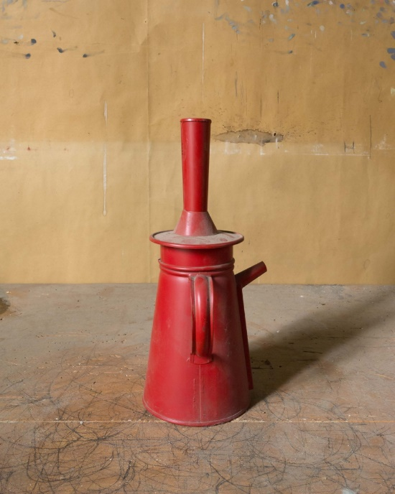
Image Analysis
Answer the questions below when you are analysing the images on the next slide.
How does Joel Meyerowit relate to Manufacture structures
Why do you think Meyerowit chose to capture this image?
What do you think he was interested in?
What do you notice about the composition?
How could you use the keywords below to describe Joel Meyerowit’s work?
Line of sight, rule of thirds, composition, shadow, symmetry, capturing everyday life, direction, leading lines
Task 2
Notes:
Why do you think Strand chose to capture this image? What do you think he was interested in?
What do you notice about how he has judged his composition?
How does Paul Strand relate to form?
Line of sight, rule of thirds with composition, shadow, symmetry, capturing everyday life, everyone’s walking in the same direction

Slide 6

IMAGE ANALYSIs
Cut out the Joel Meyerowit images and stick the images onto your image analysis page. draw the images in your sketchbook : Include rule of thirds grid

Slide 7

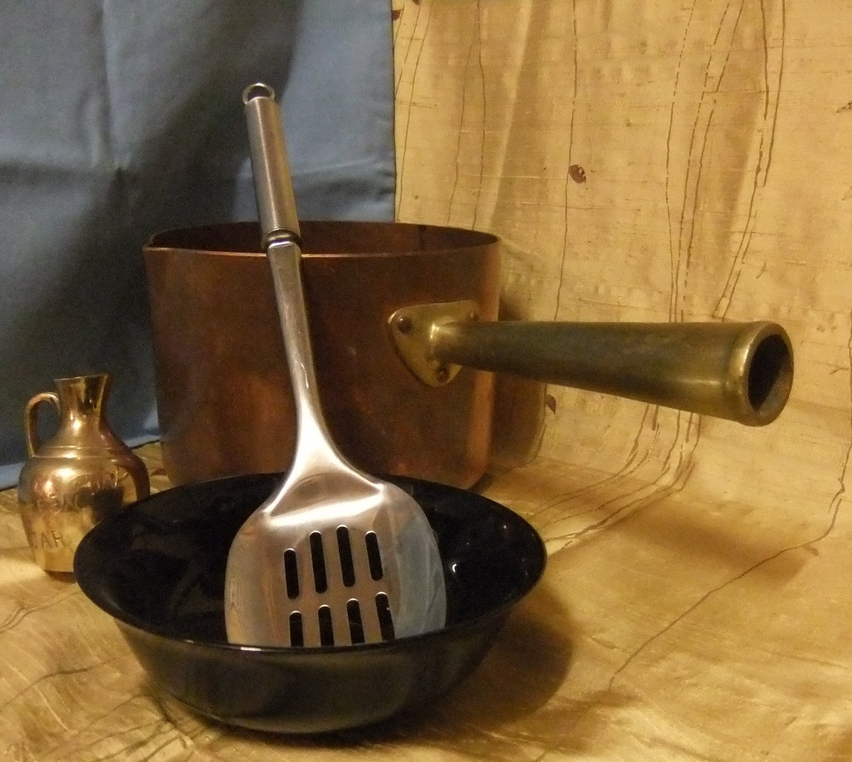
Shoot- you can use your phone ☺
Choose some objects from around your house and find a neural background that you can photograph against. Think carefully about your background. Notice how this background has two different colours/textures.

Slide 8
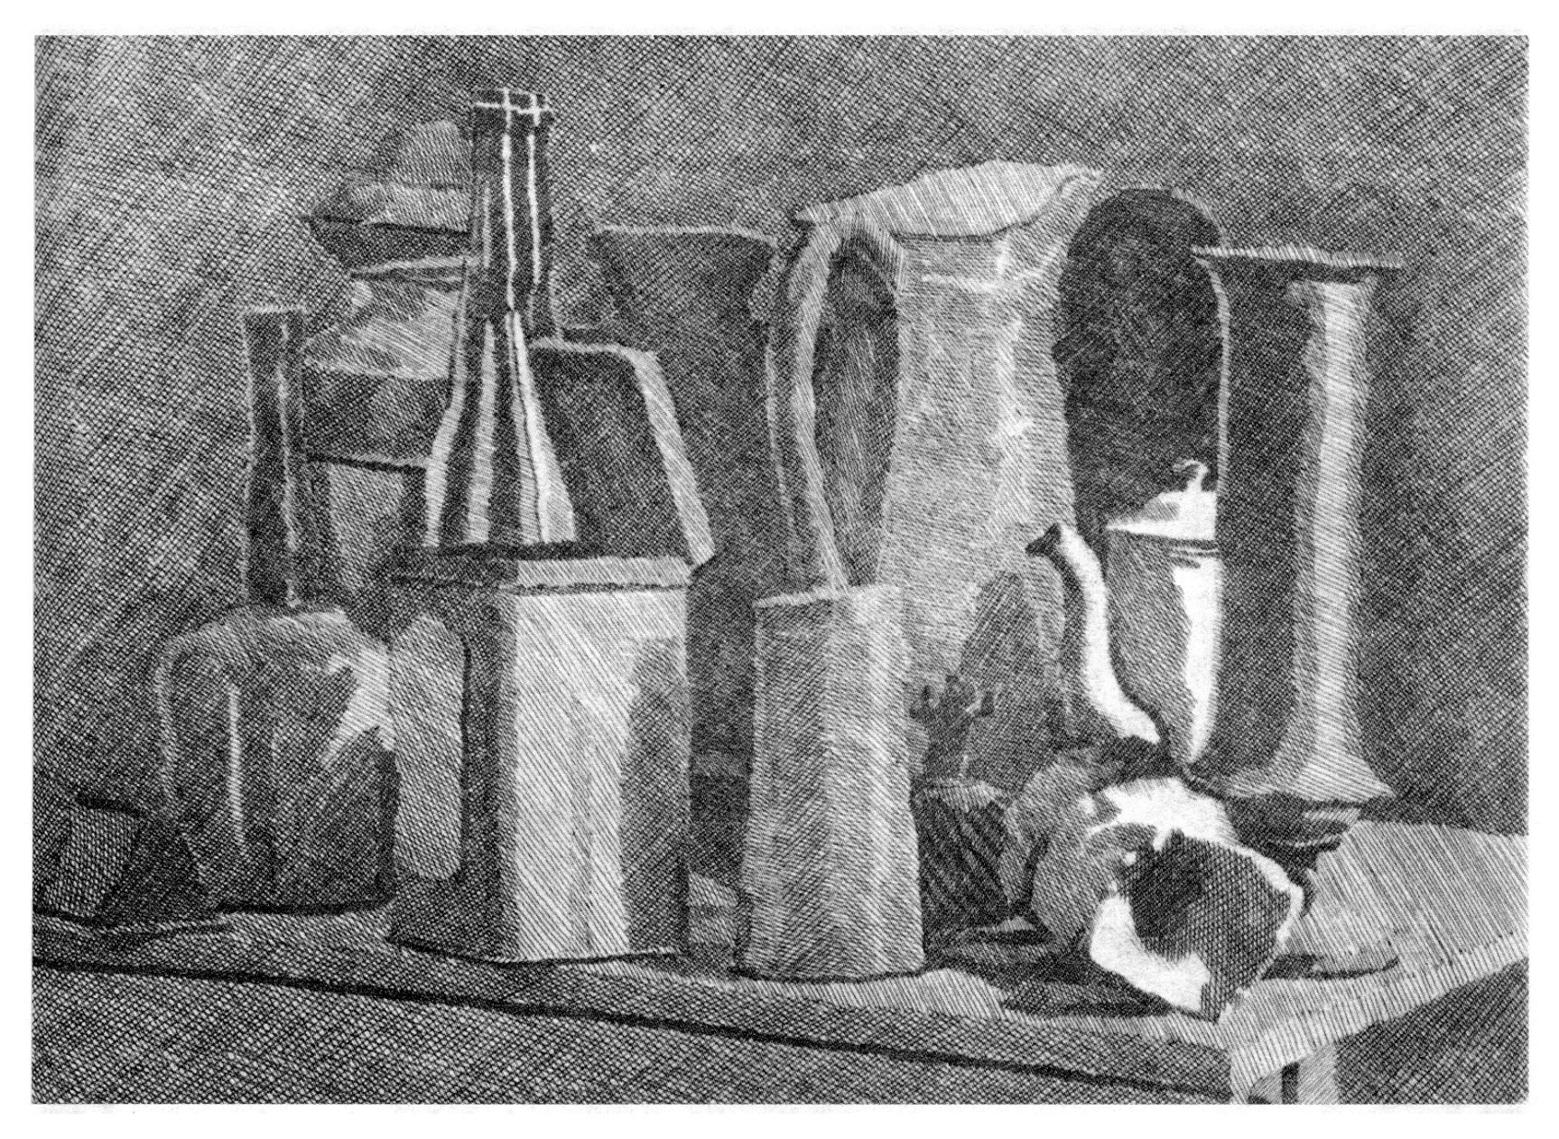
Now draw your composition: This must fill an A4 sheet. Use tone to show the lighter and darker areas
Task 3

Slide 9
Upload and PRInt (If you are able to)
If you are able to- upload your photos (email or cable) to a computer and print out contact sheet, small outcomes etc. If you are unable to do this make sure you leave space before moving onto you next photographer.
You can edit your images using an online editing program called PIXLR
Edit your images so they are high contrast.
Task 4

