Slide 1
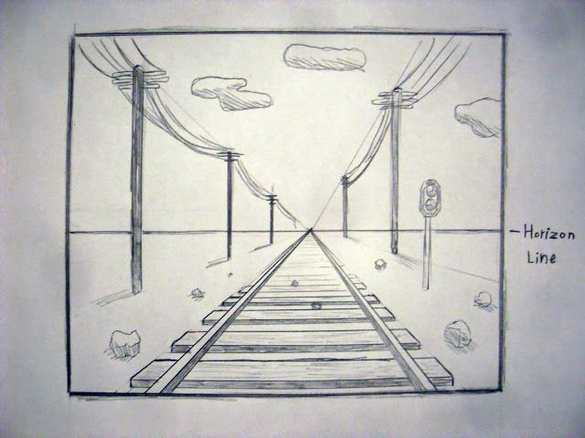
Drawing with One Point Perspective
KEYWORDS:
Horizon line
Vanishing point
Parallel Lines
Converging lines(lines coming together)

Slide 2
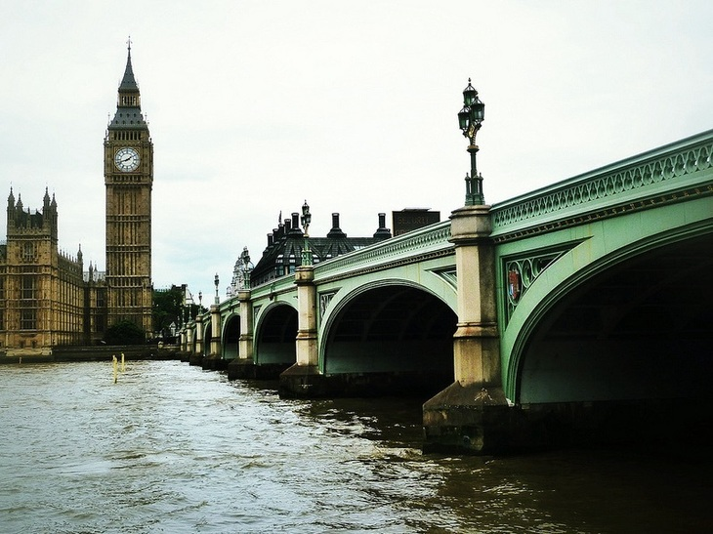
One Point Perspective is when the straight, parallel lines going away from you converge to one point.
This is called the vanishing point
Look at how I draw the converging lines to find the vanishing point:
VP

Slide 3
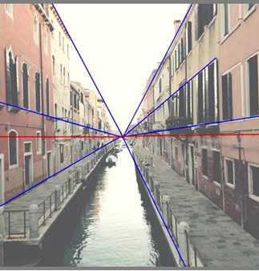
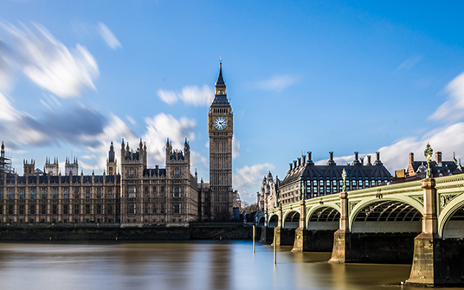
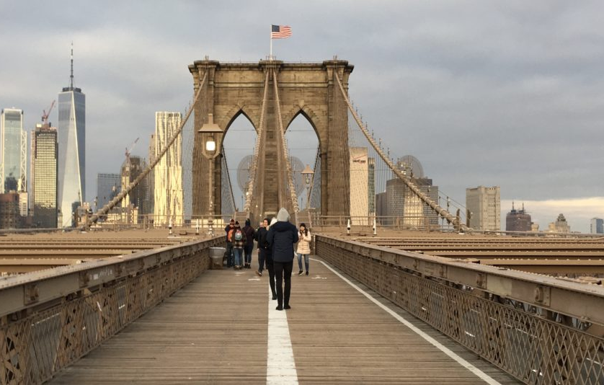

Use a pencil and a ruler to find the
Vanishing Points on these images.
Step 1: Which lines are leading away from you? Mark them
Step 2: Are there any parallel lines you didn’t see? Mark them
Step 3: Are there lines like this on both sides of the picture?
(TIP: not in #1 but there are in #2 and #3)
Step 4: Mark the point where they all meet with a Dot and VP for Vanishing Point
Now draw a horizontal line where the Vanishing point is. This is Horizon Line. This is where things ‘vanish’ because we can no longer see them from where we are.

Slide 4
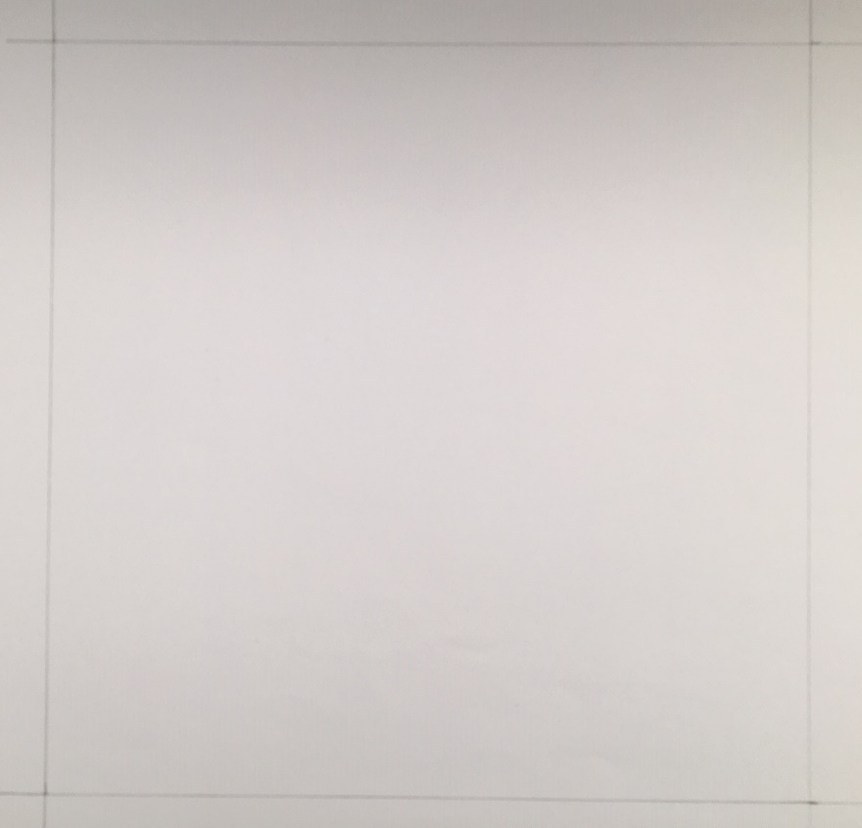
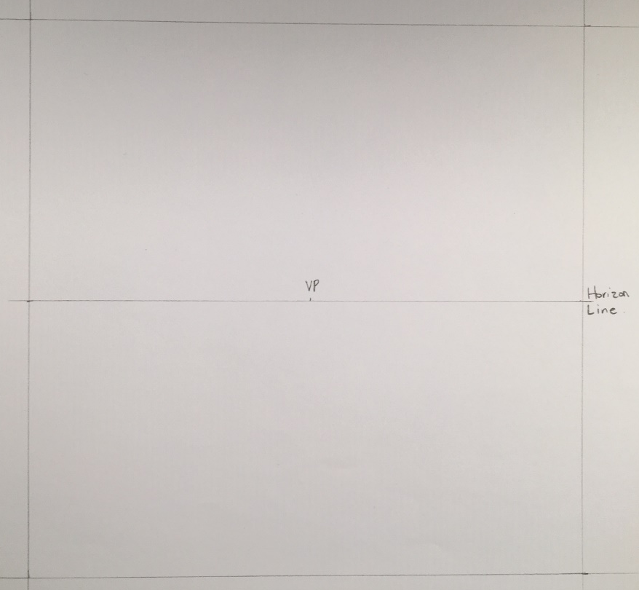
Create your own drawing with One Point Perspective
Set up your square to draw in. Make it 16x16cm.
Mark your middle on your left, right and bottom.
Join your Left and Right middle marks.
Label it the horizon line
Mark the middle of the Horizon line with an x. This is your vanishing point. As we draw, the converging lines will come to this spot in the middle of your picture.

Slide 5
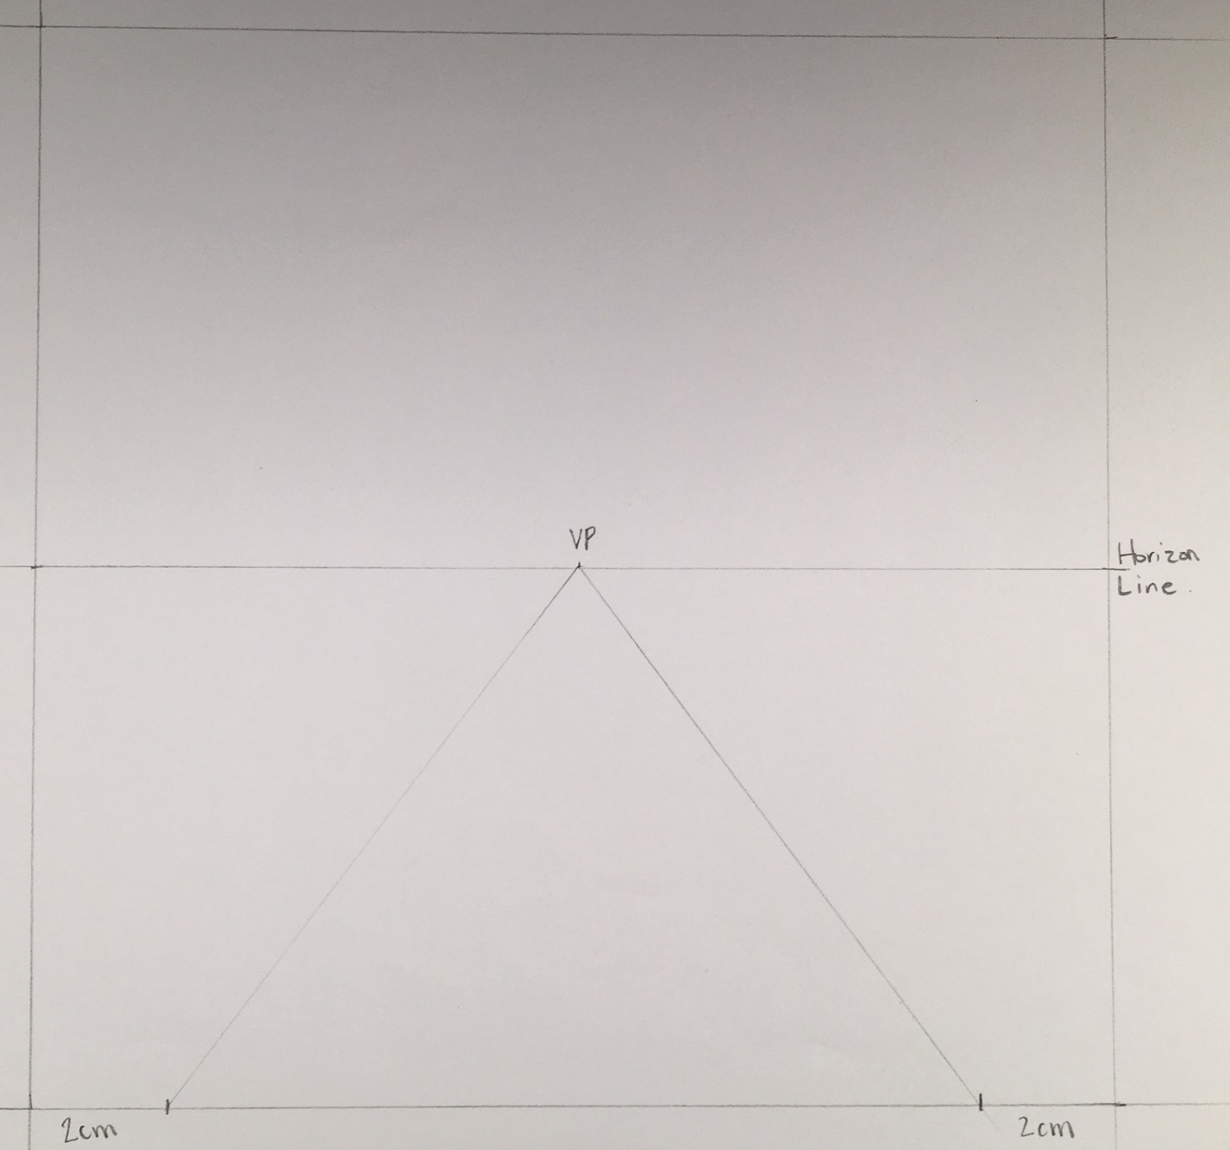
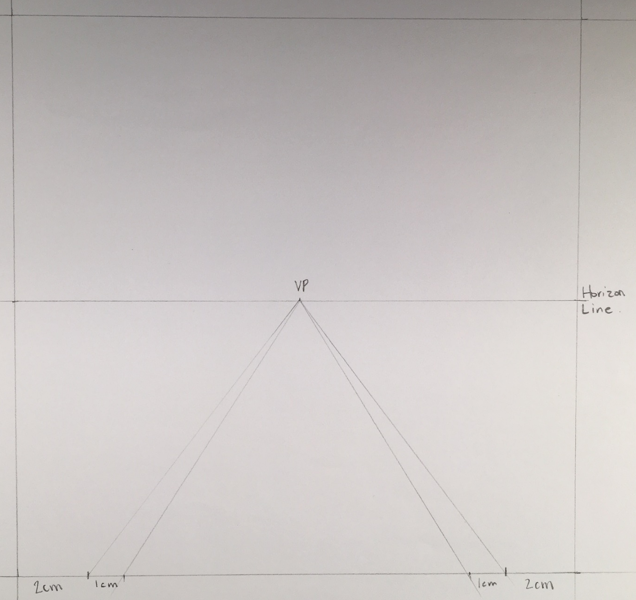
6. On the bottom, measure 2cm in from each side and join them to the VP.
7. Measure another 1cm and join them to the VP

Slide 6
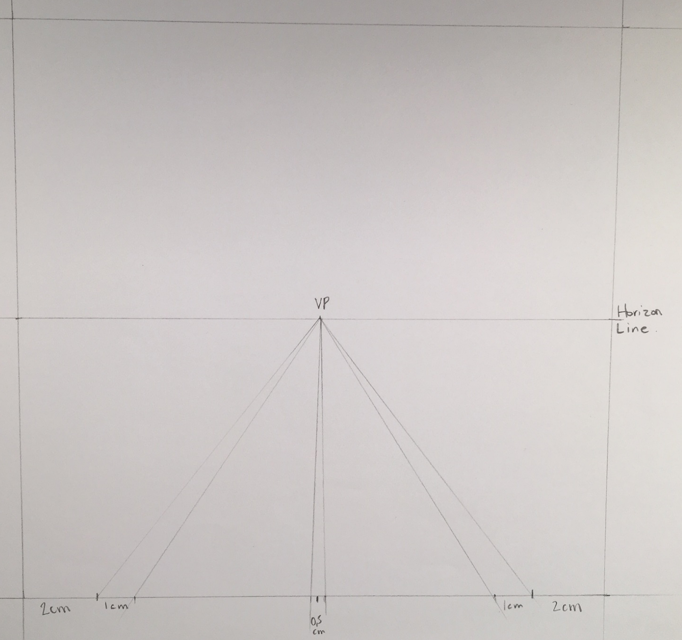
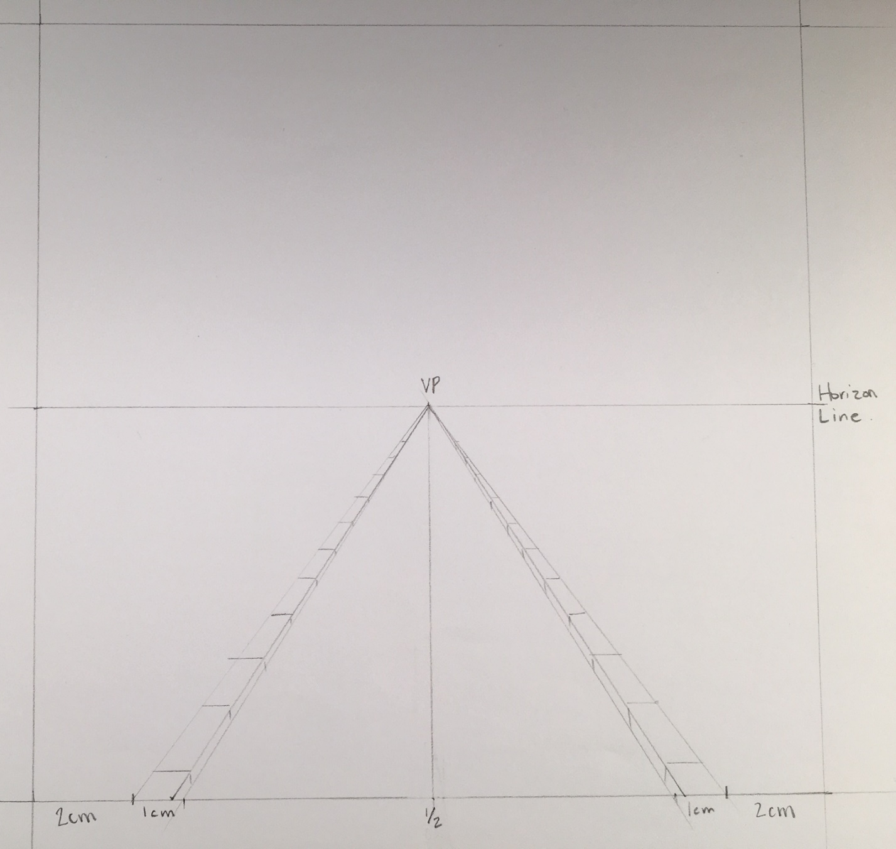
8. Craw a very thin line up the middle of the road. Make sure it joins the VP.
9. Create some paving blocks on the side of the road. Make sure they go from big to small.

Slide 7
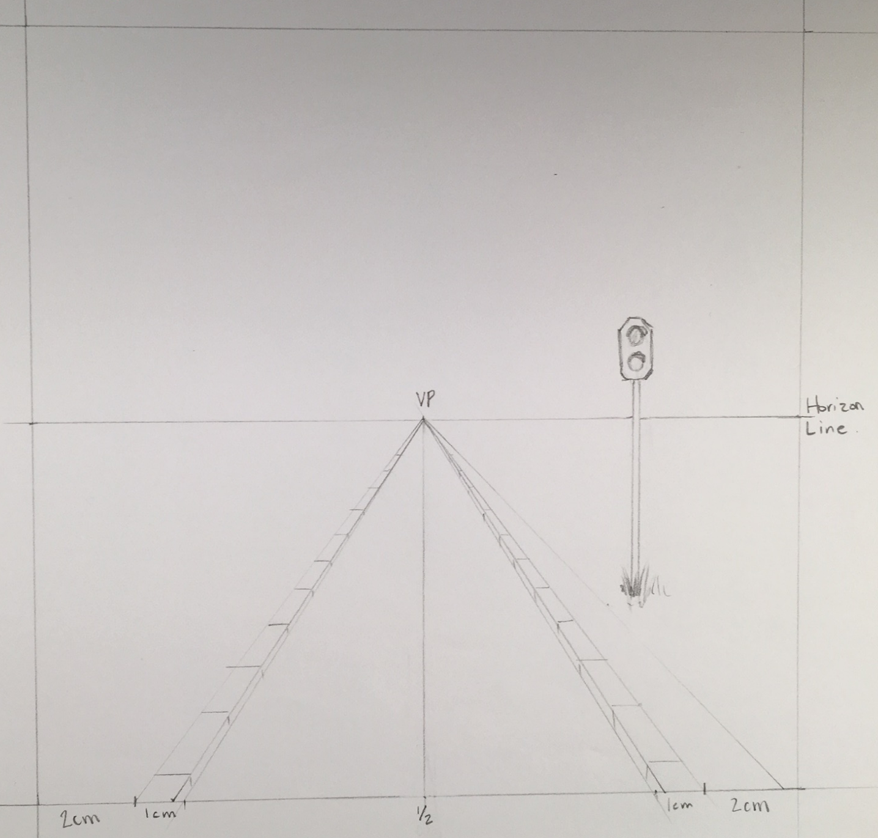
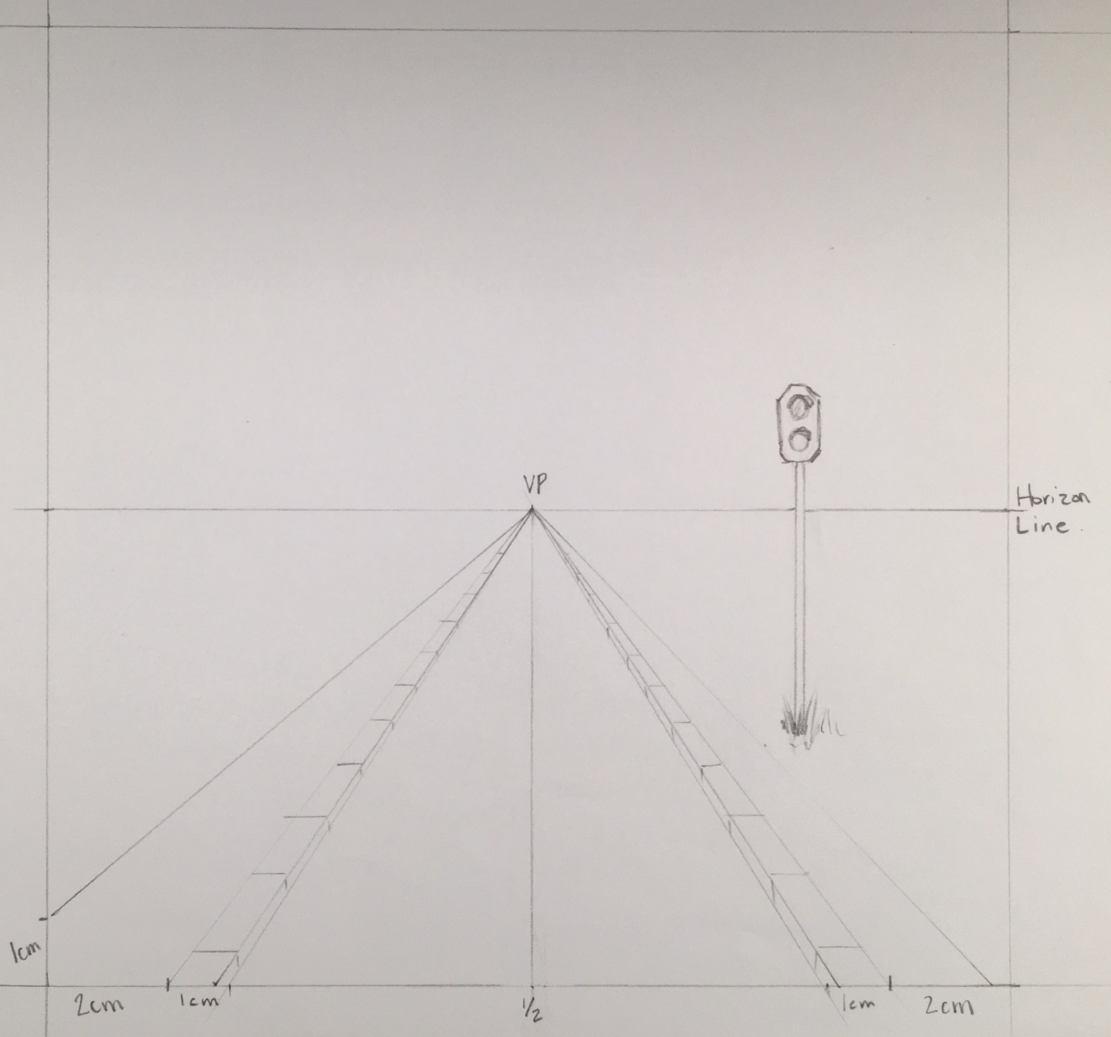
10. Create a path from the bottom right corner going up to the VP
11. Draw a sign next to the path. Be creative and make it any kind of sign you like.
12.On the left side, measure 1cm up from the corner and take it to the VP.
The work is now becoming asymmetrical.

Slide 8
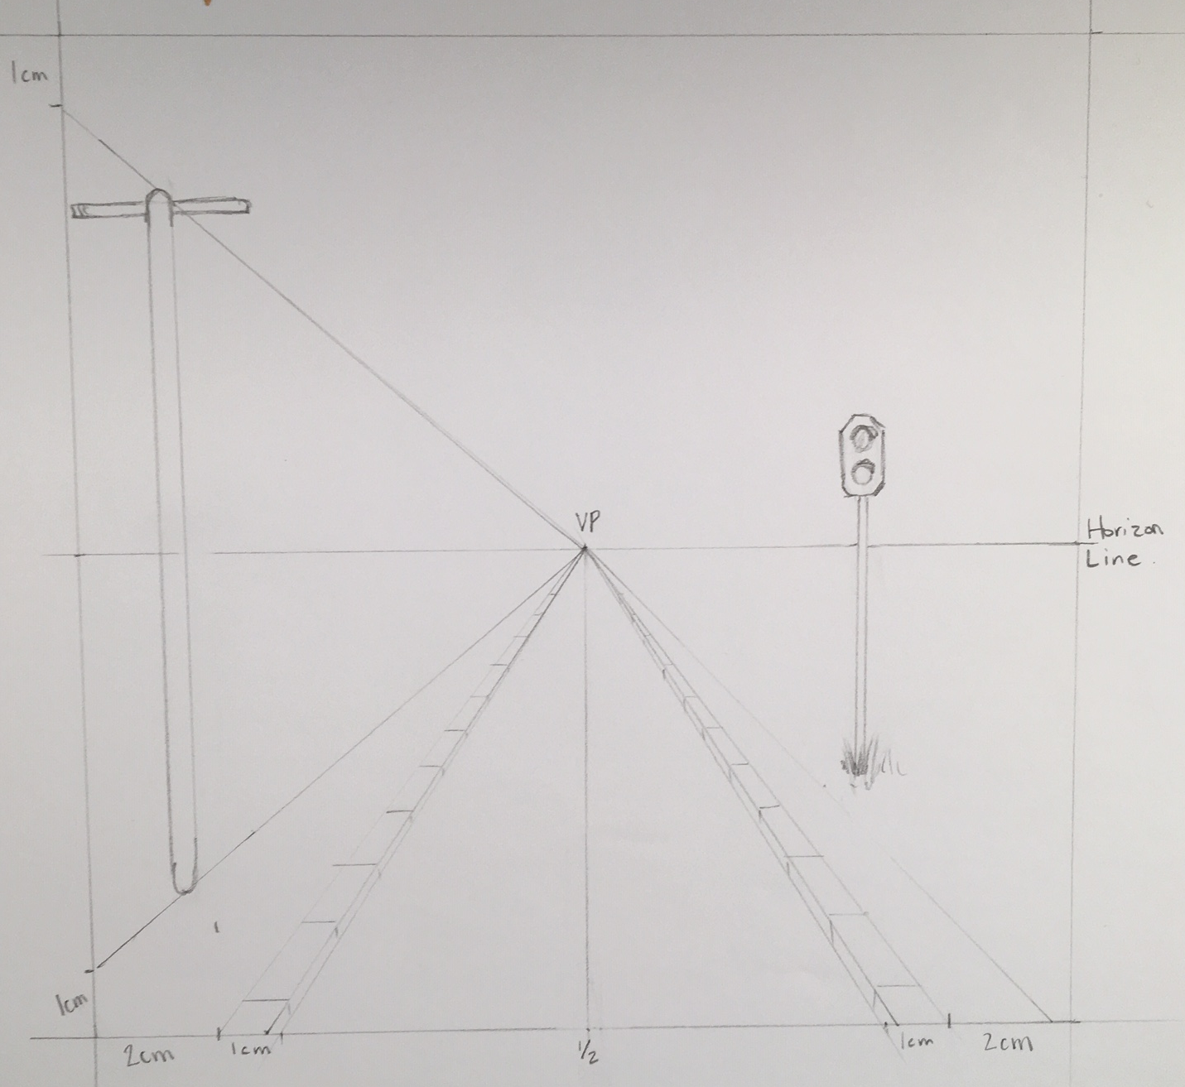
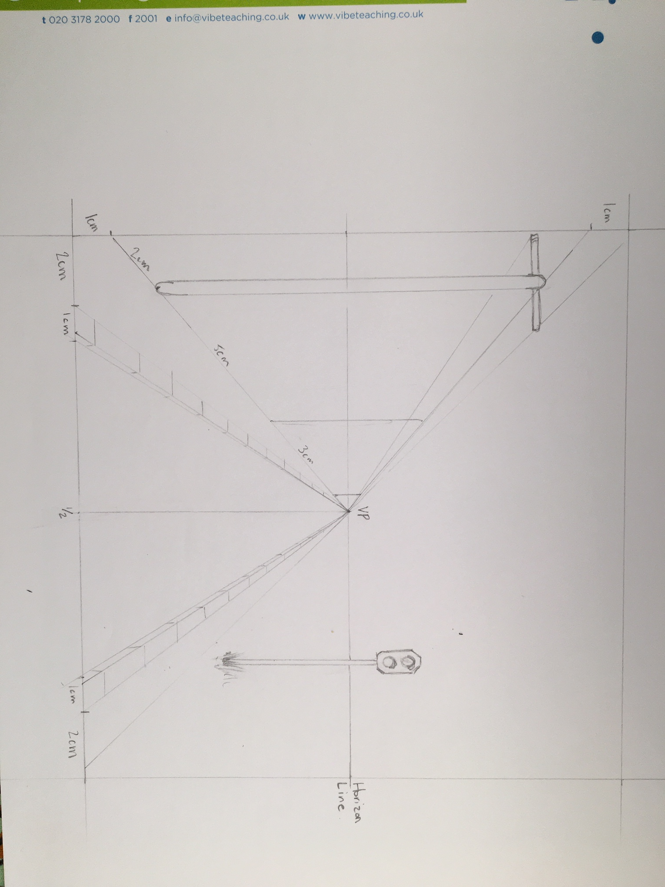
13. From the top left measure 1cm and join it to the VP.
14. Along the bottom line, measure 2cm and then create a post.
15. Repeat this to make the distant posts. Measure along the bottom line. Front post is at 2cm, then measure another 5cm, then measure another 3cm.

Slide 9
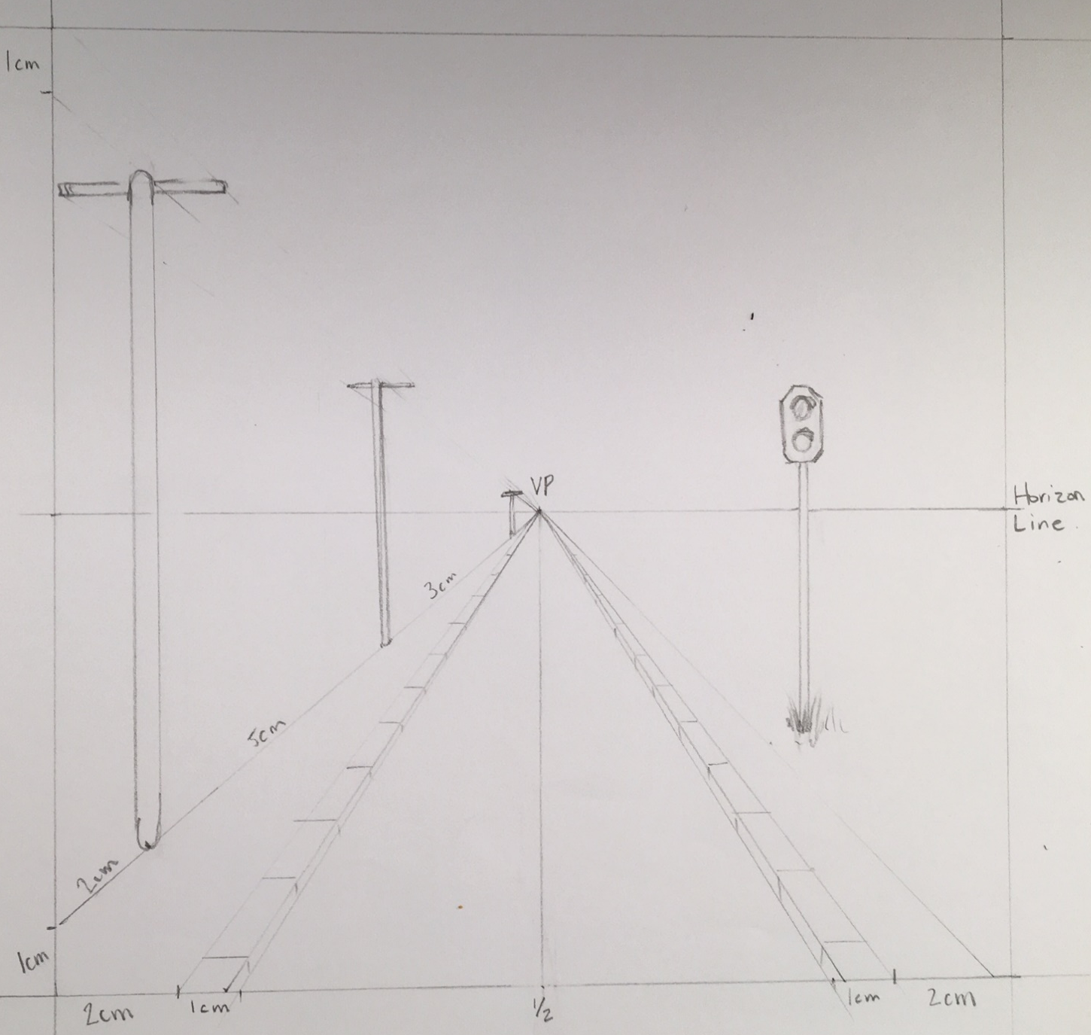
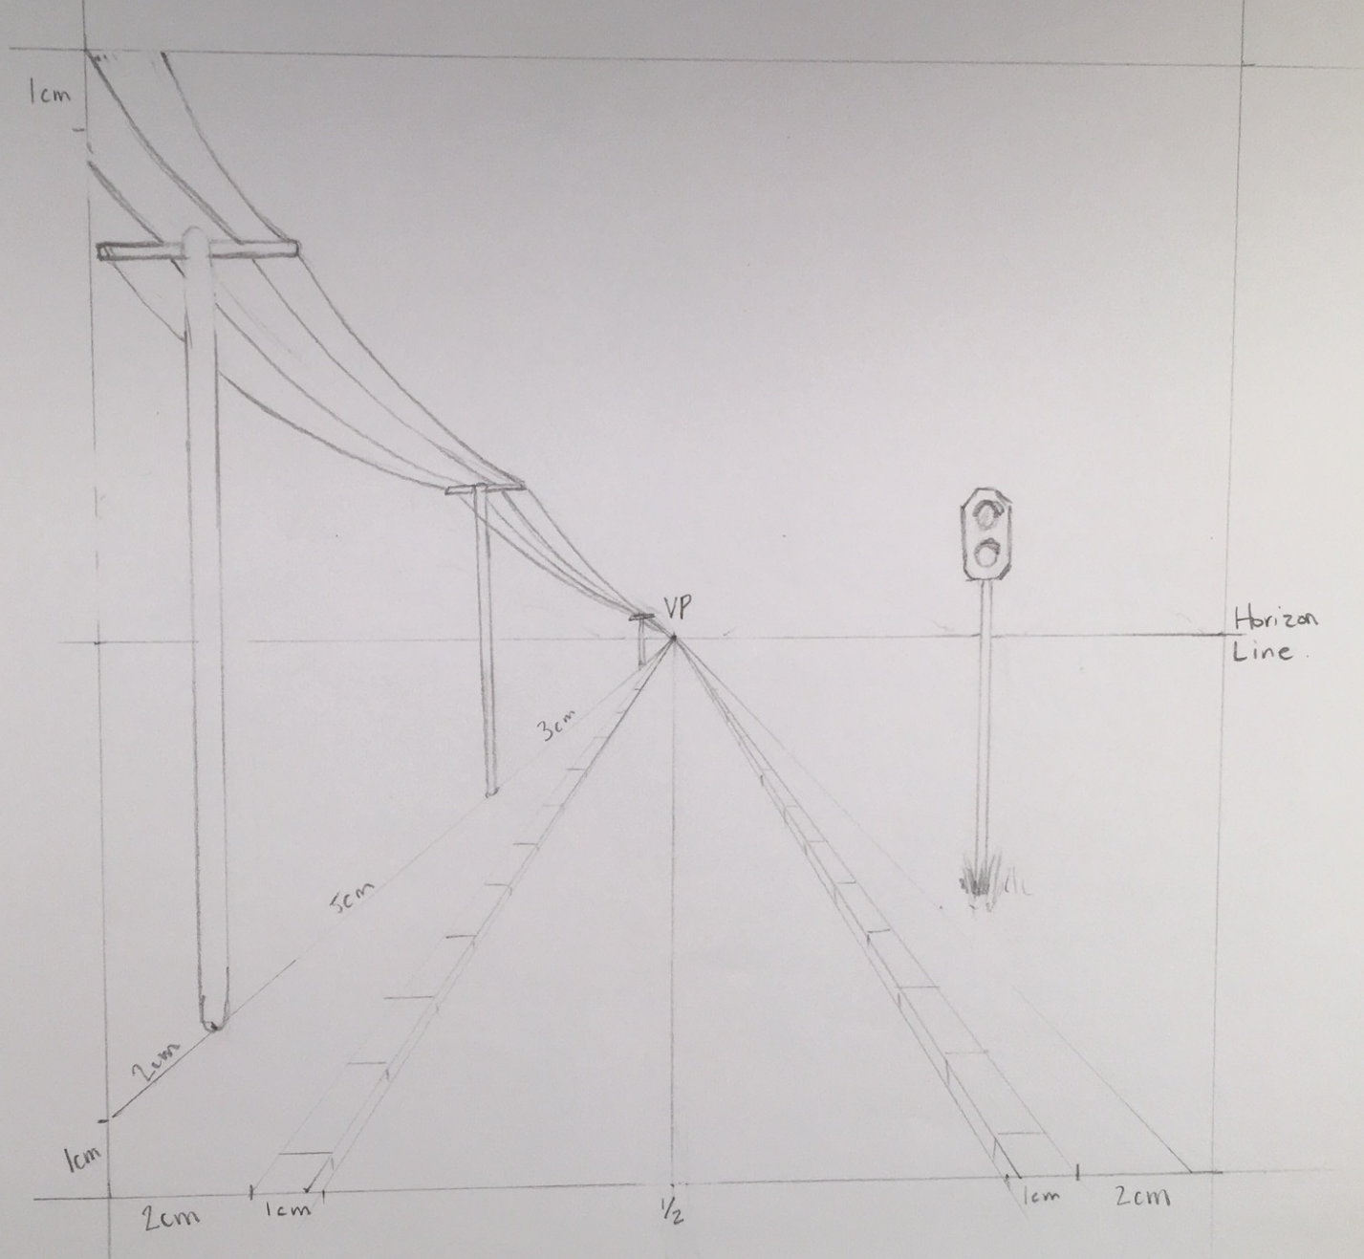
16. Create your three posts.
17. Erase the top guidelines.
18. Add 4 cables.

Slide 10
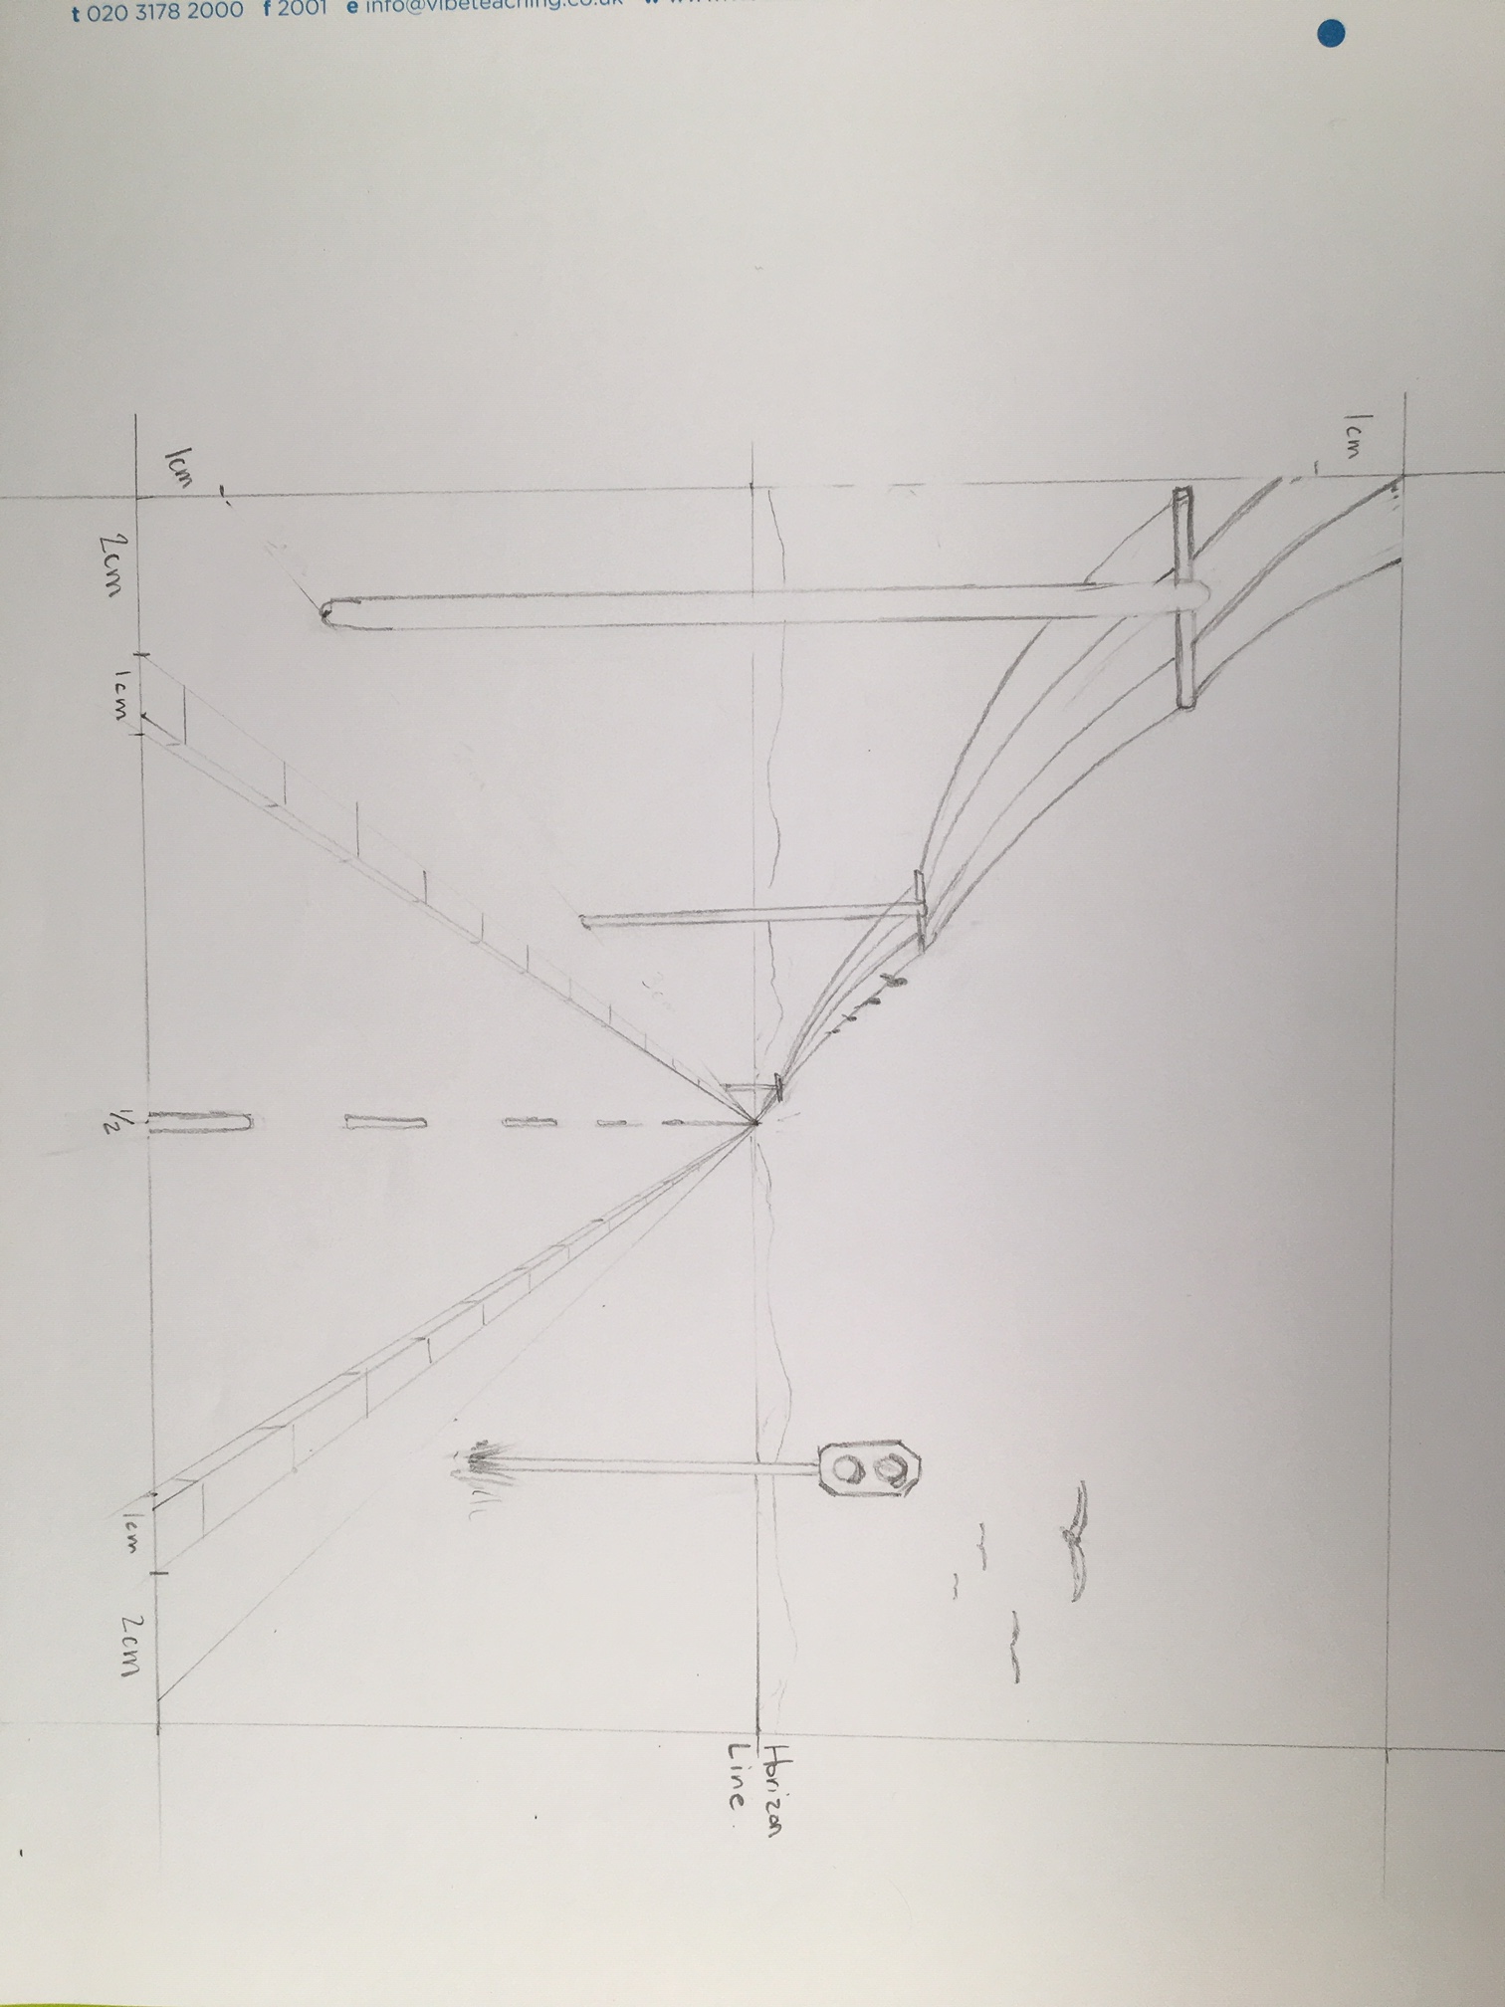
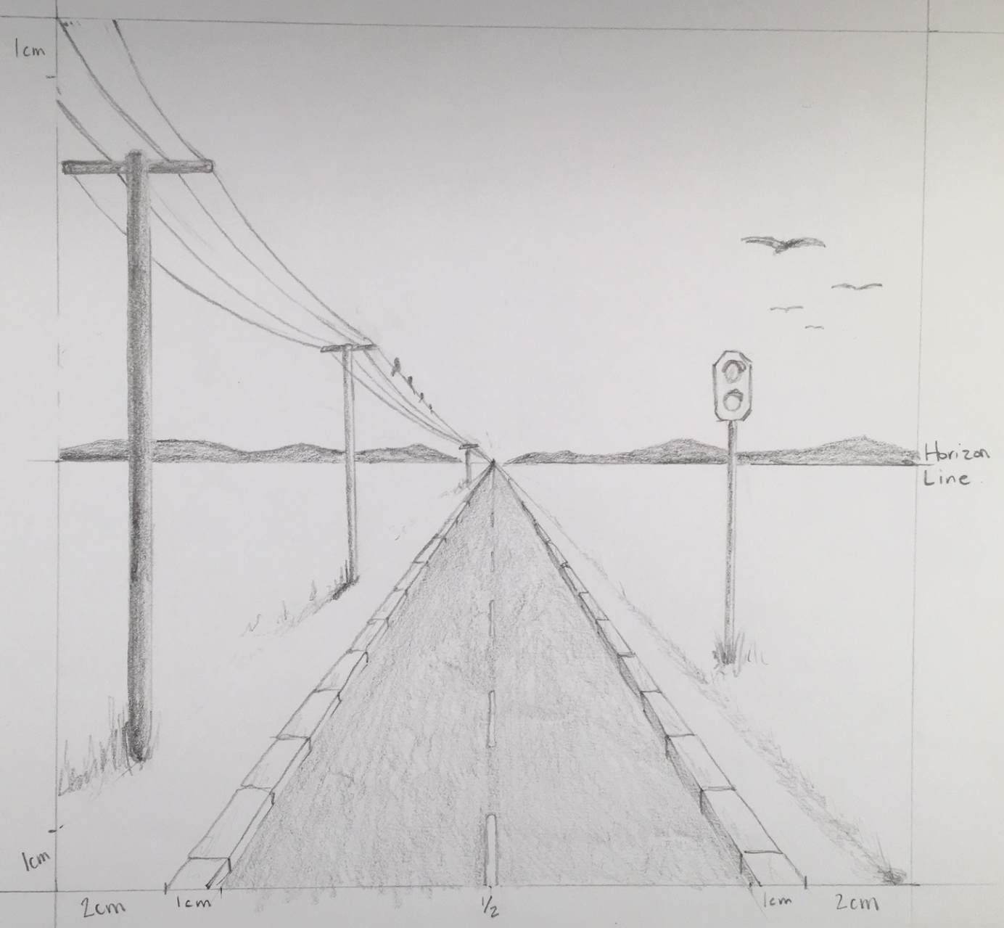
19. Erase your guideline and measurements
20. Draw some hills on the horizon
21. Draw some birds. Either in the sky or on the wire. Remember to have small ones further away.
22. Add shading and textures. AND YOUR DONE!

Slide 11
Now create your own scene. Be creative and have fun!
Here are some lines to get you going. It’s okay if they show through.

