Slide 1
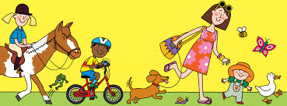

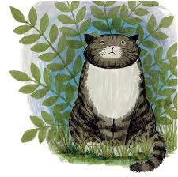
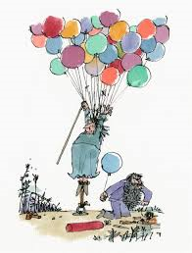
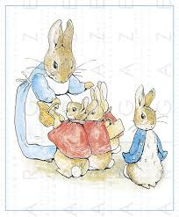
Year 7 Home learning
Complete a research page on one of the following book illustrators
Eric Carle
Judith Kerr
Beatrix Potter
Nick Sharratt
Quentin Blake
It must include:
A Moodboard
A paragraph about the illustrator
One image selected and all key features labelled
2 x drawings, these can be any media but I suggest a pencil drawing and 1 in colour.

