Slide 1


The PiXL Club The PiXL Club The PiXL Club The PiXL Club The PiXL Club The PiXL Club The PiXL Club The PiXL Club The PiXL Club The PiXL Club The PiXL Club The PiXL Club The PiXL Club The PiXL Club The PiXL Club The PiXL Club The PiXL Club The PiXL Club The PiXL Club The PiXL Club The PiXL Club The PiXL Club The PiXL Club The PiXL Club The PiXL Club The PiXL Club The PiXL Club The PiXL Club The PiXL Club The PiXL Club The PiXL Club The PiXL Club The PiXL Club The PiXL Club The PiXL Club The PiXL Club The PiXL Club The PiXL Club The PiXL Club The PiXL Club The PiXL Club The PiXL Club The PiXL Club The PiXL Club The PiXL Club XL Club The PiXL Club The PiXL Club The PiXL Club The PiXL Club The PiXL Club The PiXL Club The PiXL Club The PiXL Club The PiXL Club The PiXL Club The PiXL Club The PiXL Club The PiXL Club The PiXL Club The PiXL Club The PiXL Club The PiXL Club The PiXL Club The PiXL Club The PiXL Club The PiXL Club The PiXL Club The PiXL Club The PiXL Club The PiXL Club The PiXL Club The PiXL Club The PiXL Club The PiXL Club The PiXL Club The PiXL Club The PiXL Club The PiXL Club The PiXL Club The PiXL Club The PiXL Club The PiXL Club The PiXL Club The PiXL Club The PiXL Club The PiXL Club The PiXL Club The PiXL Club The PiXL Club The PiXL Club The PiXL Club The PiXL Club The PiXL Club The PiXL Club The PiXL Club The PiXL Club The PiXL Club The PiXL Club The PiXL Club The PiXL Club The PiXL Club The PiXL Club The PiXL Club The PiXL Club The PiXL Club The PiXL Club The PiXL Club The PiXL Club The PiXL Club The PiXL Club The PiXL Club The PiXL Club The PiXL Club The PiXL Club The PiXL Club The PiXL Club The PiXL Club The PiXL Club The PiXL Club The PiXL Club The PiXL Club The PiXL Club The PiXL Club The PiXL Club The PiXL Club The PiXL Club The PiXL Club The PiXL Club The PiXL Club The PiXL Club The PiXL Club The PiXL Club The PiXL Club The PiXL Club The PiXL Club The PiXL Club The PiXL Club The PiXL Club The PiXL Club The PiXL Club The PiXL Club The PiXL Club The PiXL Club The PiXL Club The PiXL Club The PiXL Club The PiXL Club The PiXL Club The PiXL Club The PiXL Club The PiXL Club The PiXL Club The PiXL Club The PiXL Club The PiXL Club The PiXL Club The PiXL Club The PiXL Club The PiXL Club The PiXL Club The PiXL Club The PiXL Club The PiXL Club The PiXL Club The PiXL Club The PiXL Club The PiXL Club The PiXL Club The PiXL Club The PiXL Club The PiXL Club The PiXL Club The PiXL Club The PiXL Club The PiXL Club The PiXL Club The PiXL Club The PiXL Club The PiXL Club The PiXL Club The PiXL Club The PiXL Club The PiXL Club The PiXL Club The PiXL Club The PiXL Club The PiXL Club The PiXL Club The PiXL Club The PiXL Club The PiXL Club The PiXL Club The PiXL Club The PiXL Club The PiXL Club The PiXL Club The PiXL Club The PiXL Club The PiXL Club The PiXL Club The PiXL Club The PiXL Club The PiXL Club The PiXL Club The PiXL Club The PiXL Club The PiXL Club The PiXL Club The PiXL Club The PiXL Club The PiXL Club The PiXL Club The PiXL Club The PiXL Club The PiXL Club The PiXL Club The PiXL Club The PiXL Club The PiXL Club The PiXL Club The PiXL Club The PiXL Club The PiXL Club The PiXL Club The PiXL Club The PiXL Club The PiXL Club The PiXL Club The PiXL Club The PiXL Club The PiXL Club The PiXL Club The PiXL Club The PiXL Club The PiXL Club The PiXL Club The PiXL Club The PiXL Club The PiXL Club The PiXL Club The PiXL Club The PiXL Club The PiXL Club The PiXL Club The PiXL Club The PiXL Club The PiXL Club The PiXL Club The PiXL Club The PiXL Club The PiXL Club The PiXL Club The PiXL Club The PiXL Club The PiXL Club The PiXL Club The PiXL Club The PiXL Club The PiXL Club The PiXL Club The PiXL Club The PiXL Club The PiXL Club The PiXL Club The PiXL Club The PiXL Club The PiXL Club The PiXL Club The PiXL Club The PiXL Club The PiXL Club The PiXL Club The PiXL Club The PiXL Club The PiXL Club The PiXL Club The PiXL Club The PiXL Club The PiXL Club The PiXL Club The PiXL Club The PiXL Club The PiXL Club The PiXL Club The PiXL Club The PiXL Club The PiXL Club The PiXL Club The PiXL Club The PiXL Club The PiXL Club The PiXL Club The PiXL Club The PiXL Club The PiXL Club The PiXL Club The PiXL Club The PiXL Club The PiXL Club The PiXL Club The PiXL Club The PiXL Club The PiXL Club The PiXL Club The PiXL Club The PiXL Club The PiXL Club The PiXL Club The PiXL Club The PiXL Club The PiXL Club The PiXL Club The PiXL Club The PiXL Club The PiXL Club The PiXL Club The PiXL Club The PiXL Club The PiXL Club The PiXL Club The PiXL Club The PiXL Club The PiXL Club The PiXL Club The PiXL Club The PiXL Club The PiXL Club The PiXL Club The PiXL Club The PiXL Club The PiXL Club The PiXL Club The PiXL Club The PiXL Club The PiXL Club The PiXL Club The PiXL Club The PiXL Club The PiXL Club The PiXL Club The PiXL Club The PiXL Club The PiXL Club The PiXL Club The PiXL Club The PiXL Club The PiXL Club The PiXL Club The PiXL Club The PiXL Club The PiXL Club The PiXL Club The PiXL Club The PiXL Club The PiXL Club The PiXL Club The PiXL Club The PiXL Club The PiXL Club The PiXL Club The PiXL Club The PiXL Club The PiXL Club The PiXL Club The PiXL Club The PiXL Club The PiXL Club The PiXL Club The PiXL Club The PiXL Club The PiXL Club The PiXL Club The PiXL Club The PiXL Club The PiXL Club The PiXL Club The PiXL Club The PiXL Club The PiXL Club The PiXL Club The PiXL Club The PiXL Club The PiXL Club The PiXL Club The PiXL Club The PiXL Club The PiXL Club The PiXL Club The PiXL Club The PiXL Club The PiXL Club The PiXL Club The PiXL Club The PiXL Club The PiXL Club The PiXL Club The PiXL Club The PiXL Club The PiXL Club The PiXL Club The PiXL Club The PiXL Club The PiXL Club The PiXL Club The PiXL Club The PiXL Club The PiXL Club The PiXL Club The PiXL Club The PiXL Club The PiXL Club The PiXL Club The PiXL Club The PiXL Club The PiXL Club The PiXL Club The PiXL Club The PiXL Club The PiXL Club The PiXL Club The PiXL Club The PiXL Club The PiXL Club The PiXL Club The PiXL Club The PiXL Club The PiXL Club The PiXL Club The PiXL Club The PiXL Club The PiXL Club The PiXL Club The PiXL Club The PiXL Club The PiXL Club The PiXL Club The PiXL Club The PiXL Club The PiXL Club The PiXL Club The PiXL Club The PiXL Club The PiXL Club The PiXL Club The PiXL Club The PiXL Club The PiXL Club The PiXL Club The PiXL Club The PiXL Club The PiXL Club The PiXL Club The PiXL Club The PiXL Club The PiXL Club The PiXL Club The PiXL Club The PiXL Club The PiXL Club The PiXL Club The PiXL Club The PiXL Club The PiXL Club The PiXL Club The PiXL Club The PiXL Club The PiXL Club The PiXL Club The PiXL Club The PiXL Club The PiXL Club The PiXL Club The PiXL Club The PiXL Club The PiXL Club The PiXL Club The PiXL Club The PiXL Club The PiXL Club The PiXL Club The PiXL Club The PiXL Club The PiXL Club The PiXL Club The PiXL Club The PiXL Club The PiXL Club The PiXL Club The PiXL Club The PiXL Club The PiXL Club The PiXL Club The PiXL Club The PiXL Club The PiXL Club The PiXL Club The PiXL Club The PiXL Club The PiXL Club The PiXL Club The PiXL Club The PiXL Club The PiXL Club The PiXL Club The PiXL Club The PiXL Club The PiXL Club The PiXL Club The PiXL Club The PiXL Club The PiXL Club The PiXL Club The PiXL Club The PiXL Club The PiXL Club The PiXL Club The PiXL Club The PiXL Club The PiXL Club The PiXL Club The PiXL Club The PiXL Club The PiXL Club The PiXL Club The PiXL Club The PiXL Club The PiXL Club The PiXL Club The PiXL Club The PiXL Club The PiXL Club The PiXL Club The PiXL Club The PiXL Club The PiXL Club The PiXL Club The PiXL Club The PiXL Club The PiXL Club The PiXL Club The PiXL Club The PiXL Club The PiXL Club The PiXL Club The PiXL Club The PiXL Club The PiXL Club The PiXL Club The PiXL Club The PiXL Club The PiXL Club The PiXL Club The PiXL Club The PiXL Club The PiXL Club The PiXL Club The PiXL Club The PiXL Club The PiXL Club The PiXL Club The PiXL Club The PiXL Club The PiXL Club The PiXL Club The PiXL Club The PiXL Club The PiXL Club The PiXL Club The PiXL Club The PiXL Club The PiXL Club The PiXL Club The PiXL Club The PiXL Club The PiXL Club The PiXL Club The PiXL Club The PiXL Club The PiXL Club The PiXL Club The PiXL Club The PiXL Club The PiXL Club The PiXL Club The PiXL Club The PiXL Club The PiXL Club The PiXL Club The PiXL Club The PiXL Club The PiXL Club The PiXL Club The PiXL Club The PiXL Club The PiXL Club The PiXL Club The PiXL Club The PiXL Club The PiXL Club The PiXL Club The PiXL Club The PiXL Club The PiXL Club The PiXL Club The PiXL Club The PiXL Club The PiXL Club The PiXL Club The PiXL Club The PiXL Club The PiXL Club The PiXL Club The PiXL Club The PiXL Club The PiXL Club The PiXL Club The PiXL Club The PiXL Club The PiXL Club The PiXL Club The PiXL Club The PiXL Club The PiXL Club The PiXL Club The PiXL Club The PiXL Club The PiXL Club The PiXL Club The PiXL Club The PiXL Club The PiXL Club The PiXL Club The PiXL Club The PiXL Club The PiXL Club The PiXL Club The PiXL Club The PiXL Club The PiXL Club The PiXL Club The PiXL Club The PiXL Club The PiXL Club The PiXL Club The PiXL Club The PiXL Club The PiXL Club The PiXL Club The PiXL Club The PiXL Club The PiXL Club The PiXL Club The PiXL Club The PiXL Club The PiXL Club The PiXL Club The PiXL Club The PiXL Club The PiXL Club The PiXL Club The PiXL Club The PiXL Club The PiXL Club The PiXL Club The PiXL Club The PiXL Club The PiXL Club The PiXL Club The PiXL Club The PiXL Club The PiXL Club The PiXL Club The PiXL Club The PiXL Club The PiXL Club The PiXL Club The PiXL Club The PiXL Club The PiXL Club The PiXL Club The PiXL Club The PiXL Club The PiXL Club The PiXL Club The PiXL Club The PiXL Club The PiXL Club The PiXL Club The PiXL Club The PiXL Club The PiXL Club The PiXL Club The PiXL Club The PiXL Club The PiXL Club The PiXL Club The PiXL Club The PiXL Club The PiXL Club The PiXL Club The PiXL Club The PiXL Club The PiXL Club The PiXL Club The PiXL Club The PiXL Club The PiXL Club The PiXL Club The PiXL Club The PiXL Club The PiXL Club The PiXL Club The PiXL Club The PiXL Club The PiXL Club The PiXL Club The PiXL Club The PiXL Club The PiXL Club The PiXL Club The PiXL Club The PiXL Club The PiXL Club The PiXL Club The PiXL Club The PiXL Club The PiXL Club The PiXL Club The PiXL Club The PiXL Club The PiXL Club The PiXL Club The PiXL Club The PiXL Club The PiXL Club The PiXL Club The PiXL Club The PiXL Club The PiXL Club The PiXL Club The PiXL Club The PiXL Club The PiXL Club The PiXL Club The PiXL Club
PiXL KnowIT!
GCSE Biology
Edexcel Topic – Cells and Control
© Copyright The PiXL Club Ltd, 2017
This resource is strictly for the use of member schools for as long as they remain members of The PiXL Club. It may not be copied, sold nor transferred to a third party or used by the school after membership ceases. Until such time it may be freely used within the member school.
All opinions and contributions are those of the authors. The contents of this resource are not connected with nor endorsed by any other company, organisation or institution.
www.pixl.org.uk The PiXL Club Ltd, Company number 07321607

Slide 2
Overview
Cells and control
Cell division
  Cell cycle & mitosis
  Cancer
  Stem cells
Growth and differentiation
  Growth
  Cell differentiation
Central Nervous System
  Brain structures and functions
  CT and PET Scanning (Biology HT ONLY)
  Limitations of treating problems in the CNS (Biology HT ONLY)
  Structure and function of neurons
  Reflex arc
  Eye – structure, functions and defects (Biology ONLY)

Slide 3
LearnIT!
KnowIT!
Cell division
(2.1-2.9)
  Mitosis and the cell cycle
  Cancer
  Stem cells
  Growth and cell differentiation

Slide 4
  Cells and control part 1 - Mitosis and the cell cycle
Mitosis is a type of cell division.
Mitosis occurs during growth when the number of cells needs to increase and also to repair or replace damaged cells.
Asexual reproduction occurs by mitosis in plants and simple animals.
The overall process of growth and division is known as the cell cycle.
Cytokinesis
Mitosis
Growth of the cell and increase in number of
sub-cellular structures
DNA replication occurs. Each chromosome is copied.
Notes:
https://www.youtube.com/watch?v=lpAa4TWjHQ4

Slide 5
  Cells and control part 1 - Mitosis and the cell cycle
In the cell cycle, cells divide by mitosis in a series of stages. The genetic material is doubled and then divided into two identical cells.
During interphase in the cell cycle…
Growth must occur: Before a cell can divide it needs to grow and increase the number of sub-cellular structures such as ribosomes and mitochondria. DNA is then duplicated to form two copies of each chromosome.
Interphase is the longest stage in the cell cycle.
Mitosis now begins. Four stages occur…
Prophase: the nuclear membrane dissolves and the chromosomes become shorter and fatter.
Metaphase: the spindle forms and the chromosomes line up on the equator.
Anaphase: the spindle fibres pull the identical chromosomes apart to opposite ends of the cell.
Telophase: Membranes form around the outside of each set of chromosomes. These are the nuclei of the 2 new daughter cells.
The cytoplasm and cell membrane divide and two new identical cells are formed. This process of splitting is called cytokinesis.
You need to remember the stages of mitosis and what occurs.

Slide 6
  Cells and control part 1 - Mitosis and the cell cycle
Not all stages of mitosis have been pictured.
Interphase
Metaphase
Anaphase
The rate at which a cell divides by mitosis is controlled by its genetic information.
A mutation might alter a gene controlling cell division allowing cells to start dividing uncontrollably.
This can result in the formation of a tumour.
Two diploid daughter cells are produced each with identical sets of chromosomes in the nucleus to each other and the original parent cell.

Slide 7
  Cells and control part 1- Cancer
Uncontrolled cell division and growth results in the formation of a tumour (mass of cells), these can be BENIGN or MALIGNANT, not all tumours are cancerous.
Benign tumours:
  Growths of abnormal cells
  Contained in one area
  Usually within a membrane surrounding the cells
  They do not invade other parts of the body Video - Benign Brain Tumour
Malignant tumour (CANCER):
    Growths of abnormal cells
    These are cancerous
    Invade neighbouring tissues and spread to different parts of the body in the blood where they form secondary tumours
    Can be caused by lifestyle or genes
      Video - What is Cancer?
Notes:
https://www.youtube.com/watch?v=UopUxkeC4Ls

Slide 8

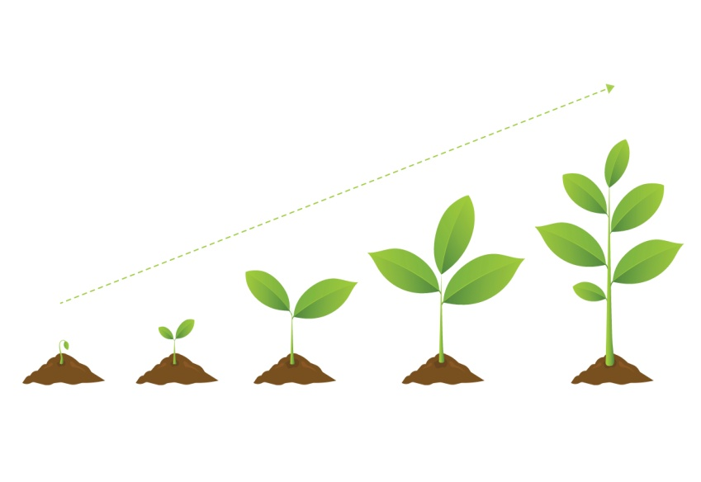
  Cells and control part 1 -Growth
Growth is defined as an increase in size or mass.
Growth occurs in young animals by rapid cell division all over the body. As animals get older most cell division is simply to replace or repair damaged cells.
Growth in plants occurs by cell division at the root and shoot tips. Cells increase in size or height by cell elongation.
This happens throughout the plants life.

Slide 9
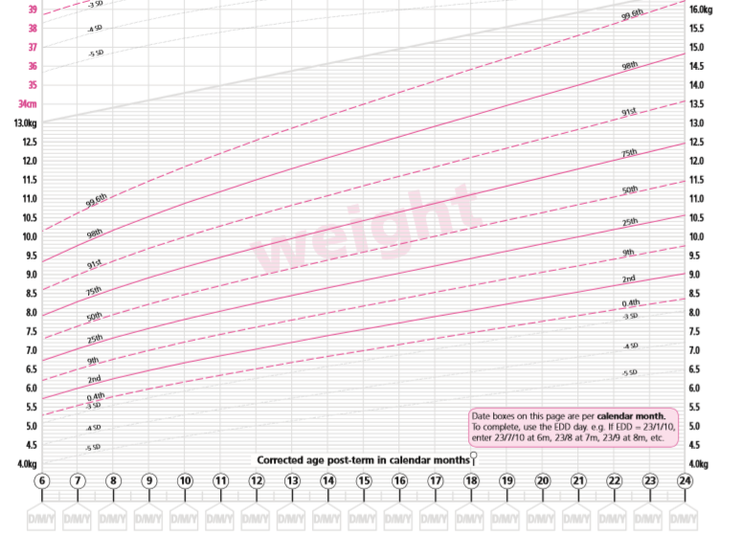
  Cells and control part 1 - growth
This is an example of a NHS percentile chart used to monitor growth of a baby girl from 6 months to 2 years. There are separate charts for length, mass and head circumference.
A 9 month old girl who weighs 7.5kg is on the 25th percentile. This means 75% of 9 month old girls are heavier and 25% are lighter. Further tests on the girl would occur if the mass fell below the bottom percentile line or was above the top line or an inconsistent pattern like low mass with large head circumference or the mass increased or decreased by two percentile lines over a short time.
Mass (kg)
Child’s age in months after birth ( 6 months – 2 years)
Notes:
Growth chart examples https://www.rcpch.ac.uk/system/files/protected/page/GIRLS%20NICM%20(4th%20Jan%202013).pdf

Slide 10
  Cells and control part 1 - Cell differentiation
Cell differentiation occurs as organisms develop and the cell changes to become specialised. As the cell differentiates, it forms different sub-cellular structures, e.g. the tail on a sperm cell or the hairs on a root hair cell.
Most types of ANIMAL cells differentiate in the early stage of development.
Most types of PLANT cells can differentiate throughout their life cycle.

Slide 11
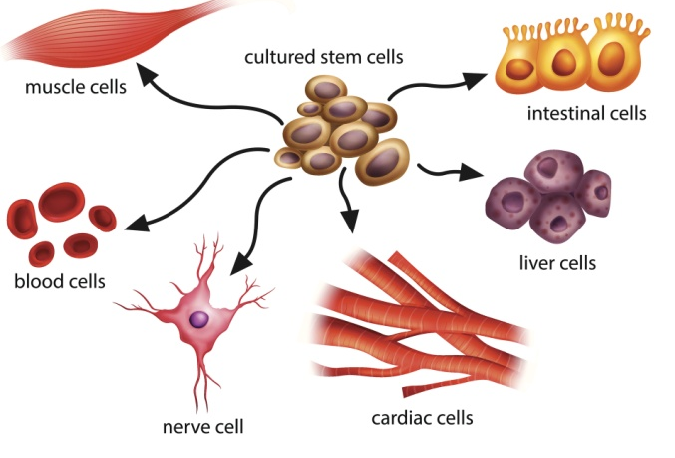
  Cells and control part 1 –Stem cells
Stem cells are undifferentiated cells within an organism. They can produce other stem cells that can then differentiate into many different types of cells.
Human embryo stem cells can be cloned and made to differentiate into most different types of human cells.
Human adult stem cells can form many (but not all) types of cells including blood cells.
Human stem cells can be used to help treat diseases like diabetes and paralysis.
Embryos produced by therapeutic cloning have the same genes as the patient.
This means stem cells from the embryo are not rejected by the patient’s body.
This is why they can be used for medical treatments.
The risks of using stem cells risks such as the transfer of viral infections.
Some people have objections to stem cell use for ethical and religious reasons. During fertility treatment doctors usually fertilise many more eggs than are going to be used. The embryos formed are used to obtain stem cells.
In the UK, scientists can use these embryos for research but only under very strict guidelines.

Slide 12
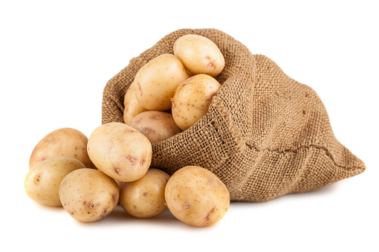
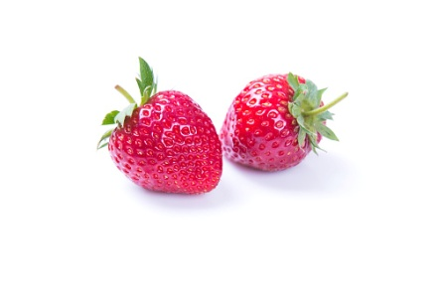
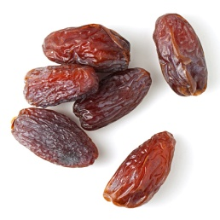
  Cells and control part 1- Stem Cells (plants)
Most types of PLANT cells can differentiate throughout their life cycle.
Undifferentiated stem cells in plants are grouped together in structures called meristems.
The undifferentiated cells can then specialise e.g. root hair cell, xylem or phloem cells.
Stem cells from meristems in plants can be used to produce clones of plants quickly and economically.
• Rare species can be cloned to protect from extinction.
• Crop plants with special features, such as disease resistance, can be cloned to produce large numbers of identical plants for farmers
e.g. potatoes, strawberries and dates.

Slide 13
QuestionIT!
Cell division
  Mitosis and the cell cycle
  Cancer
  Stem cells
  Growth and differentiation

Slide 14
1. What is mitosis?
2. What are the three main stages of the cell cycle?
3. List the 4 stages involved in mitosis, starting with prophase.
4. Why is mitosis important to the organism?
5. How many daughter cells are formed as a result of mitosis?
6. How many chromosomes are present in a human diploid cell?
7. What is cancer?
8. What is the definition of growth?
9. Does cell elongation occur in animal or plant growth?
10. What is cell differentiation?
11. If a baby was described as being on the 50th percentile for head circumference– what does that mean?
12. What is a stem cell?
13. How is a human embryonic stem cell different to an adult stem cell?
14. Where is a meristem found?
15. What is a meristem?
16. Name a benefit and a risk to using stem cells in medicine.
  Cells and control part 1 - Question IT

Slide 15
  Cells and control part 1 - Question IT
17. In what stage of an animal’s life cycle do most cells differentiate?
18. In mature animals when do cells still need to differentiate?
19. In what stage of their life cycle do plant cells differentiate?

Slide 16

AnswerIT!
Cell division
  Mitosis and the cell cycle
  Cancer
  Stem cells
  Growth and differentiation

Slide 17
1. What is mitosis? A type of cell division
2. What are the three stages of the cell cycle? Growth, DNA synthesis and mitosis.
3. List the stages involved in mitosis, starting with prophase. Prophase, metaphase, anaphase, telophase
4. Why is mitosis important to the organism?
For growth
Repair or replacement of damaged cells
Asexual reproduction in some animals
5. How many daughter cells are formed as a result of mitosis? 2
6. How many chromosomes are present in a human diploid cell? 46
7. What is cancer? Uncontrolled cell division as a result of changes in cells.
8. What is the definition of growth? Increase in size or number of cells.
  Cells and control part 1 – AnswerIT

Slide 18
  Cells and control part 1 – AnswerIT
9. Does cell elongation occur in animal or plant growth? Plant
10. What is cell differentiation? The process by which a cell changes to become specialised for a specific role.
11 If a baby was described as being on the 50th percentile for head circumference– what does that mean? 50% of children have a bigger head and 50% have a smaller head.
12. What is a stem cell? An undifferentiated cell.
13. How is a human embryonic stem cell different to an adult stem cell? Embryonic stem cells have the potential to divide and produce any type of body cell.
Adult stem cells can only differentiate to form a few types of cells e.g. red blood cells.
14. Where is a meristem found? In a plant shoot or root tip
15. What is a meristem? This is where the plant produces undifferentiated cells .

Slide 19
  Cells and control part 1 – AnswerIT
16. Name a benefit and a risk to using stem cells in medicine.
Benefits: Already in use to cure some diseases by bone marrow transplant.
Can be used to create specialised cells to replace damaged ones.
Potential for being able to find new cures to life changing conditions such as spinal injuries or CNS diseases.
Risks: Diseases can be passed on as viruses are found inside cells and may go undetected in the stem cells used.
Tumour development- stem cells divide very quickly and if this is not controlled then a tumour may develop.
Rejection – stem cells which are not from the patient are likely to trigger an immune response.
A patient undergoing stem cell treatment will have to take immunosuppressive drugs which makes them more susceptible to disease.

Slide 20
  Cells and control part 1 – AnswerIT
17. In what stage of an animal’s life cycle do most cells differentiate?
In the early stages.
18. In mature animals when do cells still need to differentiate?
For repair and replacement of cells.
19. In what stage of their life cycle do plant cells differentiate?
They differentiate throughout their lifecycle.

Slide 21
LearnIT!
KnowIT!
The Central Nervous system
Part 2 (2.10B -2.12B)
  Brain structures and functions
  CT and PET Scanning (Biology HT ONLY)
  Limitations of treating problems in the CNS (Biology HT ONLY)

Slide 22
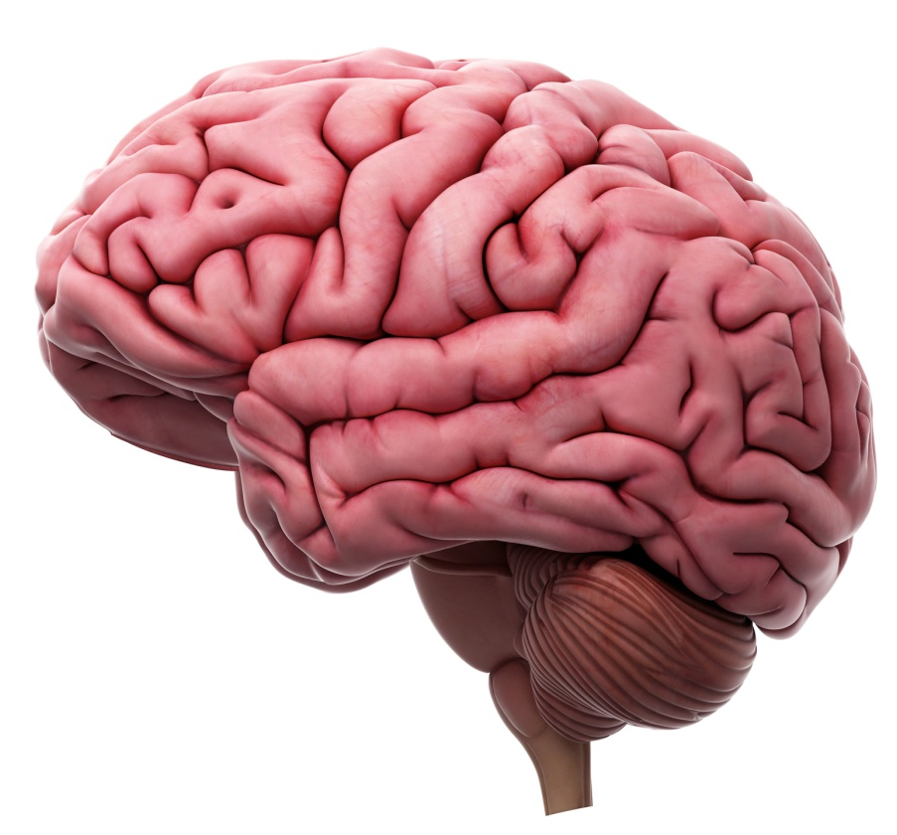
  The central nervous system Part 2 - The brain (biology only)
The brain controls complex behaviour. It is made of billions of interconnected neurones and has different regions that carry out different functions.
cerebral hemispheres
Three of the main structures in the brain are:
Cerebral hemispheres – the outer ‘wrinkled’ layers of the brain. It is responsible for intelligence, language, memory and consciousness.
Cerebellum – is located at the lower part of the back of the brain. It is responsible for voluntary coordination of the muscles and balance.
Medulla oblongata – is located in the lower part of the brain stem. It is responsible for involuntary (unconscious) coordination such as breathing, swallowing and heart rate.
front
back
medulla oblongata
cerebellum
Video - The Brain
Notes:
https://www.youtube.com/watch?v=5_vT_mnKomY

Slide 23
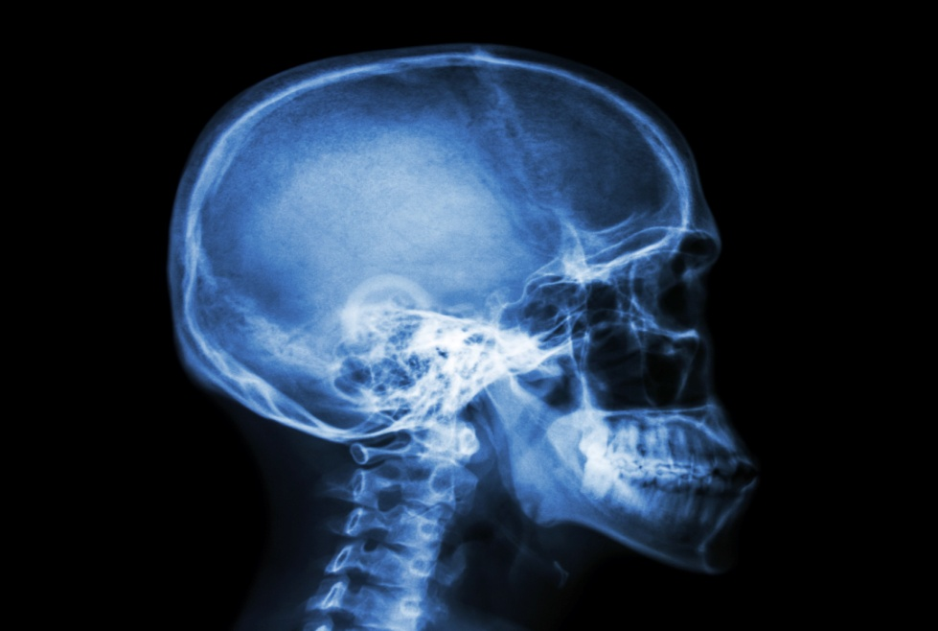
  The central nervous system Part 2 - The brain (HT biology only)
A neuroscientist is a scientist that studies the structure and function of the brain. The complexity and delicacy of the brain makes investigating the brain and treating brain disorders very difficult.
Accessing the brain tissue inside the hard, protective skull can be difficult.
Neuroscientists use CT or PET scanning to investigate brain function.
Studying brain damage
Damage to different brain areas produces different behavioural
and psychological effects. For example, damage in the front end
of the brain disturbs the ability to make decisions whereas
damage to the back of the brain disturbs vision.

Slide 24
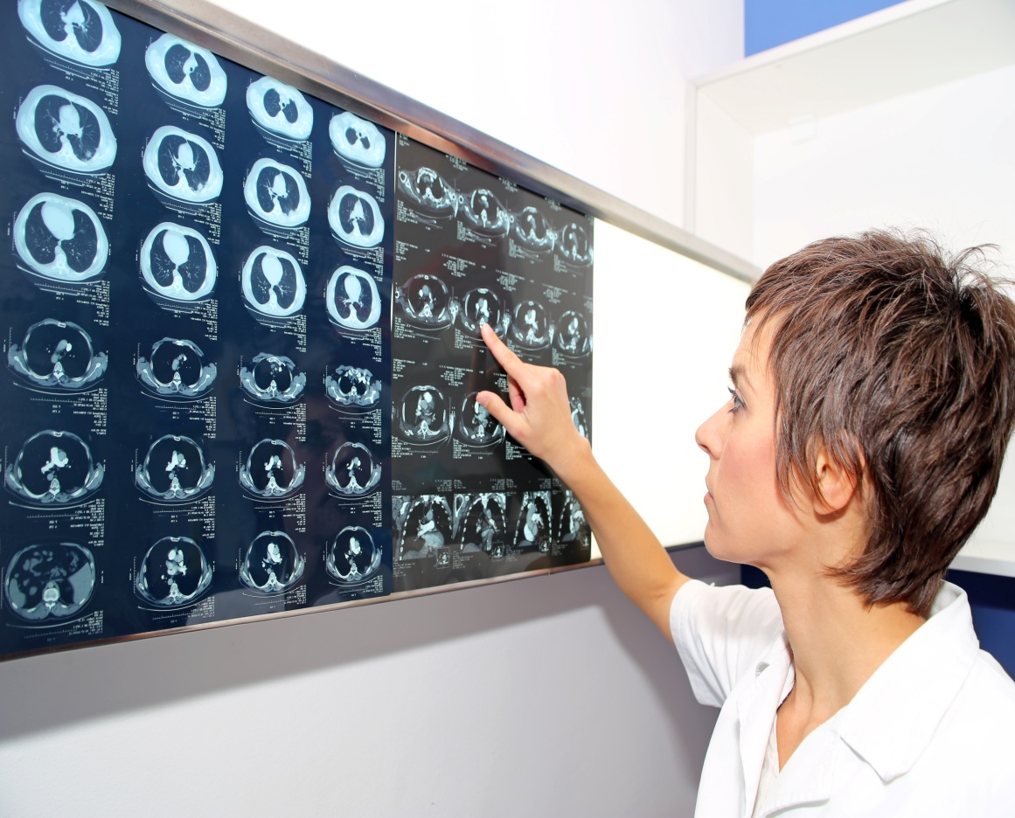
  The central nervous system Part 2 - The brain
  (HT biology only)
A CT (computerised tomography) scan uses X-rays to produce detailed 2-d images of the brain.
A CT scan results in the body being subjected to a dose of ionising radiation that is much greater than for a simple X-ray as it takes hundreds of images.
CT scans are commonly performed and generally safe. Any increased risk of cancer usually outweighs the benefits of having the scan.
A CT scan shows the main structures of the brain. The function of the brain cannot be tested using this equipment. A CT scan will show diseased or damaged areas and this can then give a good idea of why the brain is not functioning effectively.

Slide 25
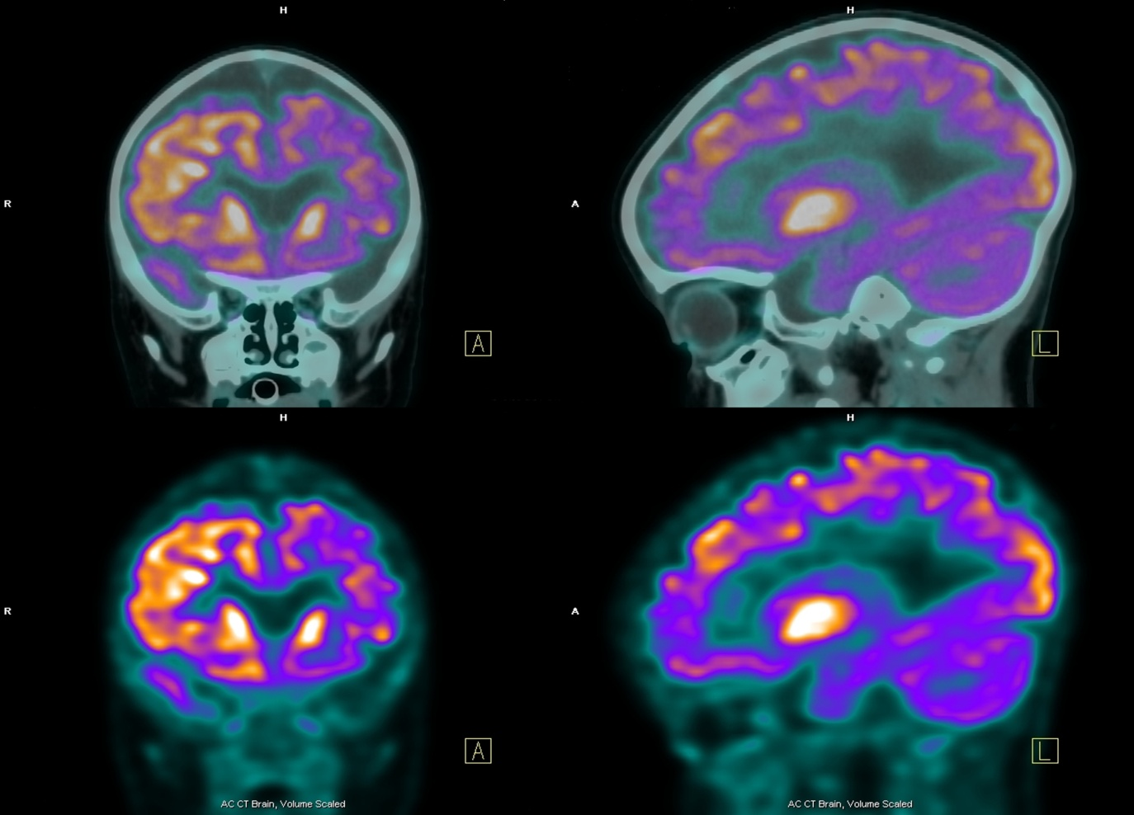
  The central nervous system Part 2 - The brain
  (HT biology only)
A PET (positron emission tomography) scan uses radioactive tracer chemicals to show which parts of the brain are functioning whilst in the scanner.
It measures oxygen use and blood flow. More active parts of the brain show in red or orange colours. Green shows low activity.
A PET scan shows both the main structures of the brain and the function of the brain in real time. PET scans are useful for studying disorders like Alzheimer’s disease where activity in parts of the brain are reduced compared to a healthy brain.

Slide 26
  The central nervous system Part 2 - The brain (biology only)
Treatment of brain or spinal cord injuries, tumours or CNS diseases can be difficult.
Drugs do not always pass through the protective membrane which surrounds the brain and spinal cord.
The skull and bony vertebrae means it is difficult to access the brain and spinal cord tissue without risky surgery which can itself lead to permanent damage being caused. Not all areas of the brain are fully understood yet.
Neurones do not automatically repair themselves unlike some other cells in the body. Stem cells are currently being pioneered as one method of treating spinal cord injuries.

Slide 27
QuestionIT!
The Central Nervous system
Part 2
  Brain structures and functions
  CT and PET Scanning (Biology HT ONLY)
  Limitations of treating problems in the
  CNS (Biology HT ONLY)

Slide 28
  The central nervous system Part 2 - Question IT
Name the three main parts of the brain and state the role of each.
What is a CT scan?
What is a PET scan?
What does a PET scan do?
What are the limitations in treating damage and disease in the brain and nervous system?

Slide 29
AnswerIT!
The Central Nervous system
Part 2
  Brain structures and functions
  CT and PET Scanning (Biology HT ONLY)
  Limitations of treating problems in the CNS (Biology HT ONLY)

Slide 30
  The central nervous system Part 2 - AnswerIT
Name the three main parts of the brain and state the role of each.
cerebral hemispheres– the outer ‘wrinkled’ layer of the brain. It is responsible for intelligence, language, memory and consciousness; cerebellum – is located at the lower part of the back of the brain and is responsible for voluntary coordination of the muscles; medulla oblongata – is located in the lower part of the brain stem. It is responsible for involuntary coordination such as breathing, swallowing and heart rate.
What is a CT scan? A scanner which uses X-rays to produce images of the brain
What is a PET scan? A scanner which uses radioactive chemicals to produce images of the brain
What does a PET scan do? The scanner can show both structure and function of the brain which can show if parts of the brain are abnormally active or inactive compared to a healthy brain.
What are the limitations in treating damage and disease in the brain and nervous system?
Drugs do not always pass through the protective membrane which surrounds the brain and spinal cord. The skull and bony vertebrae means it is difficult to access the brain and spinal cord tissue without risky surgery which can itself lead to permanent damage being caused.

Slide 31
LearnIT!
KnowIT!
The Central Nervous system
Part 3
(2.13-2.14)
  Structure and function of neurons
  Reflex arc

Slide 32
  The central nervous system Part 3 - Structure and function
The nervous system enables humans to react to their surroundings and to coordinate their behaviour.
A stimulus is any change in the soundings. These are detected by receptors (cells that detect a change) and information passes along cells (neurones) as electrical impulses to the central nervous system (CNS).
The CNS is the brain and spinal cord.
The CNS coordinates the response of effectors which may be muscles contracting or glands secreting hormones.
stimulus → receptor → coordinator → effector → response

Slide 33
  The central nervous system Part 3 - Structure and function
There are three main types of neurones:
Sensory neurones – these carry impulses from the receptors to the central nervous system (CNS).
Relay neurones – these connect the sensory neurones to the motor neurones in the CNS.
Motor neurones – these carry impulses from the CNS to an effector.
dendron
axon
Myelin sheath

Slide 34
  The central nervous system Part 3 - Structure and function
Neurones are not joined together. They have small gap between them.
The gap is called a synapse
When an impulse reaches the end of a neurone a chemical (neurotransmitter)
is released across the gap.
The chemical then diffuses across the synapse.
When the chemical reaches the next neurone in sufficient quantities this
starts another impulse.

Slide 35
  The central nervous system Part 3 - Structure and function
Structure | Function
Receptor | Specialised cells which detect stimuli and turn them into electrical impulses
Axon | Carries electrical impulses away from the cell body
Dendron | Carries electrical impulses from receptor towards cell body
Dendrite | Branched ends which receive electrical impulses
Myelin sheath | Layer of fatty insulating material around motor and sensory neurones which speeds up transmission of the impulse
Synapse | Gap between neurones which ensures impulses travel in one direction
Neurotransmitter | Chemical involved in passing impulses from one nerve cell to another across a synapse
Effector | Organ, tissue or cell which produces a response

Slide 36
  The central nervous system Part 3 - Structure and function
Reflex actions are automatic and rapid; they do not involve the
conscious part of the brain. The path that a reflex action takes is called a REFLEX ARC.
CNS
Reflex actions are important as they protect the body from injury.
Relay neurone
stimulus → receptor → sensory neurone → relay neurone → motor neurone → effector

Slide 37
QuestionIT!
The Central Nervous system
Part 3
  Structure and function of neurons
  Reflex arc

Slide 38
  The central nervous system Part 3 - Question IT
What is a stimulus?
What is a receptor?
Name the two parts of the central nervous system.
What is an effector?
What does the CNS coordinate?
Put these in the correct order: receptor, stimulus, response, coordinator, effector.
What is the role of the sensory neurone?
What is the role of the relay neurone?
What is the role of the motor neurone?
What is a synapse?
Describe what happens at the synapse.
Why are reflex actions important?
Recall the pathway of the reflex arc.

Slide 39
  The central nervous system Part 3 - Structure and function
14. Complete the missing parts of the table below:
Structure | Function
Receptor
 | Carries electrical impulses away from the cell body
 | Carries electrical impulses from receptor towards cell body
Dendrite | Branched ends which receive electrical impulses
Myelin sheath
 | Gap between neurones which ensures impulses travel in one direction.
Neurotransmitter
 | Organ, tissue or cell which produces a response

Slide 40
AnswerIT!
The Central Nervous system
Part 3
  Structure and function of neurons
  Reflex arc

Slide 41
  The central nervous system Part 3 - AnswerIT
1. What is a stimulus? Any change in the surroundings
2. What is a receptor? Cells that detect a change
3. Name the two parts of the central nervous system. Brain and spinal cord
4. What is an effector? A muscle or gland
5. What does the CNS coordinate? The response of effectors
Put these in the correct order: receptor, stimulus, response, coordinator, effector.
stimulus → receptor → coordinator → effector → response
7. What is the role of the sensory neurone? Carry impulses from the receptors to the Central nervous system (CNS)

Slide 42
  The central nervous system Part 3 - AnswerIT
8. What is the role of the relay neurone? Connect the sensory neurones to the motor neurones in the CNS.
9.What is the role of the motor neurone? These carry impulses from the CNS to an effector.
10. What is a synapse? A gap between two neurones
11. Describe what happens at the synapse An impulse reaches the end of a neurone; neurotransmitter is released across the gap. It then diffuses across the synapse and when it reaches the next neurone this starts another impulse.
12. Why are reflex actions important? They protect the body from injury
13. Recall the pathway of the reflex arc. receptor → sensory neurone → relay neurone (CNS) → motor neurone → effector

Slide 43
  The central nervous system Part 3 - Structure and function
14. Complete the missing parts of the table below:
Structure | Function
Receptor | Specialised cells which detect stimuli and turn them into electrical impulses
Axon | Carries electrical impulses away from the cell body
Dendron | Carries electrical impulses from receptor towards cell body
Dendrite | Branched ends which receive electrical impulses
Myelin sheath | Layer of fatty insulating material around motor and sensory neurones which speeds up transmission of the impulse
Synapse | Gap between neurones which ensures impulses travel in one direction.
Neurotransmitter | Chemical involved in passing impulses from one nerve cell to another across a synapse
Effector | Organ, tissue or cell which produces a response

Slide 44
LearnIT!
KnowIT!
The Central Nervous system
Part 4
(2.15B - 2.17B)
  Eye – structure, functions and defects (Biology ONLY)

Slide 45
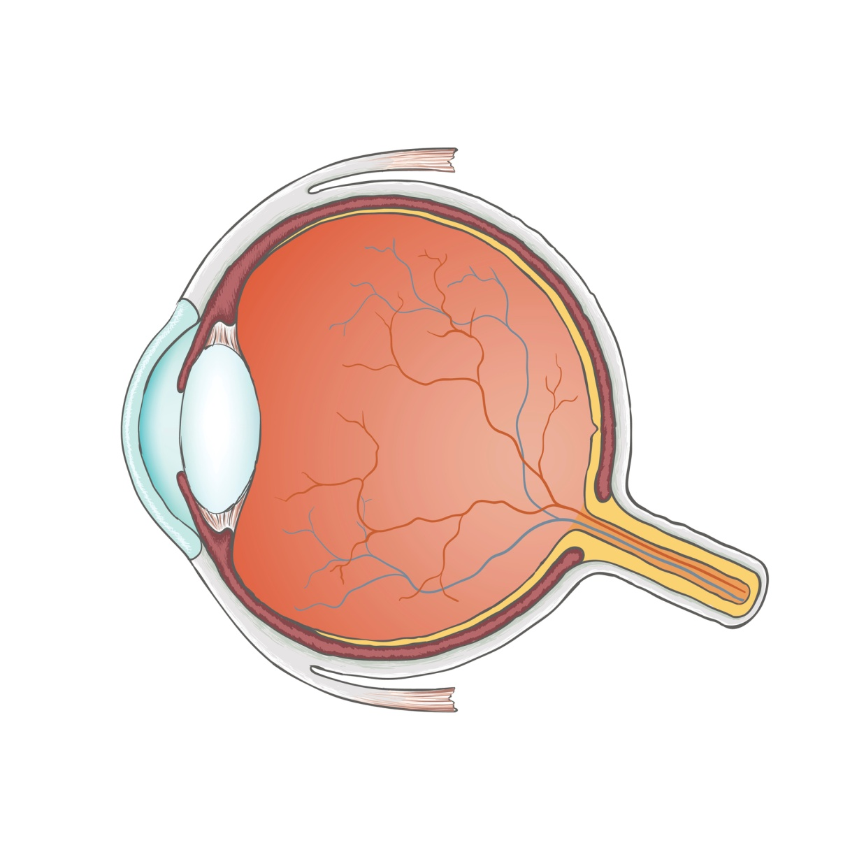
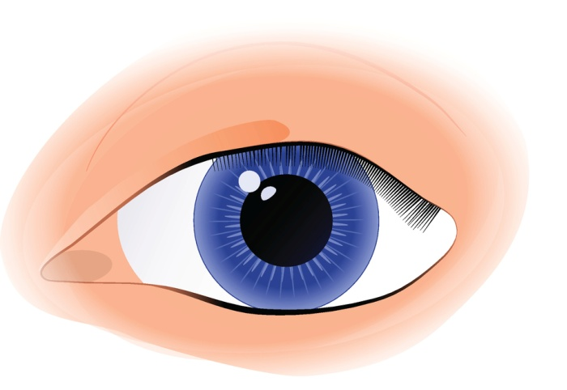
  The central nervous system Part 4 - The eye (biology only)
The eye is a sense organ containing receptors sensitive to light intensity and colour.
suspensory ligaments
lens
retina
cornea
pupil
iris
sclera
optic nerve
Video - The eye
ciliary muscles
Notes:
http://www.bbc.co.uk/programmes/p011n9qk

Slide 46
  The central nervous system Part 4 - The eye (biology only)
Part of the eye | Description and function
cornea | Transparent layer at the front of the eye. It refracts light into the eye.
iris | The coloured part of the eye that contains muscles that control the amount of light entering the eye.
pupil | The hole in the middle of the iris that lets light in. Its diameter is controlled by the iris.
lens | A transparent, biconvex structure in the eye that refracts light onto the retina.
retina | Thin layer of tissue at the back of the eye that contains receptor cells called rods and cones for light and colour.
sclera | Tough white supporting wall of the eye.
ciliary muscles | Muscles that are connected to the lens by the suspensory ligaments; they change the shape of the lens.
suspensory ligaments | These connect the lens to the ciliary muscles.
optic nerve | Carries impulses from the retina to the brain.

Slide 47
  The central nervous system Part 4 - The eye (biology only)
Accommodation is the process of changing the shape of the lens to
focus on near or distant objects.
To focus on a distant object:
• the ciliary muscles relax
• the suspensory ligaments are pulled tight
• the lens is then pulled thin and only slightly refracts light rays.
To focus on a near object:
• the ciliary muscles contract
• the suspensory ligaments loosen
• the lens is then thicker and refracts light rays strongly.
Video - accommodation
Notes:
https://www.youtube.com/watch?v=43hu11ah28Q

Slide 48
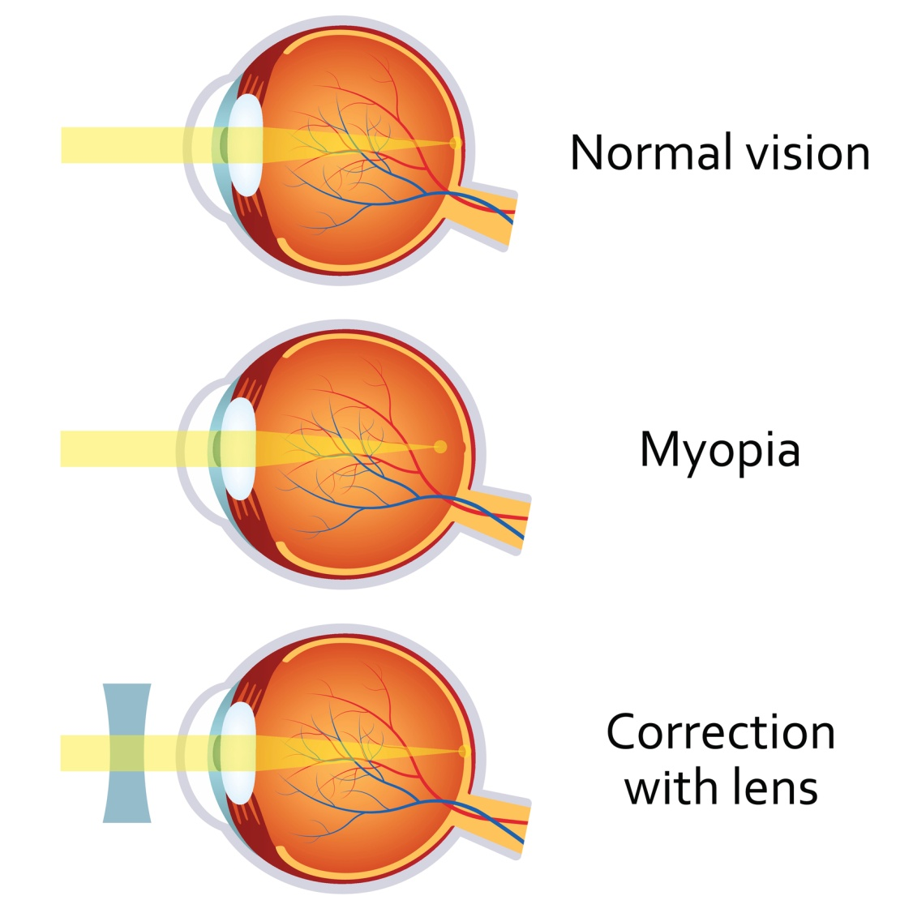
  The central nervous system Part 4 - The eye (biology only)
Two common defects of the eyes are myopia (short sightedness) and hyperopia (long sightedness) in which rays of light do not focus on the retina.
Myopia (short sightedness)
People who are short sighted cannot focus on objects that are far away.
It usually occurs when the eyeball is too long.
The light rays from distant objects focus in the eyeball in front of the retina.
Myopia can be corrected with concave lenses so that the light rays focus on the retina.
Concave lens

Slide 49
  The central nervous system Part 4 - The eye (biology only)
Hyperopia (long sightedness)
People who are long sighted cannot focus on objects that are near.
It usually occurs when the eyeball is too short.
The light rays from distant objects focus in the eyeball behind the retina.
Hyperopia can be corrected with convex lenses so that the light rays focus on the retina.
Convex lens

Slide 50
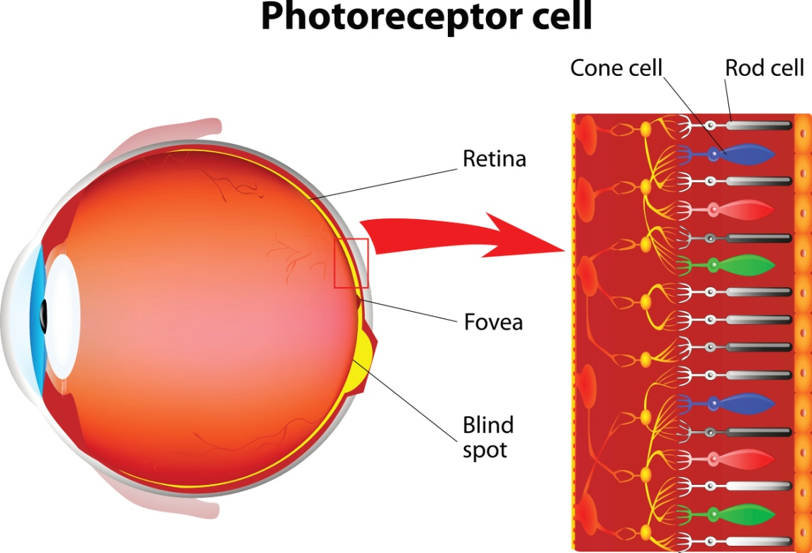
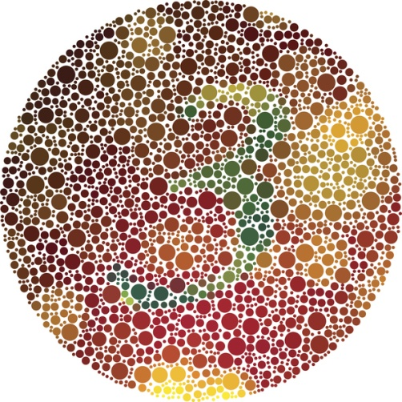
  The central nervous system Part 4 - The eye (biology only)
Rod cells enable us to see objects in dim light. They do not detect colour.
Cone cells enable us to see objects clearly in bright light and in colour. There are three types of cone – red, green and blue. They do not function well in dim light.
Colour blindness is a condition that a person is born with and is inherited from their parents. More men are colour blind because the gene is carried on the X chromosome.
A colour blind person is unable to tell the difference between certain colours. The most common condition is red green colour blindness. The red and green cones in the retina are not functioning normally. There is no cure for this condition.

Slide 51

  The central nervous system Part 4 - The eye (biology only)
Due to a cloudy patch on the lens, light is unable to enter the eye normally.
People who have cataracts often have blurred vision and find it difficult to see in bright light or in accurate colour.
Cataracts can be cured by replacing the lens with an artificial one.

Slide 52
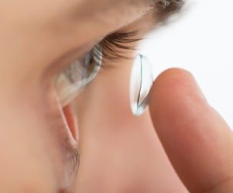
  The central nervous system Part 4 - The eye (biology only)
There are new technologies available to correct vision including:
Contact lenses – these can be hard or soft and are inserted directly into the eye and sit on the cornea. This then refracts the light rays. Advantages - lightweight, almost invisible, good for people playing sports. Disadvantages – not a permanent solution and they can cause irritation and infections.
Hard contact lens
Inserting a soft contact lens
Soft
contact lens
Laser surgery – the other layer of the cornea is peeled back and lasers are used to change the shape of the cornea so that the light rays will refract and form an image on the retina. Advantages – permanent solution to correct vision. Disadvantages – a surgical procedure, can cause infections.
Lens replacement – surgery refers to a medical procedure where an artificial acrylic or silicone lens is implanted into the eye to correct problems with vision. Advantages – permanent solution to correct vision. Disadvantages – a surgical procedure, can cause infections.

Slide 53
QuestionIT!
The Central Nervous system
Part 4
  Eye – structure, functions and defects (Biology ONLY)

Slide 54
  The central nervous system Part 4 - Question IT
Label parts A – I on the diagram below:

Slide 55
  The central nervous system Part 4 - Question IT
2. Write the name of each part of the eye in the table below:
Part of the eye | Description and function
 | Transparent layer at the front of the eye. It refracts light into the eye.
 | The coloured part of the eye; contains muscles that control the amount of light entering the eye.
 | The hole in the middle of the iris that lets light in. Its diameter is controlled by the iris.
 | A transparent, biconvex structure in the eye that refracts light onto the retina.
 | Thin layer of tissue at the back of the eye that contains receptor cells for light and colour.
 | Tough white supporting wall of the eye.
 | Muscles that are connected to the lens by the suspensory ligaments; they change the shape of the lens.
 | These connect the lens to the ciliary muscles.
 | Carries impulses fro the retina to the brain.

Slide 56
  The central nervous system Part 4 - Question IT
3. What is accommodation?
4. How does the eye focus on distant objects?
5. How does the eye focus on near objects?
6. What is myopia? How can it be corrected?
7. What is hyperopia? How can it be corrected?
8. What is a cataract? How can it be treated?
9. What is the most common form of colour blindness?
10. What causes colour blindness?

Slide 57
AnswerIT!
The Central Nervous system
Part 4
  Eye – structure, functions and defects (Biology ONLY)

Slide 58
  The central nervous system Part 4 - AnswerIT
1. Label parts A – I on the diagram below:

Slide 59
  The central nervous system Part 4 - AnswerIT
2. Write the name of each part of the eye in the table below:
Part of the eye | Description and function
cornea | Transparent layer at the front of the eye. It refracts light into the eye.
iris | The coloured part of the eye; contains muscles that control the amount of light entering the eye.
pupil | The hole in the middle of the iris that lets light in. Its diameter is controlled by the iris.
lens | A transparent, biconvex structure in the eye that refracts light onto the retina.
retina | Thin layer of tissue at the back of the eye that contains receptor cells for light and colour.
sclera | Tough white supporting wall of the eye.
ciliary muscles | Muscles that are connected to the lens by the suspensory ligaments; they change the shape of the lens.
suspensory ligaments | These connect the lens to the ciliary muscles.
optic nerve | Carries impulses fro the retina to the brain.

Slide 60
  The central nervous system Part 4 - AnswerIT
3. What is accommodation? The process of changing the shape of the lens to focus on near or distant objects
4. How does the eye focus on distant objects? The ciliary muscles relax, the suspensory ligaments are pulled tight, the lens is then pulled thin and only slightly refracts light rays.
5. How does the eye focus on near objects? The ciliary muscles contract, the suspensory ligaments loosen, the lens is then thicker and refracts light rays strongly
6. What is myopia? How can it be corrected? Short-sightedness, it can be corrected with concave lenses.
7. What is hyperopia? How can it be corrected? Long-sightedness, it can be corrected with convex lenses.
8. What is a cataract? How can it be treated? A cloudy patch on the lens. Treated by replacement with an artificial lens.
9. What is the most common form of colour blindness? Red green
10. What causes colour blindness? Cones not functioning normally- it is an inherited condition which cannot be cured.

