Slide 1
Applied Human Biology
Phase 2 Work

Slide 2
WORKING FROM HOME
Go through the slides on the following pages – read through them and answer the questions in your notebook – I will be sending the answers out to the questions at the beginning of May for you to check.
If any of the words are underlined, then they are hyperlinks to videos. Please watch the videos before answering the questions.
I have also attached the answers to the questions you completed on the kidneys – please correct these with a green pen!
Once you have started your work can you please EMAIL ME so I know you are working and not sat at home doing nothing!
Thanks,
Mr Jack

Slide 3
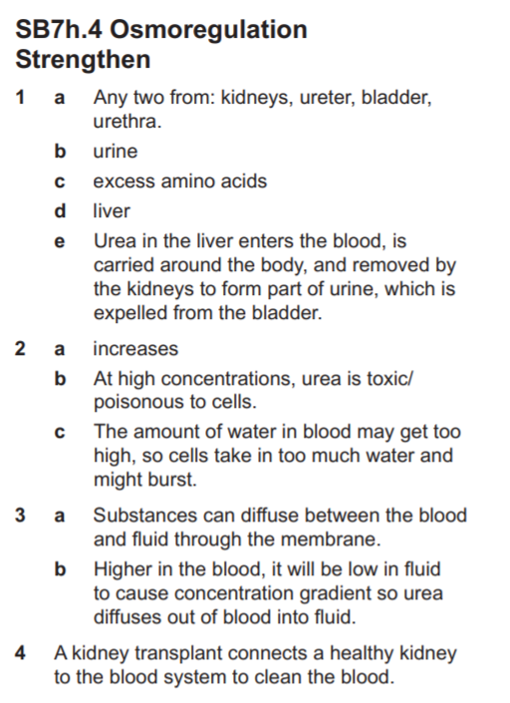
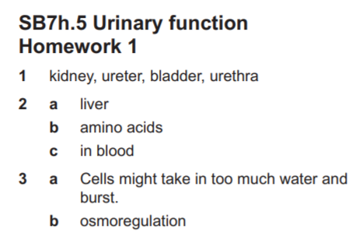
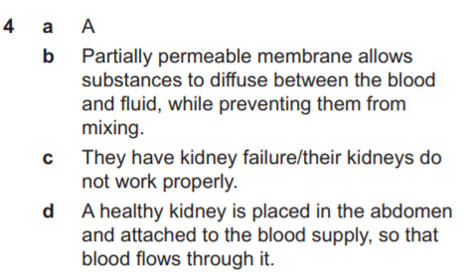
Answers to osmoregulation questions

Slide 4
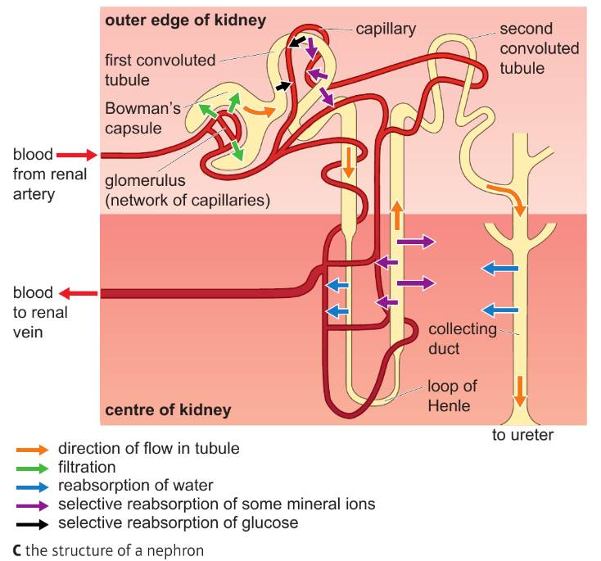
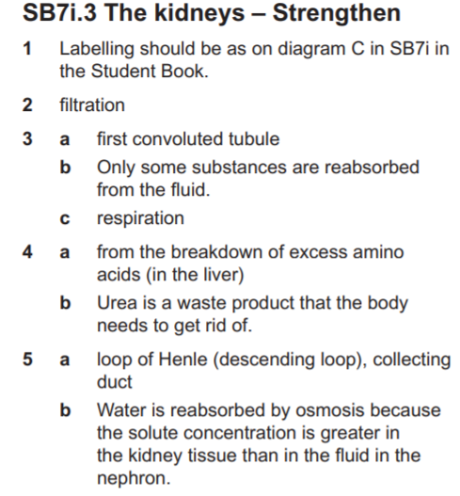
Answers to kidney questions

Slide 5
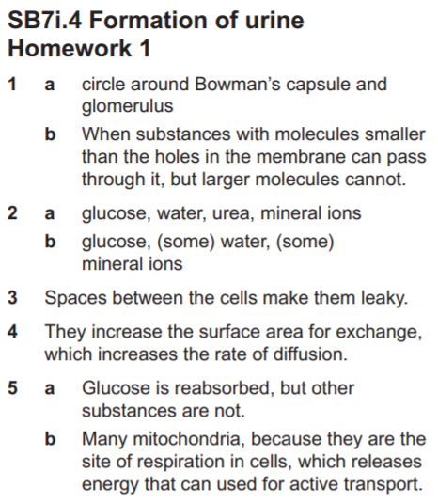

Slide 6
A4 Recap – Digestive System
1) What is the function of the oesophagus?
2) What is the function of the stomach?
3) What is bile? Where does it come from and what is it’s function?
4) For each of the following enzymes – state where are they produced; What do they break down? What are the products?
a) Amylase b) Lipase c) Trypsin d) Pepsin
5) What is the purpose of the ileum?
6) What happens in the colon?

Slide 7
A4 Controlling Blood Sugar Levels
This is a topic you looked at in GCSE Biology.
Watch this video https://www.youtube.com/watch?v=OHrX3X3LGzI
1) What hormones are involved in controlling blood sugar?
2) Why do we need glucose in our blood? What would happen if the concentration of glucose in the blood was too high?
3) What would cause our blood sugar levels to increase?
4) What hormone is released to lower your blood sugar levels? Where is this hormone released from?
5) What happens to the extra glucose molecules in your body? Where is it stored and as what chemical?
6) Which hormone is released if your blood glucose levels from? Where from?
7) What is the effect of this hormone? How does it cause your glucose levels in the blood to increase?
For extra levels of detail, watch this video – it covers the specific mechanism by which blood glucose levels are reduced. Add notes to your book from the video.
https://www.youtube.com/watch?v=rGXP8zBvPHs

Slide 8
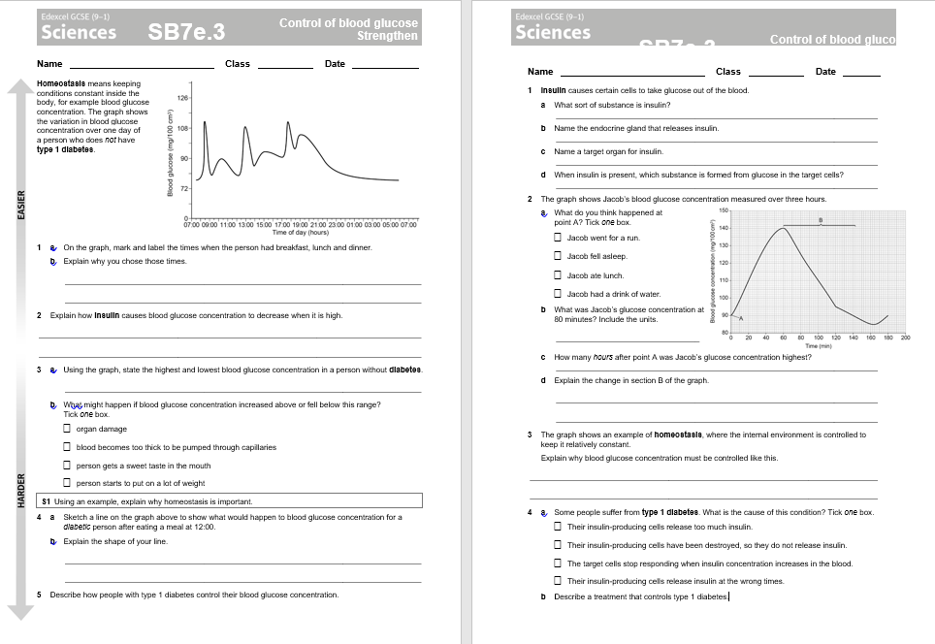
Please complete attached sheets – print if you have a printer – if you don’t then answer in your books

Slide 9
A4 Read the information on this website
Describe the roles of alpha and beta cells in the pancreas
What is diabetes?
What are the causes of Type I Diabetes and Type II diabetes?

Slide 10
A4 Food Groups
What are the 7 food groups?
For each food group name an example of a food which contains lots of that nutrient.
Describe the function of each food group. What does it provide the body with?

Slide 11
A4 Calories and Calorific Values
What are calories?
What is basal metabolic rate?
How many calories should men and women typically take in daily?
How would the amount of calories needed differ between older people and younger people? Between someone working in an office and an Olympic athlete?
Why would you gain less energy from 100g of celery than 100g of potatoes?
How can we determine the amount of calories in food?
What is a calorie controlled diet? Why would someone need to control their diet? Where can you find the information about how many calories your food contains?

Slide 12
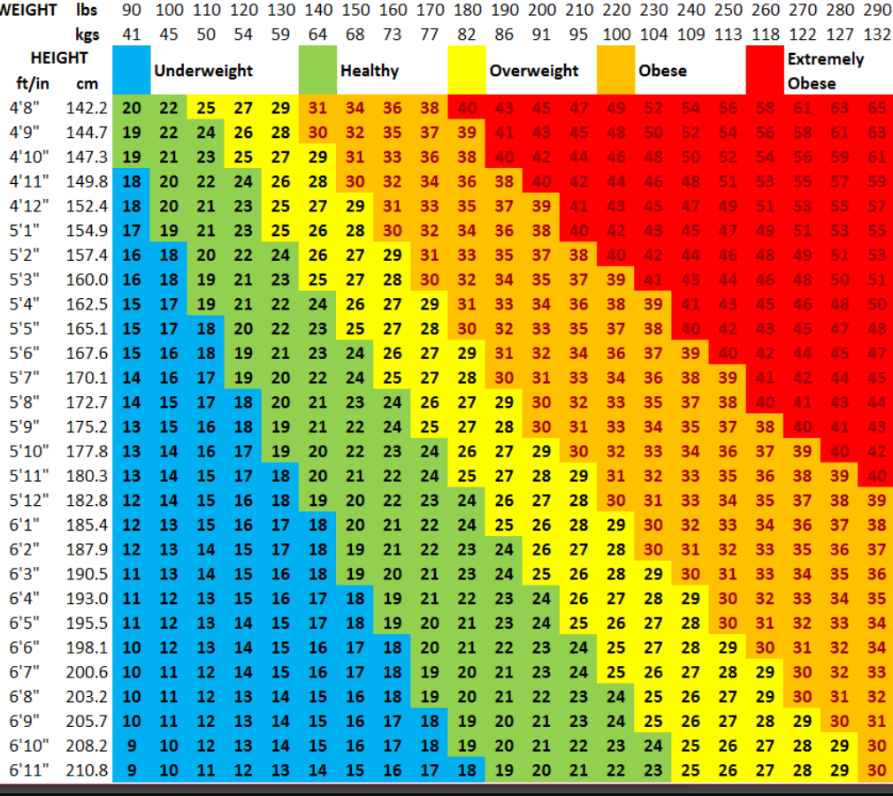
What does this chart show?
What is the purpose of it?
Which values are determined “healthy”?
Why are more nutritionists and doctors looking at alternative methods eg Waist:Hip ratio?

