Slide 1
Note:
You will be given a key words assessment during the first week
This mark will count towards DP1

Slide 2
Key Terms
https://www.youtube.com/watch?v=4rxiU826ysk#t=16

Slide 3
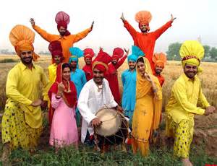
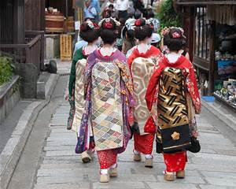
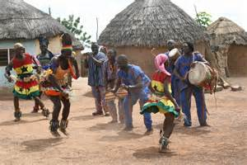
Culture
All those things which are learned and shared by a society or group of people and passed on through generations.
Culture includes customs, traditions, language skills, knowledge, beliefs, norms and values

Slide 4
Socialisation is…
The process of learning culture
We learn things for us to become accepted as member of society
Socially acceptable behaviour

Slide 5
Primary socialisation takes place in…

Slide 6
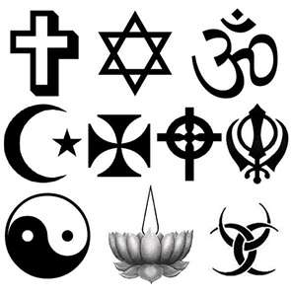
Secondary socialisation takes place in…

Slide 7
Norms
Implicit (unspoken) and explicit (spoken/ known) rules about what is acceptable and unacceptable behaviour

Slide 8
Values
General principles, personal beliefs or goals
They tell us what we should aim for

Slide 9
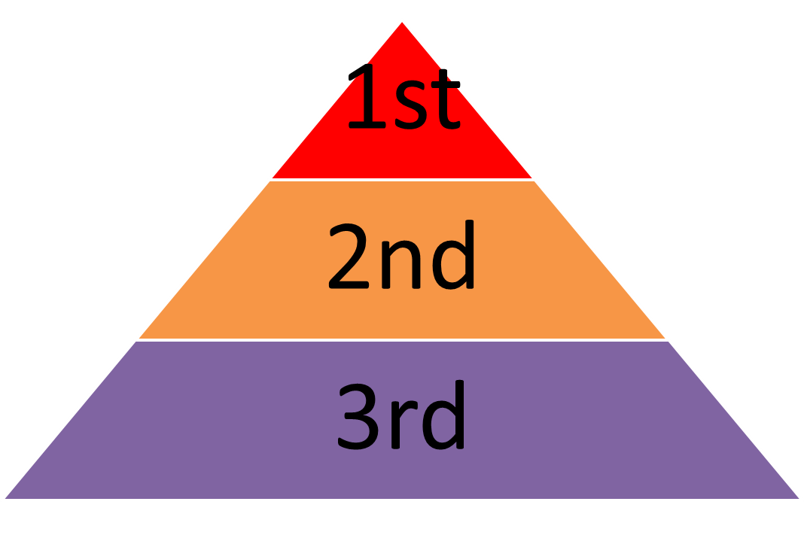
Status is…
Your position in society
Statuses can be:
Ascribed: based on fixed characteristics we are born with.
Achieved: through efforts and success.

Slide 10
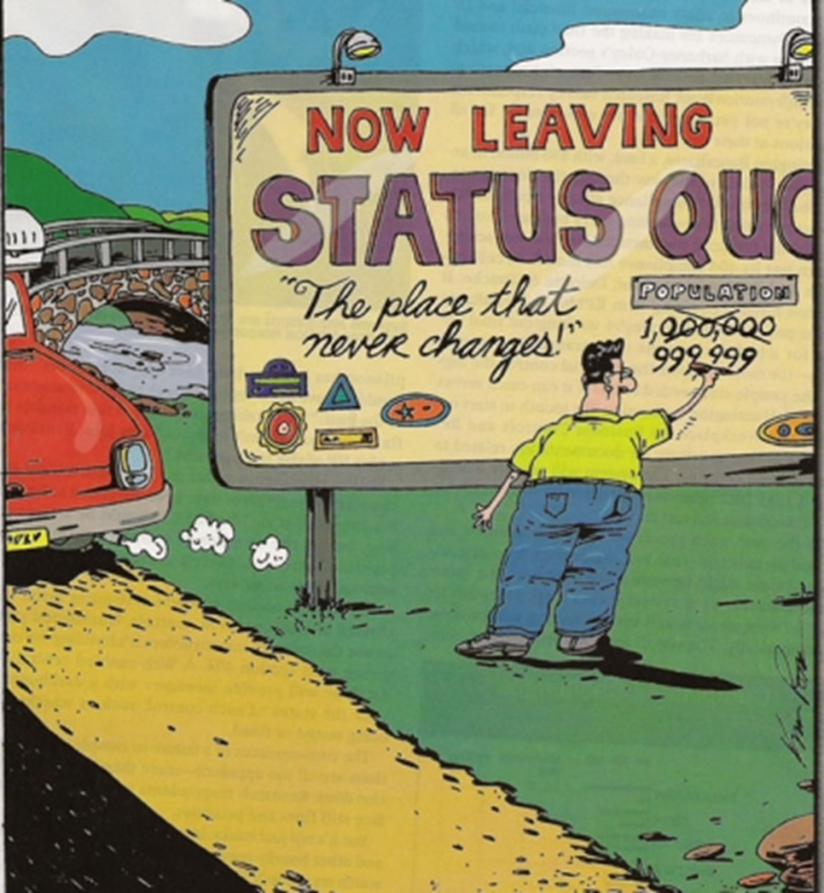
Status quo
Some people are not happy with others being able to achieve status.
There prefer to see people or a situation remain in the same.

Slide 11
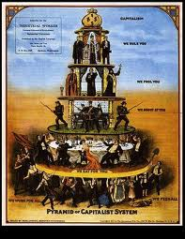
Social stratification is
The idea that societies are divided into hierarchies.
They are made of ‘strata’ or layers.
Each layer is unequally ranked upon the other.
Social stratification is inequality between groups in society.

Slide 12
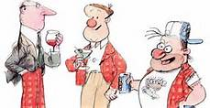
Social stratification- Social class
Upper Class
Middle Class
Working class

Slide 13
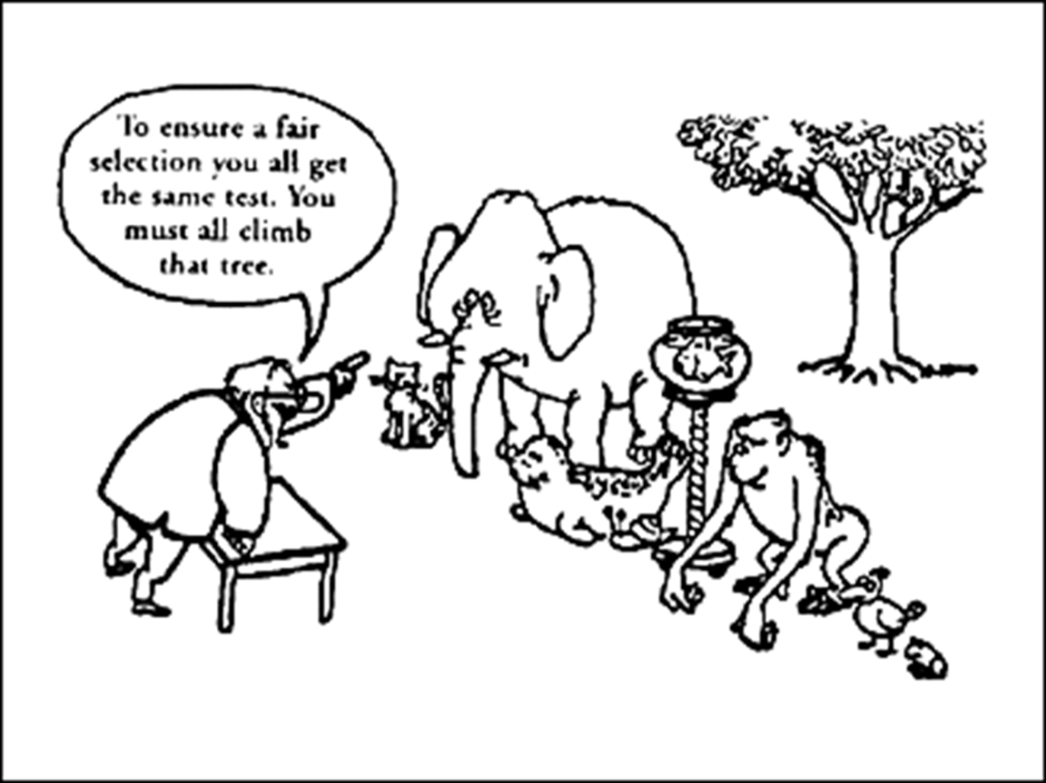
Life chances
The chances that sections of society have of achieving the ‘things’ which are valued by their society.

